Slide 1
Prototype 1 IoT4Lunch
Temperature Only

Slide 2
RaspberryPi
Teensy 1
Collect Temperature
Set Thresholds
Send Bluetooth to Raspberry Pi
Received Data from Teensy
*Set Threshold
import time
# Replace tempC with the actual temperature value you want to check
tempC = 6.5 # Example temperature value
if tempC < 4.0:
print(f"Temperature: {tempC}°C - [Safe]")
time.sleep(10) # Sleep for 10 seconds
elif 4.0 <= tempC <= 8.0:
print(f"Temperature: {tempC}°C - [Caution]")
time.sleep(10) # Sleep for 10 seconds
else:
print(f"Temperature: {tempC}°C - [Warning]")
time.sleep(10) # Sleep for 10 seconds

Slide 3
Teensy 2
Receive data from AWS
If msg.payload contains safe led 1 high
Else if msg.payload contains caution
led 2 high
Else msg.payload contains warning
led 3 high
buzzertone(1000)
delay 1 (Second)
buzztone off

Slide 4
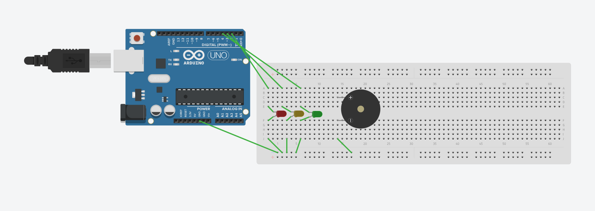
Actuator Led with Buzzer

Slide 5
Actuator Led with Buzzer
//Define Pins
const int led1 = 1; //Red LED
const int led2 = 2; //Yellow LED
const int led3 = 3; //Green LED
const int buzzer = 4; //Buzzer
void setup() {
Serial.begin(9600); // Delivering Data from Bluetooth
Serial1.begin(9600); // Incoming data from Bluetooth
pinMode(led1, OUTPUT);
pinMode(led2, OUTPUT);
pinMode(led3, OUTPUT);
pinMode(buzzer, OUTPUT);
}
void loop() {
// Check if there is incoming serial data
if (Serial1.available() > 0)
{
String str = Serial1.readString().substring(0); // Read the incoming data as a String
// Print received data for debugging
Serial.println("Received data: " + str);
// Check if the received data contains "warning" (case-insensitive)
if (str.indexOf("Warning") != -1)
{
// Turn on the LED
digitalWrite(led1, HIGH);
Serial.println("Warning");
tone(buzzer, 100);
delay(1000); // Keep the LED on for 1 second
noTone(buzzer);
digitalWrite(led1, LOW); // Turn off the LED
}
}
}

Slide 6
Receiving Notifications on Phone
What is AWS IoT Core?

