Slide 1
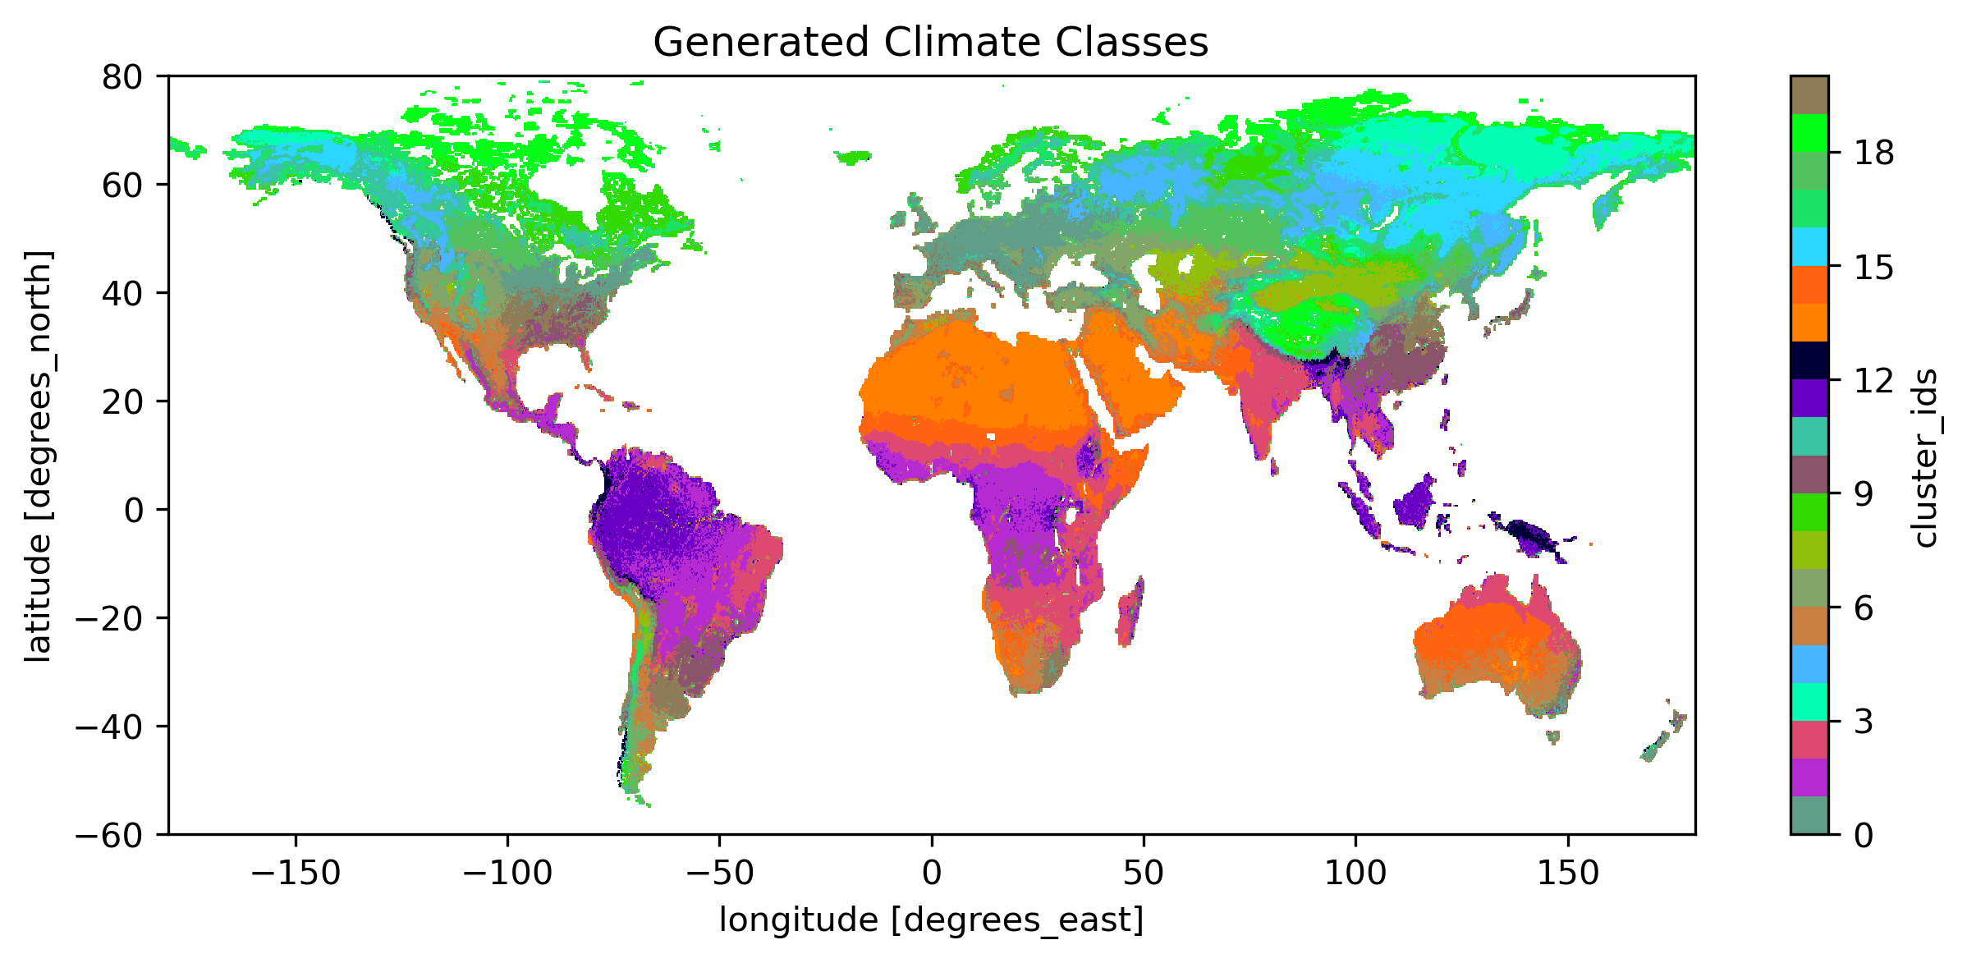
Unsupervised climate clustering using autoencoders
Leander Moesinger¹
¹Vienna University of Technology, Department of Geodesy and Geoinformation

Slide 2
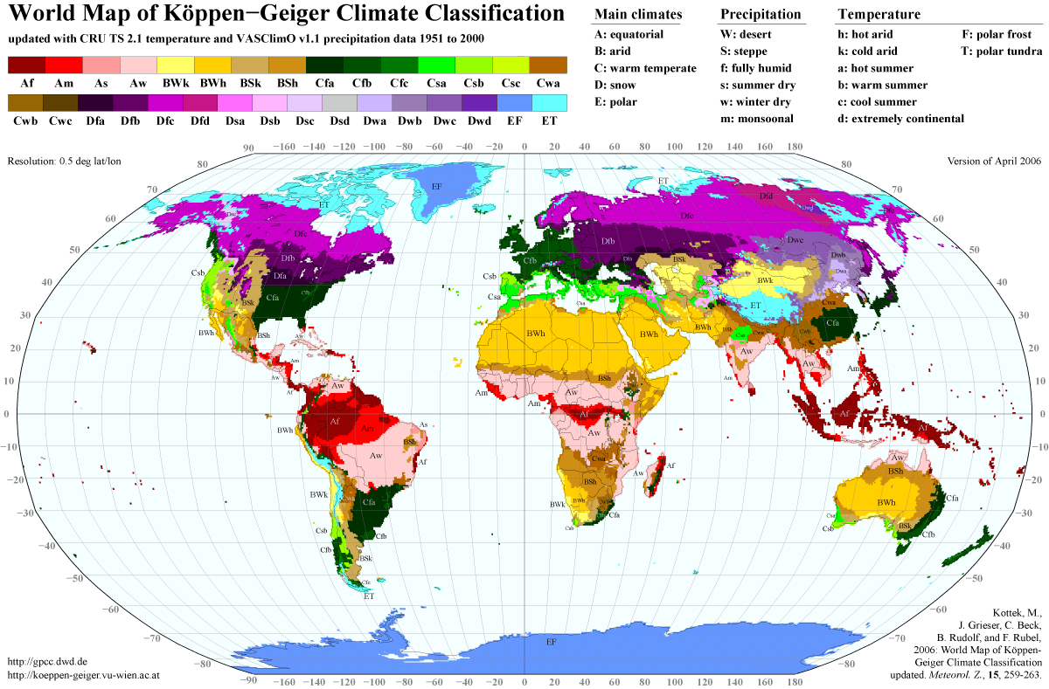
Introduction

Slide 3
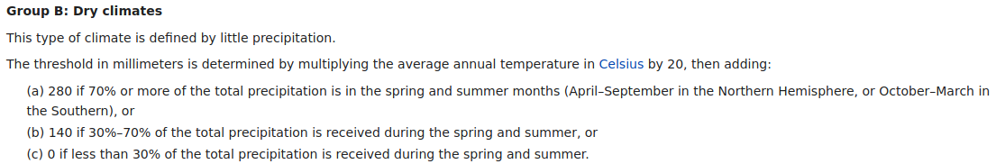
Introduction
Koeppen-geiger map list of elaborate IF/ELSE statements regarding temperature and precipitation, such as:
Fixed number of classes
https://en.wikipedia.org/wiki/Köppen_climate_classification
Can we automatize this?

Slide 4
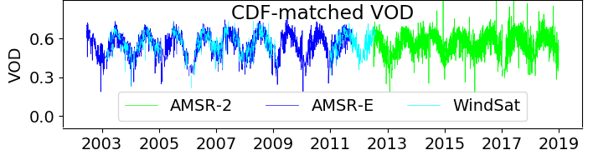
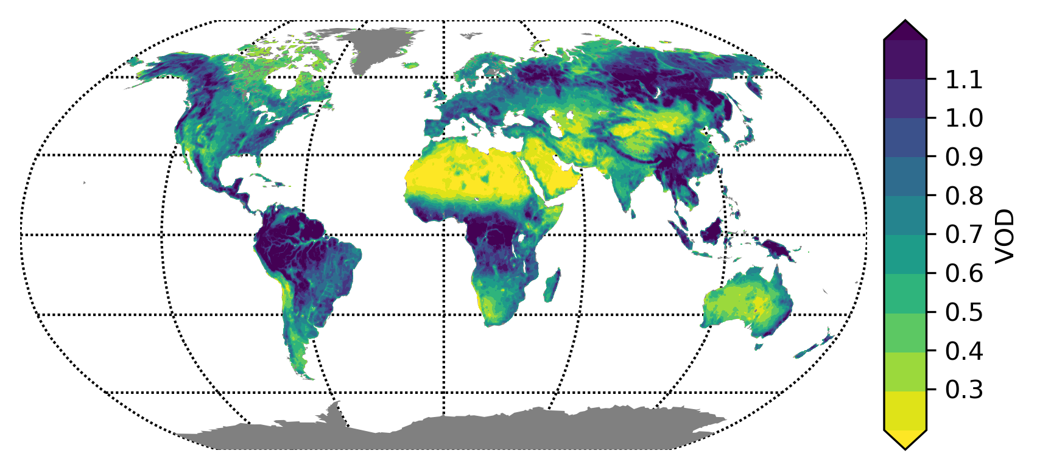
Data
Vegetation Optical Depth (VOD) time series
  Related to vegetation water content and biomass
  Global coverage
  Since 1987
  Daily values
  Has data gaps
Also mean temperature and precipitation is used
VOD time series and global mean

Slide 5
Network Architecture
Cluster encoding using K-means to generate global climate clusters!
Autoencoder
VOD
VOD TS size: ~365*30 ~=11000 values
encoder
Temp.
network
Prec.
network
encoding
Encoding size: 4
decoder
Temperature
VOD
Precipitation

Slide 6
Results

Slide 7
Lessons learned
Dont spend too much time optimizing hyperparameters, data used and preprocessing is much more important!
The loss of an autoencoder does not directly translate to how good an encoding is

