Slide 1

Power of Deep Learning in Channel Estimation for Communication Systems Academic Year : (2023-2024)
Team Members
CH ABHISHEK VARA PRASAD (21B81A0402)
MALYALA LAKSHMINARAYANA RAO (21B81A0418)
BANGARU SREE RAM KOUSHIK (21B81A0451)
Supervisor
Ms. T Padmavathi

Slide 2
OUTLINE OF THE PRESENTATION
1. Objective
2. Motivation
3. Conventional Approach
4. Deep Learning Approach
5. Algorithm/Flowchart
6. Sig2Sig Architecture
7. Description(Software)

Slide 3
OBJECTIVE
Review conventional approach
To learn and review the conventional channel estimation techniques.
Deep Learning Benefits
To explore the Deep Learning approach for channel estimation and understand the benefits of this approach.
Explore DL Architectures
To define certain DL architectures that are suitable for this task.

Slide 4
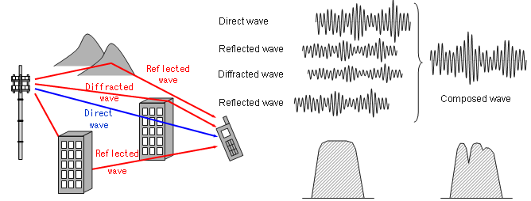
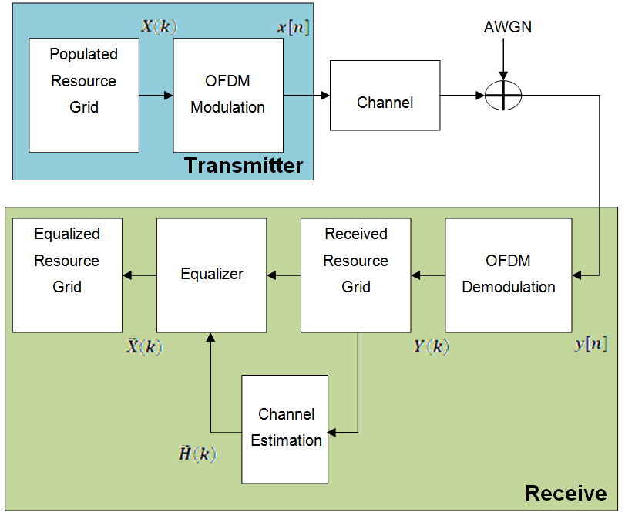
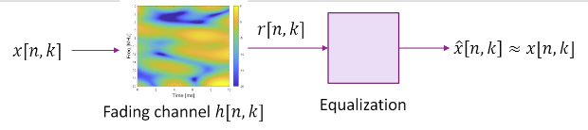
MOTIVATION
What is Channel Estimation?
Channels fade in time and frequency
Channel estimation refers to the process of estimating the characteristics of the wireless channel between the transmitter and receiver.
$$r\left[n,k\right]=h\left[n,k\right]x\left[n,k\right]+w[n,k]$$

Slide 5
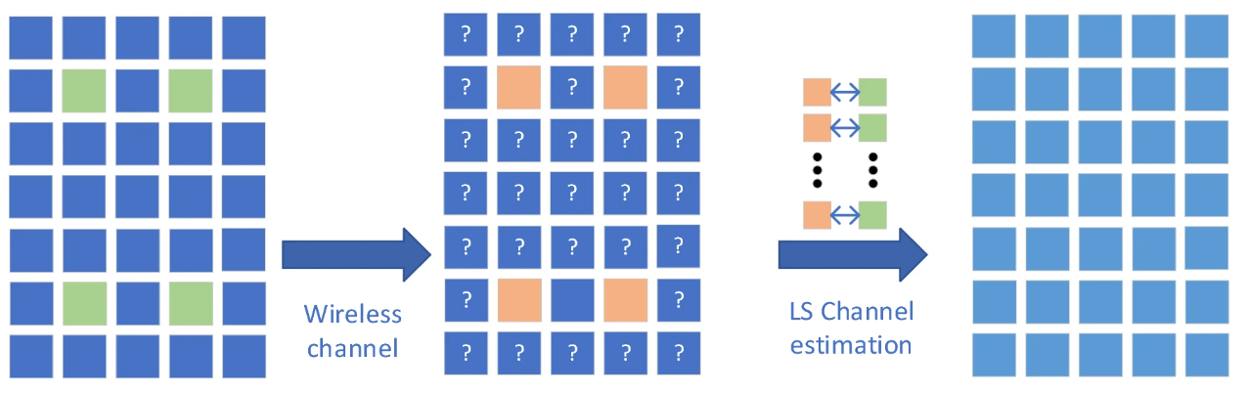


Conventional Approach
Least Squares Channel Estimation
The LS method estimates the channel at the pilot positions.
Pilots (reference values) are inserted into the transmission block.
The difference of received Pilot and transmitted Pilot is minimized for channel estimate
Where ||.||2 is the L2 distance and x_{p} contains the known pilot values and y_{p} is the corresponding observations.
The optimization of above results in
Equalization: the original message is recovered as follows
$$\hat{x}\left[k,n\right]≈\frac{r[n,k]}{h[n,k]}$$

Slide 6
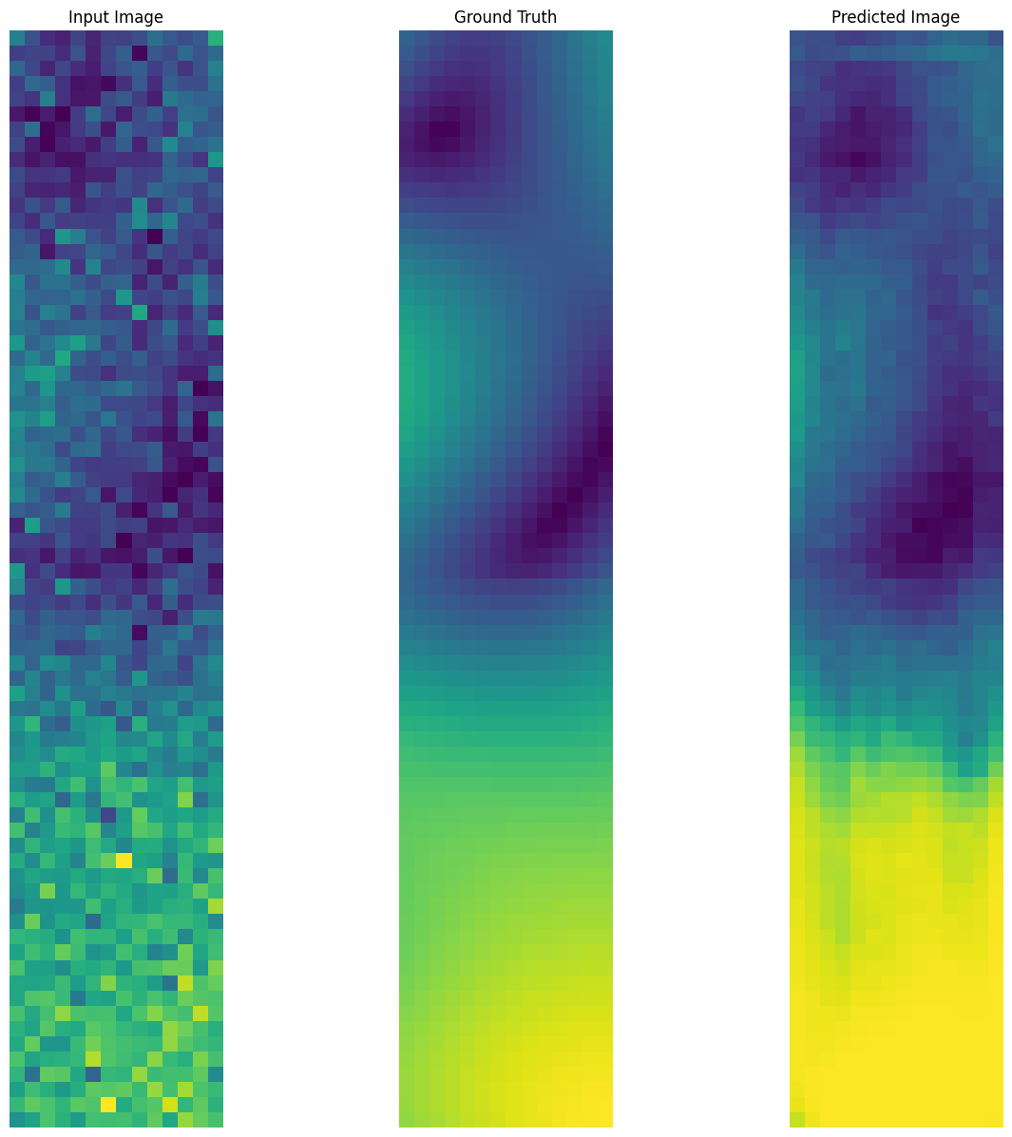
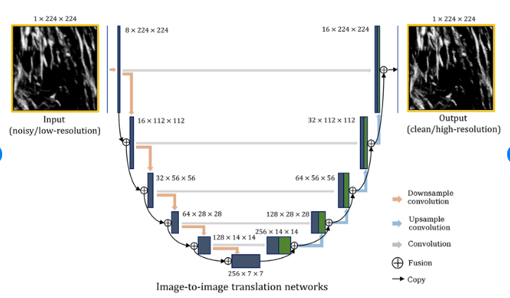
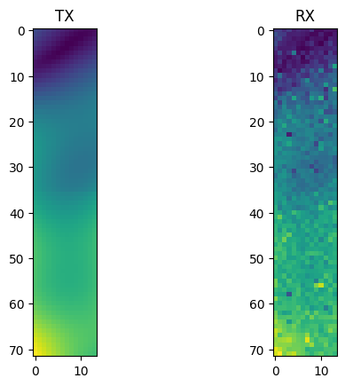
Deep Learning Approach
Deep learning based Channel estimation
In the Deep Learning method we consider the time-frequency response of a fading communication channel as a two-dimensional image.
We then design image to image translation networks such as Encoders, VAEs, GANs, Cycle GANs to perform Channel estimation and equalization in one go.
Fig: An Example of Image to Image translation network
Fig: An Example of data sample from the dataset
Fig: An Example of DL based Channel Estimation&Equalization

Slide 7
ALGORITHM / FLOWCHART
Fig: Data flow in Generator of Sig2Sig
Fig: Data flow in Discriminator of Sig2Sig

Slide 8
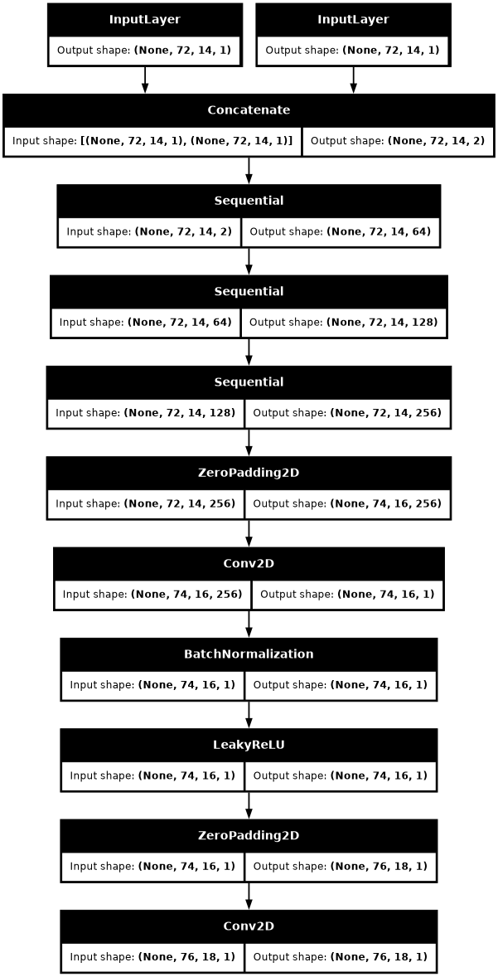
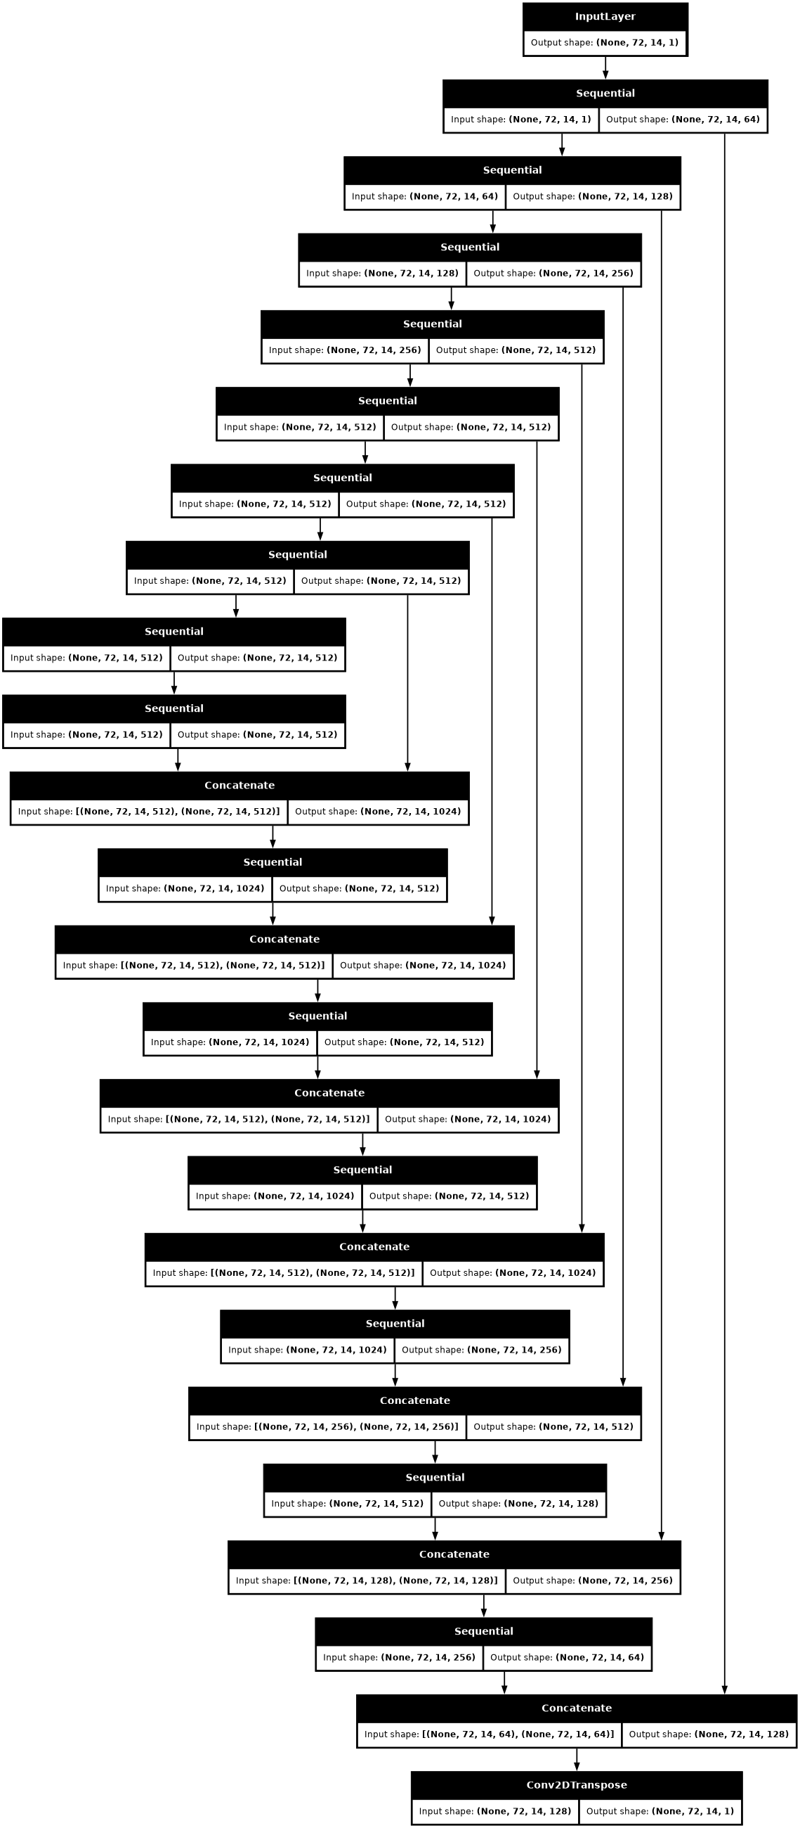
Sig2Sig Architecture
Fig: Generator of Sig2Sig
Fig: Disriminator of Sig2Sig

Slide 9
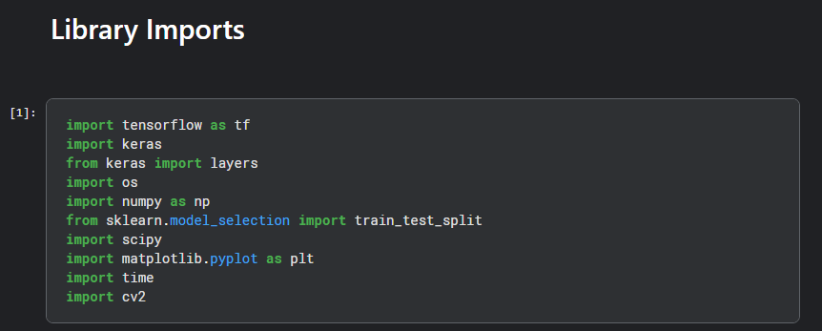
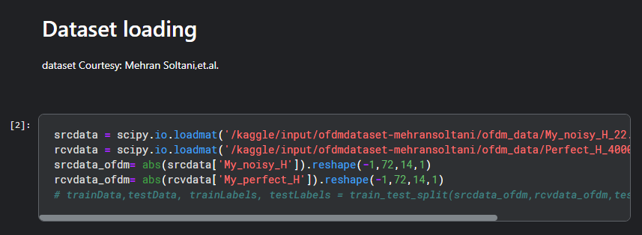
DESCRIPTION (Software)

Slide 10
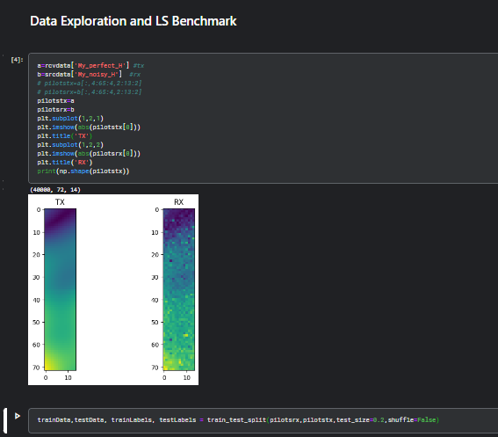
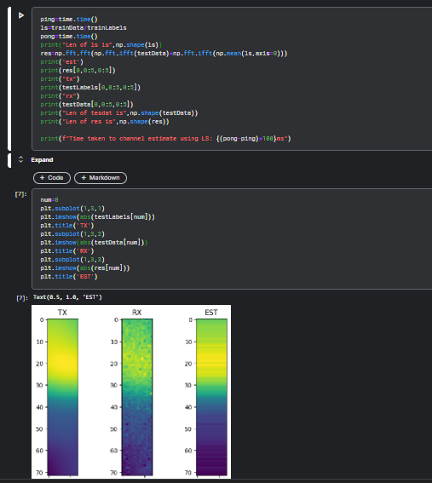
DESCRIPTION (Software)

Slide 11
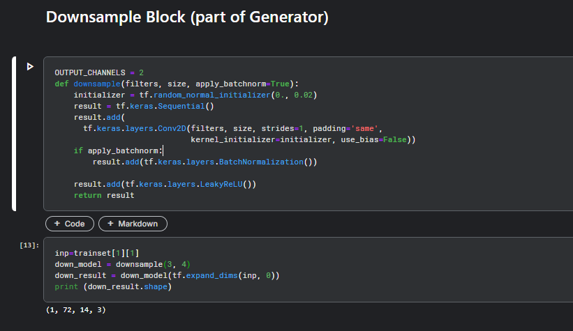
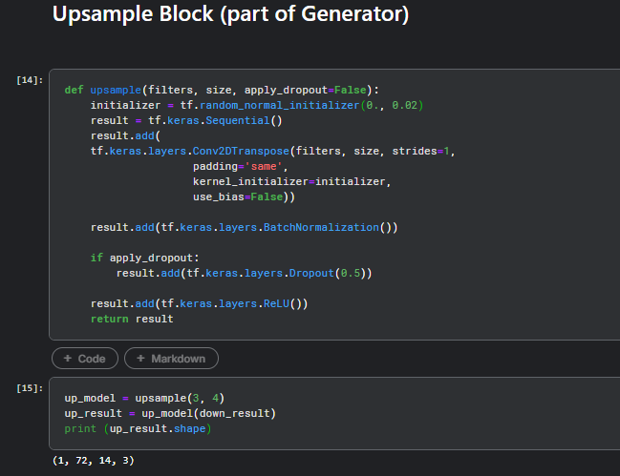
DESCRIPTION (Software)

Slide 12
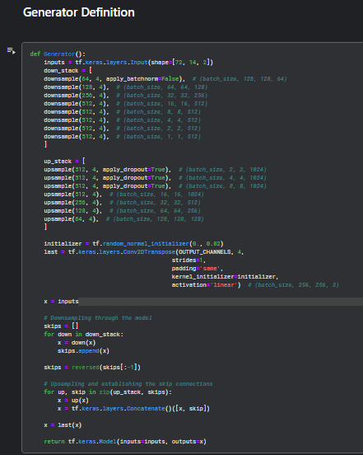
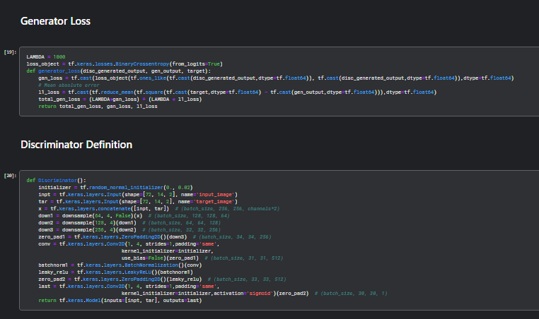
DESCRIPTION (Software)

Slide 13
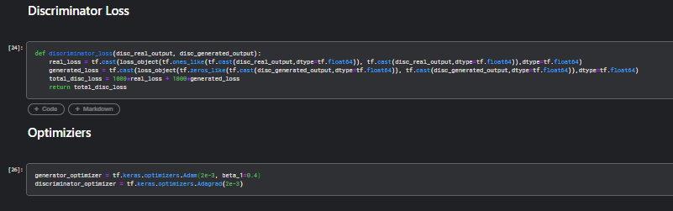
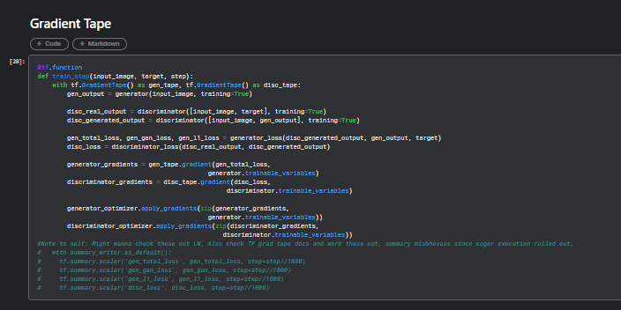
DESCRIPTION (Software)

Slide 14
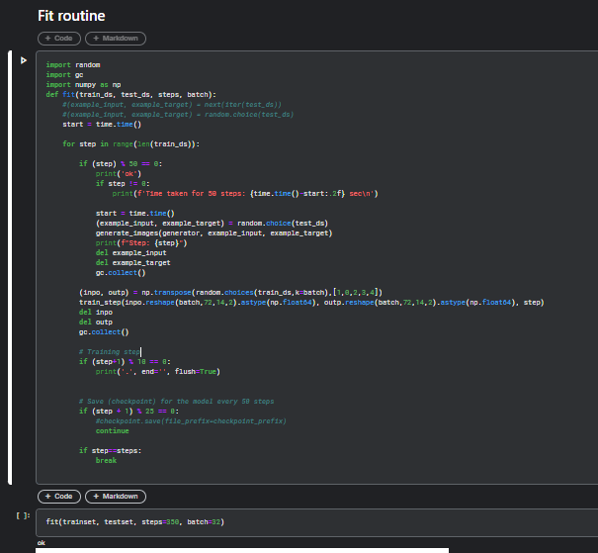
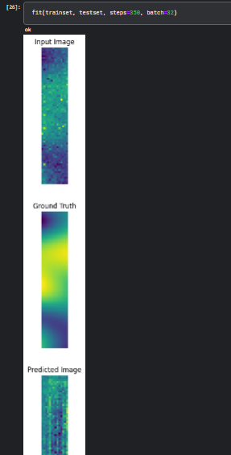
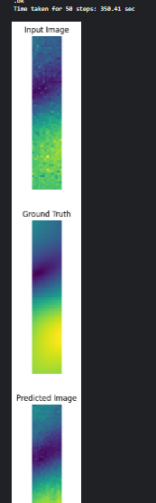
DESCRIPTION (Software)

Slide 15
References
H. Ye, et al. (2018): Power of Deep Learning for Channel Estimation and Signal Detection in OFDM Systems.
Mehran Soltani, et al.(2018): Deep Learning-Based Channel Estimation.
Wang M., Wang A., Liu Z. et al.(2023): Deep learning based channel estimation method for mine OFDM system.

Slide 16
THANK YOU

