Slide 1
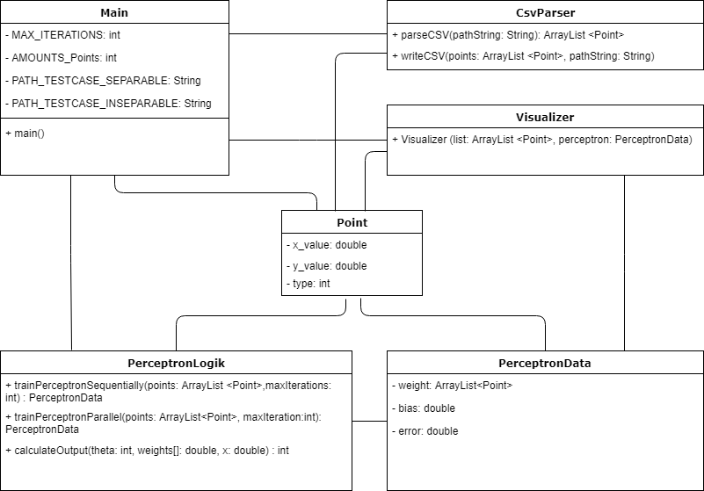
Class diagram
Notes:
To give you a quick overview of our code we have made this class diagramm, it‘s not complete but we summarize it to the most important points,
All clases using the point class, and are regulatet from the Main Class, CSV Parser for CSV Input and Output, and to visualize our results the visualizer class, our Perceptron Logik where we have our Methods for Sequetially and Parallel Training

Slide 2
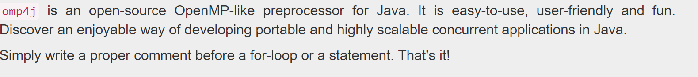
Going Parallel
Java
OMP4j
Threads
http://www.omp4j.org/
Notes:
Java: because we like to have something special, it turns out it was very special
Quote from Homepage, but nearly the oppositue happend , it wasn‘t easy to use or user friendly, we didn‘t understand the OMP specific error messages and didn‘t find helpfull documentation, so we use threads, but the cool and helpfull things that OMP usually does for us we have to do on our own, and now we show you how we did that

