Slide 1
TU DARMSTADT · FSR · ADVANCED DESIGN PROJECT
Parametric Noise
Modeling Framework
Noise prediction for aircraft that do not exist yet — as an NPD table the established ANP / Doc-29 pipeline already knows how to read.
111
2
2.99 dB
real aircraft used
as ground truth
fully independent
prediction routes
typical aircraft error,
leave-one-out
Prof. Dr.-Ing. U. Klingauf · supervised by L. Kempf · 21 July 2026
Notes:
PNMF maps a parametric aircraft definition onto an NPD-equivalent noise table in the exact ANP layout, so concepts with no certification data can be assessed inside the existing Doc-29 pipeline.

Slide 2
THE PROBLEM
A concept that has never flown has no noise data
The ANP / Doc-29 pipeline is driven by NPD tables — noise level as a function of engine power and slant distance.
Every NPD table in the ANP database comes from a certification measurement campaign on a real, flying aircraft.
A future concept has no campaign, therefore no table, therefore no way into the established pipeline.
Today's workaround is substitution: assign the concept the curves of the nearest existing aircraft. That is defined only for variants of types that already exist.
0
measurement campaigns exist for an aircraft that has not flown
19,565
certificated aircraft that EASA maps to ANP proxies by hand
1.92 / 1.35 dB
residual error that hand-curated substitution still carries (dep. / app.)
EASA aircraft-substitution table (n = 19,565 certificated aircraft), 2018 release.

Slide 3
WHAT THE FRAMEWORK DOES
Parameters in, ANP-layout table out
INPUT
PNMF
OUTPUT
ParametricAircraft
Two prediction routes
NPD table, strict ANP layout
Engine count and type · max static thrust · MTOW / MLW · noise chapter · optionally BPR and geometry
→
A data-driven surrogate trained on the real fleet, and a from-scratch physics model — each able to answer alone
→
4 metrics × 2 operating modes × 10 standard distances, per power setting — plus a per-cell uncertainty companion
Nothing downstream has to change: the consuming Doc-29 tool reads the generated table exactly as it reads a certified one.
Metrics: SEL · EPNL · LAmax · PNLTM | Modes: departure, approach | Distances: 200 – 25,000 ft | Interpolation: linear in thrust, logarithmic in distance (Doc 29)

Slide 4
ARCHITECTURE
The pipeline, end to end
1
ParametricAircraft
2
Surrogate | Physics
3
NPDTable
pnmf/core.py
pnmf/models.py · physics.py
strict ANP layout
the input object
two independent routes
+ per-cell uncertainty
4
DepartureSynthesizer
5
OperationalProfile
6
Single-event ground level
pnmf/operations.py
trajectory points
closest-approach geometry
SAE-AIR-1845 style
thrust, altitude, speed
hand-off to the Doc-29 tool
Seven modules, 40 tests (39 passed + 1 expected data-staging skip). One CLI entry point: pnmf_cli.py.

Slide 5
METHOD
Two routes that can check each other
A
Data-driven surrogate
B
From-scratch physics
Tree ensemble trained on the 111 ANP aircraft
Learns the fleet's statistical structure — power, weight, engine count and type, noise chapter
Strongest inside the fleet envelope; reports its own cross-tree spread per cell
Cannot extrapolate past what the fleet contains
Component sources: jet, fan, airframe → ISO 9613-1 propagation → simulated flyover
Four constants calibrated once on the A320-211, then frozen for every other aircraft
Independent of fleet statistics — extrapolates by construction
SEL and LAmax only; tone-corrected metrics out of scope
Agreement between the two routes is evidence; disagreement is a flag. On the demonstration concept they land 3.3 dB (SEL) and 2.2 dB (LAmax) apart — inside the band mature tools disagree by.

Slide 6
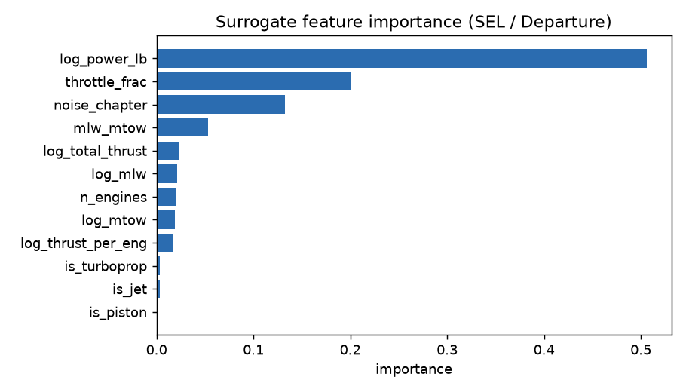
METHOD · DATA-DRIVEN
Route A — what the surrogate actually learns
Unit-aware power features. ANP publishes 'power setting' in lb, % and RPM across different aircraft; feeding one log column mixed three units over 328 rows. Split into absolute thrust and throttle fraction.
Physicality is enforced, not hoped for. Every predicted curve is projected onto the non-increasing-in-log-distance cone — all 2,776 truth rows decrease, so any prediction that rises is wrong by construction.
Uncertainty comes free. The spread across trees is reported per cell — ~1–1.5 dB inside the fleet, ~2.1 dB for an out-of-population concept. The model says when it is extrapolating.
No leakage anywhere. Grouped 5-fold CV and leave-one-aircraft-out both split by aircraft, never by row.
Power setting dominates, as it physically must — the model's input ranking matches acoustic intuition.
Feature importance, SEL / departure. Source: outputs/feature_importance_SEL_D.png.

Slide 7
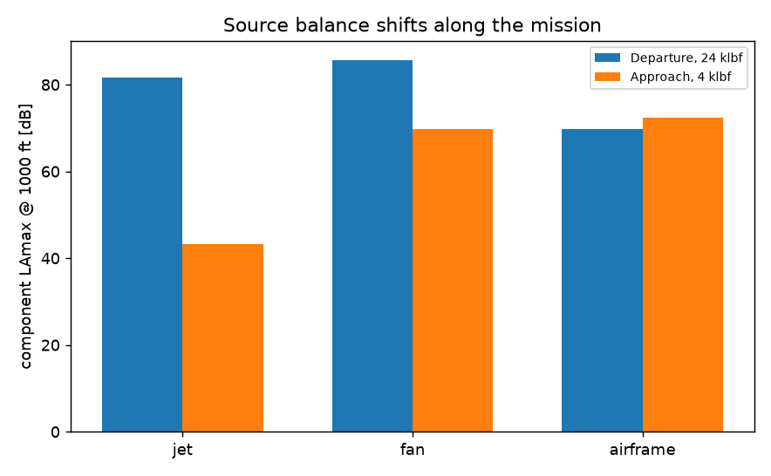
METHOD · PHYSICS
Route B — one calibration, then frozen
Component source | Formulation | Constant
Jet mixing | Stone / Lighthill V⁸ law | C_jet
Fan / turbomachinery | Heidmann form, ṁ · M_tip⁴ | C_fan
Airframe — wing & flaps | Fink, V⁵ / V⁶ | C_wingflap
Airframe — landing gear | Fink | C_gear
Band spectra are propagated with ISO 9613-1 absorption and A-weighting, then integrated over a simulated level flyover at the ANP 160 kt reference speed.
The four constants were fitted once, on the A320-211 alone (in-sample 1.57 dB). Every other aircraft in this deck is genuinely out-of-sample.
This route never touches the fleet statistics — it is an independent opinion, not a second regression.
Component split of the calibrated physics route. Source: pnmf_cli.py physics.

Slide 8
DATA
The ground truth, and how it is kept clean
111
83 / 18 / 10
2,776
ANP aircraft with a full NPD curve set — the entire study population
jet / turboprop / piston split — the non-jet classes are thin
measured NPD rows; every one decreases with distance
1 file
2 realms
QA gate
anp_data.sqlite replaced nine loose CSVs, round-trip proven lossless
truth tables and predicted tables are physically separate — predictions can never contaminate the data they are judged against
unphysical tables rejected outright; high-uncertainty ones stored flagged 'caution'
EASA ANP database v2.3 (legacy schema). Datastore built and verified by pnmf_cli.py datastore.

Slide 9
VALIDATION PROTOCOL
How the numbers were earned
1
Remove
Two error views — both reported
One aircraft is deleted from the dataset entirely — curves, rows, everything.
POOLED RMSE
Every cell of every aircraft in one pool. Sensitive to a handful of atypical airframes.
2
Retrain
The model is refitted from scratch on the remaining 110 aircraft.
PER-AIRCRAFT MEDIAN
Predict & compare
What the typical aircraft actually experiences. Barely moves when one outlier does.
3
The held-out aircraft is described only by its parameters; the predicted table is compared cell by cell against its real one.
Reporting only one of the two would be misleading — so both appear on every result slide.
Repeated for all 111 aircraft. Each one is, in turn, treated exactly like a future concept the framework has never seen.

Slide 10
RESULTS
Leave-one-aircraft-out accuracy, all eight targets
Read it like this
Approach beats departure everywhere — approach is airframe-dominated and fleet-uniform.
Departure is engine-dominated, exactly where unobserved engine technology matters.
The pooled–median gap is the outlier tail, not a spread across the whole fleet.
Leave-one-aircraft-out, n = 111. Source: docs/GAP_ANALYSIS_REPORT.md §1, run of 2026-07-15.

Slide 11
RESULTS IN CONTEXT
Is 3 dB good? Against what?
1.92 / 1.35 dB
EASA hand-curated substitution
The residual error of assigning each real aircraft its nearest real proxy — by expert judgement, on measured curves. The floor for any proxy-based method.
2.99 dB
PNMF, typical aircraft
Mean per-aircraft median across the eight targets, from parameters alone, on aircraft the model never saw.
3 – 4 dB
ANSWr inter-tool band
How far established, mature noise tools disagree with each other on the same scenario.
4.1 – 5.1 dB
PNMF, pooled
Same predictions, pooled over every cell — dominated by roughly six atypical airframes.
The framework sits inside the band that mature tools disagree by, and above the floor set by hand-picked real proxies — which is the honest place for a parametric-only method to be.

Slide 12
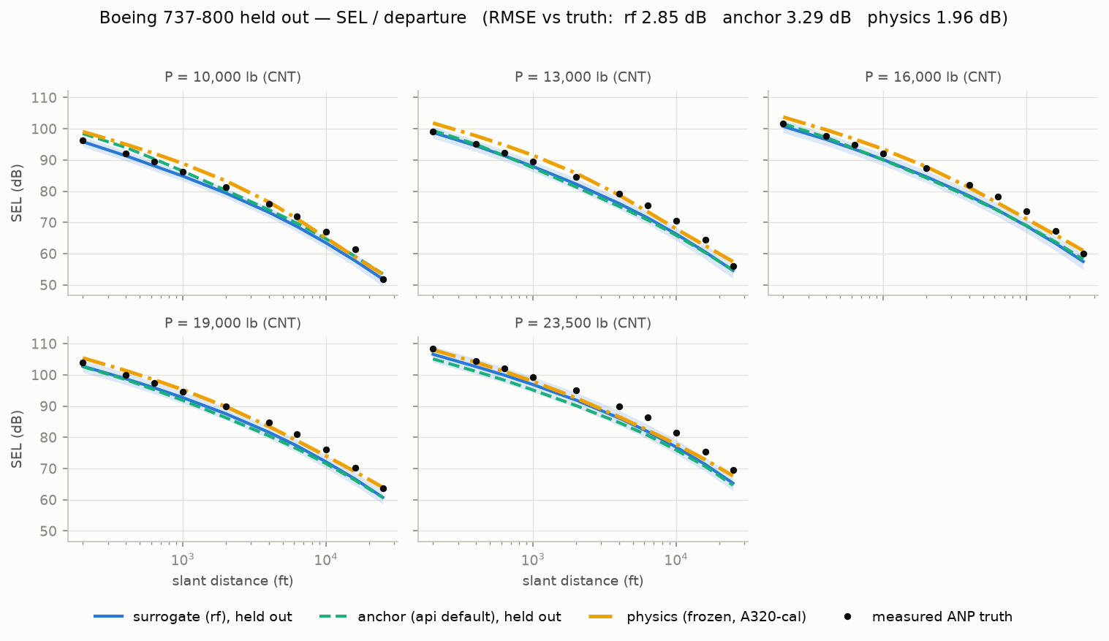
VALIDATION · CASE STUDY
Named hold-out: the Boeing 737-800
Removed from training entirely, then described to the framework only as: 2 × 26,300 lbf · MTOW 174,200 lb · MLW 146,300 lb · Chapter 3. The physics route was calibrated on an A320 and has never seen this aircraft or its engine.
metric / mode | surrogate | anchor | physics
SEL / departure | 2.85 | 3.29 | 1.96
SEL / approach | 1.20 | 1.09 | 1.59
LAmax / departure | 3.75 | 4.11 | 3.34
LAmax / approach | 1.17 | 1.12 | 1.67
EPNL / departure | 3.86 | 4.16 | —
EPNL / approach | 1.54 | 1.51 | —
PNLTM / departure | 4.06 | 5.02 | —
PNLTM / approach | 1.14 | 1.42 | —
RMSE [dB] against the real certified curves
Approach is excellent — 1.1 to 1.7 dB across every metric and both routes, at the hand-curated substitution floor.
Departure error is almost entirely a consistent −2.5 to −3.4 dB bias, not scatter: one geometry-aware feature should absorb most of it.
The physics route beats the surrogate on departure SEL despite single-aircraft calibration — evidence of modeling, not memorising.
Held-out run of 2026-07-13; 'surrogate' = rf, 'anchor' = the then-shipped default. Source: docs/FINAL_REPORT.md §2.2.

Slide 13
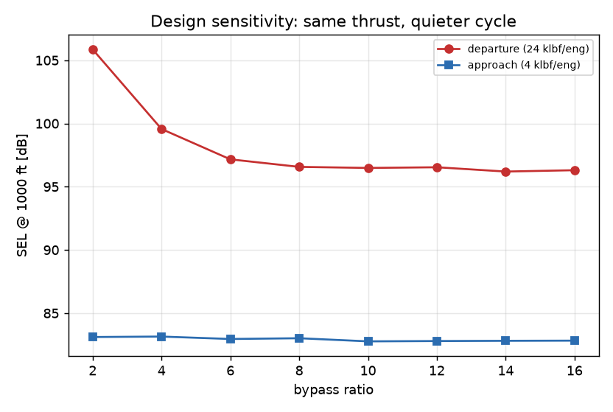
VALIDATION · PHYSICS ROUTE
The frozen physics route, on 12 aircraft it never saw
2.82 dB
median out-of-sample RMSE over 12 aircraft — no re-tuning at any point
1.0 → 9.6
bypass-ratio span covered, from the 727 / JT8D to the A350 / Trent XWB
−9.6 / −0.3 dB
SEL change over a BPR 2 → 16 sweep, departure / approach
The sweep reproduces the literature's source-balance story on its own: raising bypass ratio buys a lot on departure and almost nothing on approach, because approach noise is airframe-limited.
Source: pnmf_cli.py physics — calibration frozen on the A320-211 (in-sample 1.57 dB).

Slide 14
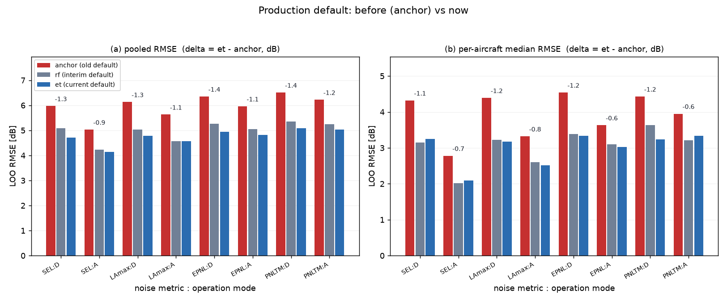
MODEL SELECTION
Which model ships — decided by evidence
# | model | what it is | mean median RMSE [dB]
1 | et | ExtraTrees, static configuration | 2.99
2 | rf | RandomForest surrogate | 3.04
3 | champion | best entry in the evolved registry | 3.08
4 | blend | 0.5 × rf + 0.5 × semi-empirical | 3.28
5 | anchor | nearest donor curve + residual | 3.92
6 | semiemp | interpretable anchor + decay + slope | 3.95
Selection rule fixed in advance: lowest mean per-aircraft median across all eight targets; ties inside 0.05 dB go to the registry-independent model.
The shipped default moved anchor → rf → et as the evidence came in, each step recorded.
'champion' is never shipped even when it wins: it needs a populated trial registry, so a fresh install would fail.
Full LOO bake-off, 6 models × 8 targets. Source: pnmf_cli.py compare, 2026-07-15.

Slide 15
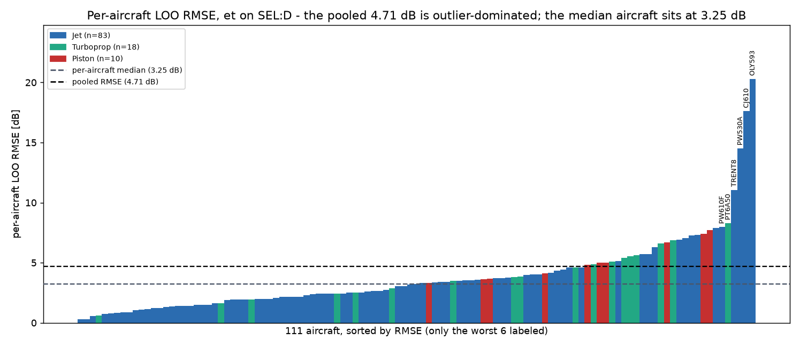
GAP ANALYSIS
The error is not spread evenly — it is six airframes
NPD id | why it is atypical | RMSE | bias
OLY593 | Concorde-class afterburning turbojet | 20.30 | −20.20
CJ610 | early-generation turbojet business jet | 17.61 | −17.18
PW530A | sparse class, envelope edge | 14.51 | +14.24
TRENT8 | 777-class heavy twin, top of thrust range | 11.06 | +10.87
PT6A50 | turboprop, sparse class | 8.29 | +8.19
PW610F | very light jet, envelope edge | 7.97 | +7.94
SEL / departure, model 'et' — dB
All six sit at or outside the edge of the training envelope. A tree ensemble cannot leave the convex hull of what it was shown — it reverts toward the fleet average, which is exactly the signed error above.
Per-aircraft LOO RMSE, sorted. Source: docs/GAP_ANALYSIS_REPORT.md §5.

Slide 16
GAP ANALYSIS
Why the remaining gap exists
1
Envelope extrapolation
2
Missing geometry & BPR
3
Departure vs approach
Tree ensembles cannot predict outside the convex hull of their training features. Atypical engines revert to fleet-average behaviour.
The input object has bypass-ratio, fan-diameter and wing fields — the ANP database populates none of them. The #1 residual-gap cause.
Departure is engine-dominated, where unobserved engine technology matters most: 3.25 dB versus 2.74 dB on approach.
4
Mixed power axes
5
Class sparsity
6
Irreducible floor
Four aircraft publish RPM instead of thrust and go through a crude throttle imputation that adds error for exactly those aircraft.
10 pistons and 18 turboprops against 83 jets — too thin for the model to learn class-specific behaviour.
Even hand-curated real-aircraft proxies carry 1.92 / 1.35 dB. A parametric-only method cannot be expected to beat measured curves.
Source: docs/GAP_ANALYSIS_REPORT.md §6.

Slide 17
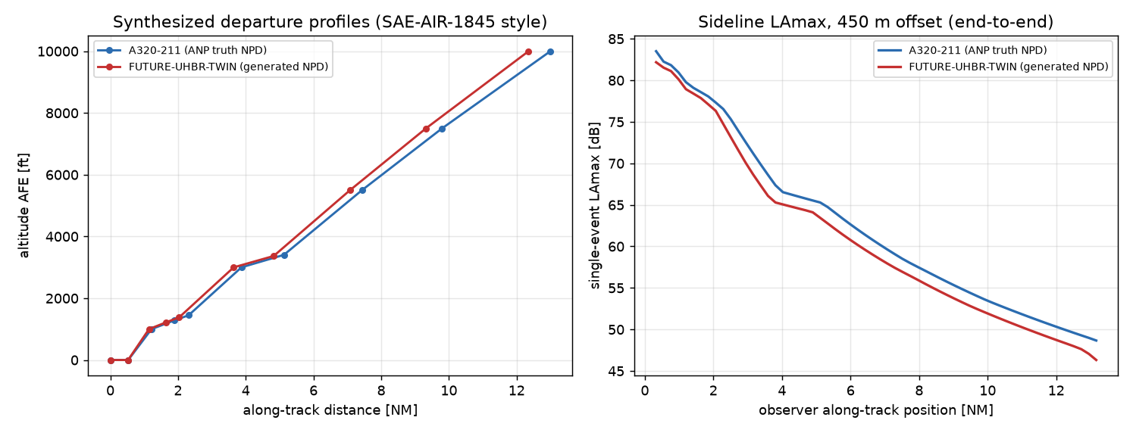
DEMONSTRATION
The point of all this: FUTURE-UHBR-TWIN
A concept that does not exist: 2 × 30,000 lbf ultra-high-bypass twin, BPR 15, MTOW 170,000 lb, Chapter 14. Defined only by those parameters — no curves, no measurements, no proxy assigned by hand.
8 / 8
NPD tables generated in strict ANP layout, all passing the QA gate — 0 caution, 0 rejected
3.27 / 2.21 dB
disagreement between the two independent routes on SEL / LAmax
82.2 vs 83.5 dB
peak sideline LAmax against a real A320-211 computed identically — the UHBR twin comes out quieter, in the physically expected direction
QA record for the shipped 'et' model; sideline comparison from the end-to-end demo (pnmf_cli.py demo).

Slide 18
OPERATIONAL CLOSURE
From a table to a flyover
An NPD table alone is not an assessment — the aircraft has to fly a trajectory past an observer.
Departure profiles are synthesised SAE-AIR-1845 style from the ANP procedural steps and the engine / aerodynamic coefficient decks: Fn/δ = E + F·Vc + Ga·h + Gb·h² + H·Tc for jets, Fn = 325.87·η·hp/V for propellers.
All 142 aircraft with procedural data produce physical profiles — jets and propellers alike; each one is asserted against plausibility bounds in the test suite.
For a concept, the synthesiser borrows the nearest neighbour's procedure — same MTOW and engine-count criteria EASA's own substitution uses — and rescales the engine deck by the thrust ratio.
Flyover level uses the analytic point-to-segment minimum distance with thrust interpolated at the closest point, not the segment midpoint.
142 / 142
aircraft with procedural data produce physically valid departure profiles
Deliberate scope split
Lateral attenuation, ground effect and duration corrections belong to the consuming Doc-29 tool, per the standard's own division of labour. PNMF delivers the table and the profile — nothing more, on purpose.
Simplifications documented in-module: ISA sea level, no wind, CAS ≈ TAS below 10,000 ft, K = 1.01 / 0.95 per Doc 29.

Slide 19
ENGINEERING RECORD
What was found and fixed along the way
# | fault | impact | fix
F1 | 'Power setting' mixed lb, % and RPM in one log feature | 328 rows contaminated | unit-aware split into thrust + throttle
F2 | nothing forced curves to decrease with distance | unphysical tables possible | isotonic projection, on by default
F3 | flyover level used segment midpoints | close approach under-read | analytic point-to-segment minimum
F4 | trajectories existed for ~20 legacy aircraft only | task under-covered | synthesiser: 142 / 142 aircraft
F5 – F8 | PNLTM unvalidated · no end-to-end closure · zero tests · uncertainty mixed into the ANP export | regressions invisible, output not consumable | validated · closed loop · 40-test suite · strict-layout export
40
5.208 → 4.678 dB
0
tests: 39 passing, 1 expected data-staging skip
grouped-CV RMSE, cumulative self-improvement search
predictions ever written into a truth table
Test count verified by re-running the suite on 2026-07-21: 39 passed, 1 skipped.

Slide 20
LIMITATIONS
What this framework does not claim
1
Feature set
Only what every ANP aircraft publishes: thrust, weights, engine count and type, noise chapter. No geometry, no bypass ratio, no fan diameter.
2
Unconventional configurations
Neither route is validated for anything that is not tube-and-wing — the database contains no such aircraft. The same caveat applies to every semi-empirical model in the literature.
3
Conceptual-design synthesiser
The trajectory module is not a Doc-29 Vol. 2 Appendix B reimplementation; verification against the Vol. 3 reference cases is still outstanding.
4
Physics route scope
SEL and LAmax only — the tone-correction machinery behind EPNL and PNLTM is not implemented.
5
Data vintage
ANP v2.3 legacy schema. The v6.3 release ships as xlsx and the current loader cannot read it.
Every one of these is stated in the module docstrings and the written report — none of them is a surprise found afterwards.

Slide 21
DISCUSSION
Open questions — where should the effort go?
Q1
Geometry and bypass ratio
The input object already has the fields; the ANP database fills none of them. Is wiring a synthesis tool (PrADO / CPACS / RCAIDE) into the feature set worth it — and would the ~3 dB departure bias actually fall?
Q2
The extrapolation problem
A tree ensemble structurally cannot leave its training hull. Do we accept that and hand outliers to the physics route, or change model class to something that extrapolates?
Q3
Which route owns the answer
Outside the fleet envelope the physics route is arguably more trustworthy than the surrogate. Should the shipped default switch by envelope distance rather than being one fixed model?
Q4
Sparse classes
10 pistons and 18 turboprops. Per-class models, transfer from the jet population, or an honest refusal to predict for those classes?
Continued on the next slide.

Slide 22
DISCUSSION
Open questions — continued
Q5
Tone correction for the physics route
EPNL and PNLTM are the metrics regulators actually certify against, and the physics route cannot produce them. Is implementing PNLT worth the effort, or do those two metrics stay surrogate-only?
Q6
ANP v6.3
The newer release is xlsx-only and the loader reads the v2.3 CSV schema. Straight converter, or is a schema change hiding behind it?
Q7
Verification against Doc 29 Vol. 3
The reference cases are the accepted way to prove a trajectory implementation. What is needed from the FSR tool interface to run them?
The one-line version
Two independent routes land 2–3 dB apart on a concept neither can verify — the honest next step is better inputs, not a better regressor.

