Slide 1
Math models 3D to 2D
Affine transformations in 3D;
Projections 3D to 2D;
Derivation of camera matrix form

Slide 2
Intuitive geometry first
Look at geometry for stereo
Look at geometry for structured light
Look at using multiple camera
THEN look at algebraic models to use for computer solutions

Slide 3
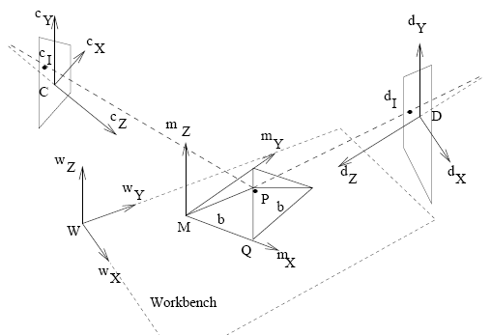
Review environment and coordinate systems

Slide 4
Imaging ray in space
Image of a point P must lie along the ray from that point to the optical center of the camera. (The algebraic model is 2 linear equations in 3 unknowns x,y,z, which constrain but do not uniquely solve for x,y,z.)

Slide 5
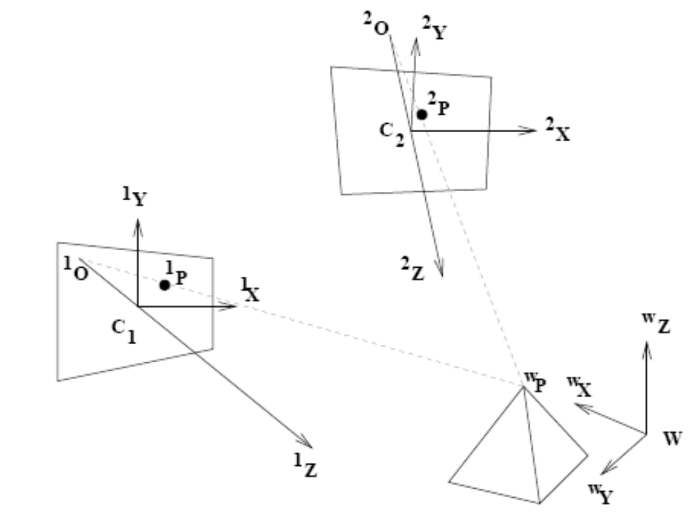
General stereo environment
A world point P seen by two cameras must lie at the intersection of two rays in space. (The algebraic model is 4 linear equations in the 3 unknowns x,y,z, enabling solution for x,y,z.) It is also common to use 3 cameras; the reason will be seen later on.

Slide 6
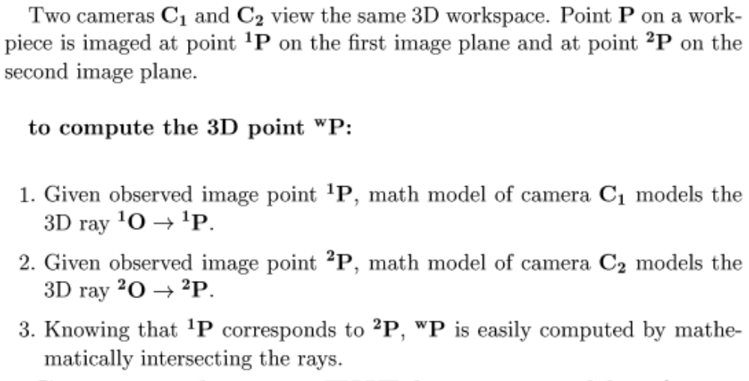
General stereo computation

Slide 7
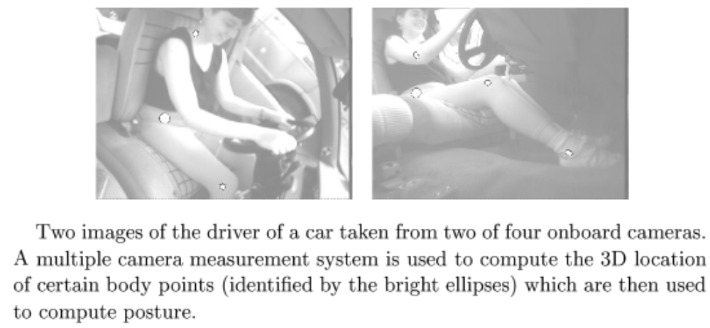
Measuring the human body in a car while driving (ERL,LLC)

Slide 8
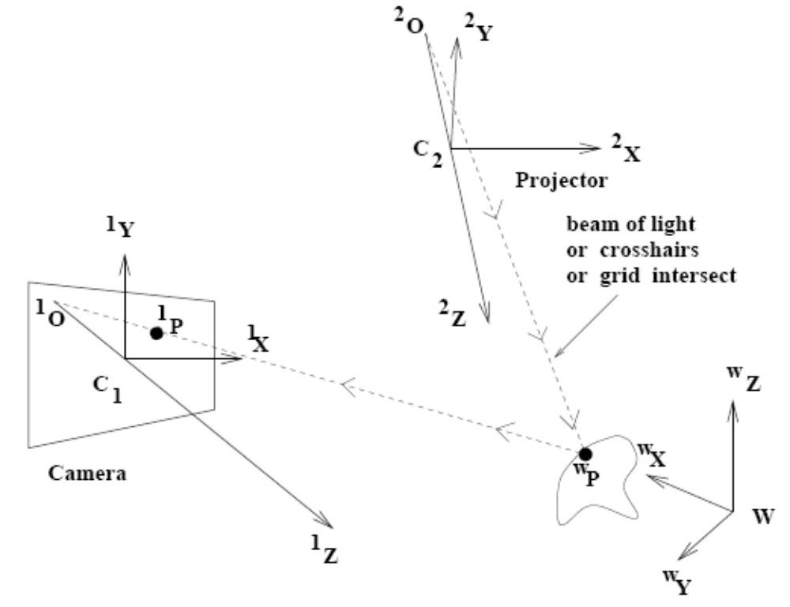
General environment: structured light projection
By replacing one camera with a projector, we can provide illumination features on the object surface and know what ray they are on. (Same algebraic model and calibration procedure as stereo.)

Slide 9
Advantages/disadvantages
+ can add features to bland surface (such as a turbine blade or face)
+ can make the correspondence problem much easier (by counting or coloring stripes, etc.)
- active sensing might disturb object (laser or bright light on face, etc.)
- more power required

Slide 10
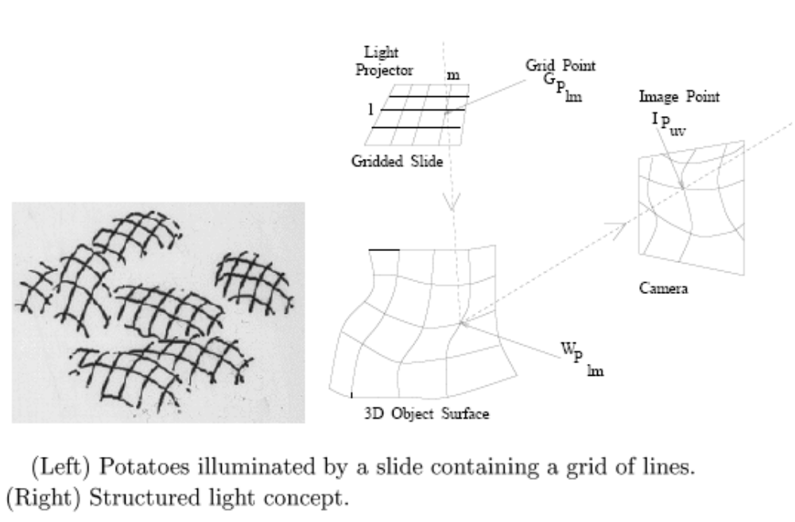
Industrial machine vision case

Slide 11
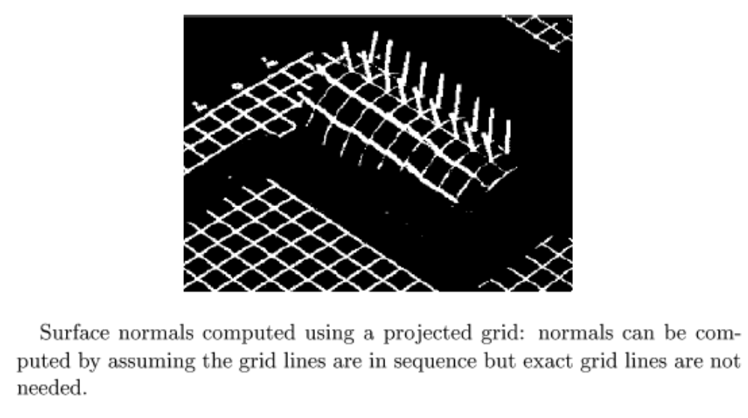
Industrial machine vision case

Slide 12
Develop algebraic model for computer’s computations
Need models for rotation, translation, scaling, projection

Slide 13
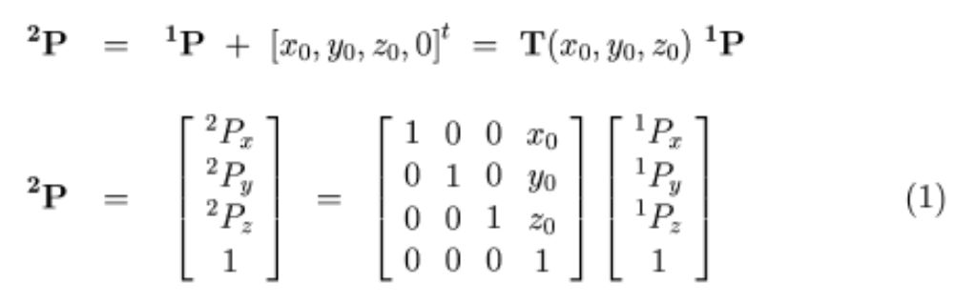
Algebraic model of translation
Shorthand model of transformation and its parameters: 3 translation components

Slide 14
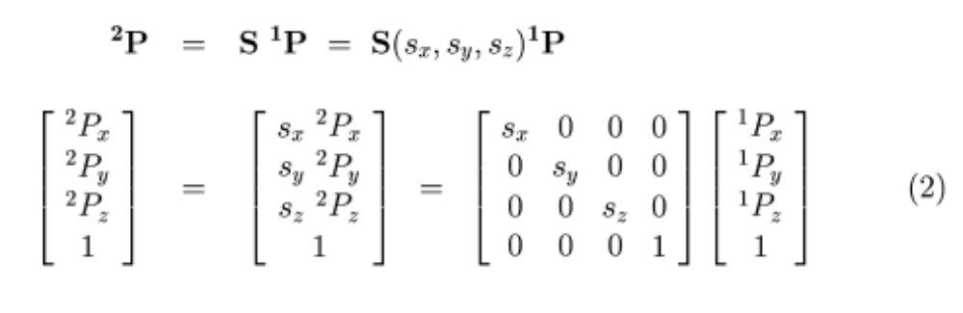
Algebraic model for scaling
Three parameters are possible, but usually there is only one uniform scale factor.

Slide 15
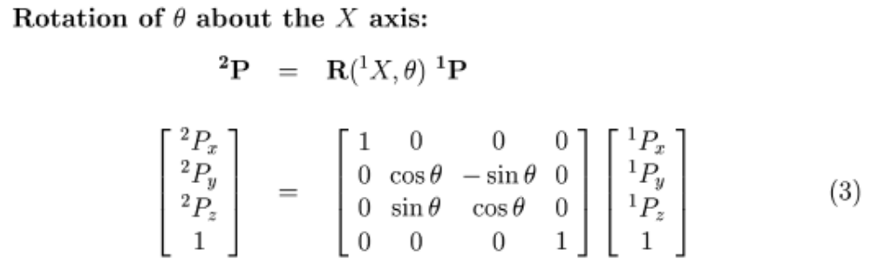
Algebraic model for rotation

Slide 16
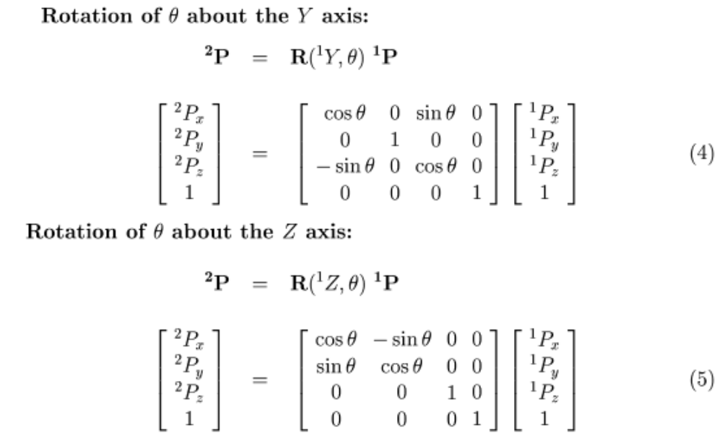
Algebraic model of rotation

Slide 17
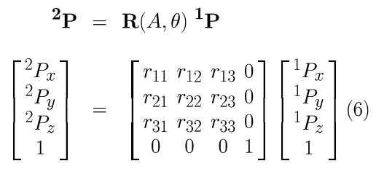
Arbitrary rotation
Rotations about all 3 axes, or about a single arbitrary axis, can be combined into one matrix by composition. The matrix is orthonormal: the column vectors are othogonal unit vectors. It must be this way: the first column is R([1,0,0,1]); the second column is R([0,1,0,1]); the third column is R([0,0,1,1]).

Slide 18
General rigid transformation
Moving a 3d object on ANY path in space with ANY rotations results in (a) a single translation and (b) a rotation about a single axis. (Just think about what happens to the basis vectors.)

Slide 19
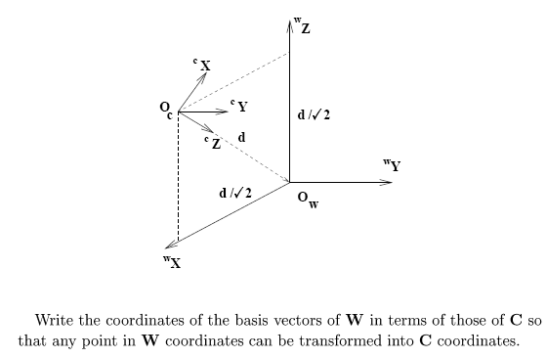
Example: transform points from W to C coordinates

Slide 20
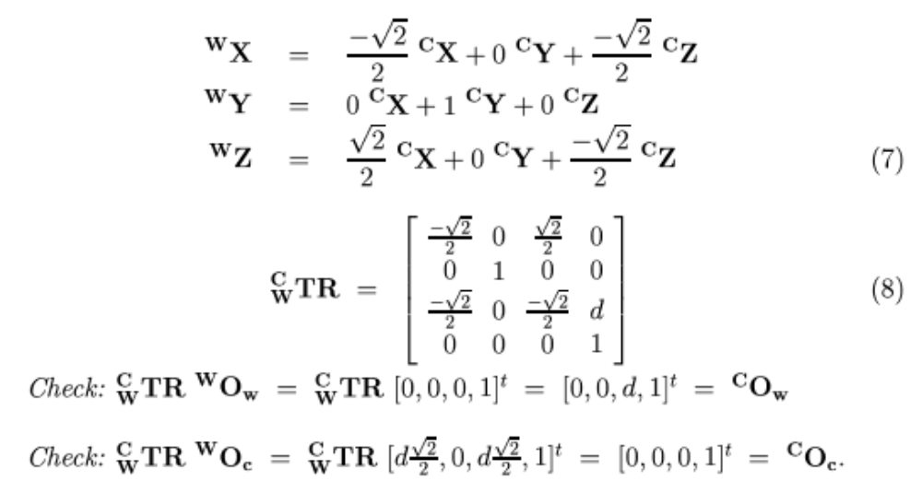
Example change of coordinates

Slide 21
How to do rigid alignment: perhaps model to sensed data
Problem: given three matching points with coordinates in two coordinate systems, compute the rigid transformation that maps all points.

Slide 22
Application: model-based inspection
auto is delivered to approximate place on assembly line (+/- 10 cm)
camera[s] take images and search for fixed features of auto
transformation from auto (model) coordinates to workbench (real world) coordinates is then computed
robots can then operate on the real object using the model coordinates of features (make weld, drill hole, etc.)
machine vision can inspect real features in terms of where the model says they should be

Slide 23
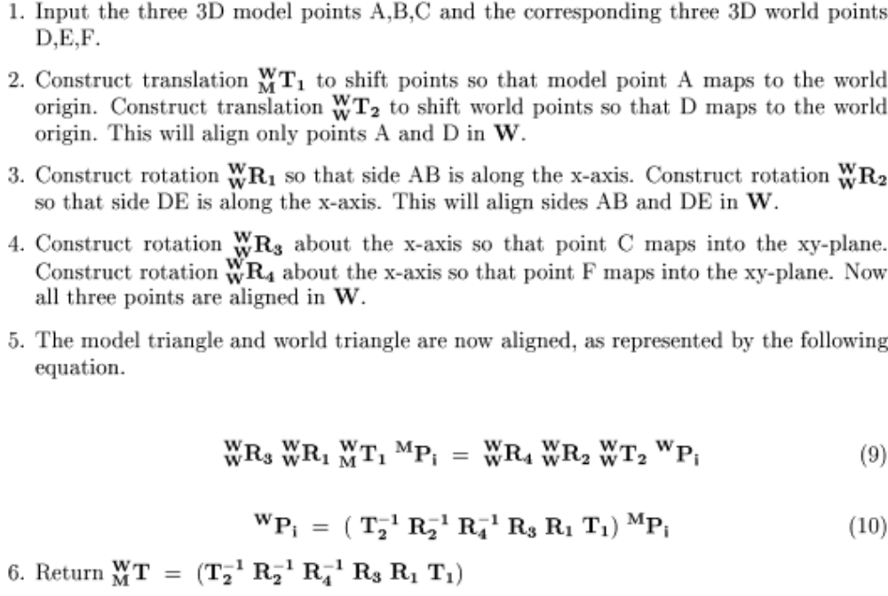
Algorithm for rigid 3D alignment using 3 correspondences

Slide 24
Algorithm for 3d alignment from 3 corresponding points
We assume that the triangles are congruent within measurement error, so they actually will align.

Slide 25
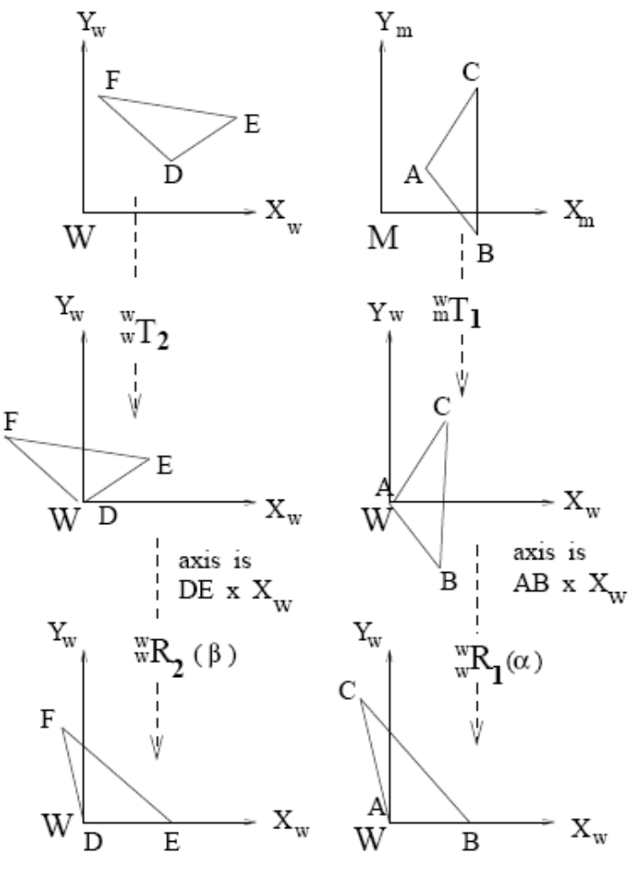
Approach: transform both spaces until they align (I)
Translate A and D to the origin so that they align in 3D
Rotate in both spaces so that DE and AB correspond along the X axis

Slide 26
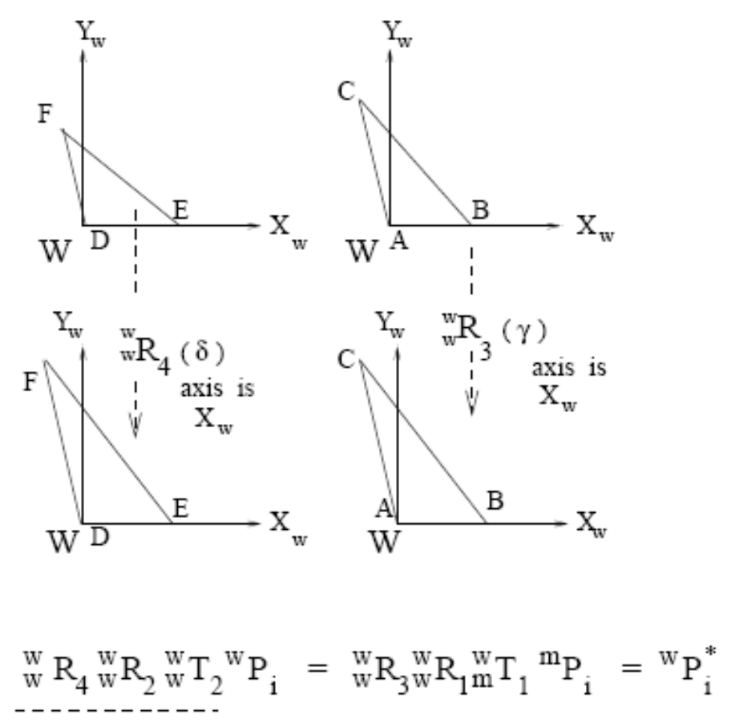
3d alignment (II)
Rotate about the X axis until F and C are in the XY-plane. The 3 points of the 2 triangles should now align.
Since all transformation components are invertible, we can solve the equation!

Slide 27
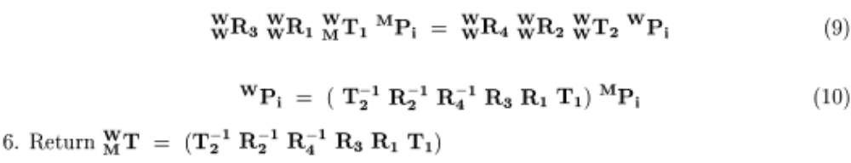
Final solution: rigid alignment

Slide 28
Deriving the camera matrix
We now combine coordinate system change with projection to derive the form of the camera matrix.

Slide 29
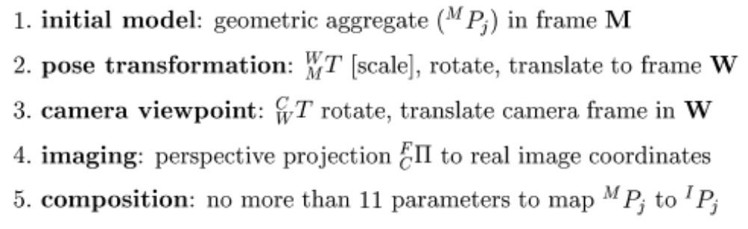
Composition to develop

Slide 30

3D world to 3D camera coords
4x4 rotation and translation matrix

Slide 31
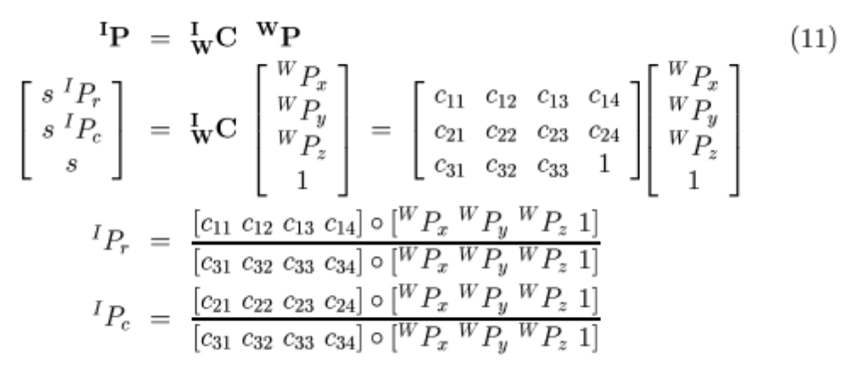
Projection of 3D point in camera coords to image [r,c]
We derive this form in the slides below.
We lose a dimension; the projection is not invertible.

Slide 32
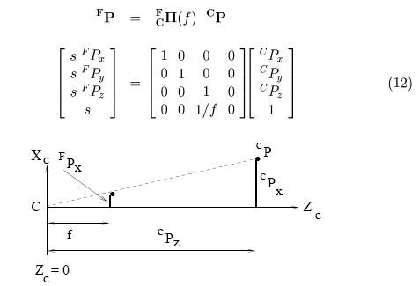

Perspective transformation (A)
Camera frame is at center of projection. Note that matrix is not of full rank.

Slide 33
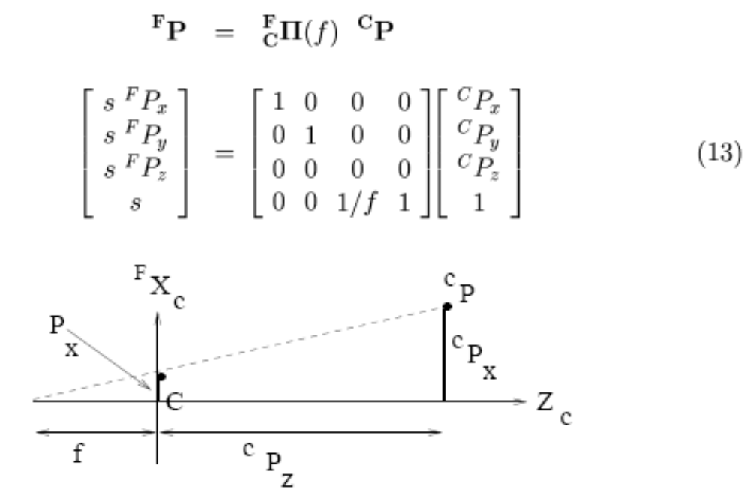

Perspective transformation (B)
As f goes to infinity, 1/f goes to 0 so it is obvious that the limit is orthographic projection with s=1.

Slide 34
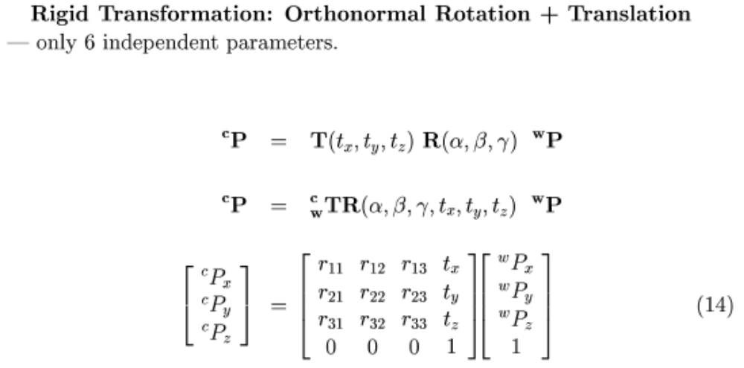
Return to overall

Slide 35
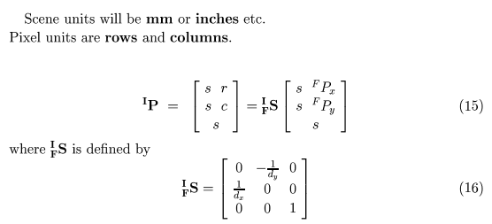
Scale from scene units to image units

Slide 36
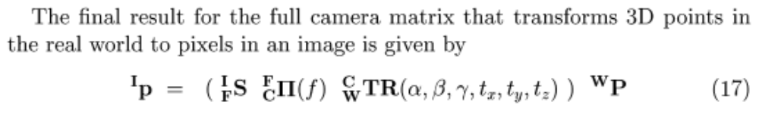
Composed transformation
Scale change in 2D space (real scene units to pixel coordinates)
Projection from 3d to 2D
Rigid transformation in 3D

Slide 37
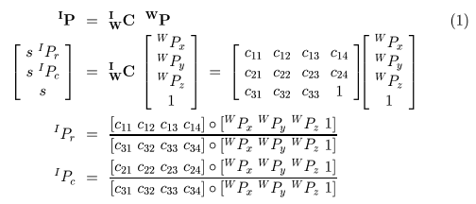
After a long way, we arrive at the camera matrix used before

