Slide 1
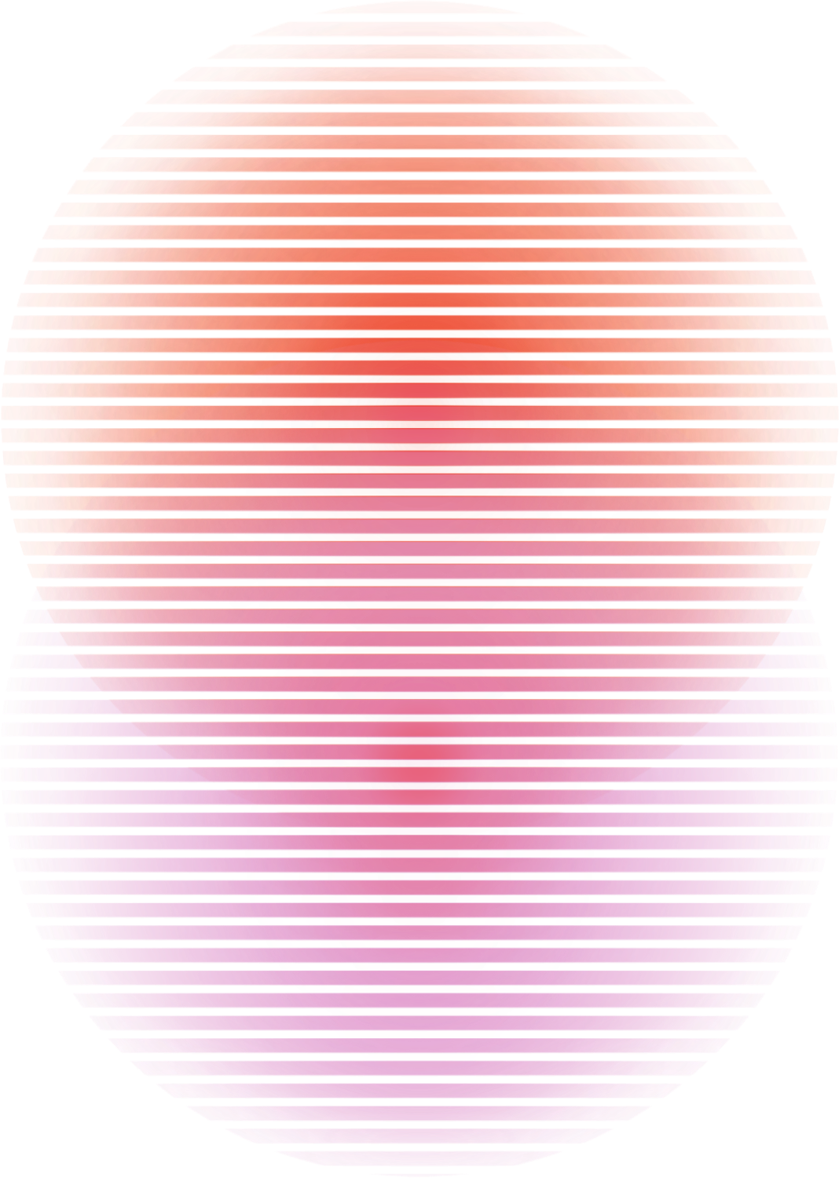

PetChat
Made by:
Shafeev Rushan

