Slide 1
Outline Day 1
Docker principle
Docker machine
Image, Repository & Tag, container
CPU, Memory and I/O
Network
Volume
Inspect and Log
Commit
Kitematic (Alpha)

Slide 2
Outline Day 2
Dockerfile and Build
Compose
Registry
Swarm & Swarm 1.12
Conceptual of Swarm
Service Discovery
Container Scheduling
Container Load balance
High Availability
Networking
Swarm 1.12
Shipyard for Docker
Q&A

Slide 3
Prerequied
Windows (64 bit)/ Mac / Linux (64 bit)machine (ubuntu / alpine prefer)
1 email address (For register “hub.docker.com”) / hub.docker.com account
Tool for editor (atom etc)
Tool for shell (putty / terminal etc)
Tool for transfer file (winscp / scp)
Basic understand for linux operate
Basic text editor skill (vim prefer) and linux structure
Internet for download / upload image

Slide 4
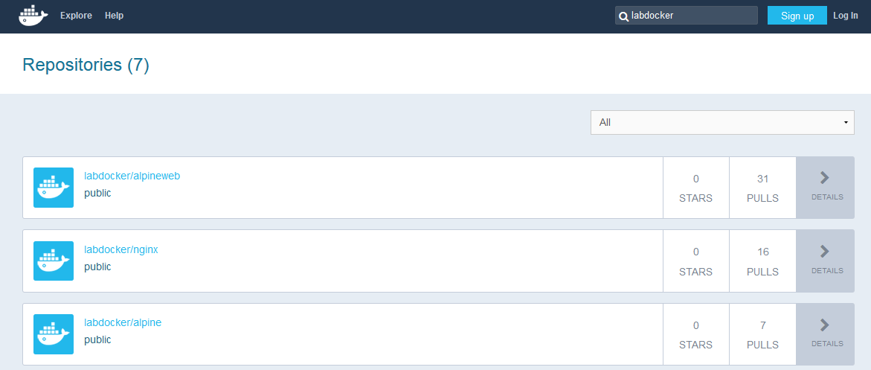
Lab Resource
Repository for lab

Slide 5
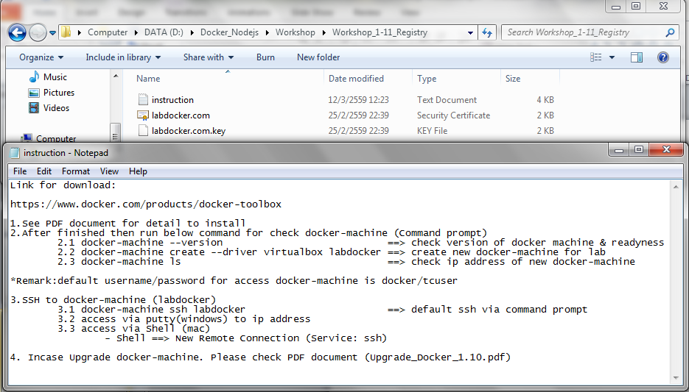
Lab Resource
Software in lab

Slide 6
