Slide 1
Final Project: PCA + MLP vs CNN for Object Localization
ECE-4563 Machine Learning Project — NYU Tandon
PRESENTED BY Max Ma, Yanbo Wang

Slide 2
Problem Statement
Object localization is a fundamental computer vision problem
Goal: predict the bounding box of an object in an image
We study localization of a single MNIST digit placed on a larger canvas
Compare a classical ML pipeline with an end-to-end deep learning approach

Slide 3
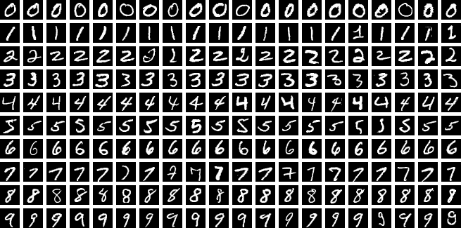
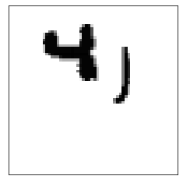
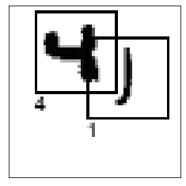
Dataset & Task Definition
Synthetic MNIST-on-Canvas dataset
Input: 64 × 64 grayscale image
Output: bounding box parameters
(a)
(b)
Figure 1: Sample images from MNIST test dataset
Figure 2: (a) Input, (b) Expected Output

Slide 4


Problem Formulation
Training Data:
$${\{\left(X_{i},y_{i}\right)\}}_{i=1}^{N}$$
$$where{ x}_{i}∈ℝ^{64×64},y_{i}=\left(x_{c},y_{c},w,h\right)∈{\left[0,1\right]}^{4}$$
We choose MSE as the Loss function:
$$ℒ\left(θ\right)=\frac{1}{N}\sum_{i=1}^{N}{{\left\|\hat{y_{i}}−y_{i}\right\|}_{2}^{2}}$$

Slide 5
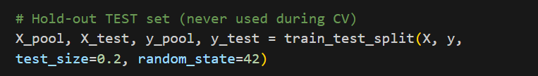
Training Procedure
1. Data Splitting and Preparation:
• Dataset is split into a pool set and a held-out test set
• Pool set is used for training and validation
• Test set is used only for final evaluation
• Prevents information leakage during model selection

Slide 6
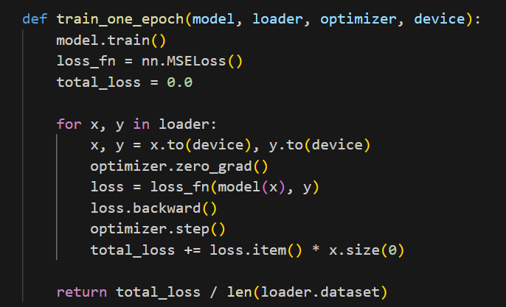
Training Procedure
2. Model Training (MLP / CNN):
• Models are trained using supervised learning
• Mini-batch gradient descent is used
• Loss function: Mean Squared Error (MSE)
• Optimizer: Adam
• Parameters updated via backpropagation

Slide 7
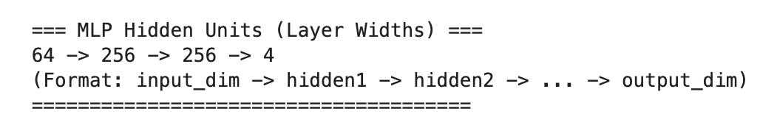
PCA + MLP
Input 64×64 image was flattened to a 4069 dim-vector and standardized before entering MLP regressor
MLP regressor predicts bounding box
Sigmoid output activation applied for enforcing valid box range
MLP layer widths (example k=64)

Slide 8
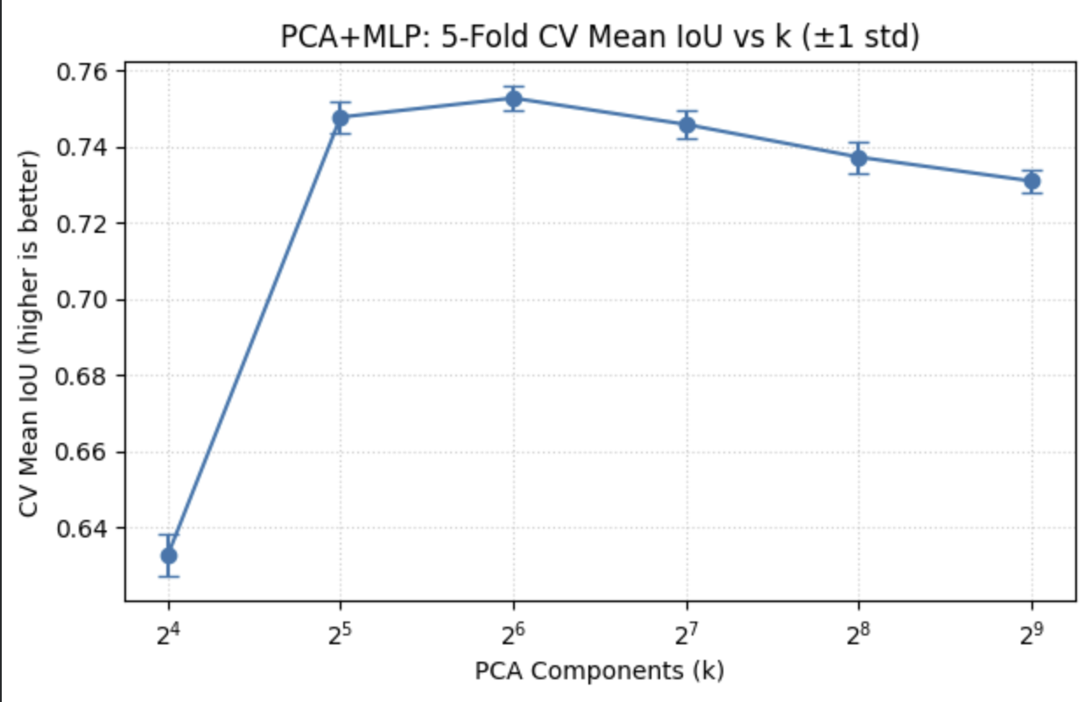
PCA Component Selection
A 5‑Fold cross‑validation was applied on training pool for selecting best dimensions from 16-512 with the highest IoU
K-Fold cross-validation applied only on training set
Best dimension count: k = 64
Best k by mean IoU: k = 64

Slide 9
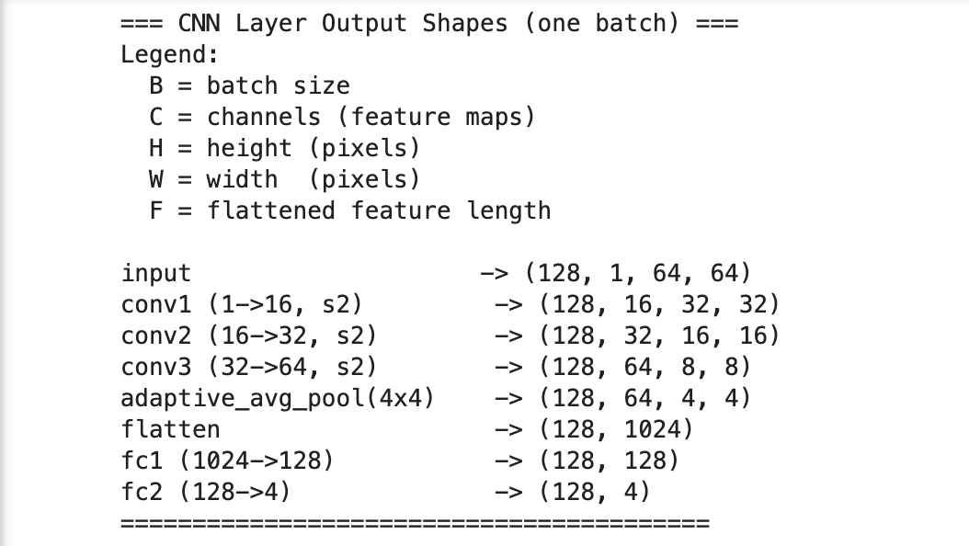
End‑to‑End CNN
Constructed with 3 convolution blocks, 1 average pooling on 4 by 4 region and 2 linear layers
Directly regressed the bounding box from the input image
Trained with MSE loss
CNN tensor shapes for one batch (B,C,H,W)

Slide 10
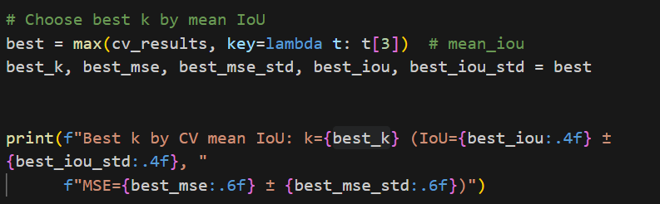
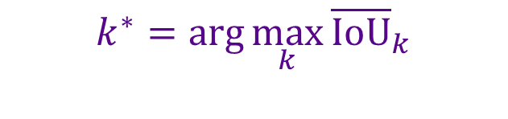
Training Procedure
3. Cross-Validation for PCA+MLP:
• PCA dimension is treated as a hyperparameter
• K-fold cross-validation is performed on the pool set
• Standardization and PCA are fit only on training folds
• Mean IoU across folds is used to select optimal PCA dimension
$$k^{∗}=\arg{\max_{k}{{\overline{\text{IoU}}}_{k}}}$$

Slide 11
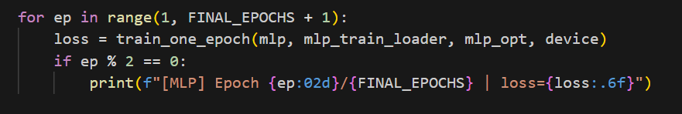
Training Procedure
4. Final Training on Full Pool Set:
• Final model is retrained using the entire pool set
• Same training procedure used as in cross-validation
• Fixed number of training epochs

Slide 12
Evaluation Results
PCA + MLP achieves competitive localization accuracy
CNN achieves higher mean IoU on test set
CNN benefits from spatial feature learning
Both models evaluated on held‑out test data
Table 1: Table for final MSE/IoU result for two models
Model | Test MSE (↓) | Mean IoU (↑)
PCA + MLP (k=64) | 0.000941 | 0.7825
CNN Regressor | 0.000683 | 0.8134

Slide 13
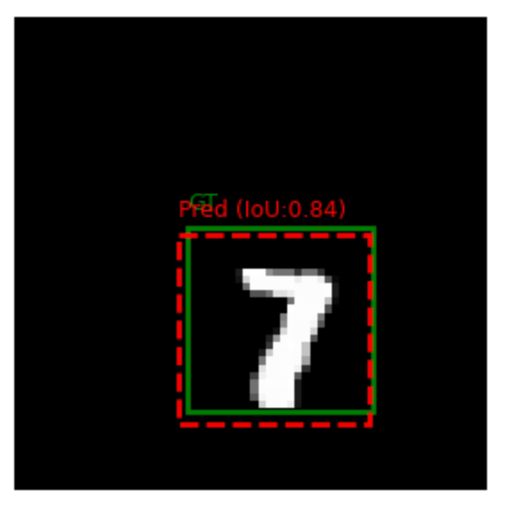
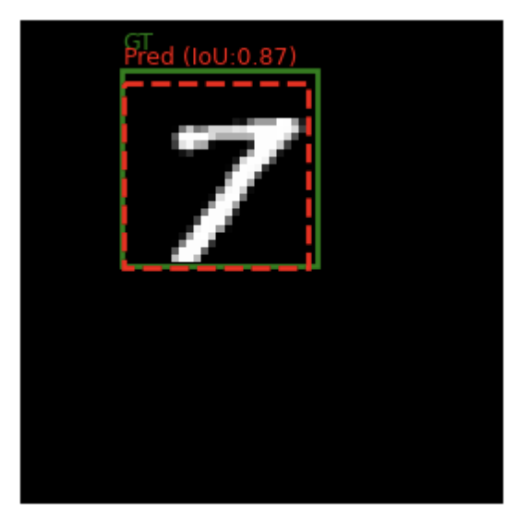
Visual Evaluation Results
Figure 3: Sample for PCA+MLP Model Prediction VS. Ground Truth
Figure 4: Sample for CNN Model Prediction VS. Ground Truth

Slide 14
Conclusion
PCA + MLP offers interpretability and efficiency
CNN provides superior end‑to‑end performance
Cross‑validation is critical for fair model selection
Demonstrates trade‑offs between classical ML and deep learning

