Slide 1

Basic Details of the Team and Problem Statement
Problem Statement Title:
Team Name:
Team Leader Name:
Institute Name:

Slide 2
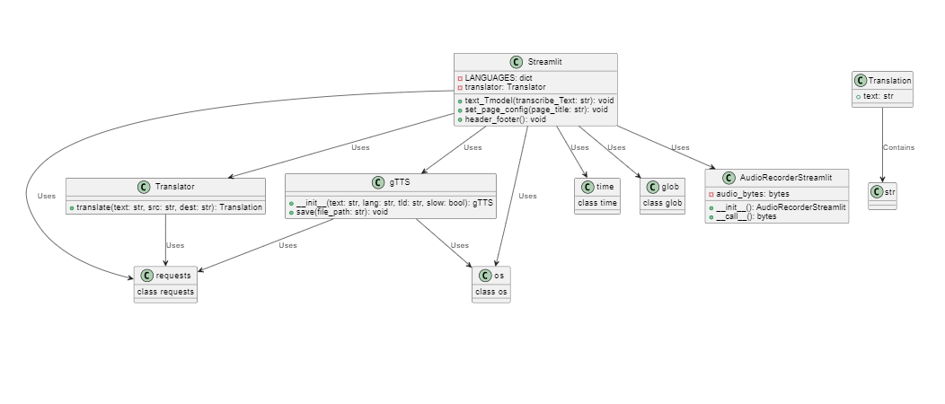
Idea/Approach Details
Describe your idea/Solution/Prototype here:
Our project is a web application designed to simplify transcribing and translating voice recordings. It empowers users to convert spoken words into written text effortlessly and, if needed, translate that text into multiple languages, catering to a diverse and global audience. Here's a breakdown of our solution.
Encoder-decoder Transformer architecture is used for large-scale supervised pre-training for speech recognition. Resampled audio, log magnitude Mel spectrogram, and stem layers are used for feature representation.
Describe your Technology stack here:

Slide 3
Idea/Approach Details
Describe your Use Cases here
Describe your Dependencies / Show stopper here
Target Audience/Users:
Content Creators (e.g., podcasters, YouTubers, journalists)
Language Learners
Multilingual Businesses
Anyone needing voice transcriptions
Streamlit:- we are using Streamlit to host our model using dependencies.
Application programming interface:– APIs are used to get the send requests from our Transcribing the input audio file the API will take in the tokenized form of audio get the transcription text and detokenize the output.
gTTs:- we are using the Google text-to-speech module to create a temp audio file of the output text.

Slide 4
Team Member Details
Team Leader Name: Type Your Name Here
Stream (ECE, CSE etc): Year (I,II,III,IV):
Team Member 1 Name: Type Your Name Here
Stream (ECE, CSE etc): Year (I,II,III,IV):
Team Member 2 Name: Type Your Name Here
Stream (ECE, CSE etc): Year (I,II,III,IV):
Team Member 3 Name: Type Your Name Here
Stream (ECE, CSE etc): Year (I,II,III,IV):
NOTE: Team mentor addition is OPTIONAL
Team Mentor 1 Name: Type Your Name Here
Category (Academic/Industry): Expertise (AI/ML/Blockchain etc): Domain Experience (in years):
Team Mentor 2 Name: Type Your Name Here
Category (Academic/Industry): Expertise (AI/ML/Blockchain etc): Domain Experience (in years):

Slide 5
Important Pointers
Please ensure below pointers are met while
Kindly keep the maximum slides limit to 5 pages
All the topics should be utilized for description of your idea
Try to avoid paragraphs and post your idea in points
Keep your explanation precisely and easy to understand
Idea should be unique and novel. If it has a business potential more weightage will be given.
Apart from this PPT, you shall be presenting your model too.

