Slide 1
Building a Mechanistic Understanding of Cellular Decisions

Slide 2
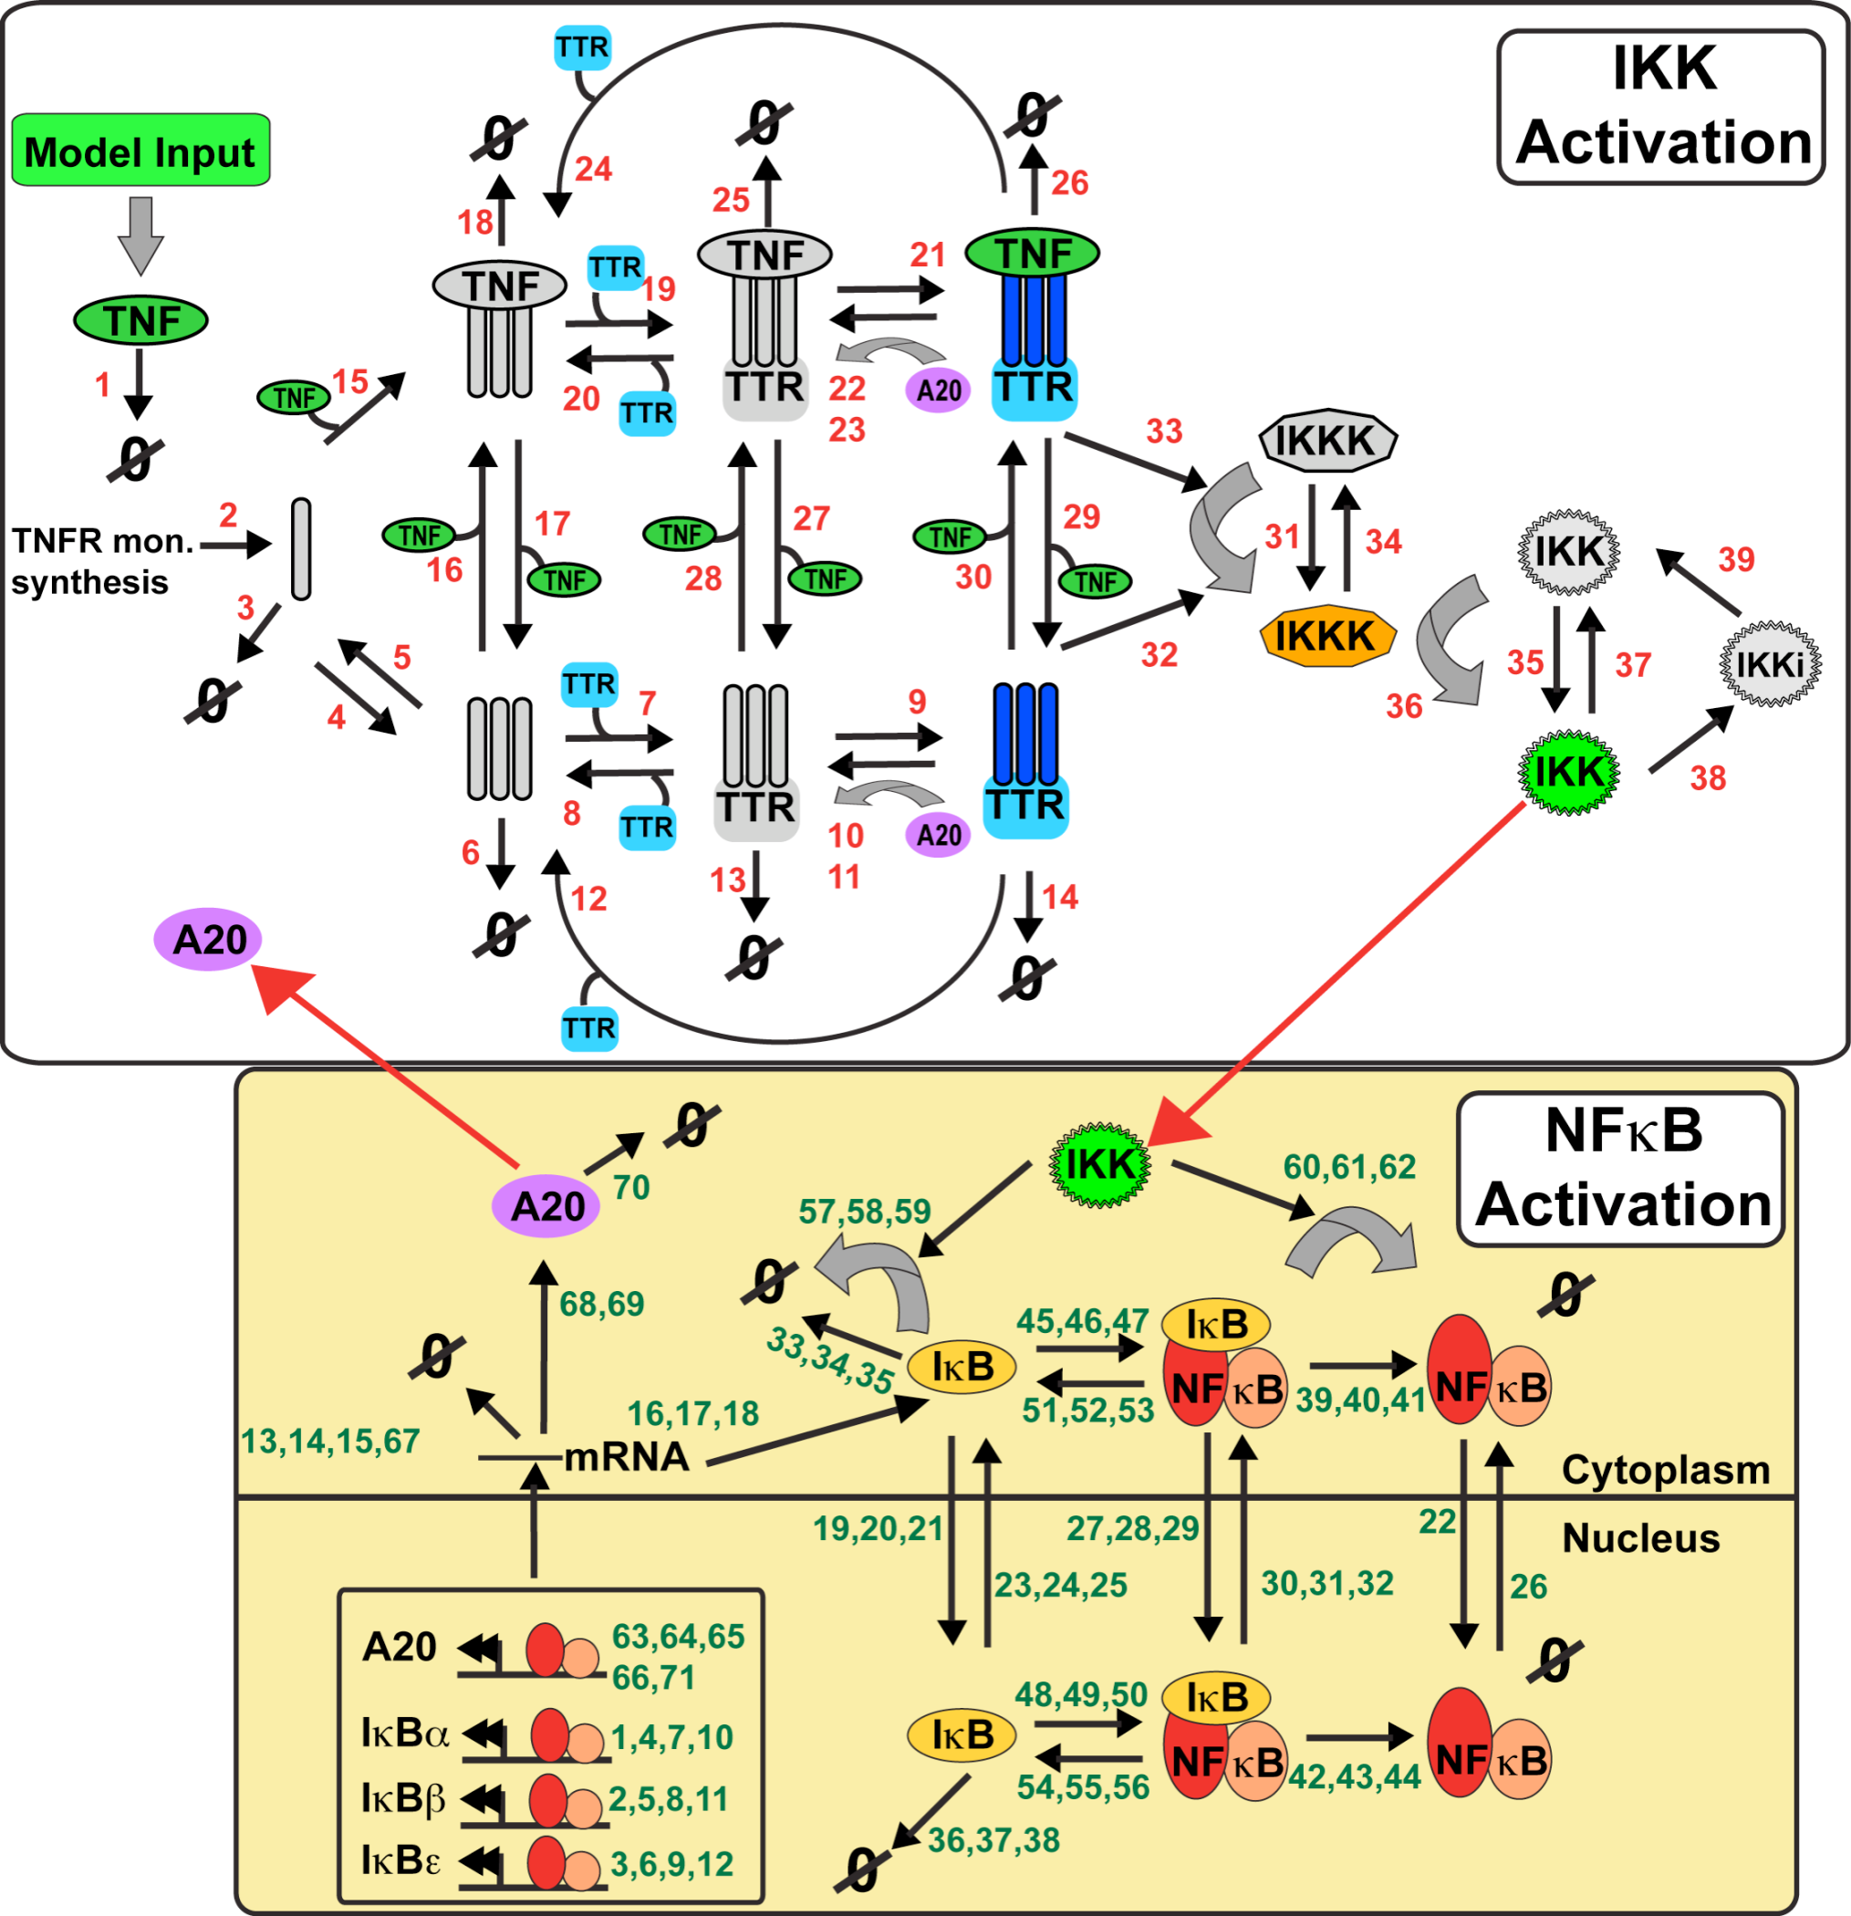
TNF response model
(Werner et al. 2008 + ikbd Shih et al. 2009)
IKK1
IkBd
IkBd
IkBd
IkBd
Notes:
IKK2

Slide 3
Quantification of death rates in L929 wt cells in response to TNF
Experimental set-up:
L929 wt cells treated with 4 different concentrations of TNF for 24 hours
(TNF is added to cells 30 min prior to imaging and stays on all the time)
Real-time imaging between 30 min and 24 hours of treatment
Quantifying dead cells by PI positivity of nucleus
Analysis:
Automated cell tracking and quantification of PI positive cells
Calculation of death rates (probability of live cells that will die in one hour)
Supplemental Figures:
Comparison between the different TNF concentrations (0.1 to 100 ng/ml)
Upper: Mean of five independent experimental replicates; lower: stdev of means

Slide 4
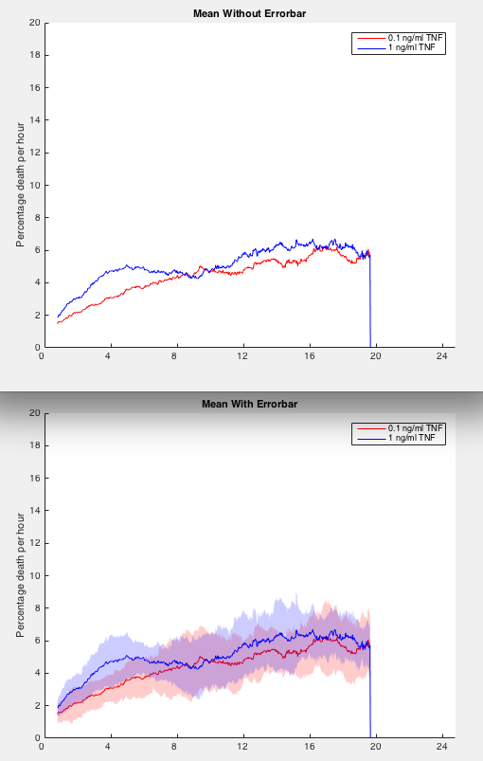
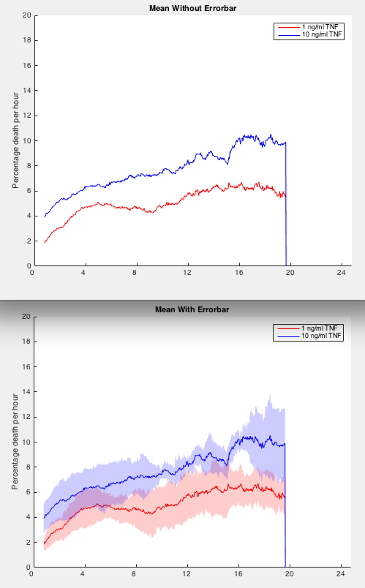
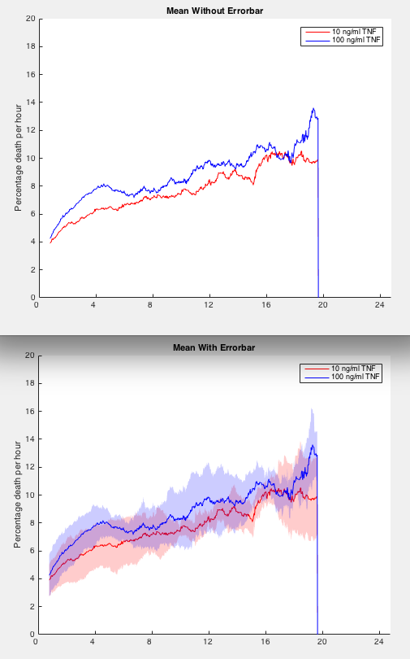
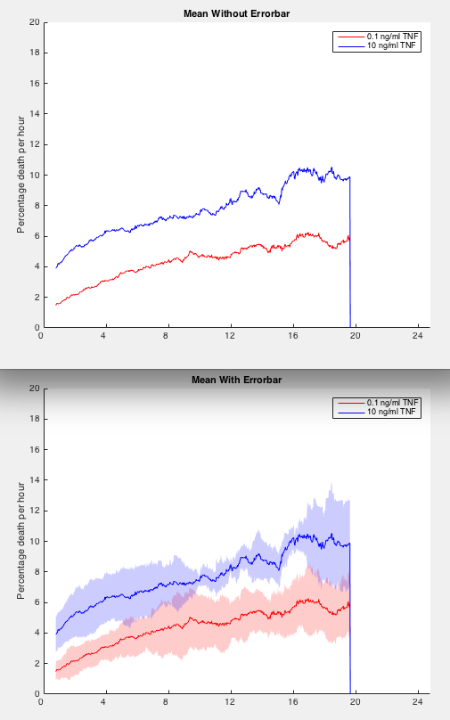
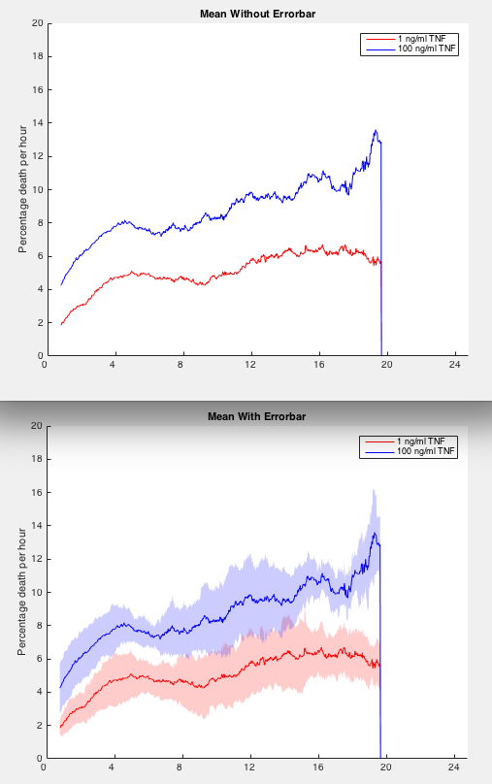
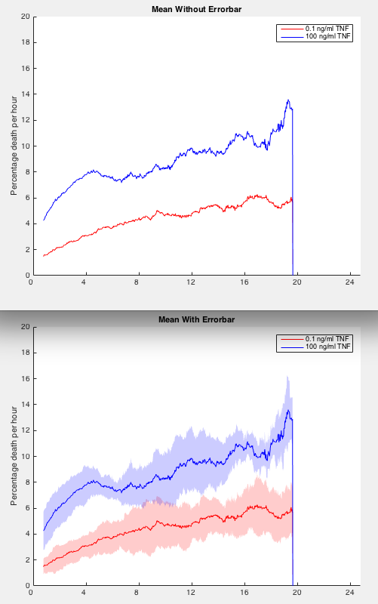
Quantification of death rates in L929 wt cells in response to TNF
0.1 vs. 1 ng/ml
1 vs. 10 ng/ml
10 vs. 100 ng/ml
0.1 vs. 10 ng/ml
1 vs. 100 ng/ml
0.1 vs. 100 ng/ml
Hours after addition of TNF
Hours after addition of TNF
Hours after addition of TNF
Hours after addition of TNF
Hours after addition of TNF
Hours after addition of TNF
Hours after addition of TNF
Hours after addition of TNF
Hours after addition of TNF
Hours after addition of TNF
Hours after addition of TNF
Hours after addition of TNF

Slide 5
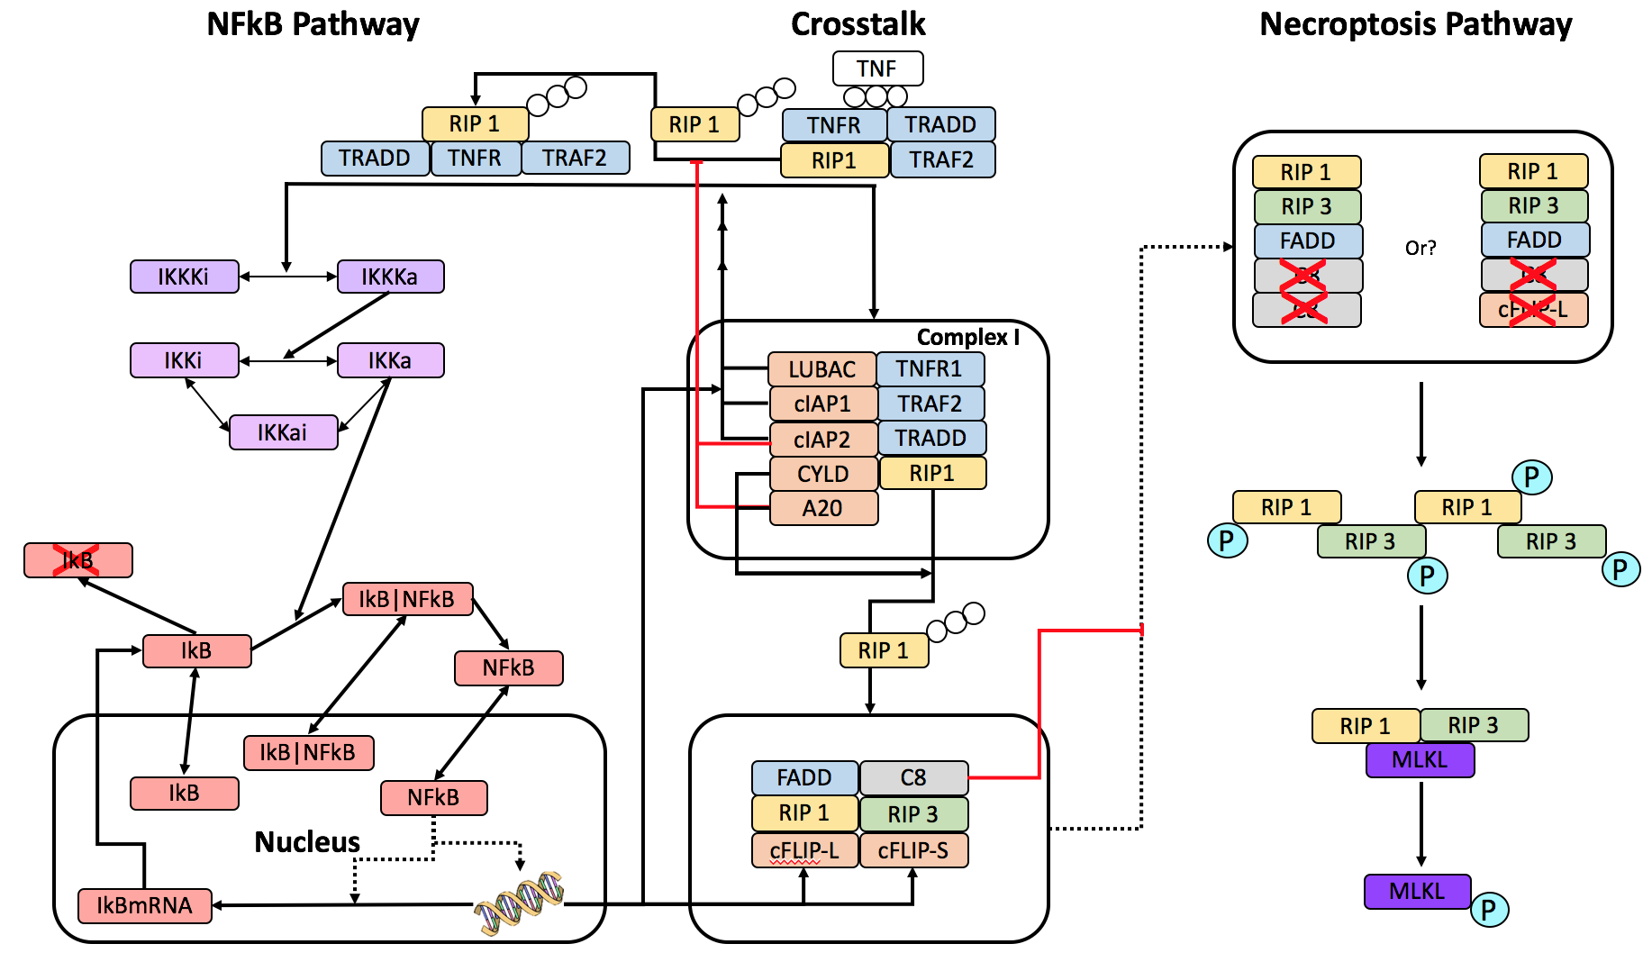
Pathway Diagram of NFkB and Necroptosis Crosstalk

Slide 6
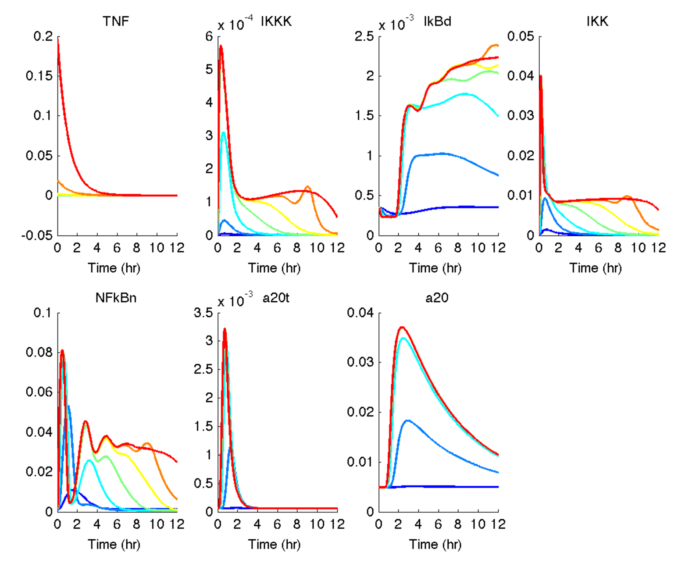
Hoffmann Model w/Delays 12 hrs

Slide 7
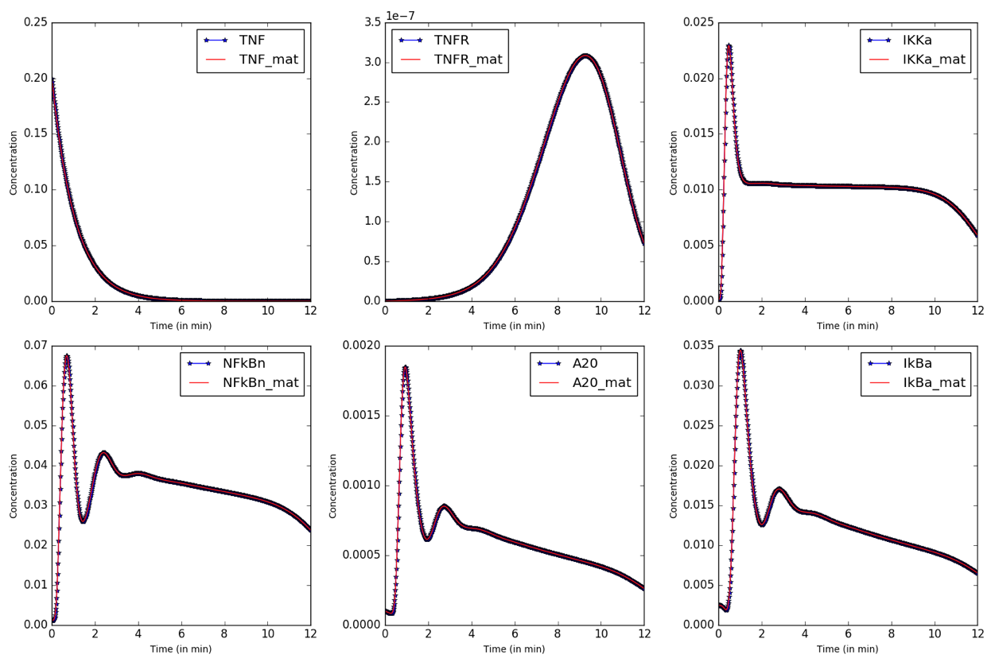
Hoffmann/Geena Module w/o Delays 12 hrs

Slide 8
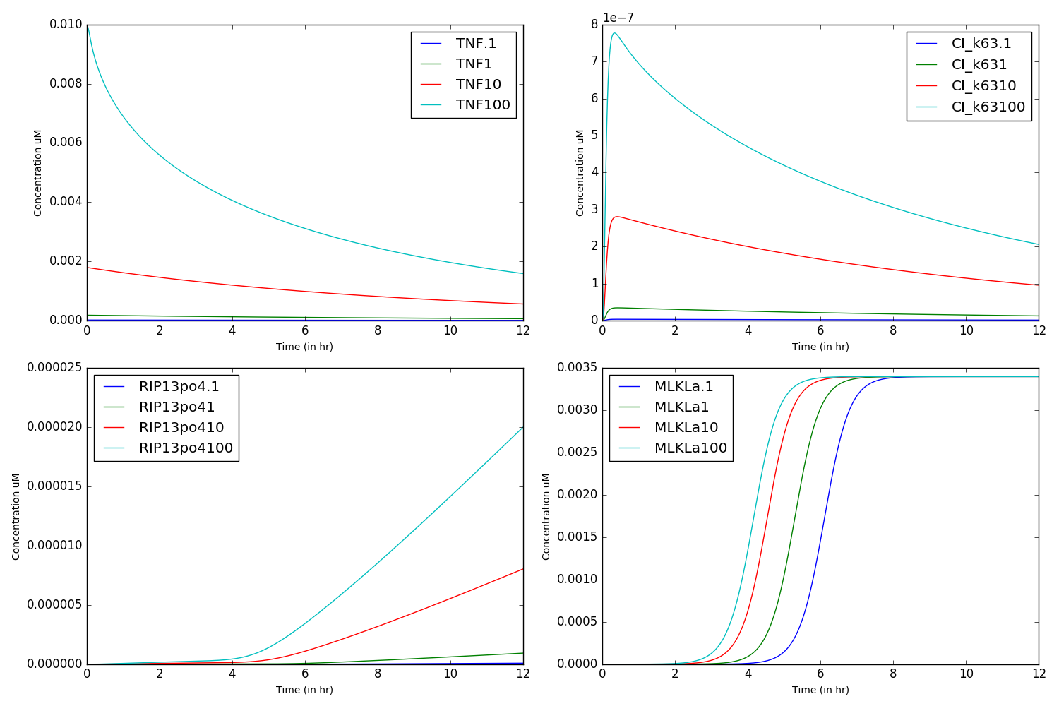
Necroptosis Module 12 hrs

Slide 9
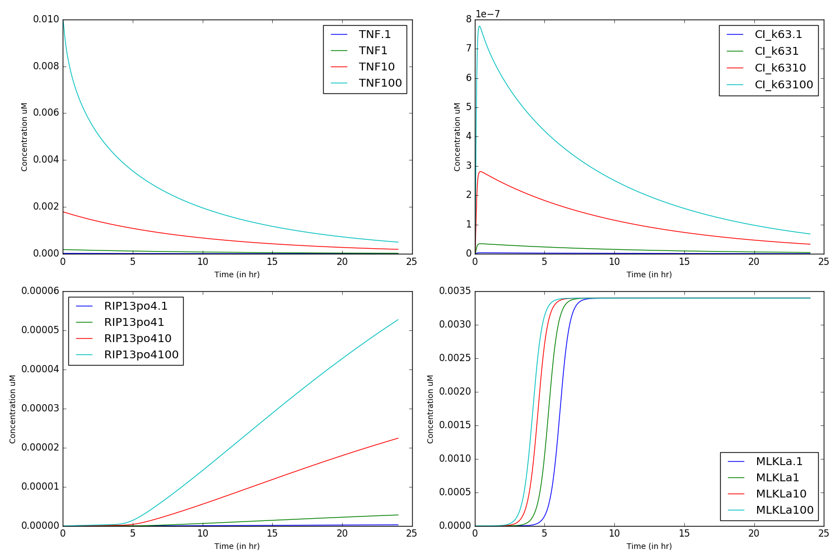
Necroptosis Module 24 hrs

Slide 10
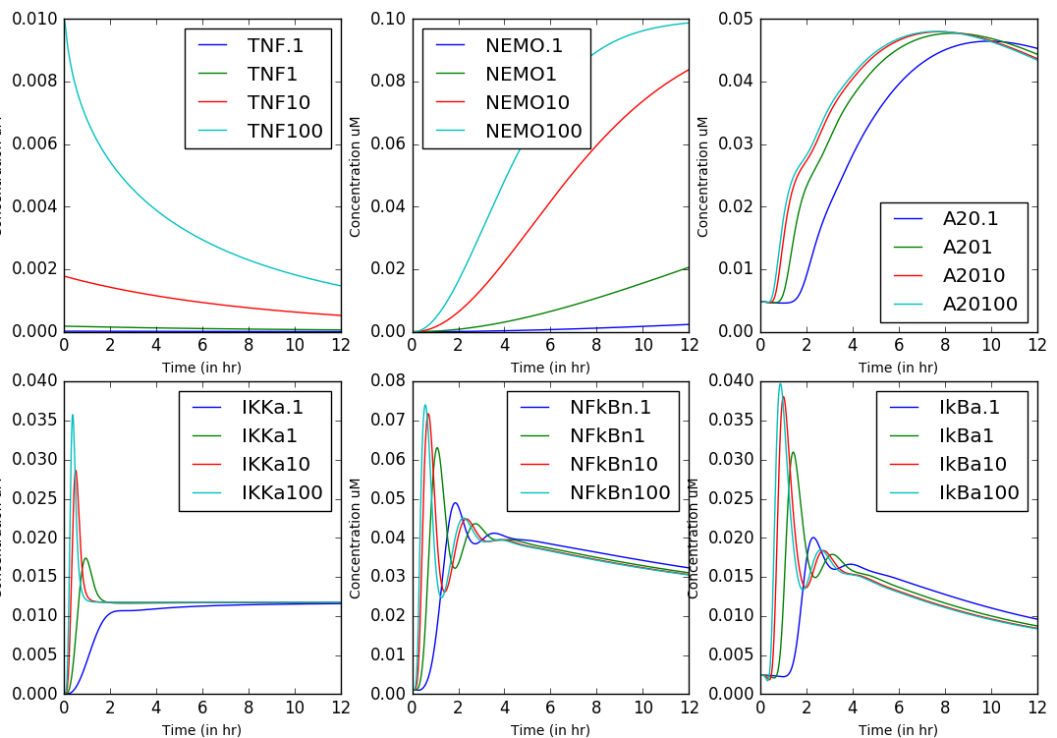
NFkB Module 12 hrs no Flip/cIAP synthesis

Slide 11
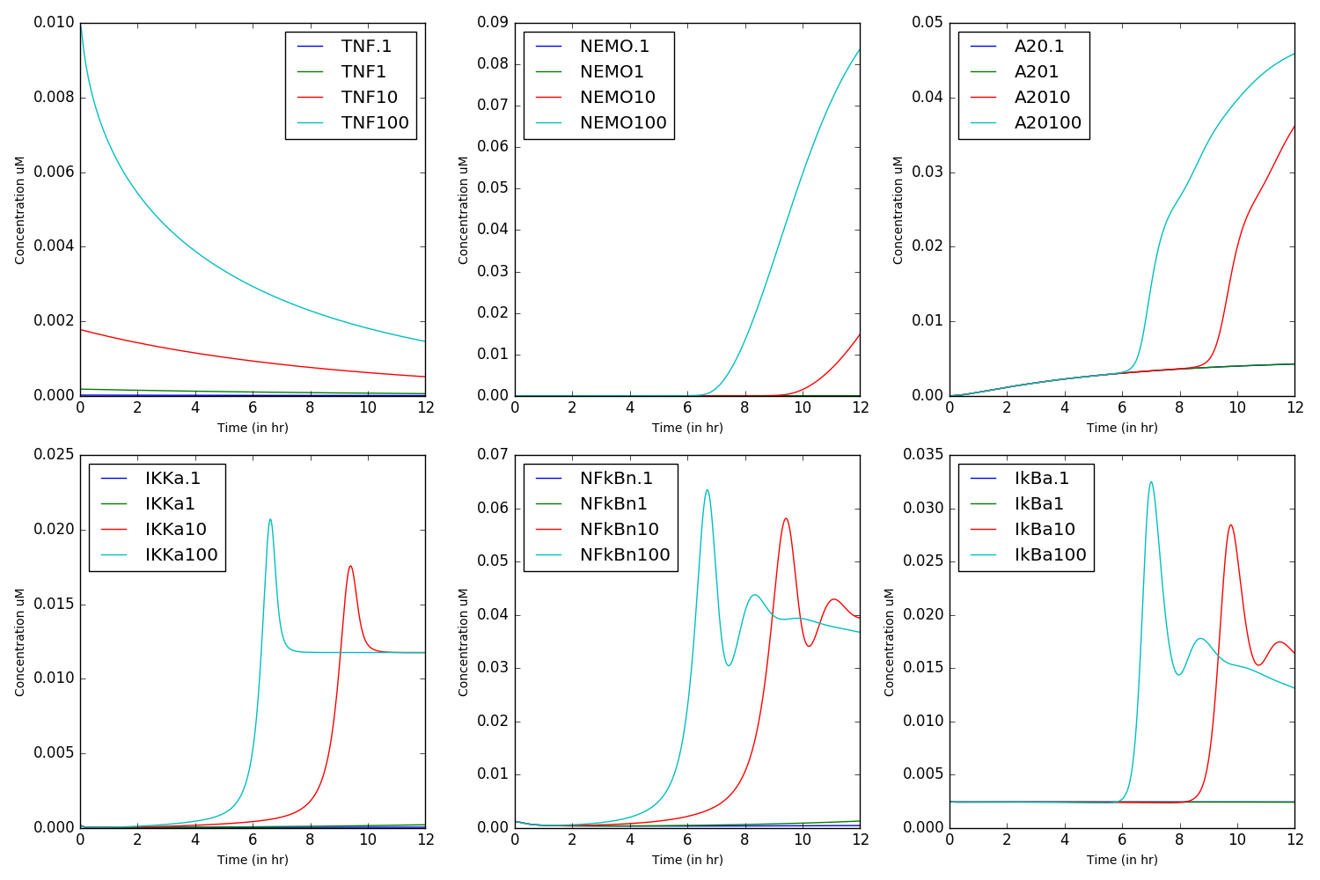
NFkB Module 12 hrs full synthesis

Slide 12
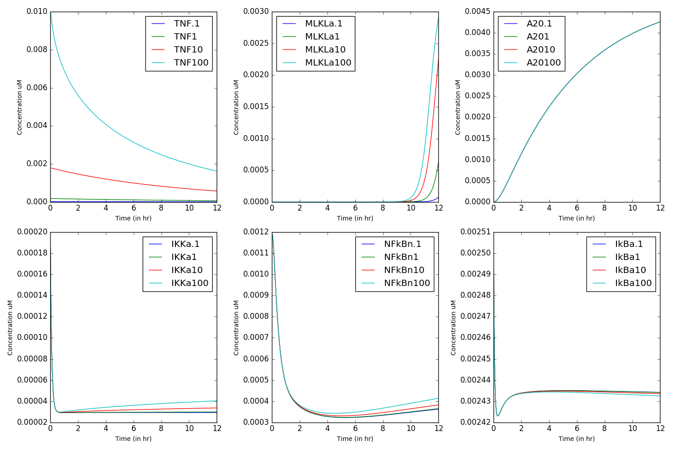
Merged Model 12 hrs

Slide 13
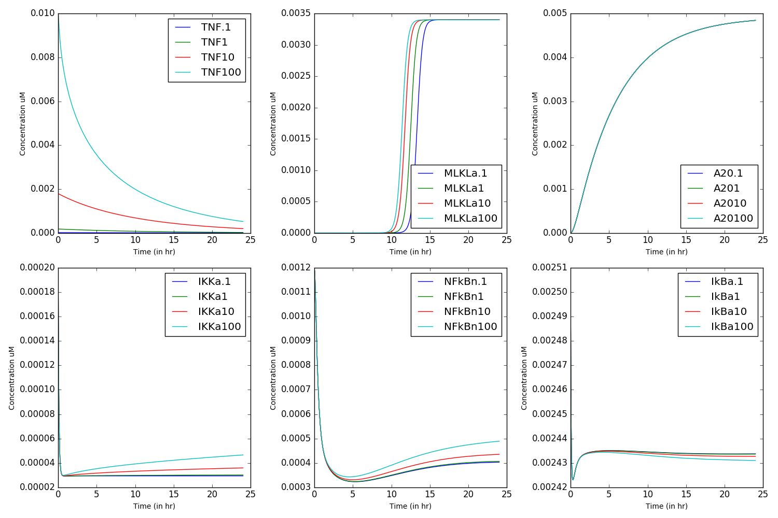
Merged Model 24 hrs

Slide 14
TNFa
Complex I
1
TNFa
2
TRADD
TNFR1
TNFa
TNFR1
TNFR1
TRADD
3
RIP1
TNFa
12a-2
TRADD
TNFR1
RIP1
11
4
TRAF2
NSC
TNFa
TRADD
TNFR1
RIP1
TRAF2
5
cIAP
TNFa
10
TNFR1
NFkB
TRADD
RIP1
TRAF2
cIAP
CYLD
7
TNFa
TNFa
TNFa
TNFR1
6
TRADD
TNFR1
9
TNFR1
TRADD
RIP1
TRAF2
RIP1
TRAF2
TRADD
RIP1
u
u
u
cIAP
CYLD
cIAP
cIAP
8
11
TNFa
TRADD
TNFR1
TRADD
RIP1
RIP1
TRAF2
cIAP
CYLD
12a-1
FADD
FADD
RIP1
12a-1
12a-2
Complex II (Hypothesis I)
FADD (bound)
RIP1 (bound)
flip_L
RIP3
16
MLKL
20
FADD (bound)
14
flip_L
RIP1 (bound)
a
flip_S
RIP3
19
15
FADD (bound)
17
p
flip_S
13
proC8
RIP1 (bound)
18
RIP1 (bound)
RIP3
RIP3
p
p
FADD (bound)
proC8
Complex IIa
Complex IIb

Slide 15
TNFa
Complex I
1
TNFa
2
TRADD
TNFR1
TNFa
TNFR1
TNFR1
TRADD
3
RIP1
TNFa
TRADD
TNFR1
RIP1
11
4
TRAF2
NSC
TNFa
TRADD
TNFR1
RIP1
TRAF2
5
cIAP
TNFa
10
TNFR1
NFkB
TRADD
RIP1
TRAF2
cIAP
CYLD
7
TNFa
TNFa
TNFa
TNFR1
6
TRADD
TNFR1
9
TNFR1
TRADD
RIP1
TRAF2
RIP1
TRAF2
TRADD
RIP1
u
u
u
cIAP
CYLD
cIAP
cIAP
8
11
TNFa
TRADD
TNFR1
TRADD
RIP1
RIP1
TRAF2
cIAP
CYLD
?
12b-2
TRADD
RIP1
TRAF2
FADD
12b-1 ?
FADD
RIP1
Complex II (Hypothesis II)
FADD (bound)
RIP1 (bound)
flip_L
RIP3
16
MLKL
20
FADD (bound)
14
flip_L
RIP1 (bound)
a
flip_S
RIP3
19
15
FADD (bound)
17
p
flip_S
13
proC8
RIP1 (bound)
18
RIP1 (bound)
RIP3
RIP3
p
p
FADD (bound)
proC8
Complex IIa
Complex IIb

Slide 16
TNFa
Complex I
Hypothesis III
1
TNFa
2
TRADD
TNFR1
TNFa
TNFR1
TNFR1
TRADD
3
RIP1
TNFa
TRADD
TNFR1
RIP1
11
4
TRAF2
NSC
TNFa
TRADD
TNFR1
RIP1
TRAF2
5
cIAP
TNFa
10
TNFR1
NFkB
TRADD
RIP1
TRAF2
cIAP
CYLD
7
TNFa
TNFa
TNFa
TNFR1
6
TRADD
TNFR1
9
TNFR1
TRADD
RIP1
TRAF2
RIP1
TRAF2
TRADD
RIP1
u
u
u
cIAP
CYLD
cIAP
cIAP
8
11
TNFa
TRADD
TNFR1
TRADD
RIP1
RIP1
TRAF2
cIAP
CYLD
?
FADD
TRADD
RIP1
TRAF2
12c?
12c?
TRADD
RIP1
FADD
Complex II (Hypothesis II)
FADD (bound)
RIP1 (bound)
flip_L
RIP3
16
MLKL
20
FADD (bound)
14
flip_L
RIP1 (bound)
a
flip_S
RIP3
19
15
FADD (bound)
17
p
flip_S
13
proC8
RIP1 (bound)
18
RIP1 (bound)
RIP3
RIP3
p
p
FADD (bound)
proC8
Complex IIa
Complex IIb

Slide 17
Mitochondrion
complex IIA
BID
TNF
TRADD
Cyt-C
FADD
BCL2
Apoptosome
TNFR
CASP8
RIP1
complex I
TNFR1
FLIP-L
XIAP
cCASP3
TRADD
RIP1
TRAF2
FLIP-S
complex IIB
cPARP = apoptosis
FADD
Werner et al. 2008
CASP8
IKK
cIAP1/2
RIP1
CYLD
MLKL
pMLKL = necroptosis
RIP3
NFκB
A20
Shih et al. 2009

Slide 18
TNF
complex I
complex IIA
TNFR1
NFkB modules
TRADD
TRAF2
RIP1
FADD
cCASP8
Mitochondrion
RIP1
4)
CASP8
BID
RIP1
RIP1
Cyt-C
BCL2
Apoptosome
TNFR1
1,3)
2)
2)
TRADD
TRAF2
2)
2)
5,6)
5,6)
RIP1
LUBAC
FLIP-S
FLIP-L
Werner et al. 2008
cIAP1
CYLD
A20
12)
XIAP
cCASP3
cIAP2
Itch
IKK
prolonged JNK
cPARP = apoptosis
11)
11)
ROS
GADD45b
FHC
NFκB
10)
Mn-SOD
11,13)
Shih et al. 2009
IAPs: Guardians of RIPK1, Meier, Cell Death Diff, 2012
Poly-ubiquitination in TNFR1-mediated necroptosis, Walczak, Cell Mol Life, 2016
cIAP1 and cIAP2 Facilitate Cancer Cell Survival by Functioning as E3 Ligases that Promote RIP1 Ubiquitination, Barker, Mol Cell, 2008
TNF-induced necroptosis in L929 cells is tightly regulated by multiple TNFR1 complex I and II members, Vanden Berghe, Cell Death and Dis, 2011
FLIP the switch: Regulation of apoptosis and necroptosis by cFLIP, Nakano, Int J Mol Sci, 2015
CIAPs Block Ripoptosome Formation, a RIP1/Caspase-8 Containing Intracellular Cell Death Complex Differentially Regulated by cFLIP Isoforms, Leverkus, Mol Cell, 2011
NF-κB inhibits TNF-induced accumulation of ROS that mediate prolonged MAPK activation and necrotic cell death, Nakano, Europ Mol Biol, 2003
Signaling crosstalk between NF-kB and JNK, Nakamo, Trends in Immun, 2004
The E3 ubiquitin ligase itch couples JNK activation to TNF-induced cell death by inducing c-FLIPL turnover, Karin, Cell, 2006
The NF-kappaB-mediated control of the JNK cascade in the antagonism of programmed cell death in health and disease, Franzoso, Cell Death and Diff, 2006

Slide 19
TNF
complex I
complex IIB
FADD
TNFR1
apoptosis
NFkB modules
TRADD
TRAF2
RIP1
CASP8
RIP1
RIP1
4)
RIP3
RIP1
5,6)
MLKL
TNFR1
1,3)
2)
2)
5,6)
8)
TRADD
TRAF2
2)
5,6)
RIP1
LUBAC
FLIP-S
FLIP-L
Werner et al. 2008
cIAP1
CYLD
A20
cIAP2
IKK
7)
ROS
XIAP(?)
pMLKL
9) ?
prolonged JNK
9) ?
GADD45b
XIAP
10)
FHC
11,13)
NFκB
necroptosis
Mn-SOD
Shih et al. 2009
IAPs: Guardians of RIPK1, Meier, Cell Death Diff, 2012
Poly-ubiquitination in TNFR1-mediated necroptosis, Walczak, Cell Mol Life, 2016
cIAP1 and cIAP2 Facilitate Cancer Cell Survival by Functioning as E3 Ligases that Promote RIP1 Ubiquitination, Barker, Mol Cell, 2008
TNF-induced necroptosis in L929 cells is tightly regulated by multiple TNFR1 complex I and II members, Vanden Berghe, Cell Death and Dis, 2011
FLIP the switch: Regulation of apoptosis and necroptosis by cFLIP, Nakano, Int J Mol Sci, 2015
CIAPs Block Ripoptosome Formation, a RIP1/Caspase-8 Containing Intracellular Cell Death Complex Differentially Regulated by cFLIP Isoforms, Leverkus, Mol Cell, 2011
XIAP Restricts TNF- and RIP3-Dependent Cell Death and Inflammasome Activation, Jost, Cell Rep, 2014
cIAP1 and TAK1 protect cells from TNF-induced necrosis by preventing RIP1/RIP3-dependent reactive oxygen species production, Bertrand, Cell Death and Diff, 2011
TNF-induced necroptosis and PARP-1-mediated necrosis represent distinct routes to programmed necrotic cell death, Adam, Cell Mol Life Sci, 2014
NF-κB inhibits TNF-induced accumulation of ROS that mediate prolonged MAPK activation and necrotic cell death, Nakano, Europ Mol Biol, 2003
Signaling crosstalk between NF-kB and JNK, Nakamo, Trends in Immun, 2004
The E3 ubiquitin ligase itch couples JNK activation to TNF-induced cell death by inducing c-FLIPL turnover, Karin, Cell, 2006
The NF-kappaB-mediated control of the JNK cascade in the antagonism of programmed cell death in health and disease, Franzoso, Cell Death and Diff, 2006

