Slide 1



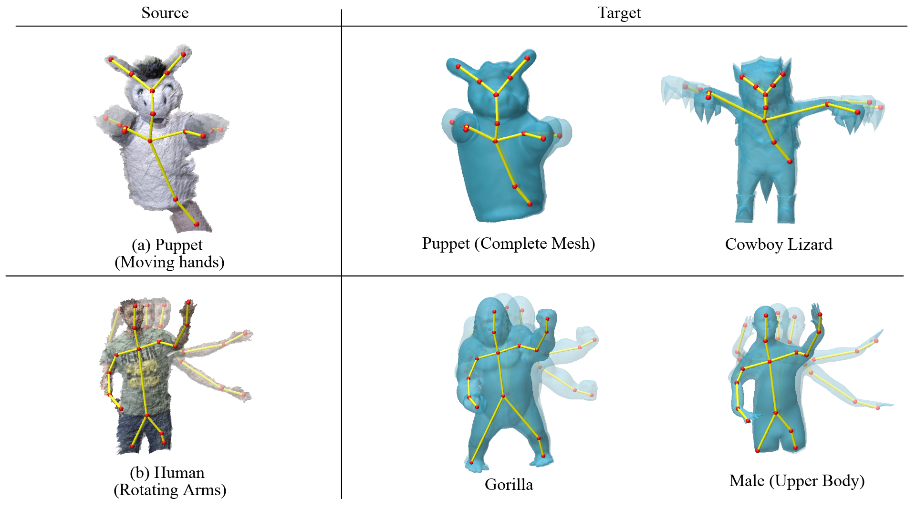
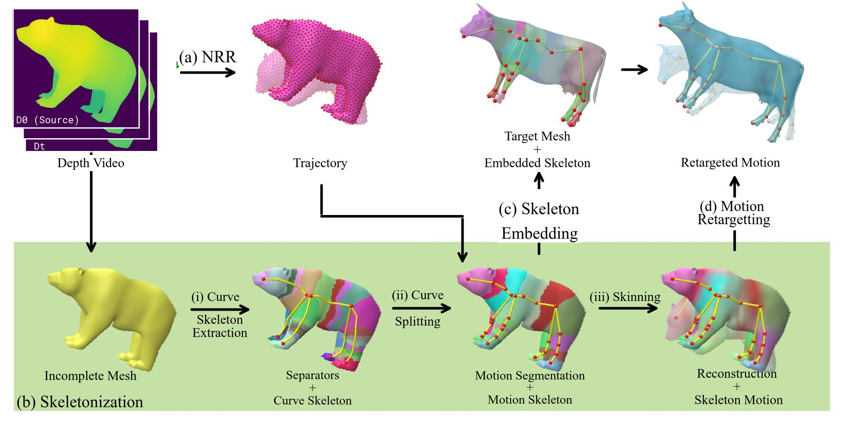
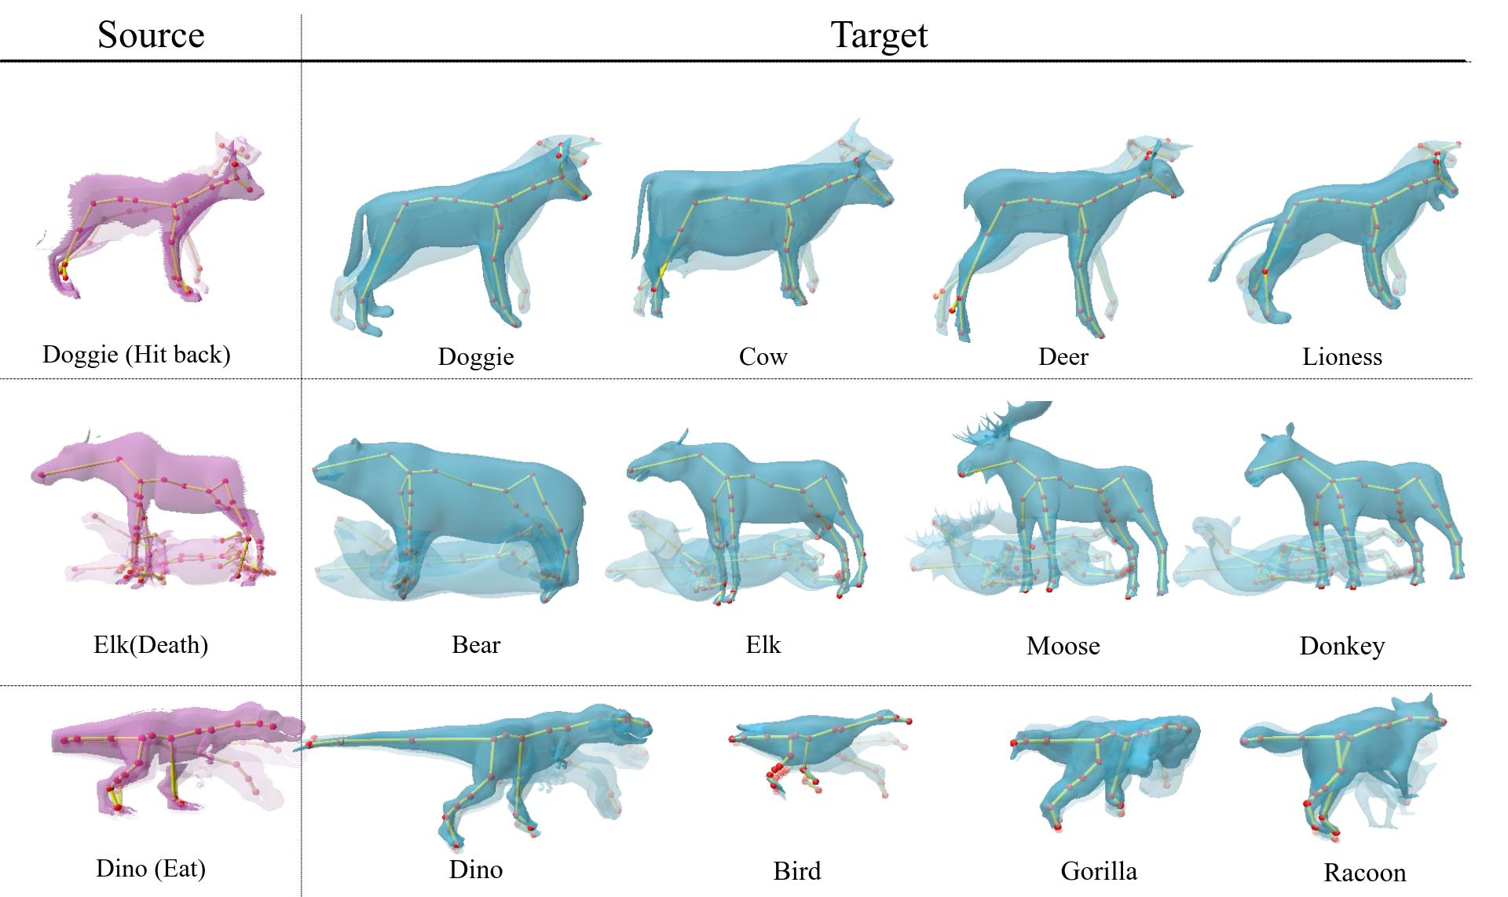
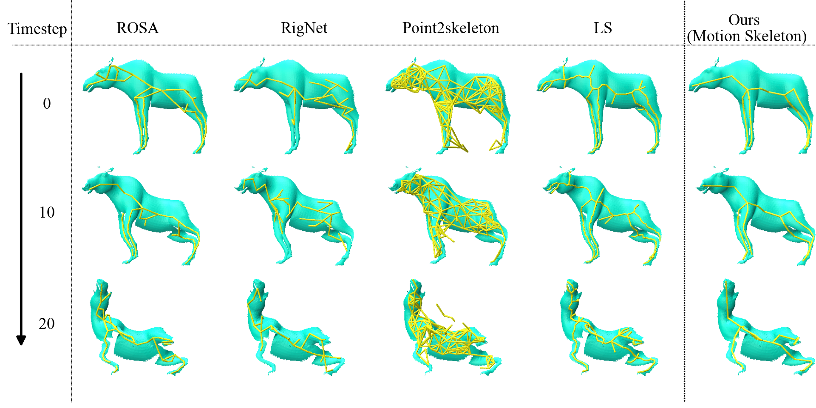
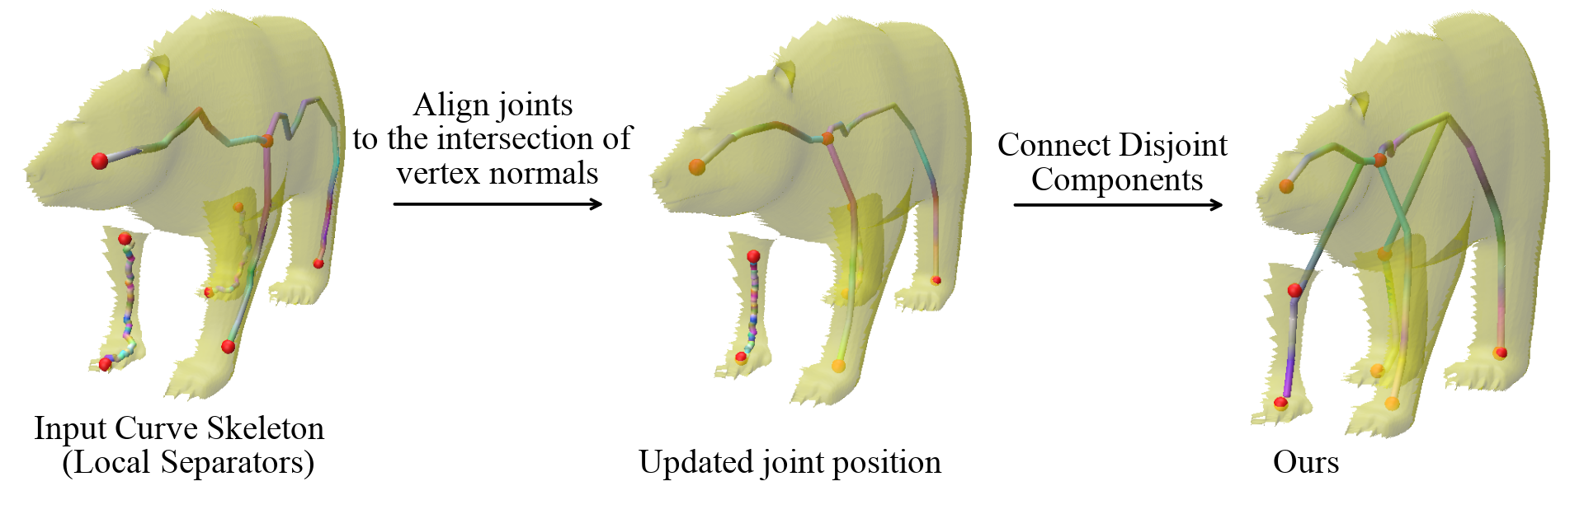
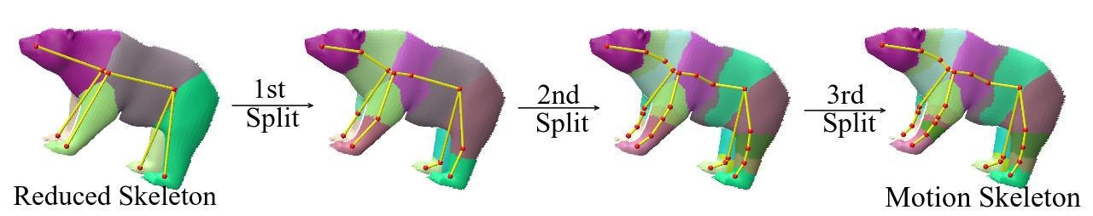
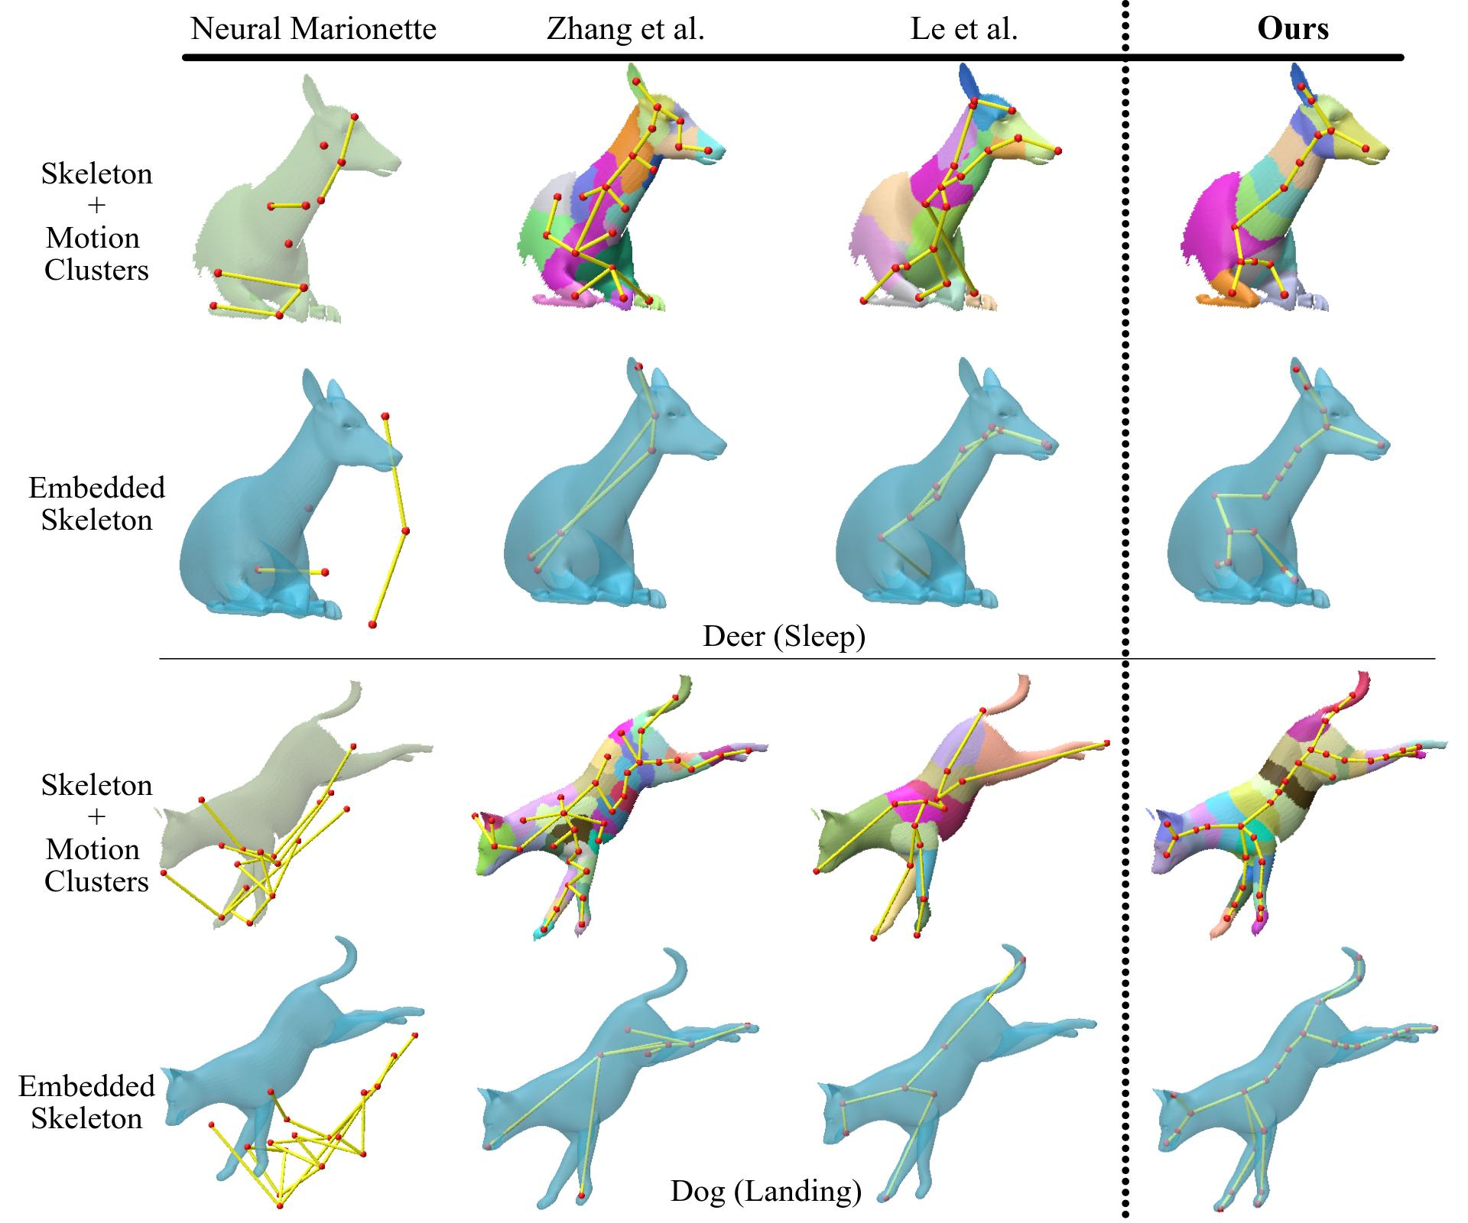
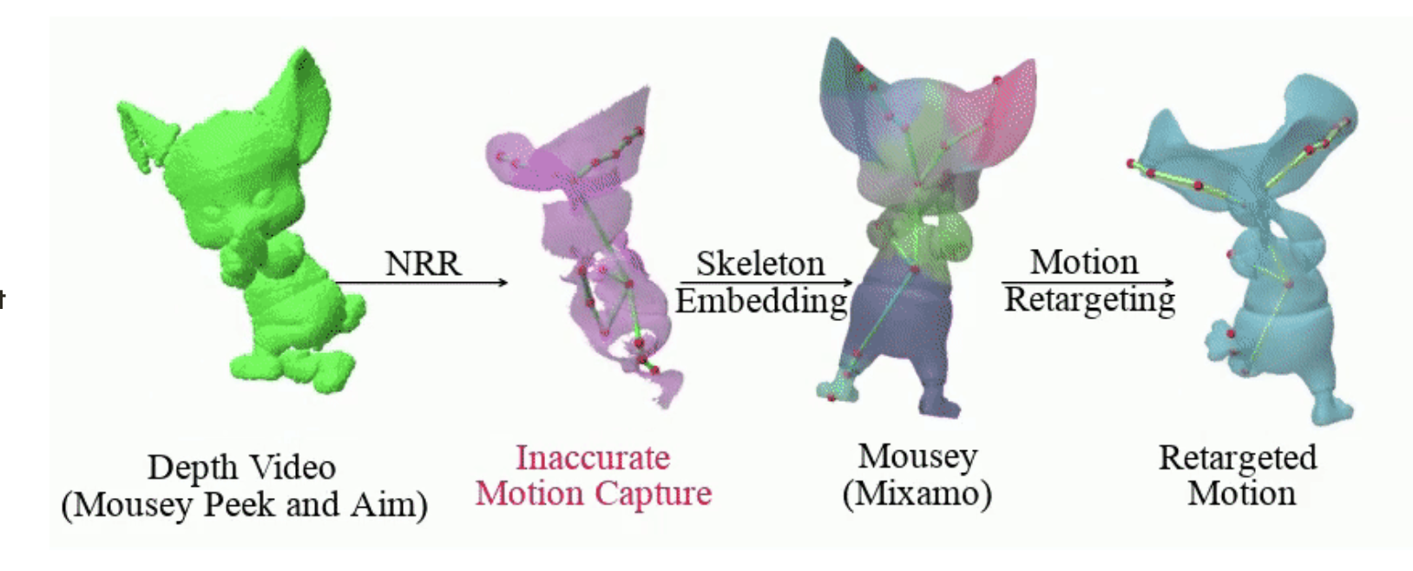
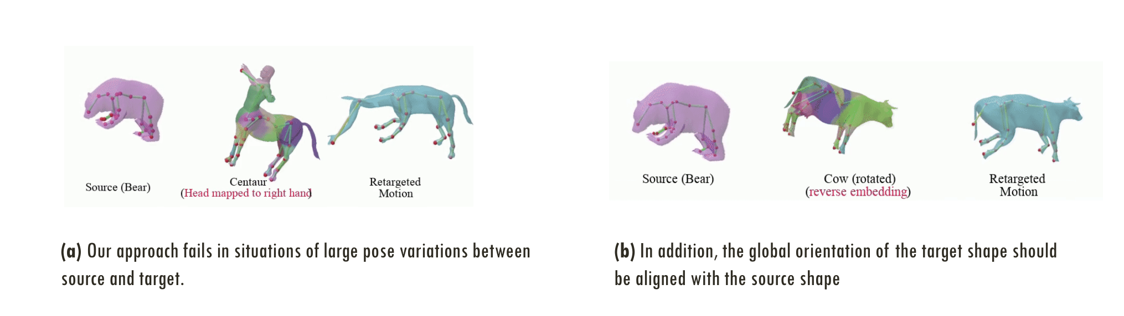
Transfer4D: A framework for frugal motion capture and deformation transfer
Shubh Maheshwari¹ Rahul Narain² Ramya Hebbalaguppe^{1,2}
¹TCS Research, India ²Indian Institute of Technology Delhi, India
How it works
Animating a virtual character based on a real performance of an actor is a challenging task that currently requires expensive motion capture setups and additional effort by expert animators, rendering it accessible only to large production houses. The goal of our work is to democratize this task by developing a frugal alternative termed Transfer4D that uses only commodity depth sensors and further reduces animators' effort by automating the rigging and animation transfer process.
Our approach can transfer motion from an incomplete, single-view depth video to a semantically similar target mesh, unlike prior works that make a stricter assumption on the source to be noise-free and watertight.
We use non-rigid reconstruction to track motion from the depth sequence, and then we rig the source object using skinning decomposition. Finally, the rig is embedded into the target object for motion retargeting.
To handle sparse, incomplete videos from depth video inputs and variations between source and target objects, we propose to use skeletons as an intermediary representation between motion capture and transfer.
We propose a novel unsupervised skeleton extraction pipeline from single-view depth sequence that incorporates additional geometric information, resulting in superior performance in motion reconstruction and transfer in comparison to the contemporary methods and making our approach generic.
Transfer4D retargets motion from a commodity depth sensor (left) to a virtual model (right).
Motion/Animation Transfer results from Transfer4D on sequences from DeformingThings4D dataset. Skeleton in the source (left) was extracted using our proposed approach and embedded into the target mesh (right). Transfer4D is able to transfer motion to diverse creatures emphasizing the generality of our approach
Contributions
Our proposed skeletonization method, (a) does not require predefined template or markers, (b) works on single-view incomplete mesh sequence, and (c) uses the geometry and motion cues to estimate skeleton motion.
Qualitative Comparison
(i) Curve skeleton
Notice that the extracted joint position from Local separators lies on the surface of the incomplete mesh. Our optimization aligns the joint position to the medial axis of the object.
(ii) Motion Skeleton
To incorporate the motion information, each curve of the extracted curve skeleton is split into multiple bones
Static skeletonisation methods do not incorporate motion information and produce temporally incoherent skeletons
Limitations
(1) Error propagation: An error in one stage of our pipeline will affect all subsequent stages.
(2) Data dependence: As skinning decomposition relies on motion data, a limited motion range in the source could lead to an irregular skeleton, which may result in an unsuccessful transfer.
(3) Large deformation between the source and target frame
(4) Fine details such as wrinkles on clothing or facial expressions are not captured or transferred.
(5) source and target shapes should be in approximately the same pose `
Compared to motion skeleton extracted from other methods, by incorporating structural cues, ours is more effective at embedding skeleton from incomplete mesh sequence.
Website: transfer4d.github.io mail: m.shubh@tcs.com

