Slide 1
Hi, we are team {x}
working on {x}

Slide 2
Our Team
Introduce yourselves

Slide 3
Our Project
Showcase your project

Slide 4
Rails Girls Summer of Code is a scholarship program that enables women to work on Open Source projects

Slide 5
This year
20 teams
40 students
67 coaches
26 project mentors
16 supervisors

Slide 6
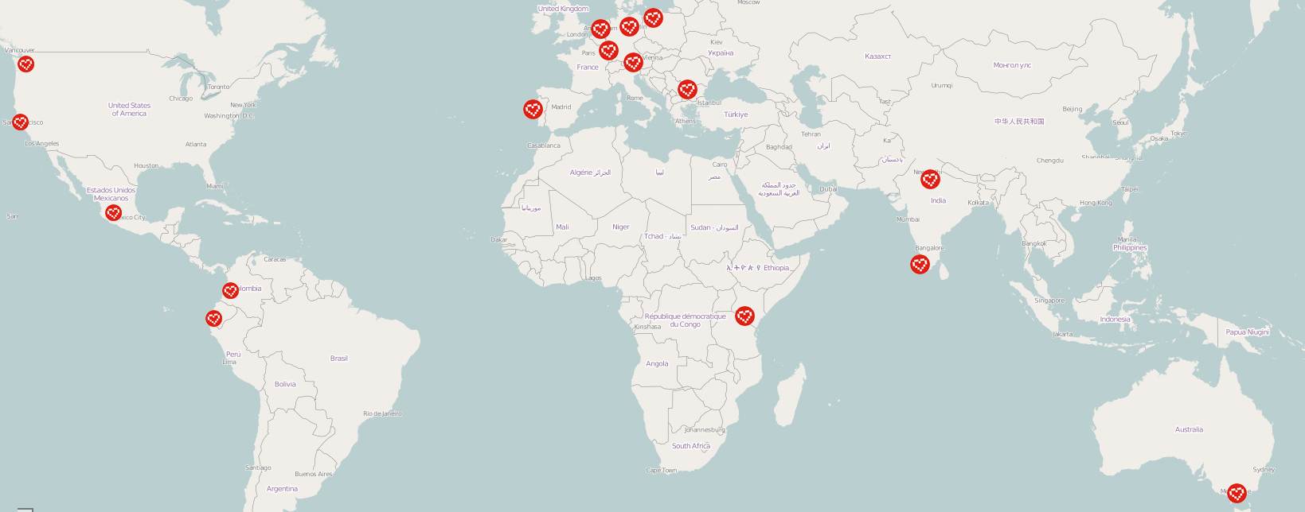
… all around the world!

Slide 7
Some of the projects
Hoodie Speakerinnen Lotus Exercism.io RubyGems Adoption Center CocoaPods RailsAdmin Official Ruby Documentation Redesign

Slide 8


Partners

Slide 9






Sponsors

Slide 10

Thank you!

