Slide 1
Hi, we are team
Load to Code (LEAP)
&
Ruby’s Secret
(Exception Notication)

Slide 2
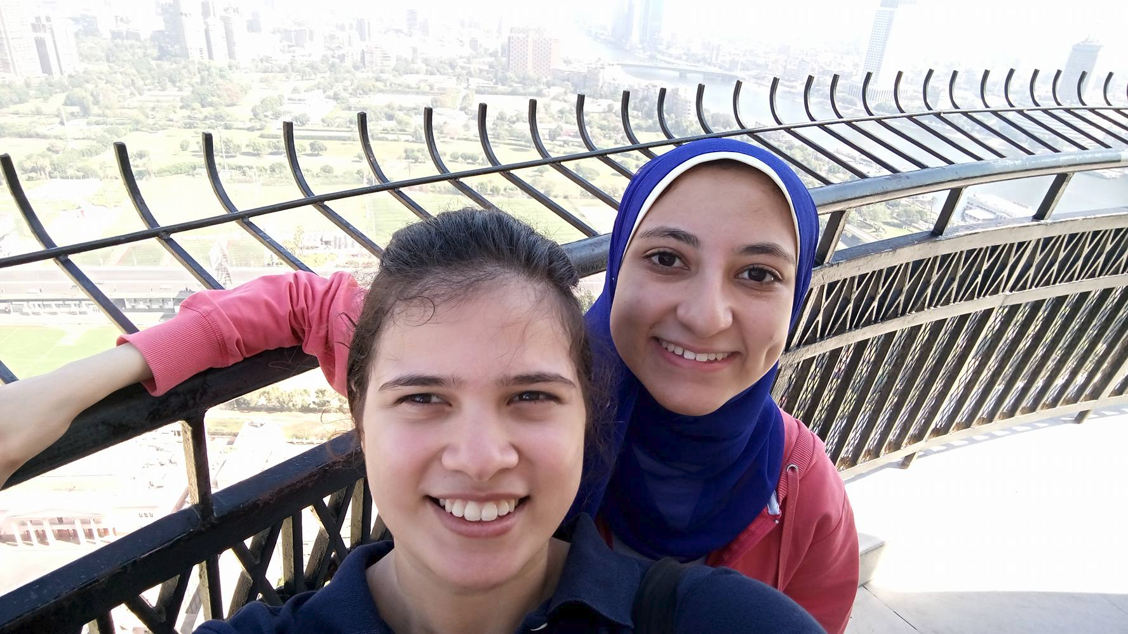
Team Ruby’s Secret
Mayar Saleh and Nada Salama
Computer Engineering and
RGSoC students 2016.
Twitter: @MayarAlaa122
Twitter: @Nada_Ashraf96
Github: MayarAlaa
Github: Nada1996

Slide 3
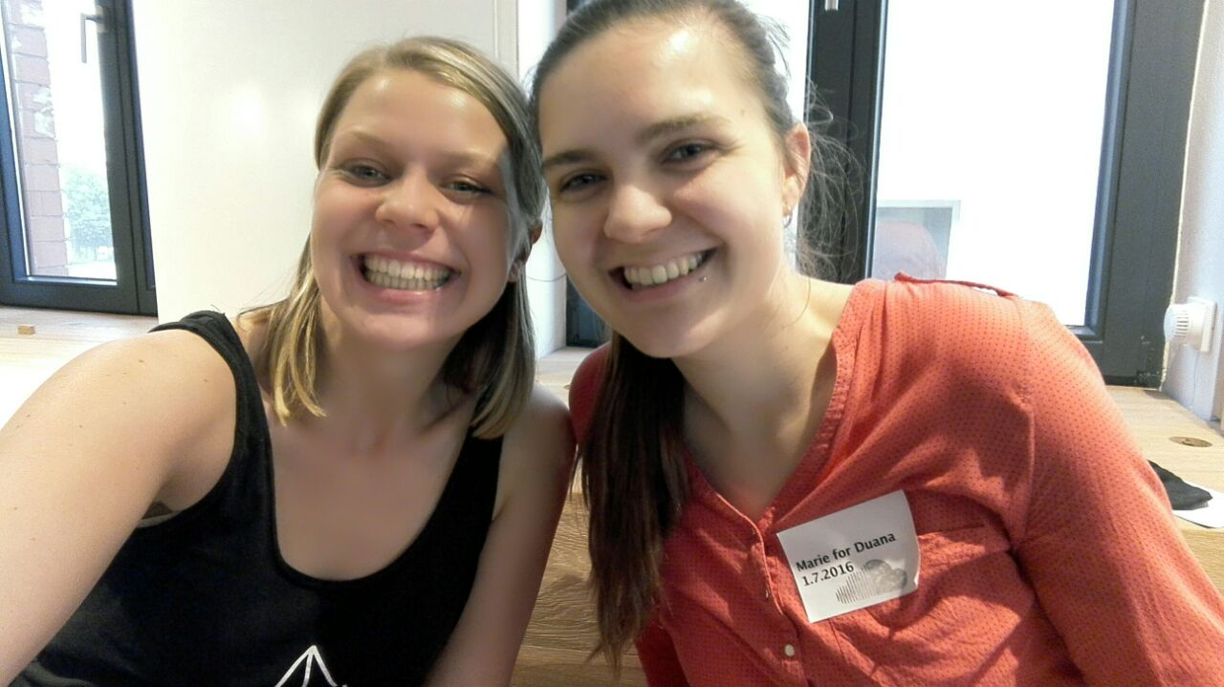
Team Load to Code
Thea Amanda Kupler (B.Sc.) and
Marie-Luise Kochsiek (M.A.)
RGSoC students 2016.
Twitter: @theatanzt
Twitter: @lila_luca
Github: theaamanda
Github: lilaluca

Slide 4

The Journey

Slide 5

Learning Ruby on Rails

Slide 6
Exception Notification gem
Dashboard
TESTING
Engines
Open source projects
Rspec & Minitest
Generators
Errors , Errors,Errors

Slide 7
Thank you !

