Slide 1

Revolutionising Ride-Hailing
Addressing user pain points for a seamless experience.

Slide 2

Introduction: The Ride-Hailing Landscape
Online network transport companies have reshaped urban mobility, offering convenience and accessibility. However, challenges persist, impacting user satisfaction and service efficiency.

Slide 3

Unpacking the Problem
High Fares
Unpredictable pricing, surge charges.
Booking Delays
Long waiting times, driver cancellations.
User Frustration
Negative experiences, reduced loyalty.

Slide 4
Our Design Thinking Journey
01
02
03
Empathise
Define
Ideate
Understanding user needs and frustrations.
Clearly articulating the core problem.
Brainstorming innovative solutions.
04
05
Prototype
Test
Building tangible solutions.
Gathering feedback, refining ideas.

Slide 5

Concept: SmartRide Optimisation
A new platform feature to address fare volatility and improve booking speed.
Dynamic pricing transparency.
AI-powered driver-matching.
Real-time demand forecasting.
Enhanced user control.

Slide 6
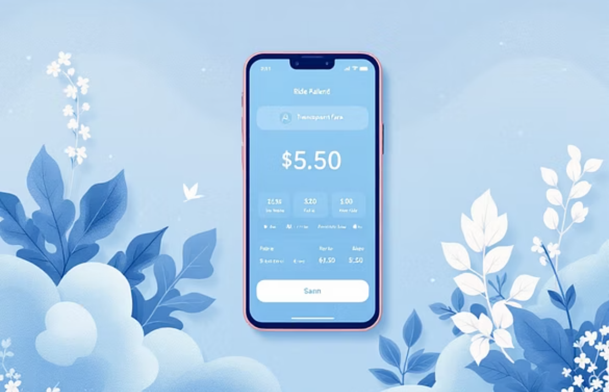
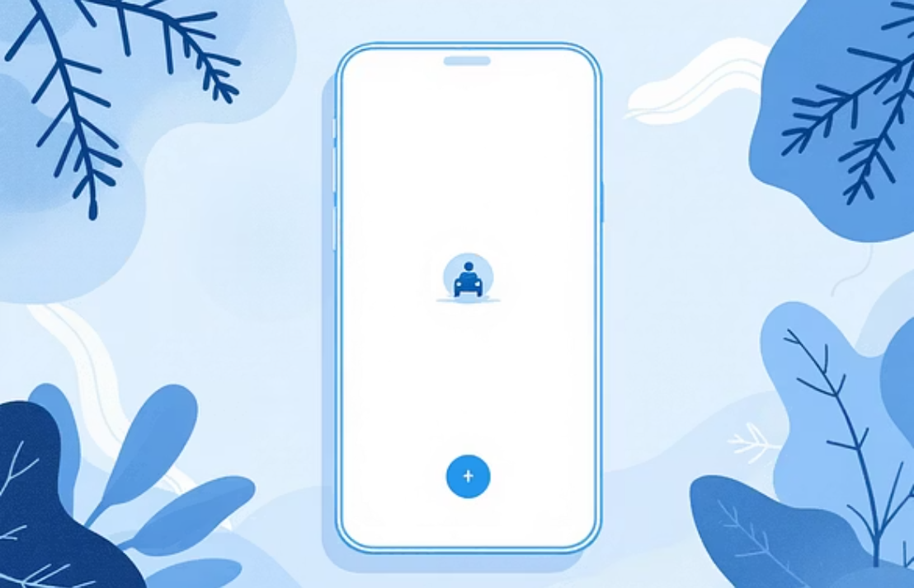
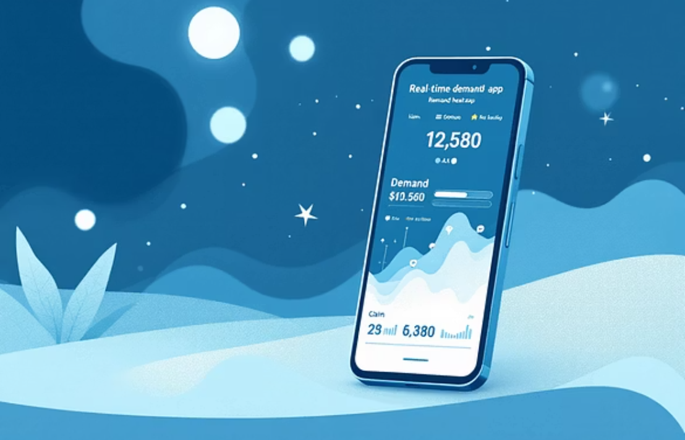
Prototype: The User Experience
Interactive mock-ups showcasing the proposed features.

Slide 7
Testing Our Solution
Pilot programme results and user feedback.
20%
35%
90%
Fare Reduction
Booking Speed
User Satisfaction
Average decrease in surge pricing.
Reduction in estimated waiting time.
Positive feedback on new features.
Initial tests show promising results, with significant improvements in key metrics.

Slide 8

Conclusion: A Smoother Journey Ahead
By integrating intelligent systems, we can transform the ride-hailing experience, making it more reliable and affordable for everyone.

Slide 9

Future Scope: Beyond Today
Sustainable Transport
Autonomous Rides
Integrating electric vehicle fleets and eco-friendly options.
Exploring the potential of self-driving technology integration.
City Integration
Personalised Services
Seamless connectivity with public transport networks.
Tailoring rides based on user preferences and history.

Slide 10

Acknowledgements
Thank you to our dedicated team, partners, and users for their invaluable contributions and feedback.
This presentation was developed with insights from our product teams and business stakeholders.

