Slide 1
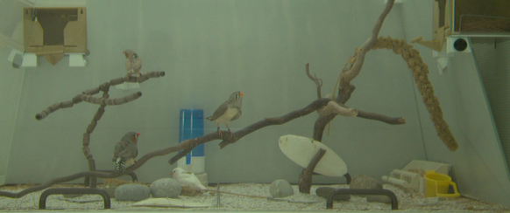
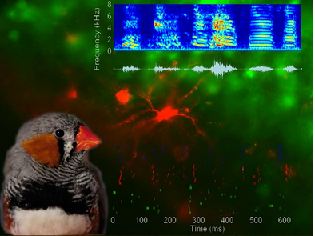
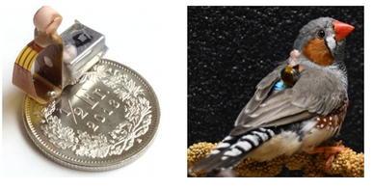
Hahnloser lab
Birdpark project
Birdsong is a model for vocal imitation
We record body vibrations using miniature wireless sensors carried as “backpacks” by the birds
We study it’s computational, neural, and behavioral principles

Slide 2


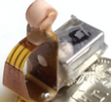
Why we need backpacks?
Wall mic
Solution: backpacks
Wall mic
Humans are excellent at this.
Still a major technical challenge.

Slide 3
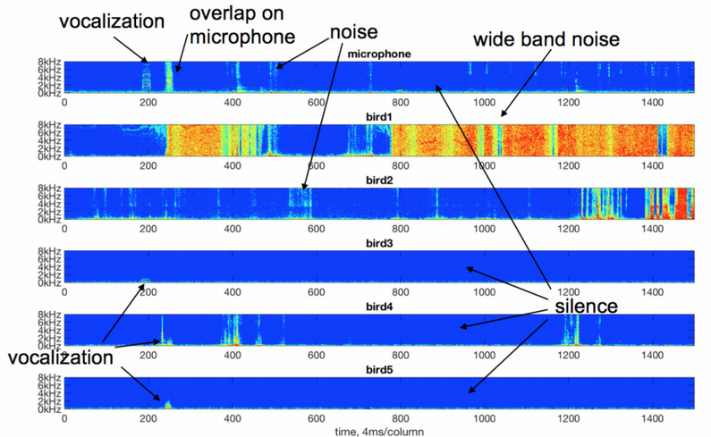
Backpacks solve the overlap problem, but face other challenges

Slide 4
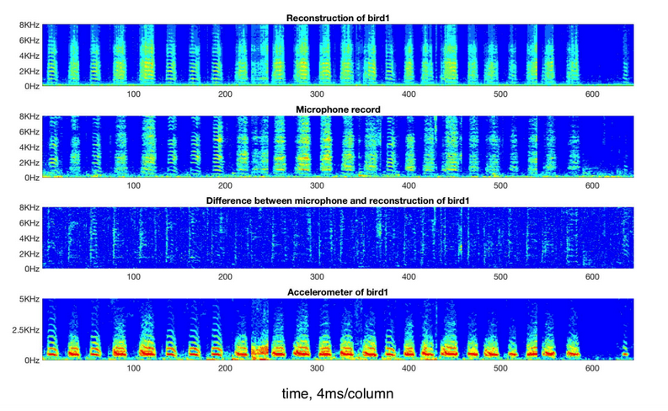


Project Backpack1 mapping f: backpack ↔ mic
e.g. implement f using deep learning
f(backpack) $≈$ mic
Bird call
mic
f(backpack) $−$ mic
Call makes body vibrate
backpack

Slide 5
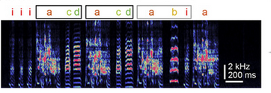
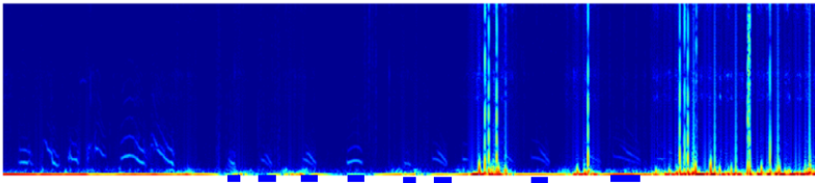
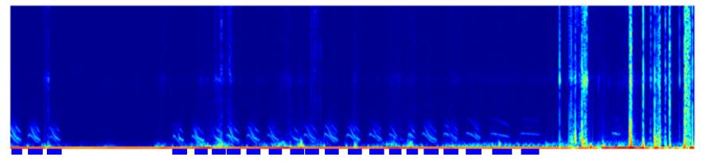
Project Backpack2 transfer learning from synthetic to real data – be creative!
The lab has a huge data base of annotated microphone data of single birds (no cocktails party)
Generate synthetic labelled backpack data
Learn labelling function f using e.g. DL
Evaluate the algorithm’s performance on real unlabeled data
1.
LPF, combine, add noise, etc
Synth backpack1
Synth backpack2
2.
f
Vocalization: “yes”

Slide 6
Expectations
Prep
Review literature
Formulate problem
Sketch solution
Main
Read and describe data
Implement, apply, evaluate solution
Discuss features/limitations/outlook
~10 students per subproject
~5 students per group

