Slide 1

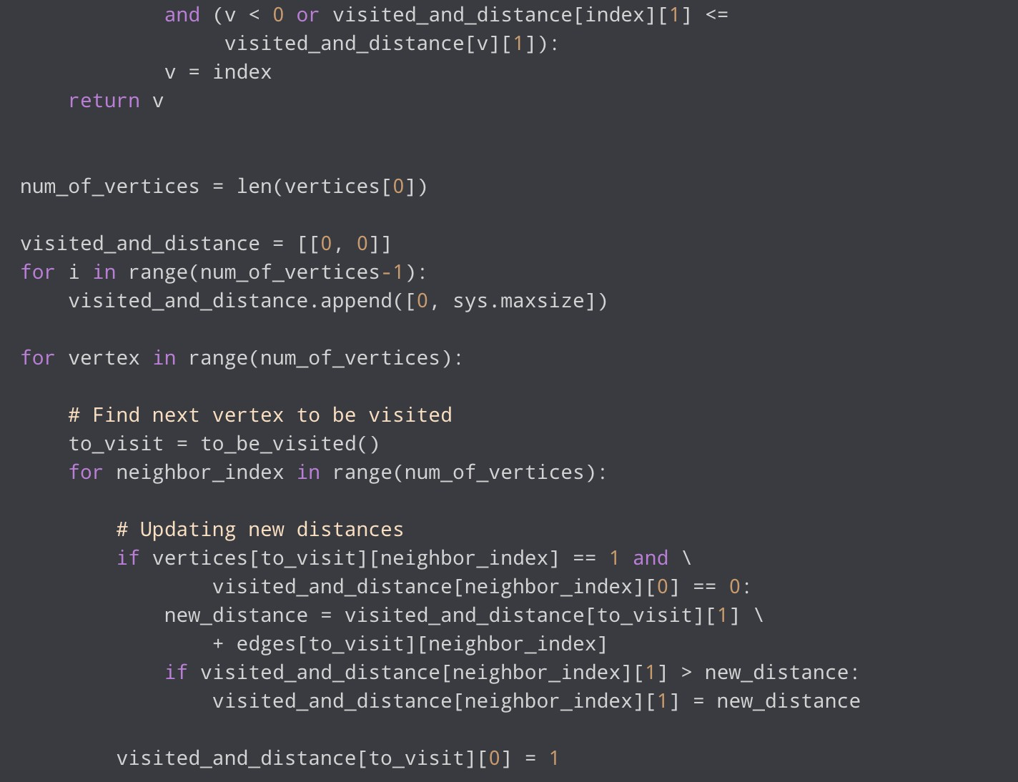
Operating systems – Final Project
Student:
Egamberdieva Lobar
File structure, File systems, Directories, File allocation.
Teacher: Prof. Ofer Wald

Slide 2

I n t o d u c t i o n
01
02
F i l e s t r u c t u r e
03
F i l e s y s t e m s
C O N T E N T S
04
D i r e c t i o n s
05
F i l e a l l o c a t i o n

Slide 3



Introduction
All computer systems interact with the user and with each other to a unique set of programs known as the operating system. If there is no OS installed on the computer, applications and services (such as text editors, tables, Internet browsers, and databases) will not run at all.
01
Components of the OS's structure:
The OS's "heart" is its core. It manages how all software and hardware components are launched. Execution of user-provided commands is provided via the command module. A system of specialized programs for the proper operation of the OS makes up a collection of drivers. Other programs for carrying out various duties include service utilities. The graphical user interface of the OS is called the shell, and it is what the computer user see. The following essential OS features can be identified

Slide 4

File Structure
File is a section of external memory with a name. An OS component called a file system controls how files are arranged, identified, and saved on storage media.
02
The actual file name and the extension are the two components
that make up the file name and are separated by a dot. The
user specifies the file's actual name. When a file is created,
the application often automatically sets the name extension.

Slide 5
File Structure
Fundamental file operations
• copying (the creation of a duplicate file in a different location or on a different media)
• relocating (transferring the file to a different location or media while destroying the original file)
• renaming (which involves changing the file's actual name)
• Removal (the object is destroyed in the source directory).You can use a file name mask, which is a string of letters, numbers, and other characters permitted in file names, to search for a certain file.
02

Slide 6
File systems
File system is a hierarchical organization (tree) of directories and files. This structure resembles an upside-down tree, with the base at the top and the branches pointing below. Data and programs are organized into groups called directories in this type of file tree, allowing you to control the directory's whole contents at once. There are some tasks that are easier to complete on the whole file system rather than one directory at a time. For instance, you may migrate the file system, make a backup copy of it, or add security to it.
03

Slide 7
File systems
Using the same logic-based method of document storage and retrieval, digital file systems and files are called after and modeled after paper-based filing systems. Operating systems (OS) like Microsoft Windows, macOS, and Linux-based systems can have different file systems. Certain file systems are created for particular uses. Distributed file systems, disk-based file systems, and special purpose file systems are the three main categories of file systems.
03

Slide 8
File systems
Types of file systems
There are various kinds of file systems, each having a unique logical structure and set of characteristics including speed and size. Depending on the OS and its requirements, the type of file system can change. Microsoft Windows, Mac OS X, and Linux are the top three most widely used Computer operating systems. Apple iOS and Google Android are examples of mobile OSs.
03

Slide 9
Directories
I
A directory is a special kind of file that only has the data required to access other directories or files. A directory thus takes up less space than other kinds of files.
04
Directory access can be secured because directories frequently include data that shouldn't be made available to all system users. Setting a directory's permissions allows you to manage who has access to it and which users, if any, have the ability to edit its contents.

Slide 10
Directories
I
Types directories
The operating system, the system administrator, or users can all define directories.
Directory structure
Files, subdirectories, or a combination of both can be found in directories. An internal directory is known as a subdirectory. The parent directory is the one that houses the subfolder.
Naming standards for directories
Each directory's name must be distinct from other names in the directory where it is stored. By doing this, the directory is guaranteed to have a special path name in the file system.
04

Slide 11
Directories
I
Names of directory paths
Through the file system tree structure, each file and directory can be reached by a distinct path, also referred to as the path name. The path name indicates where a directory or file is located in the file system.
Directory creation (mkdir command)
To create one or more directories, use the mkdir command and the Directory parameter.
Directory relocation or renaming (mvdir command)
To relocate or rename a directory, use the mvdir command.
Showing the active directory (pwd command)
To write the complete path name of your current directory (originating in the /(root) directory), use the pwd command.
04

Slide 12
Directories
I
Switching to a different directory (cd command)
To switch from your current directory to another directory, use the cd command. To execute (search) in the designated directory, you need to have permission.
Directory copies (cp command)
By specifying the SourceFile or SourceDirectory parameters and the TargetFile or TargetDirectory parameters, you may use the cp command to duplicate the contents of one file or directory into the other.
Displaying a directory's contents
To view a directory's contents, use the ls command.folders being deleted or removed (rmdir command)
To delete the directory indicated by the Directory parameter from the system, use the rmdir command.
04

Slide 13
File allocations
I
There are numerous sorts of file allocation mechanisms, however we primarily employ three types:
Consecutive distribution
Allocation of linked lists
Indexed distribution
05

Slide 14
File allocations
I
Contiguous allocation
One of the most popular ways for allocating resources is contiguous allocation. Contiguous allocation entails allocating the block in a way that ensures that every block on the hard drive receives a contiguous physical block.
05

Slide 15
File allocations
I
Linked List Allocation
The disadvantages of the contiguous allocation approach are overcome by the linked list allocation method. Each file is considered as a linked list of disk blocks in this file allocation approach. It is not necessary for disk blocks assigned to a particular file to be on the disk in contiguous sequence when using the linked list allocation method. A pointer to the beginning and ending file blocks are included in the directory entry. Each disk block that is allocated to a file has a pointer that points to the following block on the disk that is also assigned to that file.
05

Slide 16
File allocations
I
Indexed Allocation
We have an additional block in the index allocation method, and that block is referred to as the index block. There is a unique index block for each file. The ith entry in the index block contains the ith file block's disk address. The address of the index block is included in the directory entry, as seen in the image below.
05

Slide 17
File allocations
I
In shared Windows, Linux, and DOS environments, for example, FAT is still utilized on devices that are anticipated to be used by several operating systems. A utility to directly convert a FAT file system into NTFS without having to rewrite any files is also pre-installed with Microsoft Windows, however this conversion cannot be readily undone. Removable storage devices like floppy disks, super floppies, memory and flash memory cards, and USB flash drives all use the FAT file system. Portable electronics like PDAs, digital cameras, camcorders, media players, and mobile phones all support FAT.
05

Slide 18
Packages on Go Language
The main function provides a command-line interface to the user to execute the functions listed above.
Package bufio implements buffered I/O. It wraps an io.Reader or io.Writer object, creating another object (Reader or Writer) that also implements the interface but provides buffering and some help for textual I/O.
Package fmt implements formatted I/O with functions analogous to C's printf and scanf. The format 'verbs' are derived from C's but are simpler.
Package io provides basic interfaces to I/O primitives. Its primary job is to wrap existing implementations of such primitives, such as those in package os, into shared public interfaces that abstract the functionality, plus some other related primitives.
Because these interfaces and primitives wrap lower-level operations with various implementations, unless otherwise informed clients should not assume they are safe for parallel execution.

Slide 19
Packages on Go Language
Package ioutil implements some I/O utility functions.
Package os provides a platform-independent interface to operating system functionality. The design is Unix-like, although the error handling is Go-like; failing calls return values of type error rather than error numbers. Often, more information is available within the error. For example, if a call that takes a file name fails, such as Open or Stat, the error will include the failing file name when printed and will be of type *PathError, which may be unpacked for more information.
The os interface is intended to be uniform across all operating systems. Features not generally available appear in the system-specific package syscall.
Here is a simple example, opening a file and reading some of it.

Slide 20
Packages on Go Language
Package filepath implements utility routines for manipulating filename paths in a way compatible with the target operating system-defined file paths.
The filepath package uses either forward slashes or backslashes, depending on the operating system. To process paths such as URLs that always use forward slashes regardless of the operating system, see the path package.
Package strings implements simple functions to manipulate UTF-8 encoded strings.

Slide 21
Functions on Go Language
This is a Go program that provides a basic command-line interface for file and directory operations such as creating files and directories, copying files and directories, moving files and directories, renaming files and directories, and deleting files and directories.
The createFile function takes a filename as input and creates a new file with that name if it does not already exist. If the file or directory already exists, it prints an error message.
The createDir function takes a directory name as input and creates a new directory with that name if it does not already exist. If the file or directory already exists, it prints an error message.
The copyFile function takes two file paths as input, the source file and the destination file, and copies the contents of the source file to the destination file. It also copies the permissions of the source file to the destination file.
The copyDir function takes two directory paths as input, the source directory and the destination directory, and recursively copies all files and directories in the source directory to the destination directory.

Slide 22
Project on Go Language
The move function takes two file or directory paths as input, the source and the destination, and moves the source file or directory to the destination directory. If the destination directory does not exist, it is created.
The rename function takes two file or directory names as input, the old name and the new name, and renames the file or directory with the old name to the new name.
The delete function takes a file or directory path as input and deletes the file or directory if it exists.
The list function lists the files and directories in the current directory.
cd: This command prompts the user for a directory name and changes the current directory to the specified directory.
back: This command goes back to the parent directory.
exit: This command exits the program.

Slide 23
Conclusion
The list function lists the contents of the current directory, and the cd function changes the current working directory to the specified directory. If the specified directory does not exist, the program prompts the user to create the directory. The back function changes the current working directory to the parent directory. The exit function terminates the program.
Overall, this program provides a useful set of file system manipulation commands that can be run from the command line.

Slide 24
The links for source code
https://github.com/LobarD/FileManager

Slide 25
E n d o f p r o j e c t . T h a n k y o u f o r a t t e n t i o n !

