Slide 1
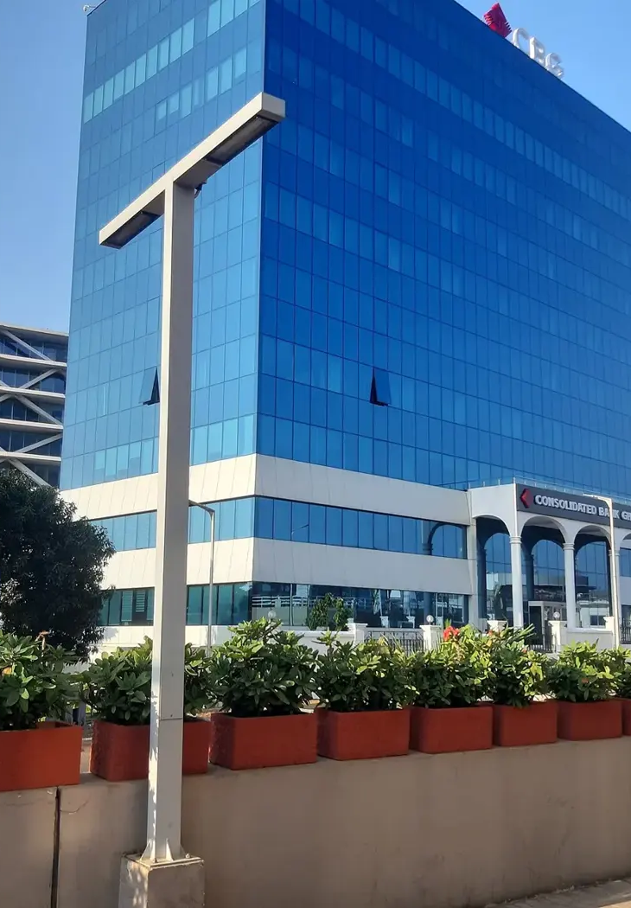

GOTHAM CONSULT
Build partnerships
in Ghana
Business advisory, technology
and international projects
gothamconsult.com
Notes:
Introduce Gotham Consult as an Accra-based business development and international projects consultancy. Explain that the next slides describe the services already published on the site. Cover photo is the existing Gotham website Airport City image.
Published service source: https://gothamconsult.com/about
Content date: 5 October 2026. No prices, investment returns or delivery guarantees are asserted.

Slide 2

GOTHAM CONSULT
Business & investment
01
Company setup and market entry
02
Business plans and financial models
03
Partner and project due diligence
04
Compliance and ESG support
Notes:
Discuss the client’s sector and stage. Company setup, investment readiness, market entry and compliance support are delivered with professional partners where required. Do not imply guaranteed funding or regulatory approval.
Published service source: https://gothamconsult.com/services
Content date: 5 October 2026. No prices, investment returns or delivery guarantees are asserted.

Slide 3

GOTHAM CONSULT
AI, digital & creative services
01
AI readiness audits and staff training
02
Finance and reporting automation
03
Websites, apps and managed hosting
04
Jingles, adverts and voiceovers
Notes:
Show the live website chatbot as an example if internet is available. Scope each automation with the client. Do not claim that a certified GRA integration, automatic bank feeds or a complete payroll system have already been delivered. Technology image comes from existing website assets.
Published service source: https://gothamconsult.com/services/ai
Content date: 5 October 2026. No prices, investment returns or delivery guarantees are asserted.

Slide 4

GOTHAM CONSULT
Projects, people & partnerships
01
Energy, mining and infrastructure
02
Education and school development
03
Senior citizens and family support
04
Forums, media and investor roundtables
Notes:
These are the remaining published service areas. Explain that specialist lawyers, geologists and engineers join projects where needed. Family support is practical coordination, not an unsupported medical-service promise. Forum image is an existing public website asset.
Published service source: https://gothamconsult.com/services
Content date: 5 October 2026. No prices, investment returns or delivery guarantees are asserted.

Slide 5
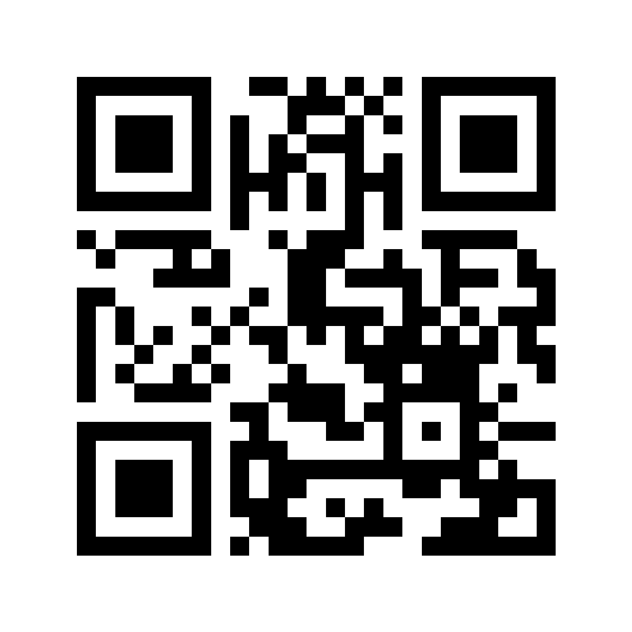
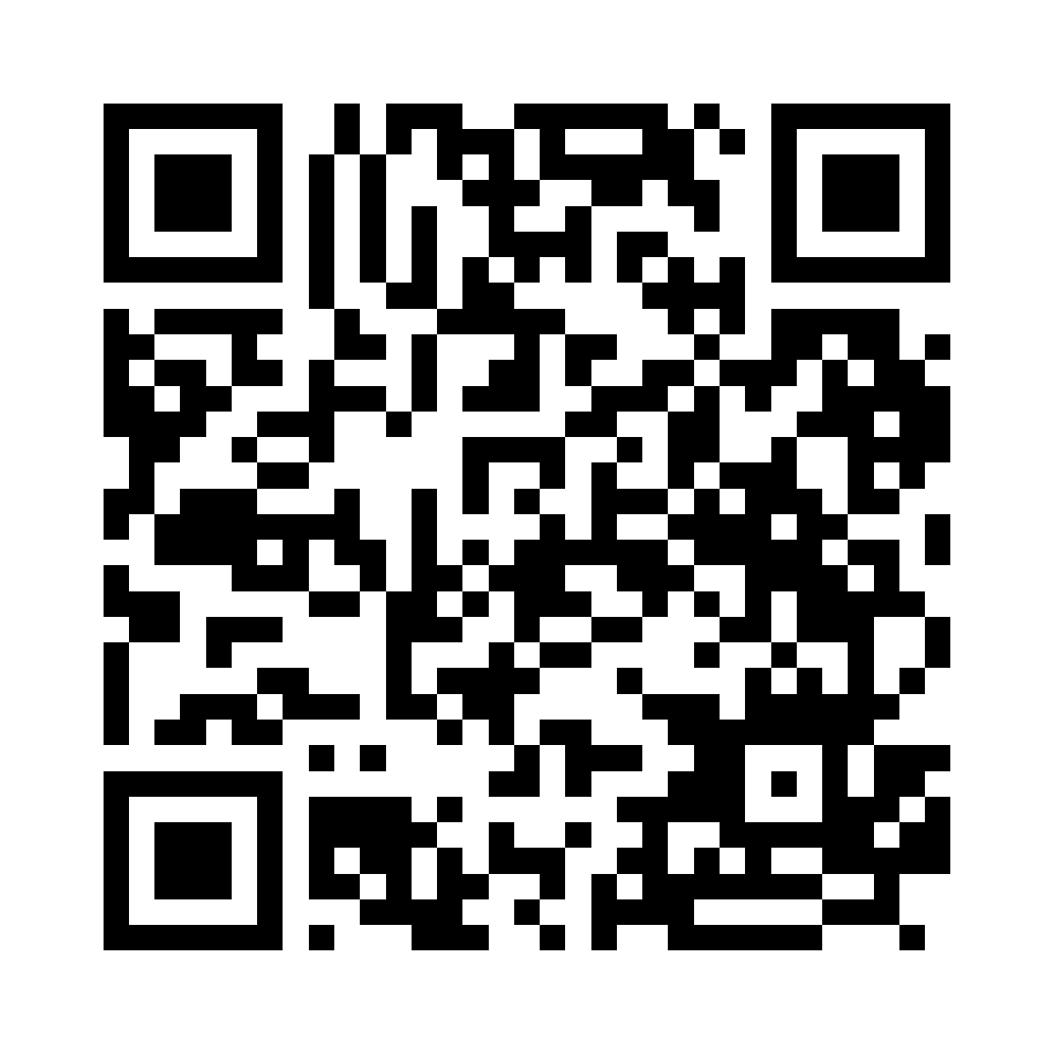
GOTHAM CONSULT
Stay connected with Gotham
Explore our services
Follow us on LinkedIn
gothamconsult.com
Gotham Consult
Notes:
Leave this slide on screen after the talk so the audience can scan. The first QR opens the public website, including services, forums and the chatbot. The second opens the LinkedIn company page linked in the website footer. Invite people to follow the page in LinkedIn; scanning alone does not follow an account. Phone: +233 55 041 6627. Email: info@gothamconsult.com.
Published service source: https://gothamconsult.com/
Content date: 5 October 2026. No prices, investment returns or delivery guarantees are asserted.

