Slide 1
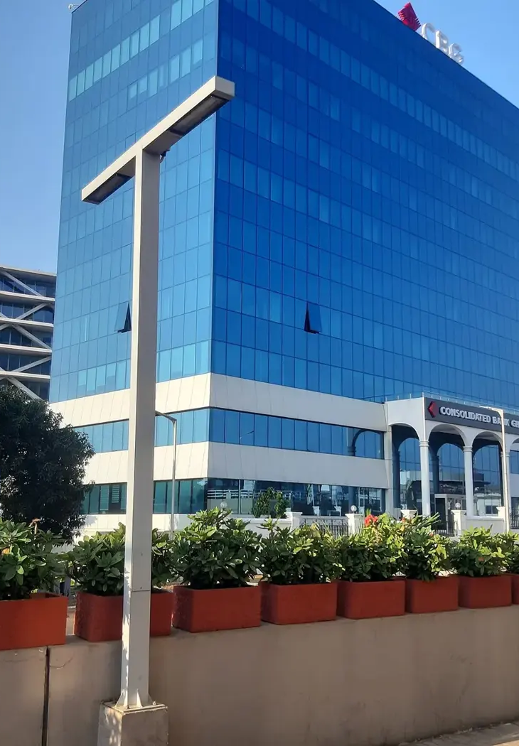

GOTHAM CONSULT
Alianzas de negocio
en Ghana
Asesoría empresarial, tecnología
y proyectos internacionales
gothamconsult.com
Notes:
Introduce Gotham Consult as an Accra-based business development and international projects consultancy. Explain that the next slides describe the services already published on the site. Cover photo is the existing Gotham website Airport City image.
Published service source: https://gothamconsult.com/about
Content date: 5 October 2026. No prices, investment returns or delivery guarantees are asserted.

Slide 2

GOTHAM CONSULT
Empresas e inversión
01
Creación de empresas y entrada al mercado
02
Planes de negocio y modelos financieros
03
Evaluación de socios y proyectos
04
Cumplimiento y apoyo en ESG
Notes:
Discuss the client’s sector and stage. Company setup, investment readiness, market entry and compliance support are delivered with professional partners where required. Do not imply guaranteed funding or regulatory approval.
Published service source: https://gothamconsult.com/services
Content date: 5 October 2026. No prices, investment returns or delivery guarantees are asserted.

Slide 3

GOTHAM CONSULT
IA, servicios digitales y creativos
01
Auditorías de IA y formación de equipos
02
Automatización financiera y de informes
03
Sitios web, aplicaciones y alojamiento
04
Jingles, anuncios y locuciones
Notes:
Show the live website chatbot as an example if internet is available. Scope each automation with the client. Do not claim that a certified GRA integration, automatic bank feeds or a complete payroll system have already been delivered. Technology image comes from existing website assets.
Published service source: https://gothamconsult.com/services/ai
Content date: 5 October 2026. No prices, investment returns or delivery guarantees are asserted.

Slide 4

GOTHAM CONSULT
Proyectos y alianzas
01
Energía, minería e infraestructura
02
Educación y desarrollo de escuelas
03
Apoyo a personas mayores y familias
04
Foros, medios y encuentros de inversores
Notes:
These are the remaining published service areas. Explain that specialist lawyers, geologists and engineers join projects where needed. Family support is practical coordination, not an unsupported medical-service promise. Forum image is an existing public website asset.
Published service source: https://gothamconsult.com/services
Content date: 5 October 2026. No prices, investment returns or delivery guarantees are asserted.

Slide 5
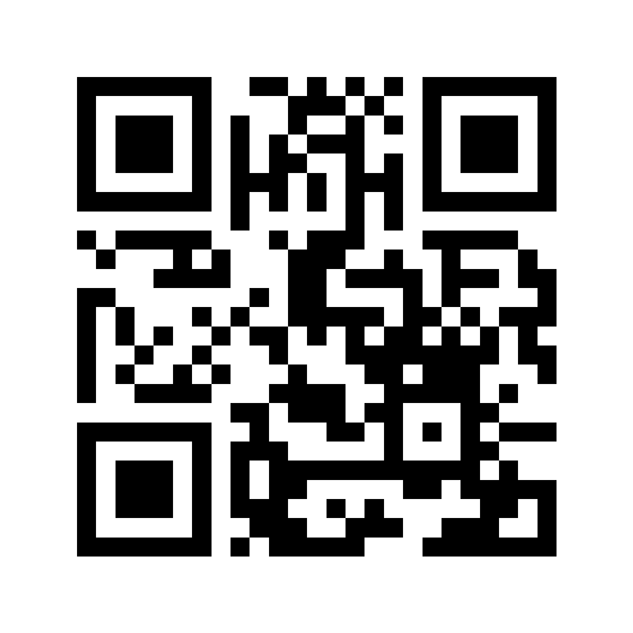
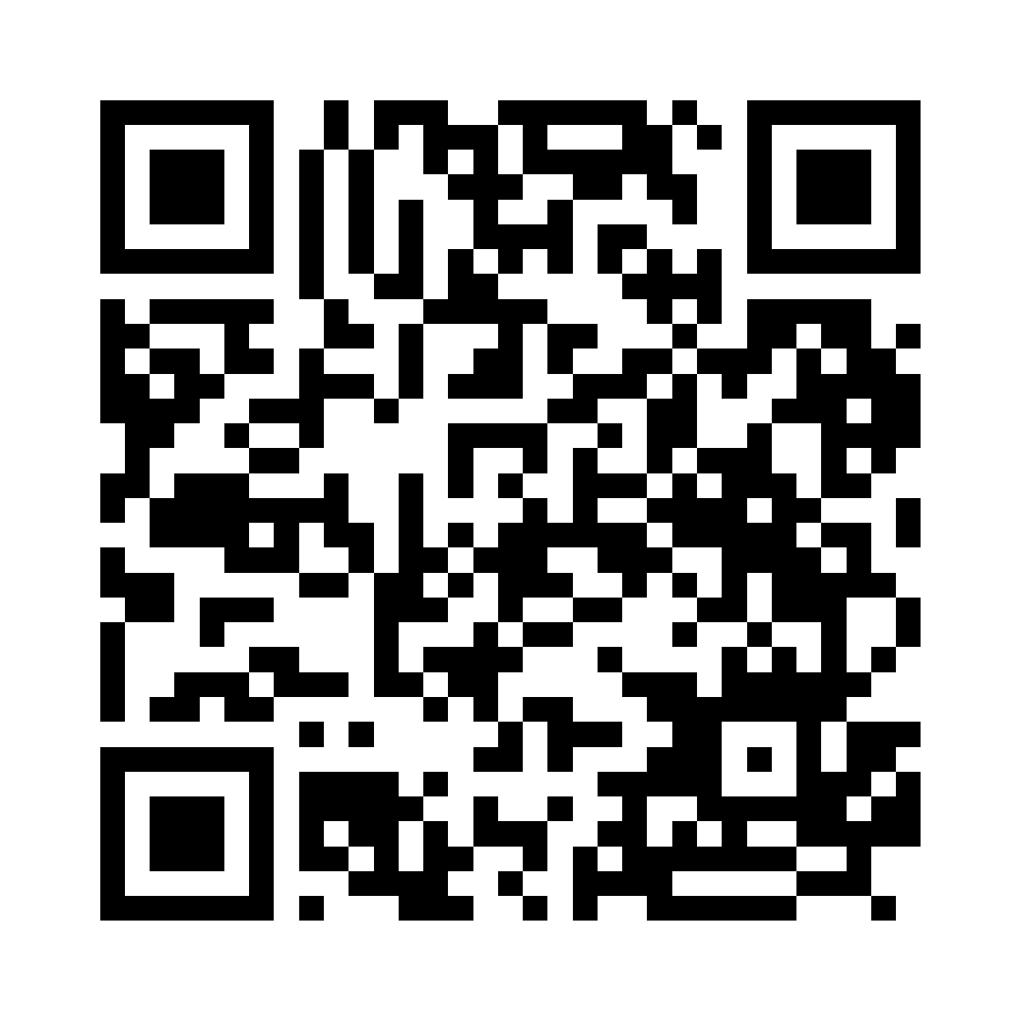
GOTHAM CONSULT
Sigue en contacto con Gotham
Descubre nuestros servicios
Síguenos en LinkedIn
gothamconsult.com
Gotham Consult
Notes:
Leave this slide on screen after the talk so the audience can scan. The first QR opens the public website, including services, forums and the chatbot. The second opens the LinkedIn company page linked in the website footer. Invite people to follow the page in LinkedIn; scanning alone does not follow an account. Phone: +233 55 041 6627. Email: info@gothamconsult.com.
Published service source: https://gothamconsult.com/
Content date: 5 October 2026. No prices, investment returns or delivery guarantees are asserted.

