Slide 1
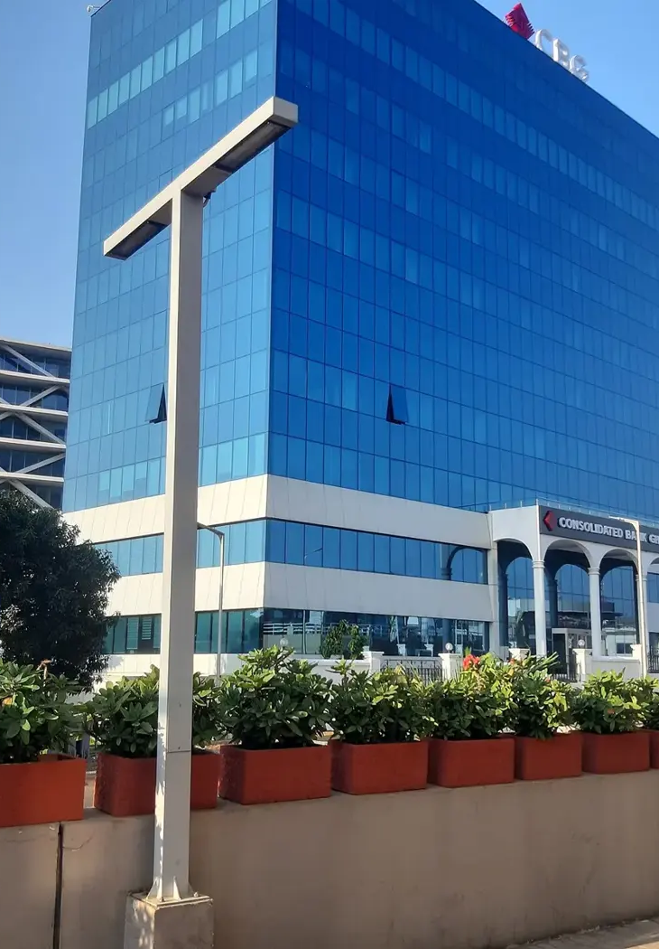

GOTHAM CONSULT
Des partenariats
au Ghana
Conseil aux entreprises, technologie
et projets internationaux
gothamconsult.com
Notes:
Introduce Gotham Consult as an Accra-based business development and international projects consultancy. Explain that the next slides describe the services already published on the site. Cover photo is the existing Gotham website Airport City image.
Published service source: https://gothamconsult.com/about
Content date: 5 October 2026. No prices, investment returns or delivery guarantees are asserted.

Slide 2

GOTHAM CONSULT
Entreprises et investissement
01
Création d’entreprise et accès au marché
02
Plans d’affaires et modèles financiers
03
Vérification des partenaires et projets
04
Conformité et accompagnement ESG
Notes:
Discuss the client’s sector and stage. Company setup, investment readiness, market entry and compliance support are delivered with professional partners where required. Do not imply guaranteed funding or regulatory approval.
Published service source: https://gothamconsult.com/services
Content date: 5 October 2026. No prices, investment returns or delivery guarantees are asserted.

Slide 3

GOTHAM CONSULT
IA, numérique et création
01
Audits IA et formation des équipes
02
Automatisation financière et des rapports
03
Sites web, applications et hébergement
04
Jingles, publicités et voix off
Notes:
Show the live website chatbot as an example if internet is available. Scope each automation with the client. Do not claim that a certified GRA integration, automatic bank feeds or a complete payroll system have already been delivered. Technology image comes from existing website assets.
Published service source: https://gothamconsult.com/services/ai
Content date: 5 October 2026. No prices, investment returns or delivery guarantees are asserted.

Slide 4

GOTHAM CONSULT
Projets et partenariats
01
Énergie, mines et infrastructures
02
Éducation et développement des écoles
03
Soutien aux seniors et aux familles
04
Forums, médias et rencontres d’investisseurs
Notes:
These are the remaining published service areas. Explain that specialist lawyers, geologists and engineers join projects where needed. Family support is practical coordination, not an unsupported medical-service promise. Forum image is an existing public website asset.
Published service source: https://gothamconsult.com/services
Content date: 5 October 2026. No prices, investment returns or delivery guarantees are asserted.

Slide 5
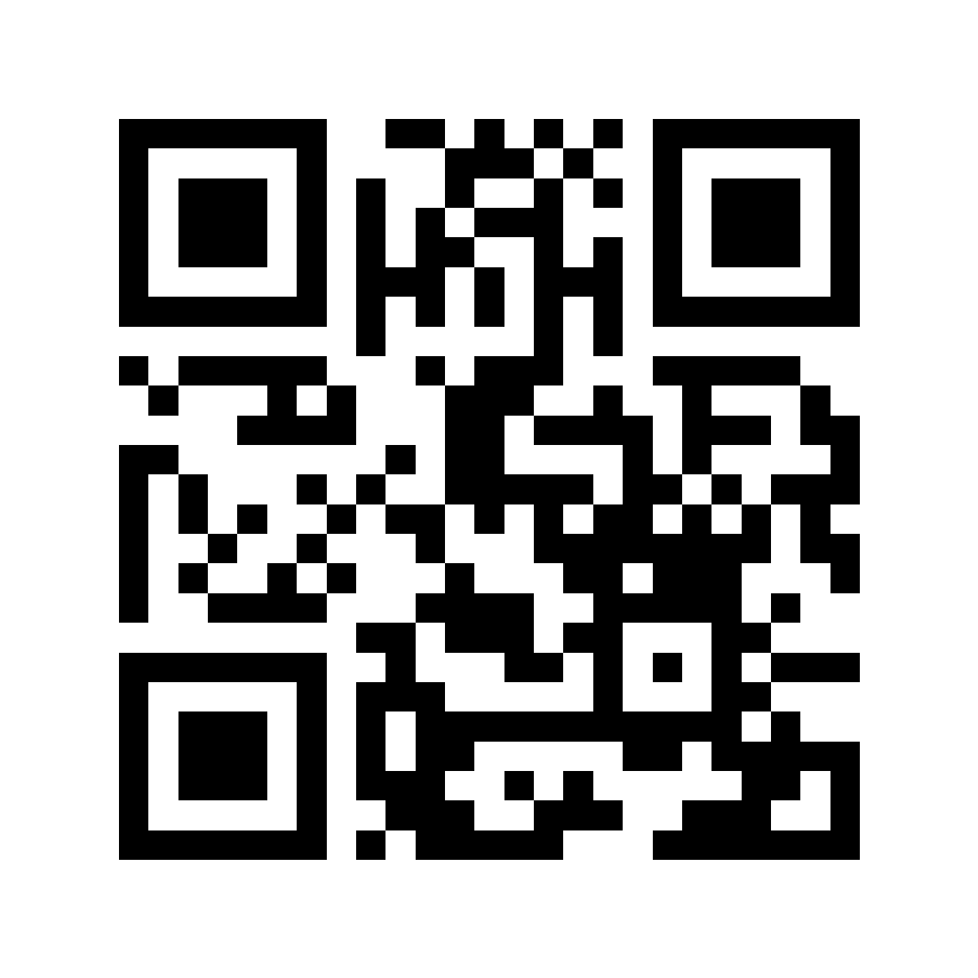
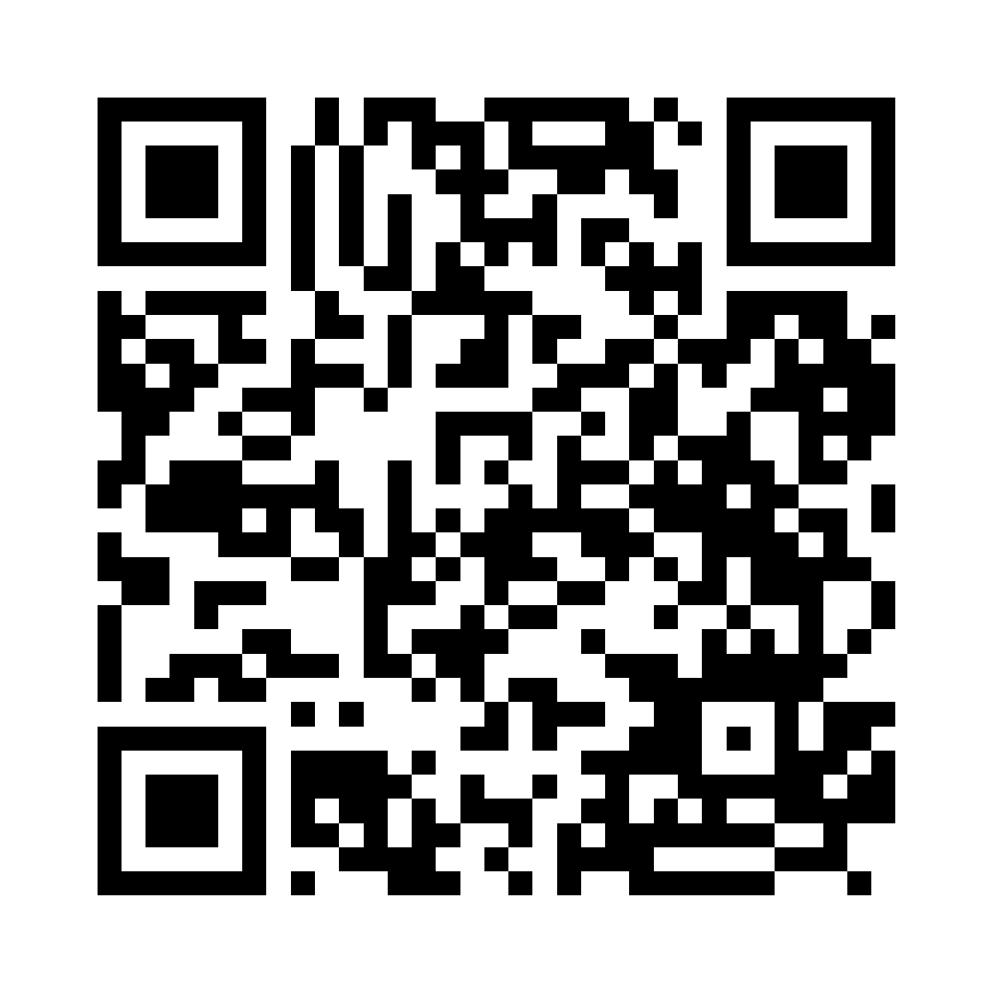
GOTHAM CONSULT
Restons en contact avec Gotham
Découvrez nos services
Suivez-nous sur LinkedIn
gothamconsult.com
Gotham Consult
Notes:
Leave this slide on screen after the talk so the audience can scan. The first QR opens the public website, including services, forums and the chatbot. The second opens the LinkedIn company page linked in the website footer. Invite people to follow the page in LinkedIn; scanning alone does not follow an account. Phone: +233 55 041 6627. Email: info@gothamconsult.com.
Published service source: https://gothamconsult.com/
Content date: 5 October 2026. No prices, investment returns or delivery guarantees are asserted.

