Slide 1
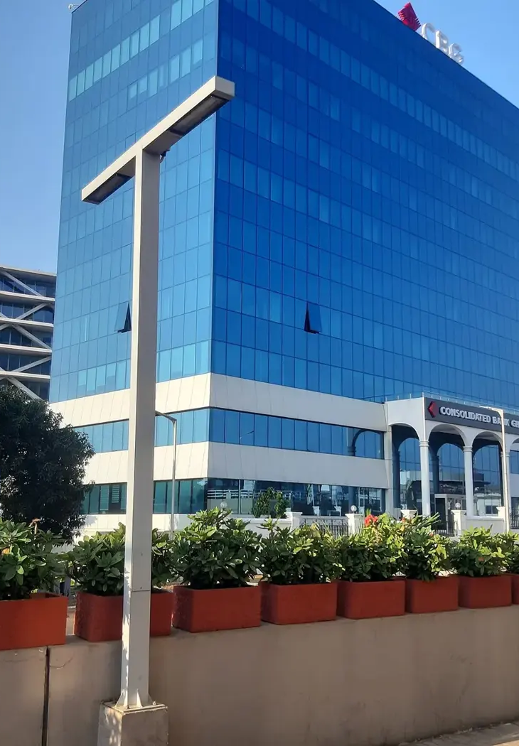

GOTHAM CONSULT
ابنوا شراكات
في غانا
استشارات الأعمال والتكنولوجيا
والمشاريع الدولية
gothamconsult.com
Notes:
Introduce Gotham Consult as an Accra-based business development and international projects consultancy. Explain that the next slides describe the services already published on the site. Cover photo is the existing Gotham website Airport City image.
Published service source: https://gothamconsult.com/about
Content date: 5 October 2026. No prices, investment returns or delivery guarantees are asserted.

Slide 2

GOTHAM CONSULT
الأعمال والاستثمار
01
تأسيس الشركات ودخول السوق
02
خطط الأعمال والنماذج المالية
03
العناية الواجبة للشركاء والمشاريع
04
دعم الامتثال والحوكمة البيئية والاجتماعية والمؤسسية
Notes:
Discuss the client’s sector and stage. Company setup, investment readiness, market entry and compliance support are delivered with professional partners where required. Do not imply guaranteed funding or regulatory approval.
Published service source: https://gothamconsult.com/services
Content date: 5 October 2026. No prices, investment returns or delivery guarantees are asserted.

Slide 3

GOTHAM CONSULT
الذكاء الاصطناعي والخدمات الرقمية والإبداعية
01
تقييم الجاهزية للذكاء الاصطناعي وتدريب الموظفين
02
أتمتة الشؤون المالية وإعداد التقارير
03
المواقع الإلكترونية والتطبيقات والاستضافة المُدارة
04
الأناشيد الإعلانية والإعلانات والتعليق الصوتي
Notes:
Show the live website chatbot as an example if internet is available. Scope each automation with the client. Do not claim that a certified GRA integration, automatic bank feeds or a complete payroll system have already been delivered. Technology image comes from existing website assets.
Published service source: https://gothamconsult.com/services/ai
Content date: 5 October 2026. No prices, investment returns or delivery guarantees are asserted.

Slide 4

GOTHAM CONSULT
المشاريع والشراكات
01
الطاقة والتعدين والبنية التحتية
02
التعليم وتطوير المدارس
03
دعم كبار السن والأسر
04
المنتديات والإعلام وموائد المستثمرين المستديرة
Notes:
These are the remaining published service areas. Explain that specialist lawyers, geologists and engineers join projects where needed. Family support is practical coordination, not an unsupported medical-service promise. Forum image is an existing public website asset.
Published service source: https://gothamconsult.com/services
Content date: 5 October 2026. No prices, investment returns or delivery guarantees are asserted.

Slide 5
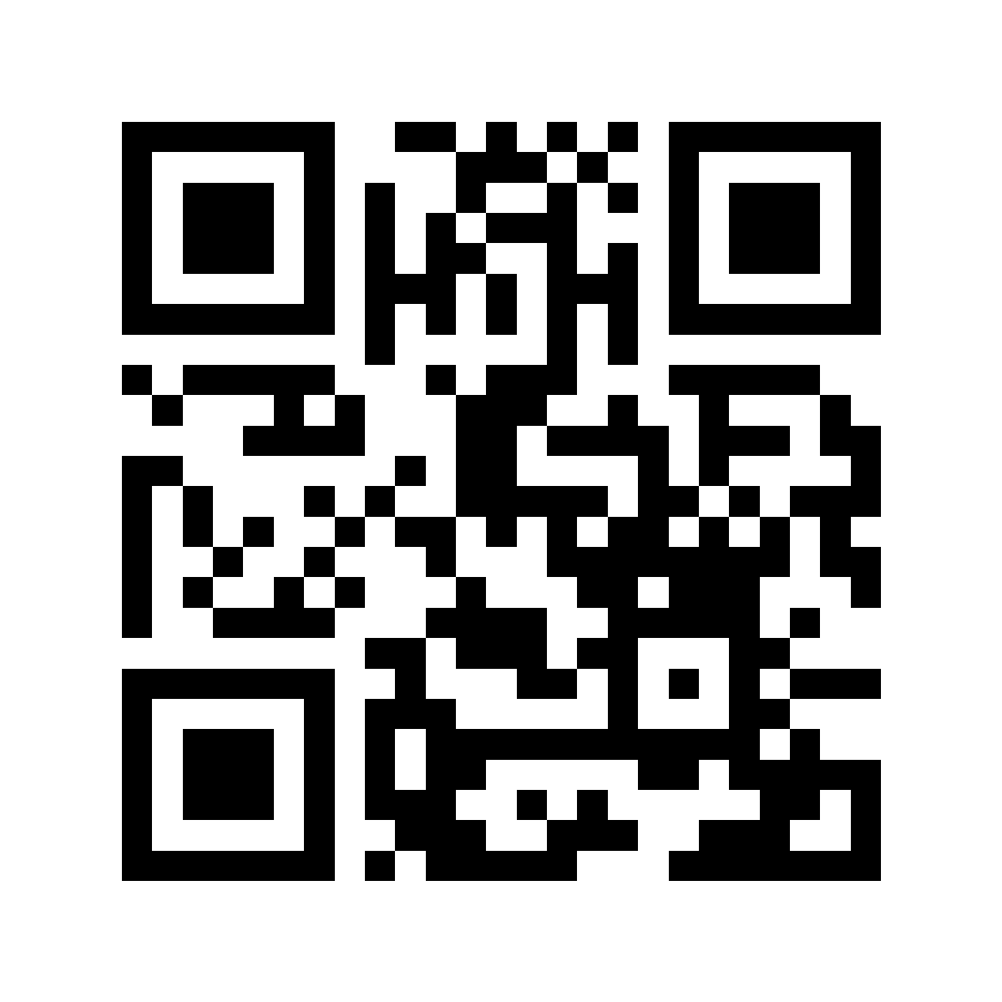
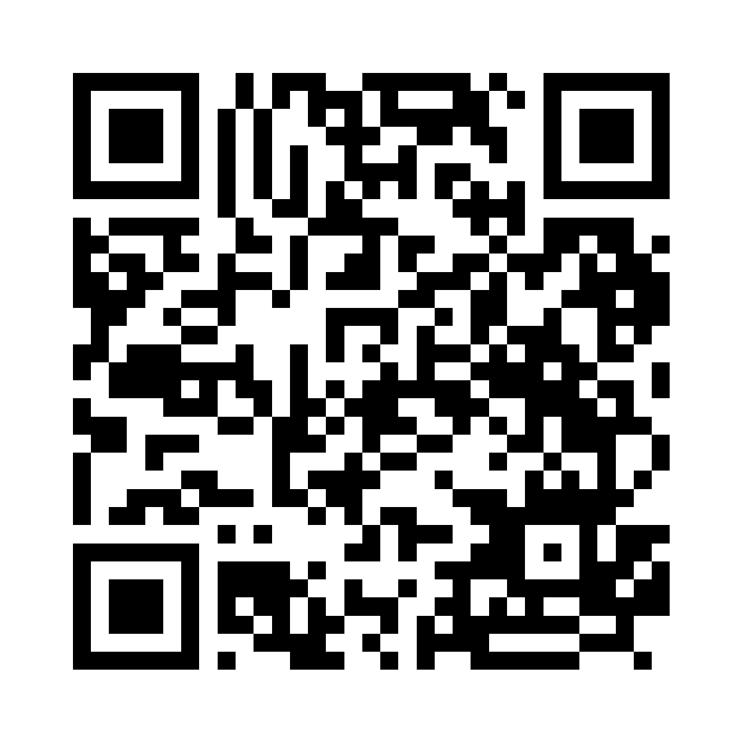
GOTHAM CONSULT
ابقوا على تواصل مع Gotham
تعرّفوا على خدماتنا
تابعونا على LinkedIn
gothamconsult.com
Gotham Consult
Notes:
Leave this slide on screen after the talk so the audience can scan. The first QR opens the public website, including services, forums and the chatbot. The second opens the LinkedIn company page linked in the website footer. Invite people to follow the page in LinkedIn; scanning alone does not follow an account. Phone: +233 55 041 6627. Email: info@gothamconsult.com.
Published service source: https://gothamconsult.com/
Content date: 5 October 2026. No prices, investment returns or delivery guarantees are asserted.

