Slide 1
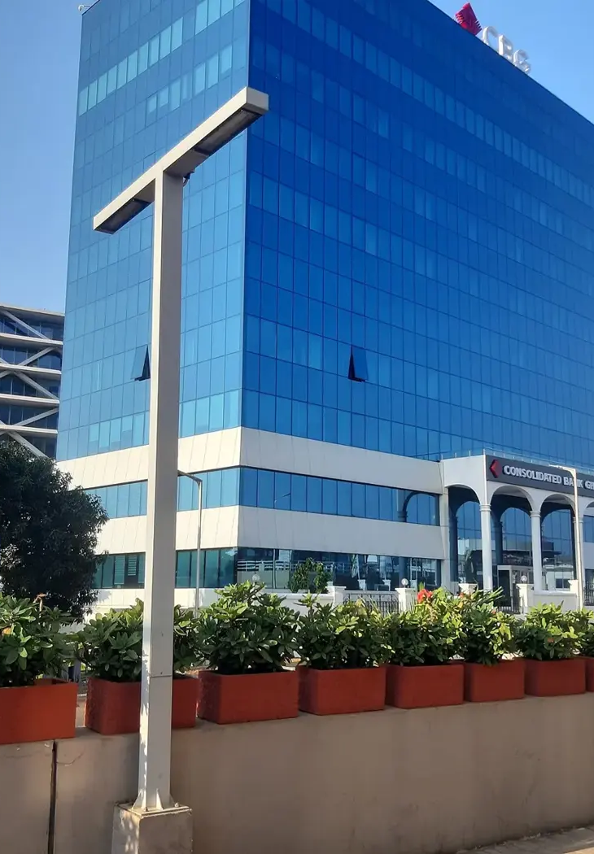

GOTHAM CONSULT
Partnerschaften
in Ghana aufbauen
Unternehmensberatung, Technologie
und internationale Projekte
gothamconsult.com
Notes:
Introduce Gotham Consult as an Accra-based business development and international projects consultancy. Explain that the next slides describe the services already published on the site. Cover photo is the existing Gotham website Airport City image.
Published service source: https://gothamconsult.com/about
Content date: 5 October 2026. No prices, investment returns or delivery guarantees are asserted.

Slide 2

GOTHAM CONSULT
Unternehmen und Investitionen
01
Unternehmensgründung und Markteintritt
02
Geschäftspläne und Finanzmodelle
03
Prüfung von Partnern und Projekten
04
Unterstützung bei Compliance und ESG
Notes:
Discuss the client’s sector and stage. Company setup, investment readiness, market entry and compliance support are delivered with professional partners where required. Do not imply guaranteed funding or regulatory approval.
Published service source: https://gothamconsult.com/services
Content date: 5 October 2026. No prices, investment returns or delivery guarantees are asserted.

Slide 3

GOTHAM CONSULT
KI, digitale und kreative Leistungen
01
KI-Bestandsaufnahme und Mitarbeiterschulung
02
Automatisierung von Finanzen und Berichten
03
Websites, Apps und betreutes Hosting
04
Jingles, Werbung und Sprecheraufnahmen
Notes:
Show the live website chatbot as an example if internet is available. Scope each automation with the client. Do not claim that a certified GRA integration, automatic bank feeds or a complete payroll system have already been delivered. Technology image comes from existing website assets.
Published service source: https://gothamconsult.com/services/ai
Content date: 5 October 2026. No prices, investment returns or delivery guarantees are asserted.

Slide 4

GOTHAM CONSULT
Projekte und Partnerschaften
01
Energie, Bergbau und Infrastruktur
02
Bildung und Schulentwicklung
03
Unterstützung für Senioren und Familien
04
Wirtschaftsforen, Medien und Investorentreffen
Notes:
These are the remaining published service areas. Explain that specialist lawyers, geologists and engineers join projects where needed. Family support is practical coordination, not an unsupported medical-service promise. Forum image is an existing public website asset.
Published service source: https://gothamconsult.com/services
Content date: 5 October 2026. No prices, investment returns or delivery guarantees are asserted.

Slide 5
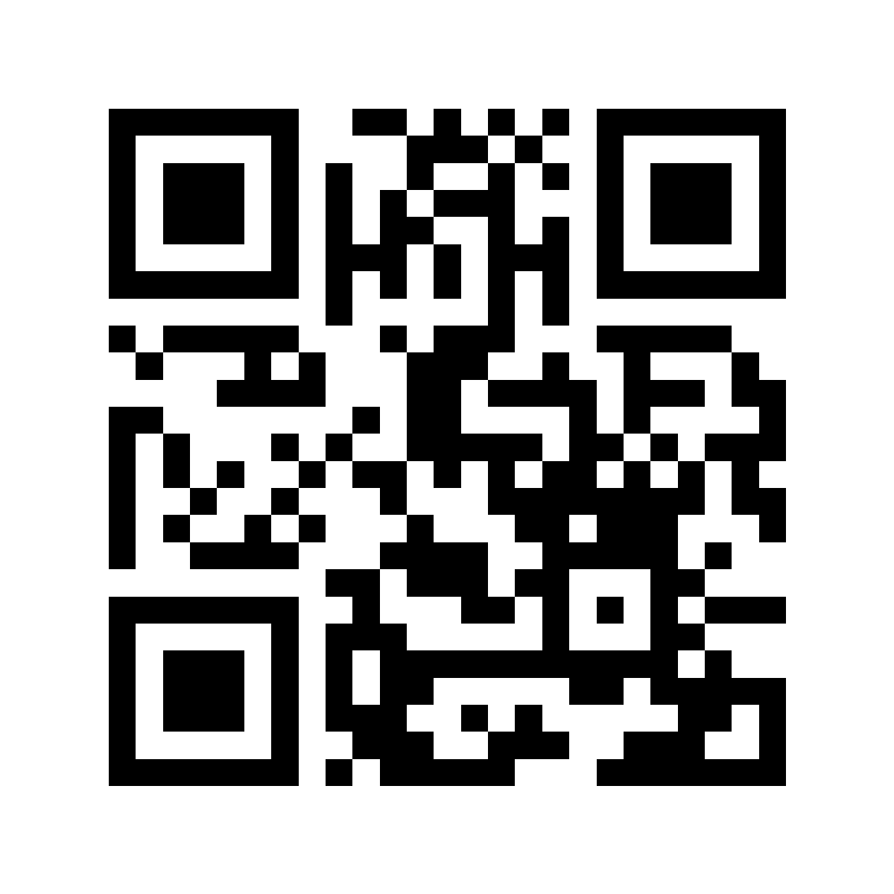
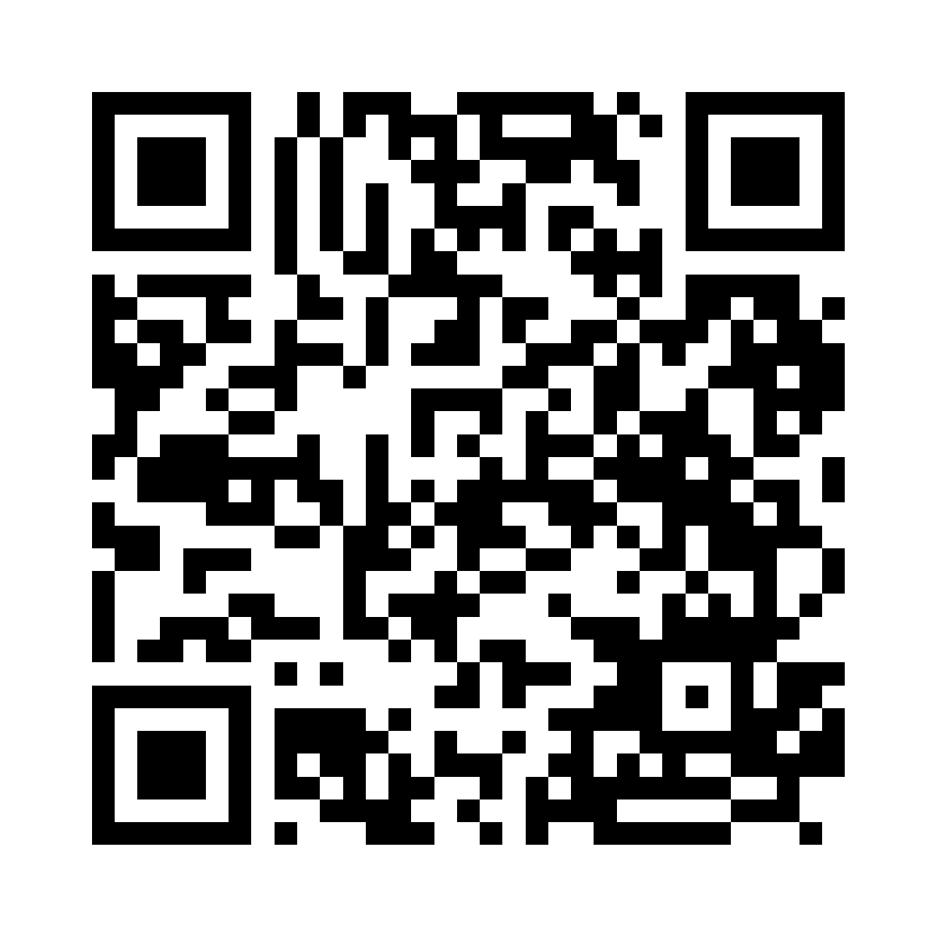
GOTHAM CONSULT
Mit Gotham in Verbindung bleiben
Leistungen entdecken
Folgen Sie uns auf LinkedIn
gothamconsult.com
Gotham Consult
Notes:
Leave this slide on screen after the talk so the audience can scan. The first QR opens the public website, including services, forums and the chatbot. The second opens the LinkedIn company page linked in the website footer. Invite people to follow the page in LinkedIn; scanning alone does not follow an account. Phone: +233 55 041 6627. Email: info@gothamconsult.com.
Published service source: https://gothamconsult.com/
Content date: 5 October 2026. No prices, investment returns or delivery guarantees are asserted.

