Slide 1
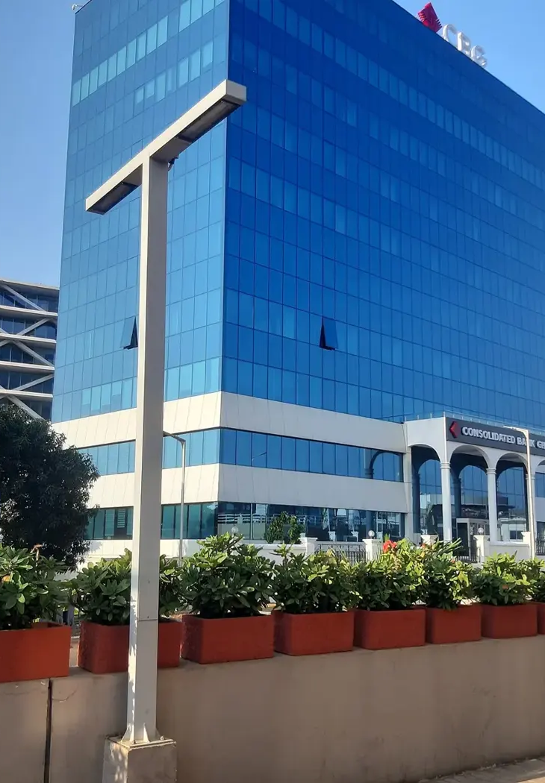

GOTHAM CONSULT
在加纳
建立合作伙伴关系
企业咨询、技术
与国际项目
gothamconsult.com
Notes:
Introduce Gotham Consult as an Accra-based business development and international projects consultancy. Explain that the next slides describe the services already published on the site. Cover photo is the existing Gotham website Airport City image.
Published service source: https://gothamconsult.com/about
Content date: 5 October 2026. No prices, investment returns or delivery guarantees are asserted.

Slide 2
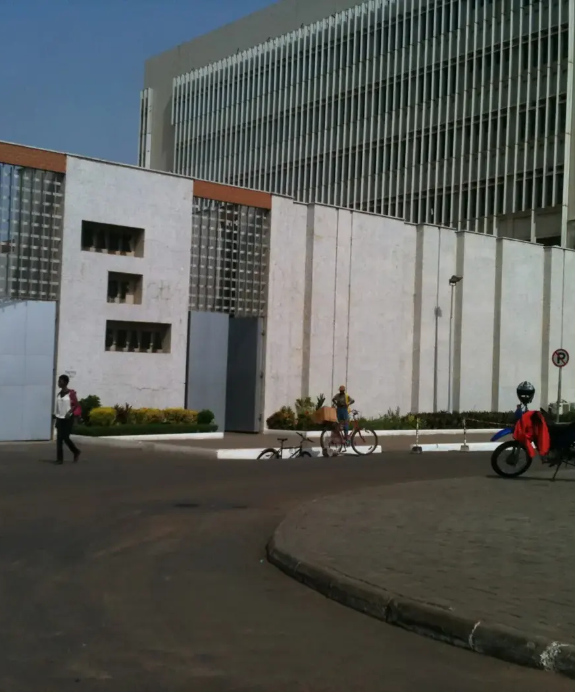
GOTHAM CONSULT
企业与投资
01
企业设立与市场准入
02
商业计划与财务模型
03
合作伙伴与项目尽职调查
04
合规与 ESG 支持
Notes:
Discuss the client’s sector and stage. Company setup, investment readiness, market entry and compliance support are delivered with professional partners where required. Do not imply guaranteed funding or regulatory approval.
Published service source: https://gothamconsult.com/services
Content date: 5 October 2026. No prices, investment returns or delivery guarantees are asserted.

Slide 3

GOTHAM CONSULT
人工智能、数字化与创意服务
01
人工智能准备度评估与员工培训
02
财务与报告自动化
03
网站、应用程序与托管服务
04
广告配乐、广告制作与配音
Notes:
Show the live website chatbot as an example if internet is available. Scope each automation with the client. Do not claim that a certified GRA integration, automatic bank feeds or a complete payroll system have already been delivered. Technology image comes from existing website assets.
Published service source: https://gothamconsult.com/services/ai
Content date: 5 October 2026. No prices, investment returns or delivery guarantees are asserted.

Slide 4

GOTHAM CONSULT
项目与合作伙伴关系
01
能源、采矿与基础设施
02
教育与学校发展
03
长者与家庭支持
04
商务论坛、媒体与投资者圆桌会议
Notes:
These are the remaining published service areas. Explain that specialist lawyers, geologists and engineers join projects where needed. Family support is practical coordination, not an unsupported medical-service promise. Forum image is an existing public website asset.
Published service source: https://gothamconsult.com/services
Content date: 5 October 2026. No prices, investment returns or delivery guarantees are asserted.

Slide 5
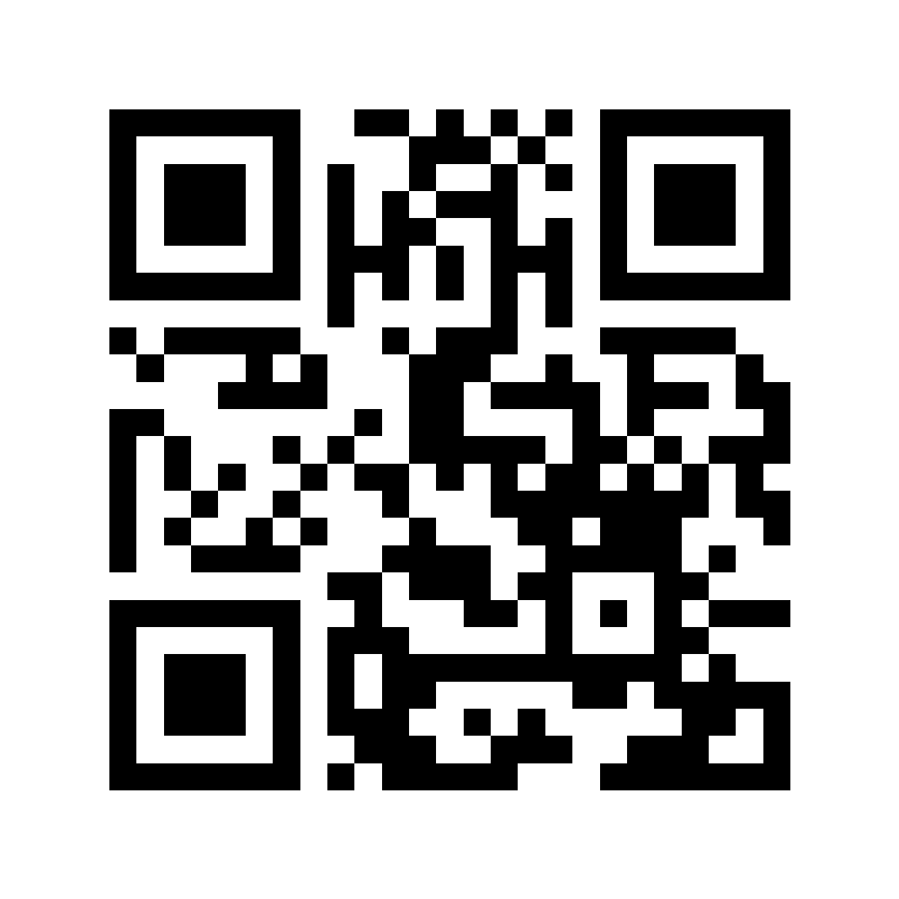
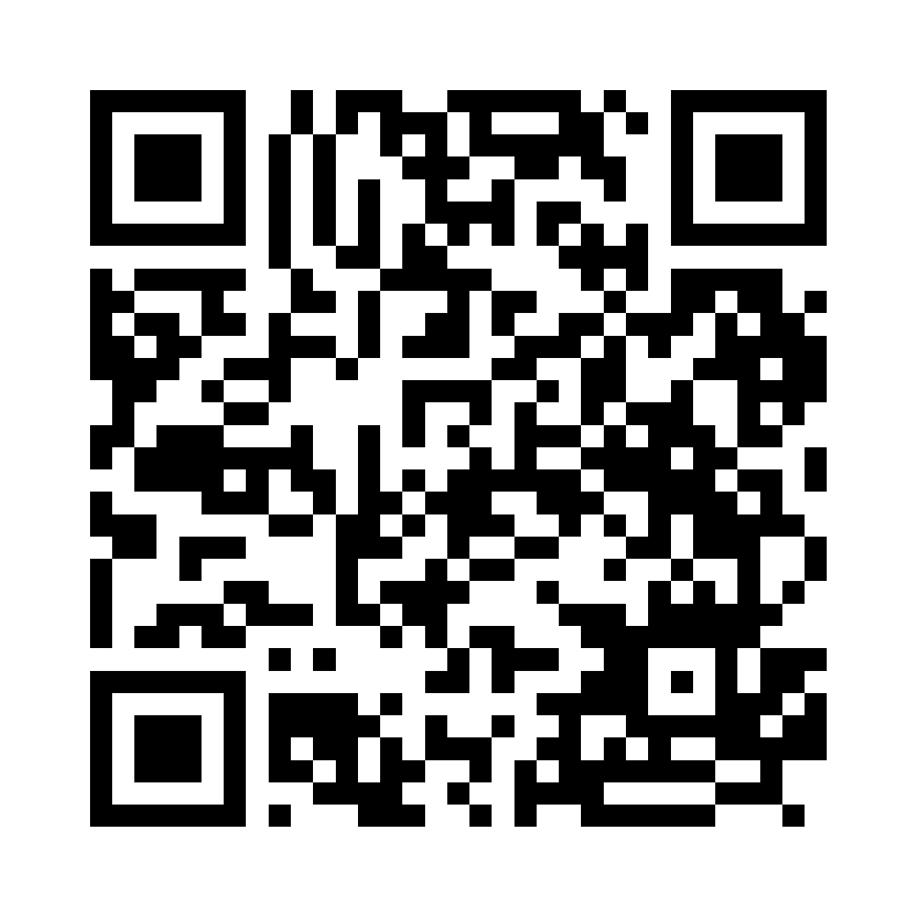
GOTHAM CONSULT
与 Gotham 保持联系
了解我们的服务
在 LinkedIn 上关注我们
gothamconsult.com
Gotham Consult
Notes:
Leave this slide on screen after the talk so the audience can scan. The first QR opens the public website, including services, forums and the chatbot. The second opens the LinkedIn company page linked in the website footer. Invite people to follow the page in LinkedIn; scanning alone does not follow an account. Phone: +233 55 041 6627. Email: info@gothamconsult.com.
Published service source: https://gothamconsult.com/
Content date: 5 October 2026. No prices, investment returns or delivery guarantees are asserted.

