Slide 1

Data Madness
Xavier Weber and Jeroen Vermazeren

Slide 2
Topic Introduction
MovieLens Dataset: Movies , User Ratings
Research Questions:
How to cluster similar movies according to their genre?
How to determine which group of users would like a movie?

Slide 3
Approach
Clustering using K-Means
Construct User Groups using Mean Rating per Cluster

Slide 4
Principal Component Analysis
Make Data Suitable for K-Means
Reduce Data Dimensions

Slide 5
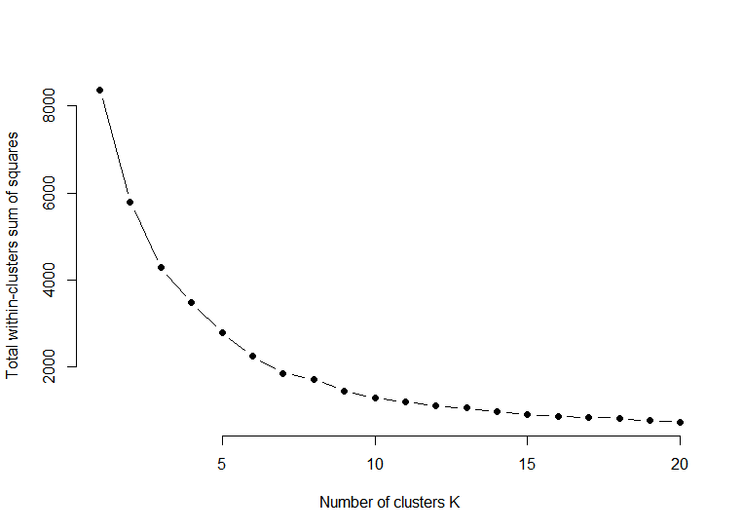
Elbow
Elbow Method
K = 7

Slide 6
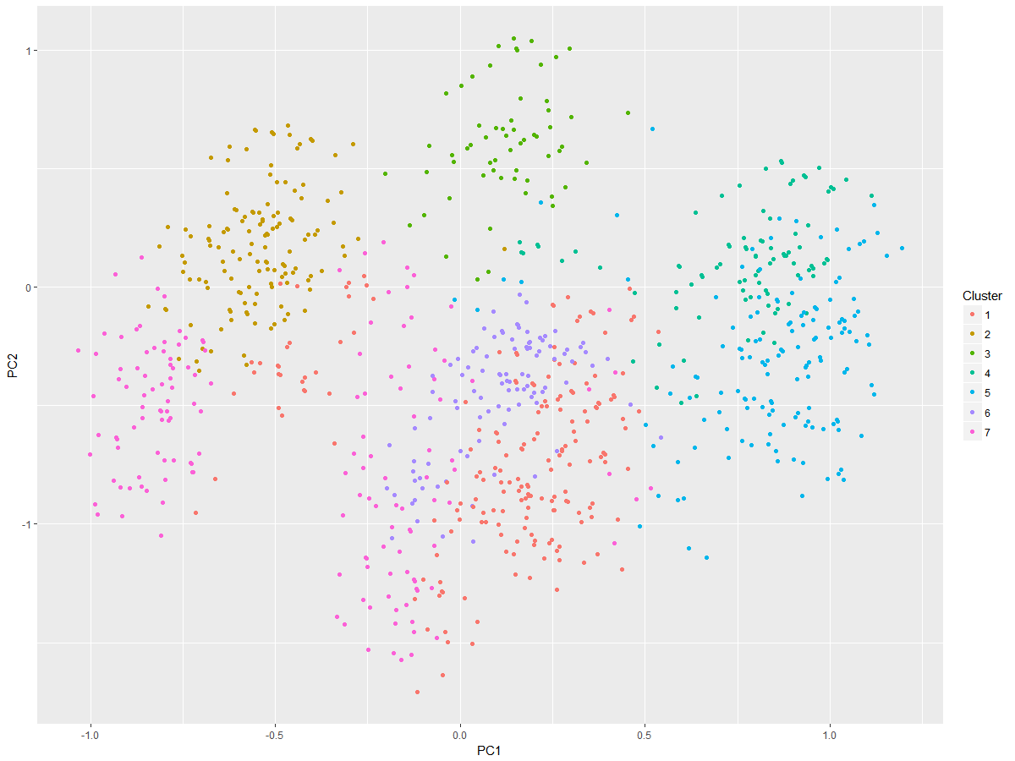
K-Means
Audition (1999)
Alphaville (1965)
movieId | title | Romance | Drama | Thriller | Horror | Mystery | Sci-Fi
680 | Alphaville (1965) | 1 | 1 | 1 | 0 | 1 | 1
27317 | Audition (1999) | 1 | 1 | 1 | 1 | 1 | 0

Slide 7
User Group
userId | Cluster | Mean Rating
28 | 7 | 4.71
46 | 7 | 5.00
71 | 7 | 5.00
89 | 7 | 4.62
91 | 7 | 4.60
113 | 7 | 4.60
145 | 7 | 4.57
147 | 7 | 4.60
169 | 7 | 4.72
…. | 7 | >4.5

Slide 8
Conclusion
Research Questions :
How to cluster similar movies according to their genre?
How to determine which group of users would like a movie?
Practical Use:
Find popular movies for Netflix

