Slide 1
LobTag2
An R Based Approach to Tagging Data Management

Slide 2
Package Description
This package is intended as a tool for researchers studying animal movement using public reporting of tagged animals. The package runs in R and allows the user to call functions which facilitate intuitive inputting and organization of release and recapture data into Oracle tables, as well as generating plausible paths of animal movement, with the end product being movement maps tailored to individual participants who report tags. Fundamentally, the package provides a standardized method for maintaining data quality in tagging projects and allowing easy access to these data for further investigations.

Slide 3
R
This package was written for R version 4.2.2. It is assumed that the user has this or a later version of R installed.

Slide 4
Oracle
This package works with tables in Oracle. To use the package, the user must have the following credentials for an Oracle space in which they have permission to create and edit tables:
username
password
dbname (database/server name)

Slide 5
Included data files
The following required files are installed with the package and are stored in the local git repository in the app.files folder:
NS_extent
depthraster2.tif
releases_template.csv
recaptures_template.csv
user_guide

Slide 6
Map Token
The package’s mapping functionality uses Mapbox to generate map tiles. To use this functionality, you will need to create an account with Mapbox in order to get a mapping token. This is quick and easy, just go to:
https://account.mapbox.com/auth/signup/
and create an account. Once you log into your account, look under “Access tokens” and you should see your “Default public token” which is a long string of characters. Copy a paste this and either save it in R as a variable or paste it directly when using the generate_maps() function, like so:
generate_maps(map_token = “your token” )

Slide 7
Installation
Enter these lines into the R console to install the package:
Install.packages(“devtools”)
devtools::install_github(“jakeelement/LobTag2”)

Slide 8
Functions (Overview)
The package is made up of the following functions used to create and manipulate the Oracle database, as well as generate movement maps from tagging “release” and “recapture” data entered by the user:
upload_releases()
upload_recaptures()
batch_upload_recaptures()
generate_paths()
generate_maps()
delete_recaptures()

Slide 9
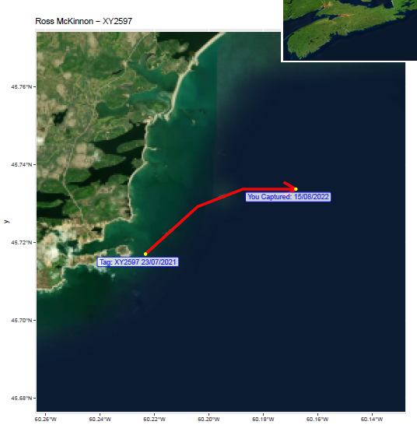
Functions (Overview)
Oracle Table Created
/ Affected
upload_releases()
LBT_RELEASES
generate_paths()
upload_recaptures()
LBT_RECAPTURES
LBT_PEOPLE
OR
End Product
batch_upload_recaptures()
LBT_PATH
LBT_PATHS
generate_maps()
delete_recaptures()

Slide 10
upload_releases()
The first phase of most tagging projects will be releasing the tagged animals. At the bare minimum, this will produce data for location and time of release for each tag.

