Slide 1
LobTag2
An R Based Approach to Tagging Data Management

Slide 2
Package Description
This package is intended as a tool for researchers studying aquatic animal movement using public reporting of tagged animals. The package runs in R and allows the user to call functions which facilitate intuitive inputting and organization of release and recapture data into Oracle tables, as well as generating plausible paths of animal movement, with the end product being movement maps tailored to individual participants who report tags. Fundamentally, the package provides a standardized method for maintaining data quality in tagging projects and allowing easy access to these data for further investigations.

Slide 3
R
This package was written for R version 4.2.2. It is assumed that the user has this or a later version of R installed.

Slide 4

Oracle
This package works with tables in Oracle. To use the package, the user must have the following credentials for an Oracle space in which they have permission to create and edit tables:
username
password
dbname (database/server name)
All functions in this package will require these values entered as arguments when calling the function, for example:
For simplicity, these values can be stored in the user’s R environment to avoid having to enter them each time they call a function. For this approach, store the variables as follows:
This will remove the need to enter these arguments when running any of the functions.

Slide 5
Included data files
The following required files are installed with the package and are stored in the user’s R library in the “data” and “extdata” folders:
data:
NS_extent
depthraster2.tif
user_guide
extdata:
releases_template.csv
recaptures_template.csv

Slide 6
Map Token
The package’s mapping functionality uses Mapbox to generate map tiles. To use this functionality, you will need to create an account with Mapbox in order to get a mapping token. This is quick and easy, just go to:
https://account.mapbox.com/auth/signup/
and create an account. Once you log into your account, look under “Access tokens” and you should see your “Default public token” which is a long string of characters. Copy a paste this and either save it in R as a variable or paste it directly when using the generate_maps() function, like so:
generate_maps(map_token = “your token” )

Slide 7
Installation
Enter these lines into the R console to install the package:
Install.packages(“devtools”)
devtools::install_github(“jakeelement/LobTag2”)
After installation:
The location of your template csv files for data entry is found with:
system.file("extdata", package = "LobTag2")
To begin using the package, load the package using:
Library(

Slide 8
Functions (Overview)
The package is made up of the following functions used to create and manipulate the Oracle database, as well as generate movement maps from tagging “release” and “recapture” data entered by the user:
upload_releases()
upload_recaptures()
batch_upload_recaptures()
generate_paths()
generate_maps()
delete_recaptures()

Slide 9
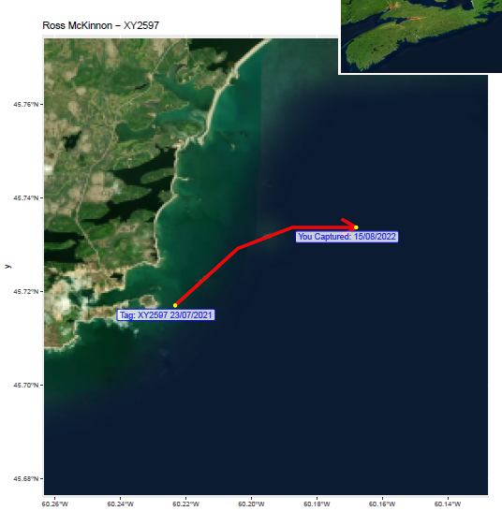
Functions (Overview)
Oracle Table Created
/ Affected
upload_releases()
LBT_RELEASES
generate_paths()
upload_recaptures()
LBT_RECAPTURES
LBT_PEOPLE
OR
End Product
batch_upload_recaptures()
LBT_PATH
LBT_PATHS
generate_maps()
delete_recaptures()

Slide 10
Release Uploading: upload_releases()
The first phase of most tagging projects will be releasing the tagged animals. At the bare minimum, this will produce data for location and time of release for each tag. Begin the process of uploading release data by running function upload_releases() which will then prompt you to upload a csv file with the data. The package includes a template file (releases_template.csv) to standardize creation of this csv file. The following are mandatory columns with specific formatting:
DAY, MONTH, YEAR, TAG_PREFIX, TAG_NUM, LAT_DEGREES, LAT_MINUTES, LON_DEGREES, LON_MINUTES
The remaining columns are optional and originate from lobster tagging programs.

Slide 11
Release Uploading: TAG_PREFIX
Most tagging programs use a Prefix-Number system to identify unique tags. The package assumes that tag numbers have a prefix to separate them from other tagging programs. This is usually a simple pair of characters (for example, “XY” such as in tag ID “XY1234”) but can be any character combination entered by the user. Even if your tagging program does not use a prefix, one must be entered when uploading data with this package. This ensures that multiple tagging programs can be accommodated without duplicate tag numbers causing issues.

Slide 12
Release Uploading: TAG_NUM
The tag number following the tag prefix is entered as a simple number in its own column called “TAG_NUM”.

Slide 13
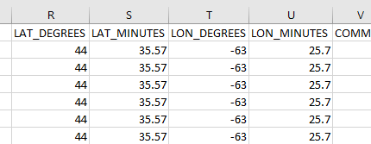
Release Uploading: Latitude and Longitude
All release coordinates are uploaded in the format Degrees Decimal Minutes (DDM), split into 4 columns: LAT_DEGREES, LAT_MINUTES, LON_DEGREES, LON_MINUTES. Columns ending in “DEGREES” receive the degree value, and those ending in “MINUTES” receive the MINUTES value as a decimal. For cases when Longitude is west (for example, 58°30.50 W), the proper “-” must be included in front of the degree value to denote this, otherwise the package will not know that the longitudes are westerly, for example:

Slide 14
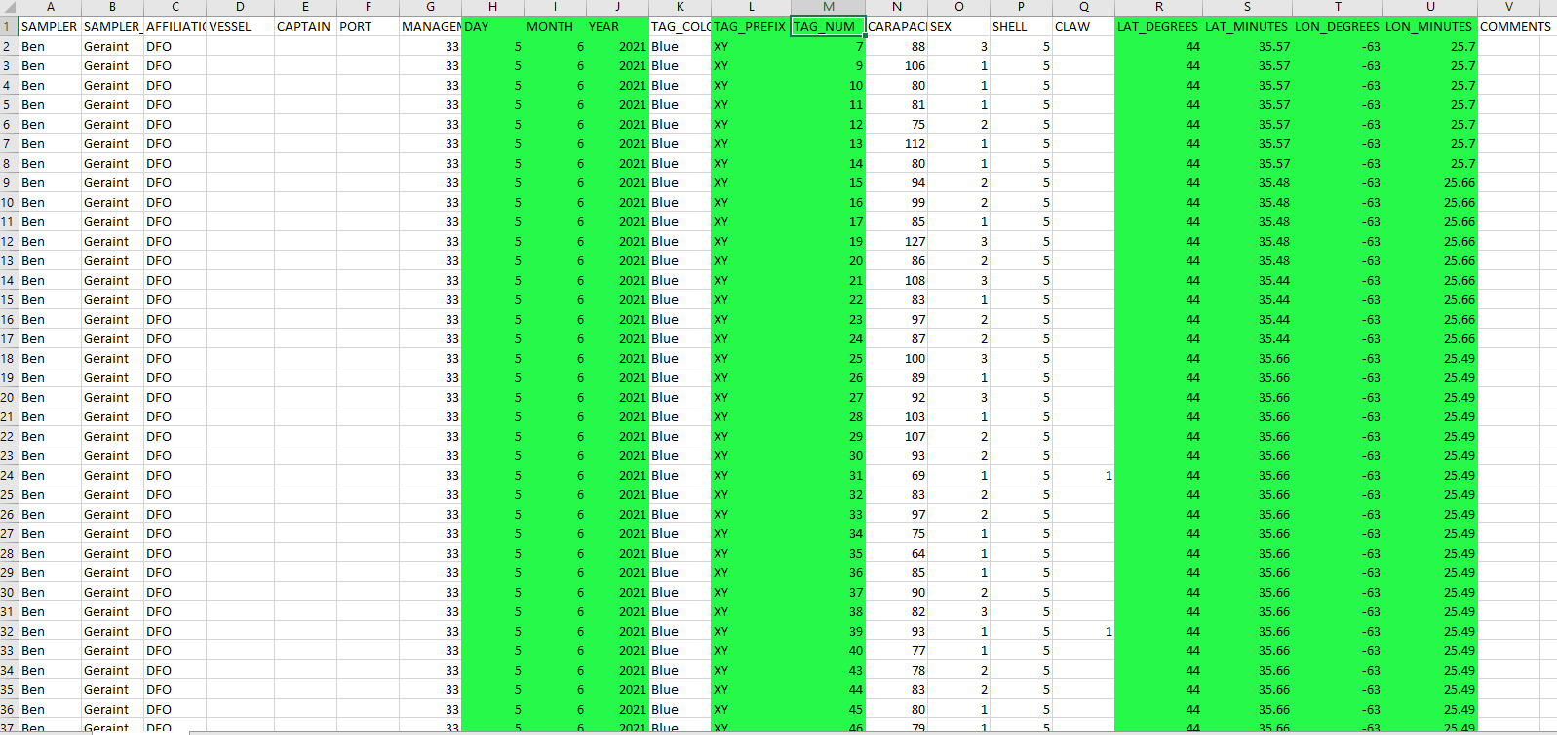
Release Uploading: Example
Green = mandatory columns

Slide 15
Release Uploading: Error Checking and Upload Completion
When the user has run upload_releases() and selected a data file, the function will perform some general error checking. If there are crucial errors found in the mandatory columns, a dialogue box will appear alerting the user to the location of errors and instructing them to fix these before attempting the upload again. If there are no errors, the user will receive a dialogue alerting them that the upload has completed without errors. This means that the database table LBT_RELEASES has been created and now contains the release data.

Slide 16
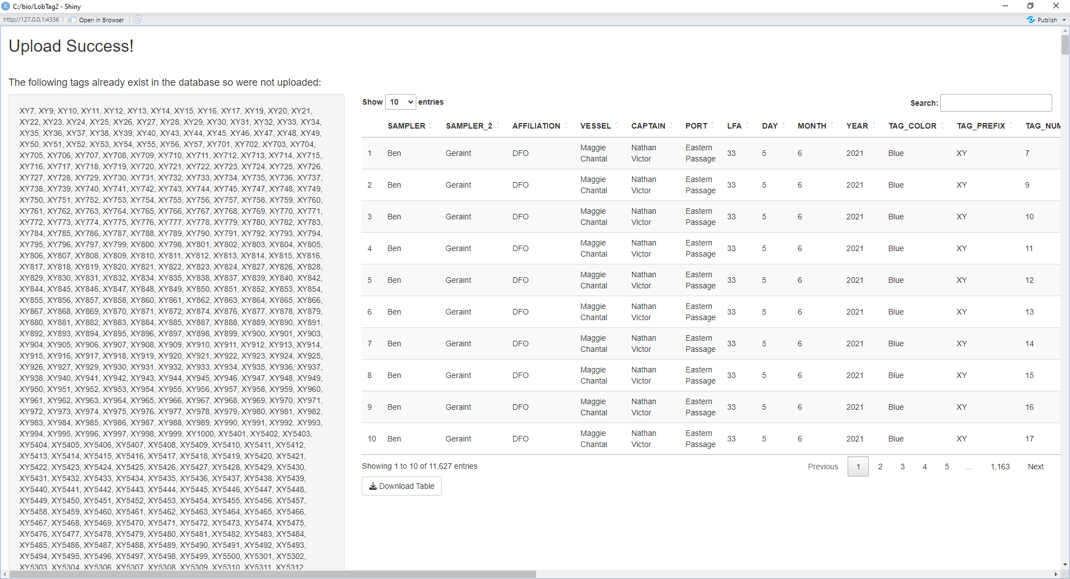
Release Uploading: Existing Tags
The function also checks if any of the tags being uploaded are the same as tags already existing in the Oracle table, defined as having both identical prefix and number. Existing tags will not be uploaded again. If the upload file contains existing tags, the upload will still proceed, but the user will receive a dialogue box alerting them of the tags that were skipped because they were found in LBT_RELEASES.

Slide 17
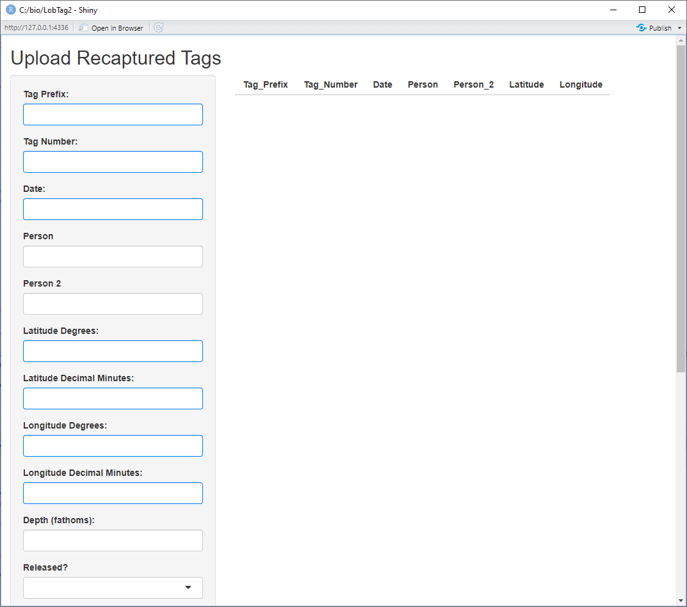
Recapture Uploading: upload_recaptures()
Generally, once tags are released, recapture reports will then come in individually over time. For public programs, these data may be highly variable in format and quality. Running the function upload_recaptures() provides the user with a data entry window which standardizes the entry of these data into the database. Mandatory fields are highlighted in blue.

Slide 18
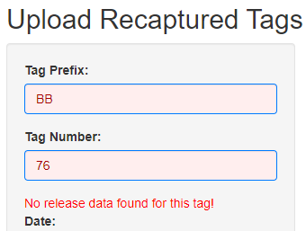
Recapture Uploading: Tag Checking
The GUI for uploading recaptures communicates with the Oracle database in real-time, allowing it to check if the tag being entered exists in LBT_RELEASES. If the Prefix and Number combination are not found, the user will be alerted:
This is just a warning, and the user may still choose to upload this tag. However, if a release data are not eventually entered for this tag, then path generation will not be possible.

Slide 19
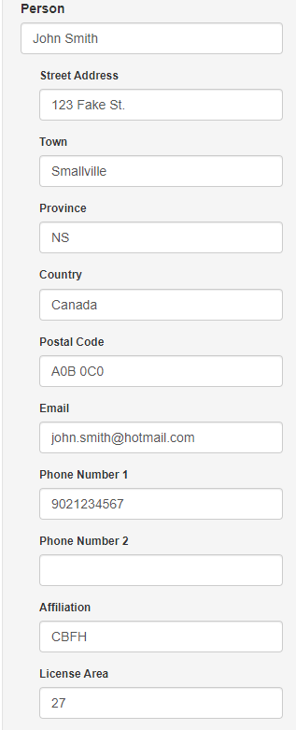
Recapture Uploading: Person Info
Some tagging programs may wish to collect contact information for the person reporting tag recaptures to allow a reward system to be implemented. For this purpose, the Oracle database includes the LBT_PEOPLE table, which is created/updated when a name is entered in the “PERSON” field during recapture uploading. When this happens, additional fields will appear prompting the user for more contact information. Since the GUI communicates with Oracle, these will be auto-filled with any existing information for the entered name so this does not have to be re- entered each time the person reports a recapture.

Slide 20
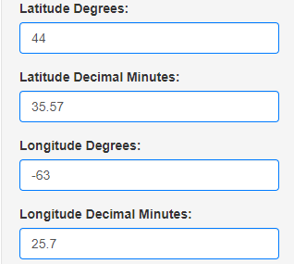
Recapture Uploading: Latitude and Longitude
The GUI interface largely standardizes the input of coordinate values, making it impossible to enter a “non-coordinate”, however, the user must be aware and check that:
Coordinates are being entered in DDM format
Westerly values for “Longitude Degrees” are negative. The GUI scroller for this value goes down for negative values. This is the only way for the functions to know that coordinates are in the western hemisphere.

Slide 21
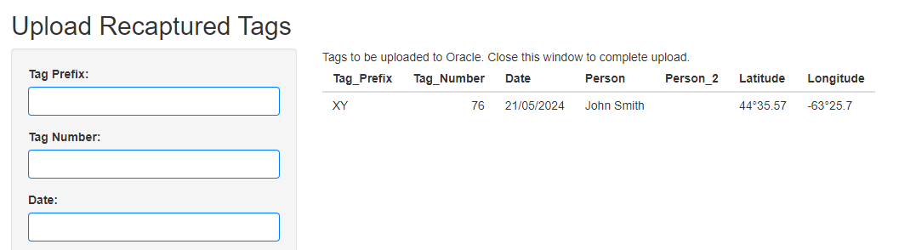
Recapture Uploading: Submitting Recaptures
When the user clicks “Submit” in the recapture uploading window, the information for the submitted tag appears in the upper right, and each tag submitted will appear listed this way so that the user can double-check what they just submitted. Upload of all the listed tags will not occur until the user closes the window.

Slide 22
Path Generation: generate_paths()
Once the user has completed uploads of releases and at least one recapture, they can begin generating movement paths between these. Running the function generate_paths() will calculate plausible paths for all recaptures found in LBT_RECAPTURES. This function can be run as many times as needed whenever new recaptures are added; recaptures with existing paths will simply be skipped. Pathing relies on functions in the R package “PBSmapping” and uses a “least cost” method in combination with a depth raster map to calculate plausible paths of movement between tag release and each sequential (chronologically) recapture event.

Slide 23
Path Generation: LBT_PATH & LBT_PATHS
Pathing information generated by generate_paths() is stored in two tables, LBT_PATH and LBT_PATHS. LBT_PATH contains the calculated straight line distance between each chronological location of the tag. In this table, the column CID (Capture ID) contains the chronological numbering of each recapture event. LBT_PATHS contains the proposed plausible movement paths of each tag. The POS (Position) column contains the sequence for each coordinate making up the plausible path from the last real known location, up to the known recapture location. Rows representing the recapture event will contain date and name values in the REC_DATE (Recapture Date) and REC_PERSON (Recapture Person) columns.

Slide 24
Map Generation: generate_maps()
Once paths have been created, these can be presented graphically using the generate_maps() function. This function has a number of additional arguments that change the output. These are:
“map.token = ” Mapping requires a public mapping token for Mapbox.
“output.location = ” Character string specifying the directory in which to put the maps (example: "C:/Users/Username/Documents/”)
“person = ” This specifies the recapture person for whom to generate maps. This will cause maps to be generated showing releases and each recapture location (and the plausible connecting path) for each tag ID reported by the chosen person. (Default = NULL)
“all.people = ” (Default = FALSE), if changed to TRUE, maps for every person who has reported recaptures will be generated.

