Slide 1


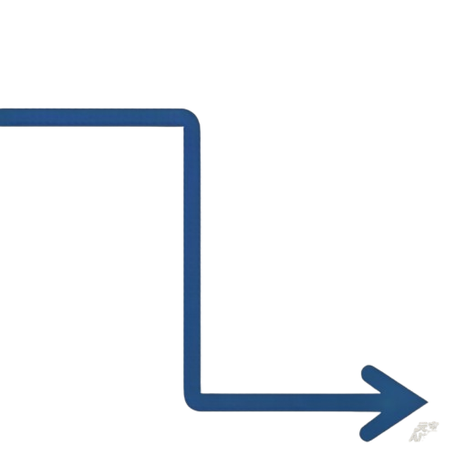







Fig.1a UroIPND Evaluation Framework and Hierarchial Curation Pipeline
L1 DATASET ORIGIN
(2018-2024)
L2 HIERARCHIAL QUALITY CONTROL CURATION PIPELINE
L3 EVALUATION TESTBED ＆SCENARIO MAPPING
Junior Urological Teams
(≥3 yrs exp)
initial review ＆normalization
deconfounder annotation
de-identification
UroIPND-702
broad heterogeneous cohort
n=600
broad clinical heterogeneity
Real-World EMR
n=600
retrospective data,
Registry Grounded source
UroIPND-102
Curated Reference Standard
n=102
high-complexity reasoning cases
reasoning testbed
Case
Extraction Structuring ＆
De-identification
Tiered Quality Control and Adjudication Flow
Final Dataset
Generation ＆
Deployment
Consensus
3 Senior Consultants
(≥25 yrs exp)
Expert adjudication
(Formal Audit ＆ Refinement)
consensus adjudication
double-blind review
EAU Guidelines alignment
UroIPND-20
(n=20 Core Stress Subset)
Teaching/Literature Cases
n=102
tailored ＆ redesigned
reasoning-rich cases by
SRRSH specialized teams
n=20 high-pressure
interactive SP
interactive
Benchmarking
derived ror interaction-level
stress-test
All n=702 cases went through all steps, Consolidation is accurate ＆ technical meaning.

Slide 2




Assessment for eligibility
(n=154,633 examinations)
Excluded with reasons
Did not complete normal consultation
Did not write medical records normally
Multiple cases per person(only 1 counted)
(n=38 excluded)
Included after physician criteria
(n=116,336 examinations)
Excluded based on case criteria
Less than 8 physicians completed parallel consultation
Less than 3 physicians completed case review
(n=22 excluded)
Final analysis cohort
(n=94,228 examinations)

Slide 3














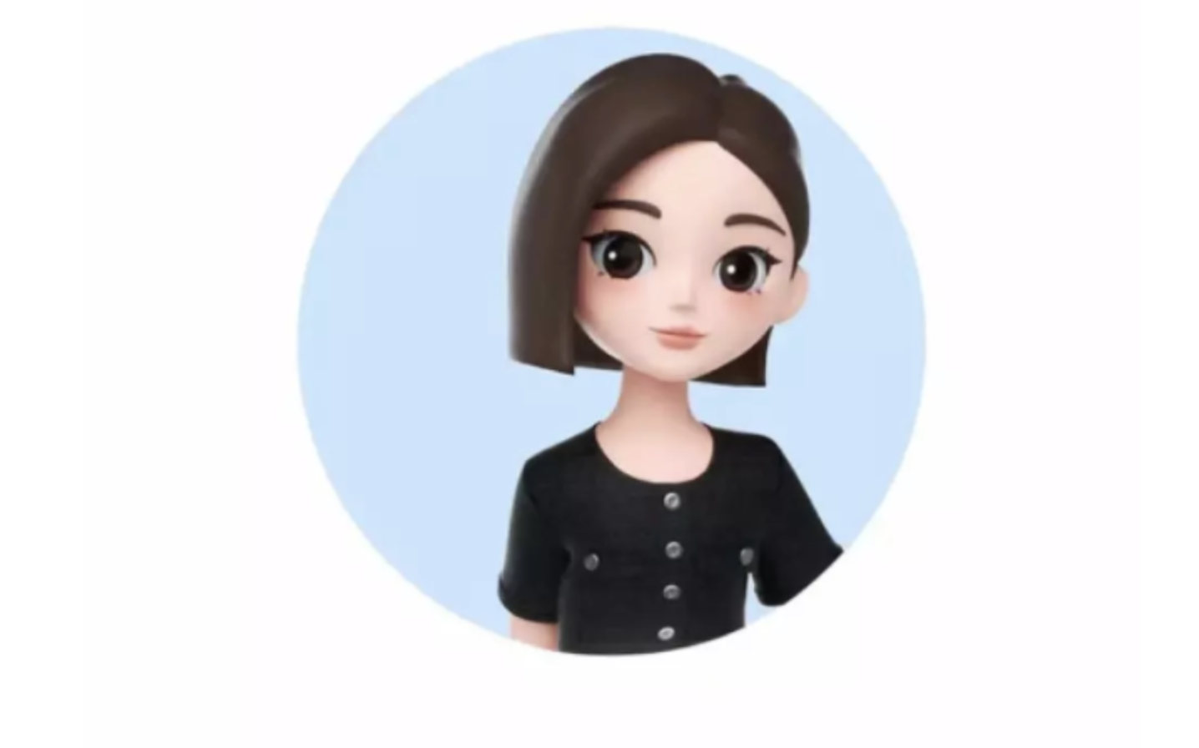
a)
Patient Interaction Layer
Patient Interaction Module Clinical User Interface
Chief Complaint
Electronic Health Record
Symptoms&
Medical History
Interactive Feedback & Data Revision Cycle
Diagnosis & Treatment Recommendations
Knowledge Retrieval
& Evidence
Mixed Search Component
Nexus
Arbiter
Oracle
Semantic
Dialogue Information Capture & Initial Prograssing
Patient Confirmation & Arbitration-Feedback Management
Confirmed Patient Profile & Requirements
Expert Diagnosis Agent-Clinical Decision Making
Clinical
Knowledge Queries
Keyword
Vector Search
Multi-Agent Coordination Core
Structured Dialogue
Validated Data Package
Decision Support Refinement
Initial Search Results
Cortex
Annotated information
Sentinel
Re-ranking Engine
Prioritized
Medical Evidence
Evidence Refinement-Relevance
Scoring & Ranking
Expert Authoring Agent-Information Structuring
Quality Control Validation Loop
Integrity Review Agent-Quality Assurance
b)
Standardized Patient Agent
20 Complex Urolithiasis Cases
Written initial progress notes
Diverse Clinical Manifestations: Flank pain, Hematuria, Pyuria
Comorbidities: Urosepsis, Anticoagulation, Congenital Anomalies
Real-world clinical cases with de-identified personal data
Rubrics based Grading Agents
Grading Agent 1
Grading Agent 2
Grading Agent 3
Interactive history collection via natural language dialogue
Output Scores based on Rubrics
UroMAS V.S.
General Large Models
Junior Doctors & Examination Cohort
Rubrics based Grading Experts
Total Participants: 94
Grading Expert 1
Grading Expert 2
Grading Expert 3
Output Scores based on Rubrics
Doubao-Seed
Total Examinations: 228

