Slide 1



4-bit CPU DATAPATH
Student Information:
  Lam Duy Loc
  Student ID: SE190907

Slide 2


System Architecture & 3-Stage Pipeline Overview
  Harvard Hardware Architecture: Physically separated Instruction ROM and Data RAM, completely preventing memory bus access contention.
  3-Stage Pipeline Structure:
    Stage 1 (IF - Fetch): Program Counter (PC) fetches 12-bit instruction into IF/ID pipeline register (instruction_register).
    Stage 2 (ID - Decode): Control Unit decodes 4-bit Opcode into 11 concurrent control lines; fetches dual source operands from Register File.
    Stage 3 (EX - Execute & Write-Back): ALU executes arithmetic/logic operations; accesses RAM (LOAD/STORE); updates Zero/Carry flags; writes back to Register File.
  Internal Register File: 4 general-purpose 4-bit registers (R0-R3) with dual asynchronous read ports and single synchronous write port.

Slide 3
Hierarchical RTL Design & Elaborated Schematic
  Modular Hardware Organization:
    IF Stage: PC_MUX, program_counter, instruction_memory, instruction_register (IF/ID).
    ID Stage: control_unit, register_file, pipeline_register (ID/EX).
    aEX & WB Stage: OPERAND_MUX, alu, flag_register, data_memory, WB_MUX.
  Control Synchronization: Control signals are latched through the ID_EX register in parallel with operand data, eliminating timing skew at the execution stage.

Slide 4
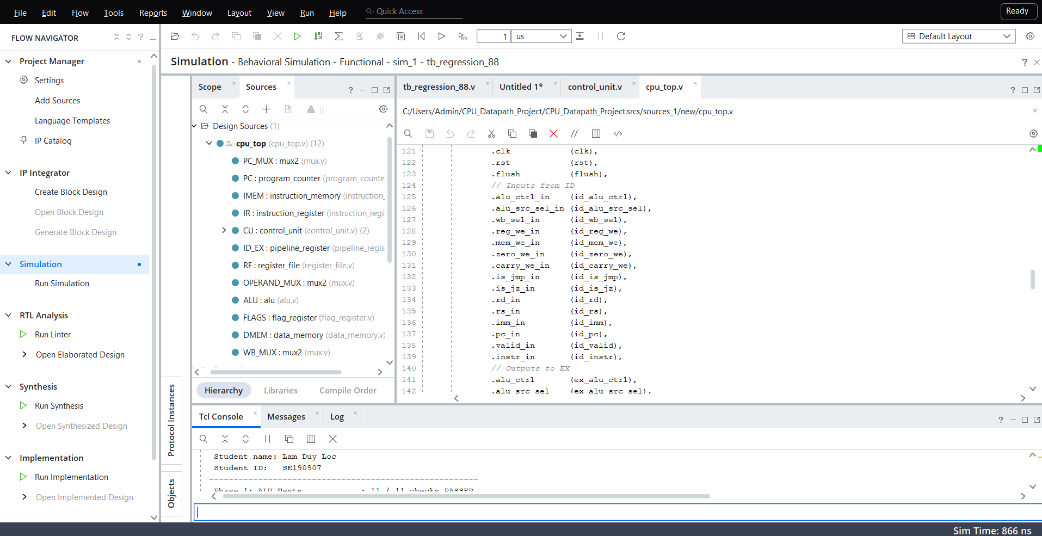
Hierarchical RTL Design & Elaborated Schematic

Slide 5
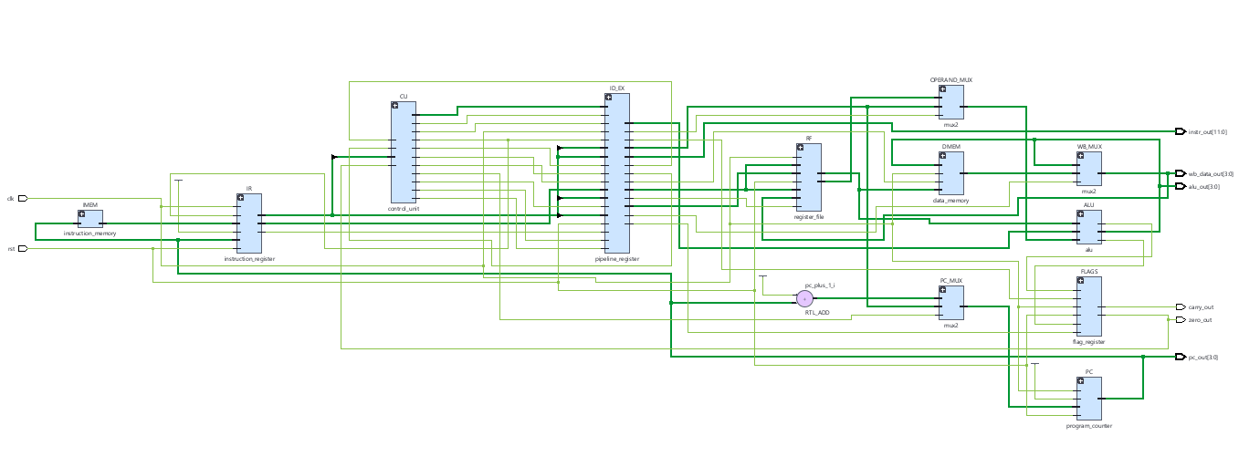
Hierarchical RTL Design & Elaborated Schematic

Slide 6
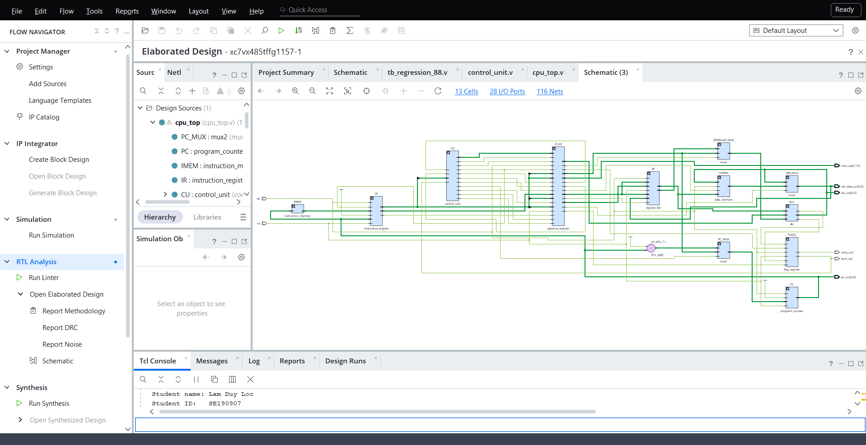

Slide 7
Comprehensive Automated Verification
  Automated Regression Suite (tb_regression_88.v):
    Phase 1 - ALU (11 checks): Verifies all arithmetic/logic operations, carry-out overflow, and zero detection.
    Phase 2 - Register File (11 checks): Validates reset, dual-port simultaneous reads, and write inhibition when we = 0.
    Phase 3 - Control Unit (22 checks): Validates 16 opcodes and 6 branch unit decision vectors.
    Phase 4 - CPU Top Integration (44 checks): Executes 4 full programs (program.mem, prog_arith.mem, prog_logic.mem, prog_jump.mem).

Slide 8
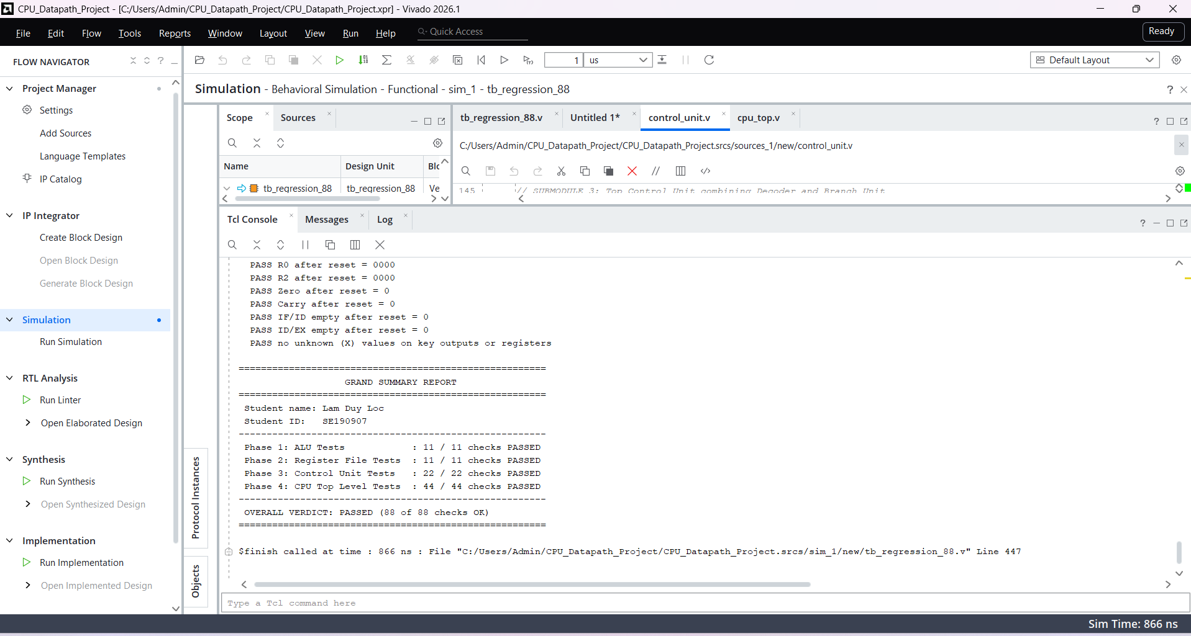

Slide 9
Simulation Waveform Analysis & Hazard Resolution
  Pipeline Behavioral Verification:
    Pipeline Priming (200ns - 240ns): Deasserting reset at 210ns allows instruction 645 (LDI R1, 5) to fetch at 220ns, decode at 230ns, and write back to R1 at 240ns.
    Peak Throughput: Demonstrates steady 1 IPC execution on sequential streams (683 -> 060 -> 6ca -> 470).
    Control Hazard Handling (300ns): a05 (JMP 5) reaches the EX stage -> pc_sel = 1 and flush = 1: PC loads target 5, succeeding instructions at addresses 6 and 7 become bubbles (c00 NOP), protecting register state integrity.

Slide 10
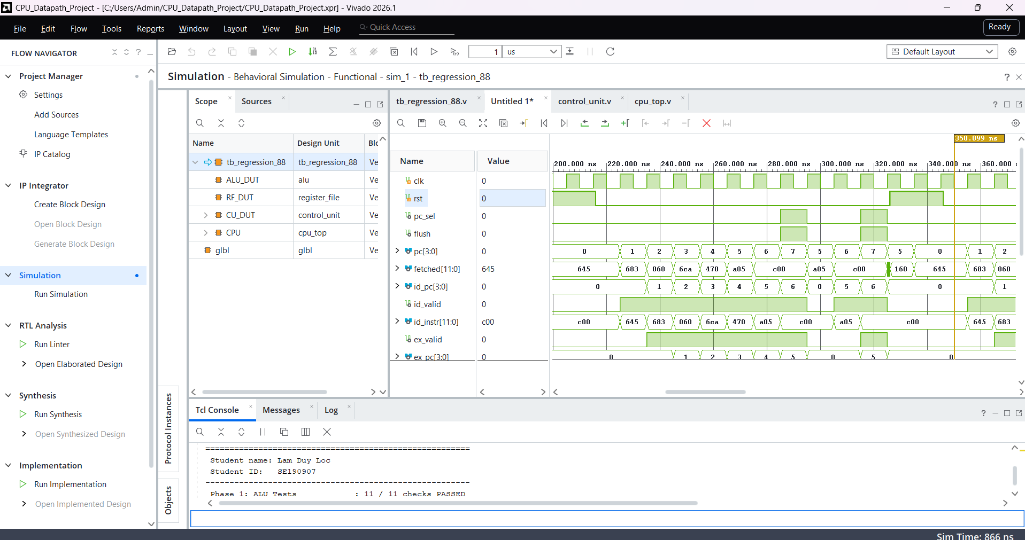

Slide 11
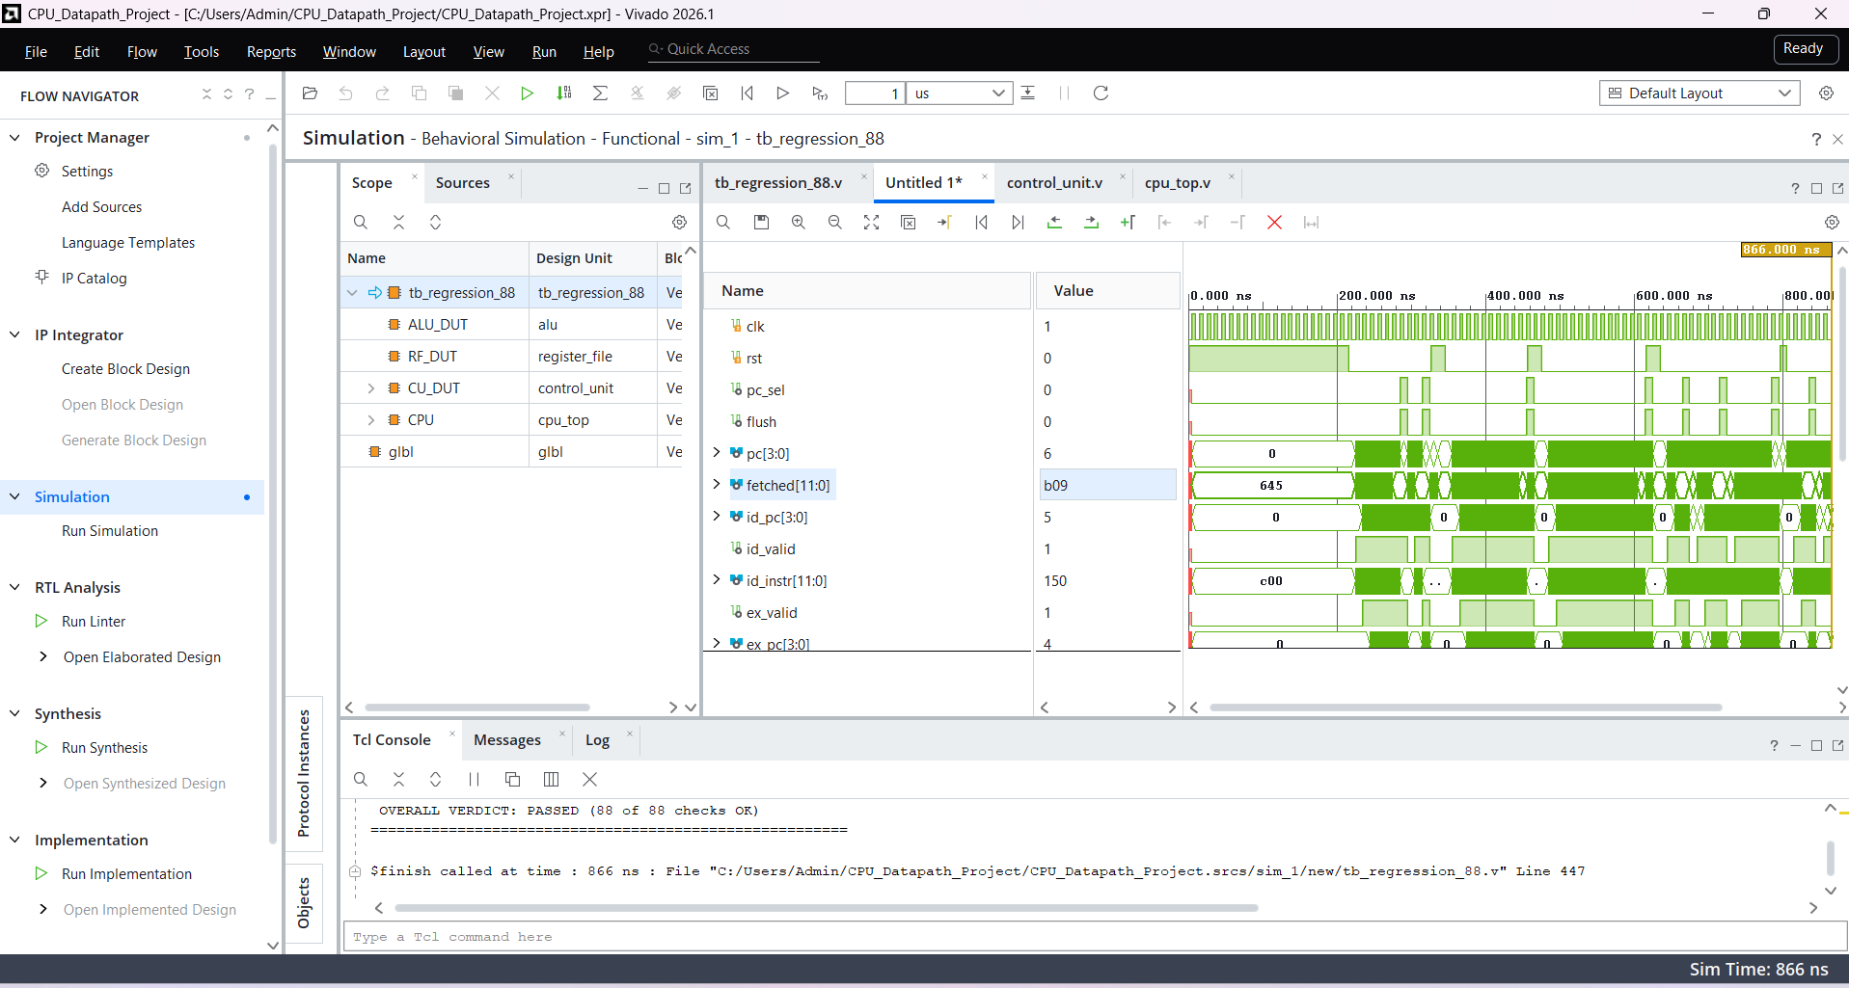

Slide 12
Synthesis Results & FPGA Resource Utilization
  Slice LUTs: 35 / 303,600 (0.01%) -> Implements ALU, Decoder, Branch Unit, and 3 Multiplexers.
  Slice Registers / FFs: 50 / 607,200 (0.01%) -> 4 FFs for PC, 16 FFs for Register File (R0-R3), 2 FFs for Flags, 28 FFs for IF/ID and ID/EX pipeline registers.
  Bonded I/O Pins: 28 / 600 (4.67%) -> 2 inputs (clk, rst) and 26 observation/debug outputs.

Slide 13
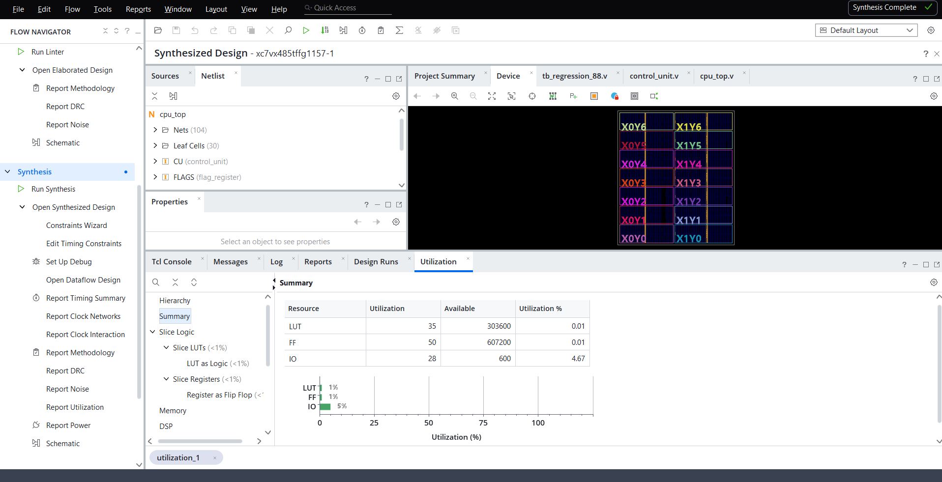

Slide 14
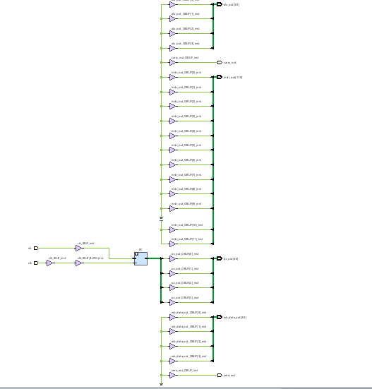

Slide 15
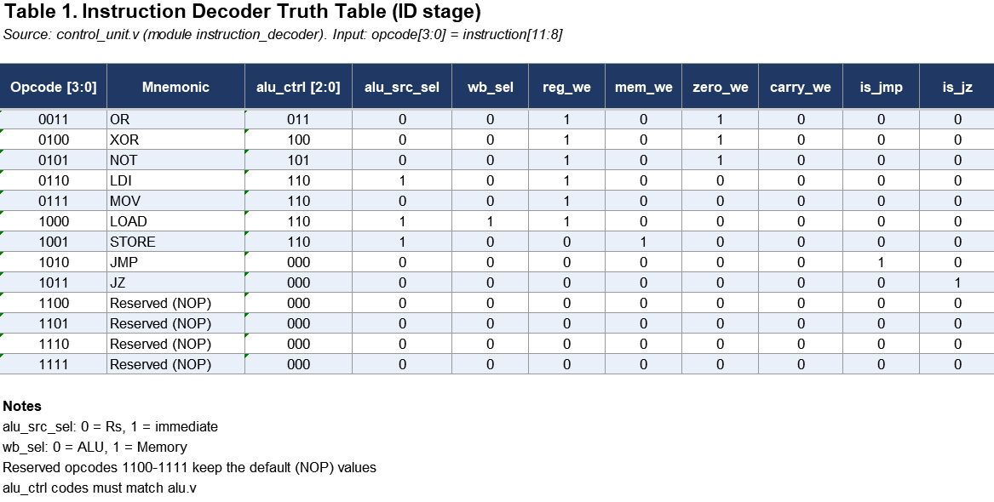
Verification & Truth Table
Truth Table

Slide 16
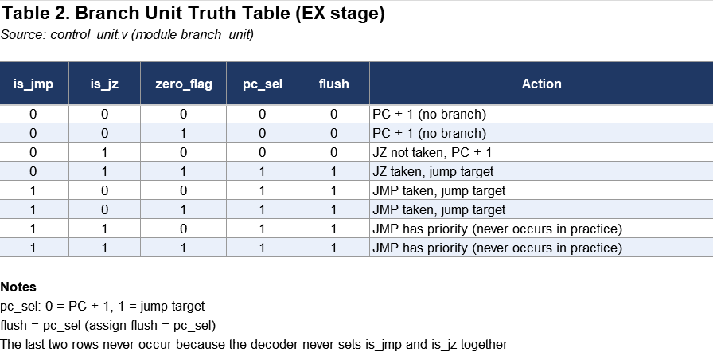

Slide 17
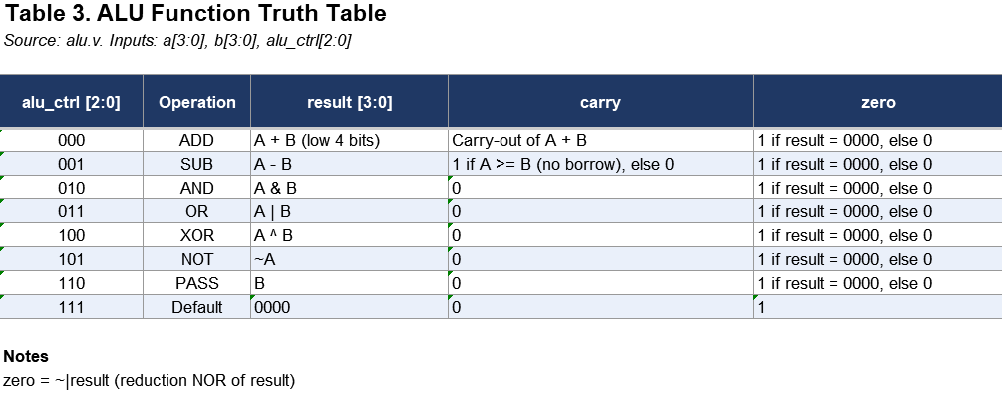

Slide 18
Thank You
for your time and attention

