Slide 1

GETTING STARTED WITH

Slide 2
WHAT IS SASS?
SASS(Syntactically Awesome Style Sheets)
A CSS preprocessor
A layer between the stylesheets you author and the .css files you serve to the browser
Used to describe the style of a document cleanly and structurally, with more power than flat CSS allows
The most mature, stable, and powerful professional grade CSS extension language in the world

Slide 3
WHY WE NEED SASS?
Sass makes writing maintainable CSS easier
You can get more done, in less code, more readably, in less time
The Sass language is developed in a way to help you reduce repetition with your CSS and save you time

Slide 4
1.
SETTING UP SASS

Slide 5
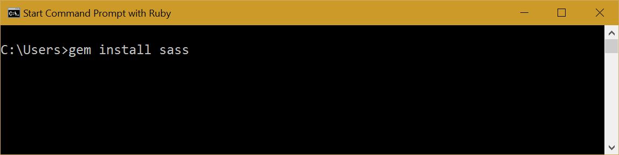
INSTALLING SASS
Install ruby via http://rubyinstaller.org/
Open up the Ruby's Command Prompt
Run the command “gem install sass’’ to install Sass
http://sass-lang.com/install

Slide 6
2.
USING SASS

Slide 7
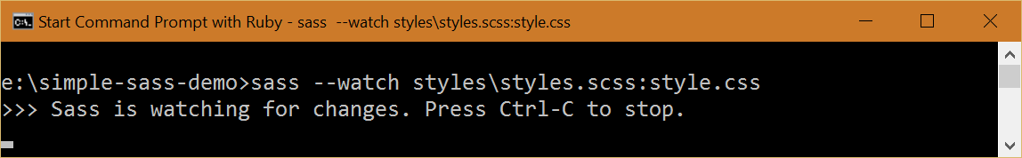
MONITORING SASS CHANGES FOR INDIVIDUAL FILE
Navigate to inside the downloaded template folder and run the following command in the terminal to translate the SCSS files into one CSS file.
sass –watch style\style.scss:style.css

Slide 8
SASS OUTPUT STYLES
Nested:
sass --watch style.scss:style.css --style nested
Compressed:
sass --watch style.scss:style.css --style compressed
Expanded:
sass --watch style.scss:style.css --style expanded
Compact:
sass --watch style.scss:style.css --style compact

Slide 9
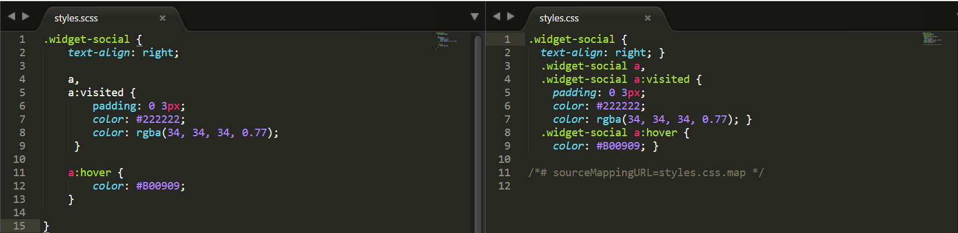
SASS OUTPUT STYLES
Nested:
sass --watch style.scss:style.css --style nested

Slide 10
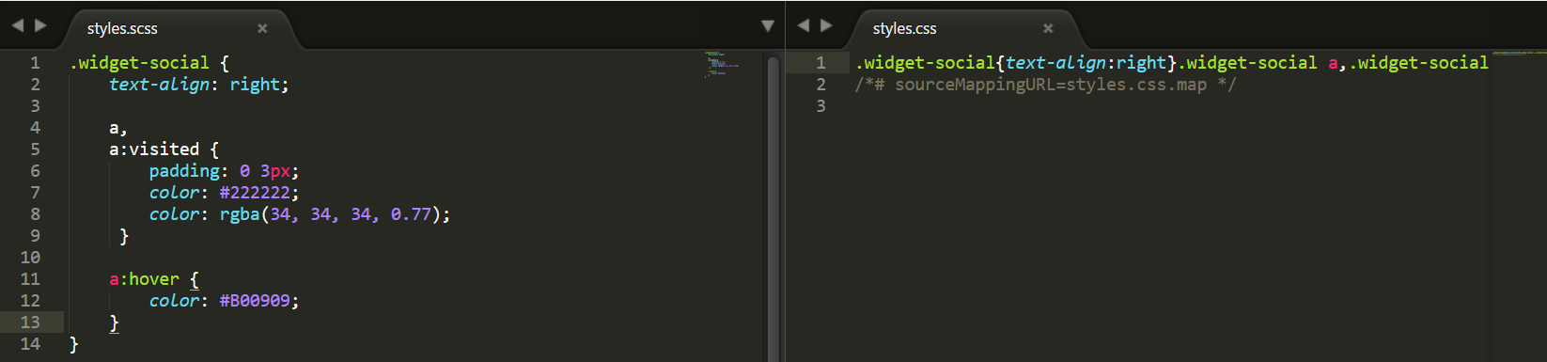
SASS OUTPUT STYLES
Compressed:
sass --watch style.scss:style.css --style compressed

Slide 11
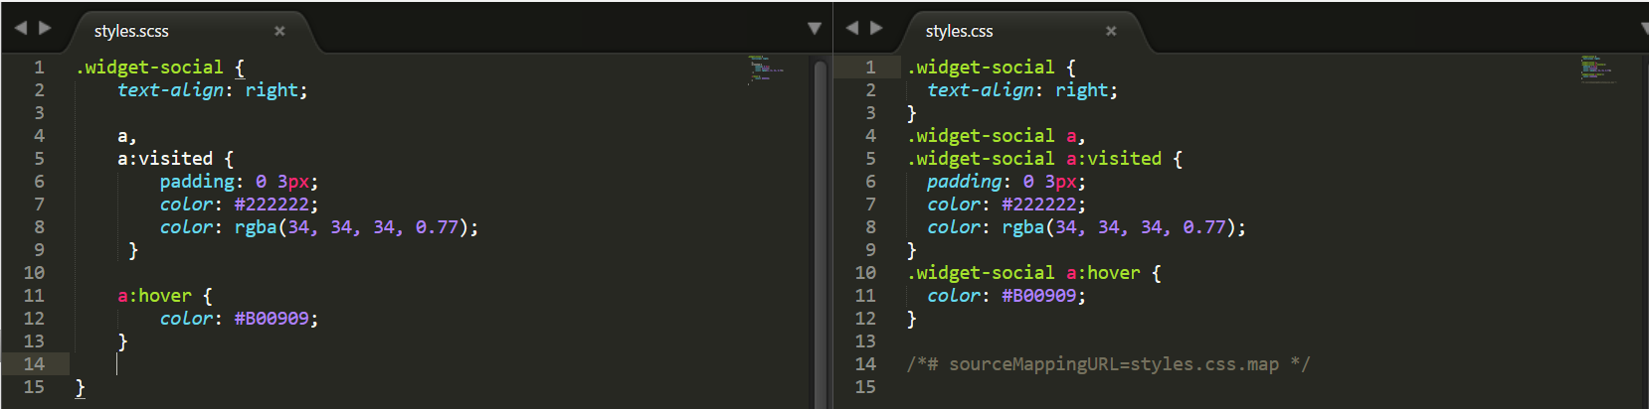
SASS OUTPUT STYLES
Expanded:
sass --watch style.scss:style.css --style expanded

Slide 12
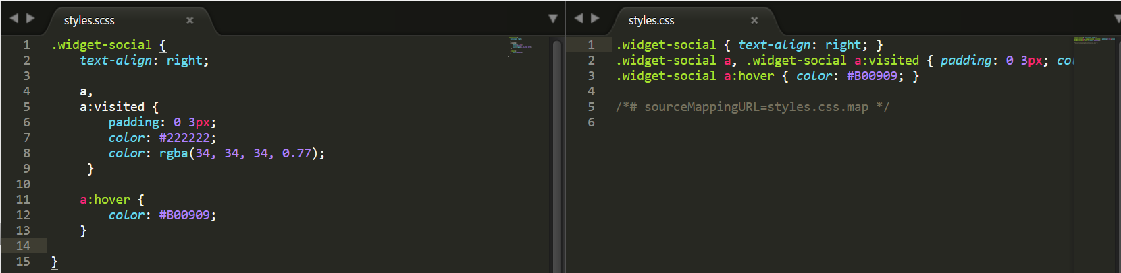
SASS OUTPUT STYLES
Compact:
sass --watch style.scss:style.css --style compact

Slide 13
SASS FEATURES
Variables
Nesting
Import
Partial
Mixins
Extend/Inheritance
Operatprs
http://sass-lang.com/guide

Slide 14
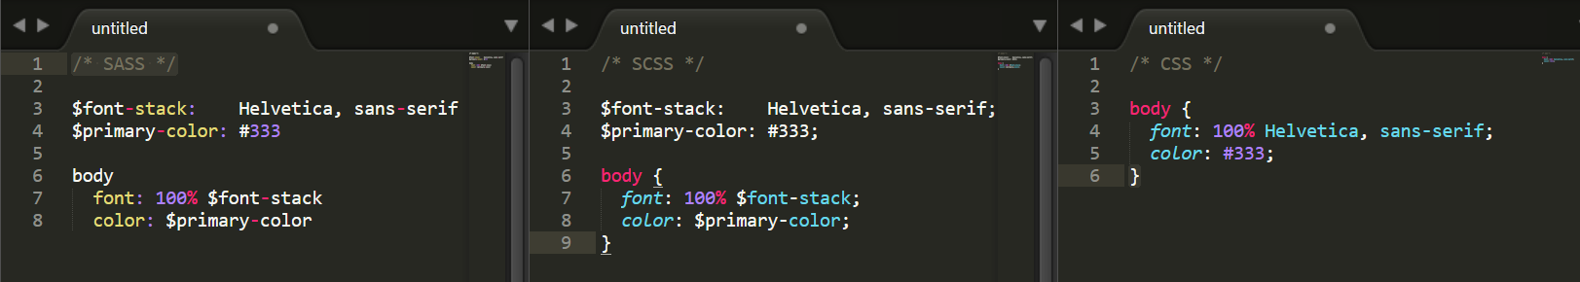
SASS FEATURES
Variables: Used to store information that you want to reuse throughout your stylesheet(colors, font stacks, or any CSS)

Slide 15
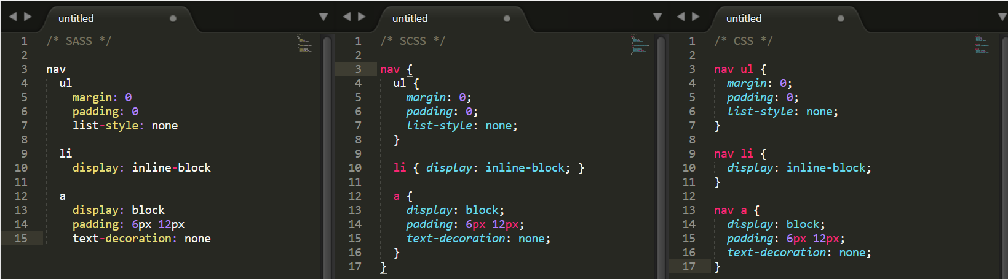
SASS FEATURES
Nesting: Sass will let you nest your CSS selectors in a way that follows the same visual hierarchy of your HTML

Slide 16
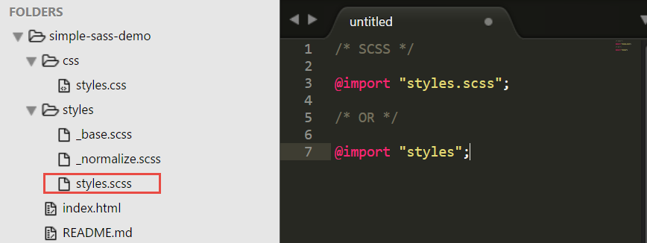
SASS FEATURES
Import: allows to break your styles into separate files and import them into one another.

Slide 17
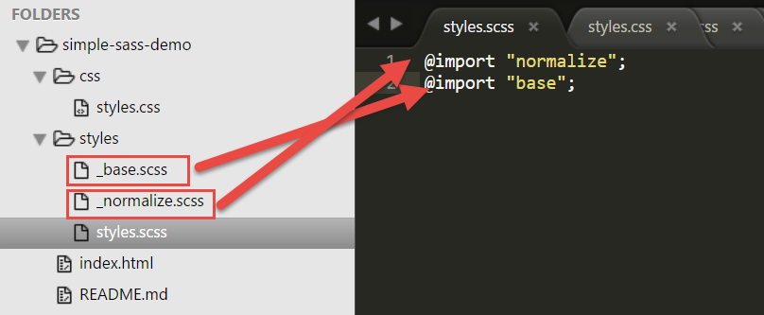
SASS FEATURES
Partial: Used to import a SCSS or Sass file but don’t want to compile to a CSS file, you can add an underscore to the beginning of the filename. This is a great way to modularize your CSS and help keep things easier to maintain

Slide 18
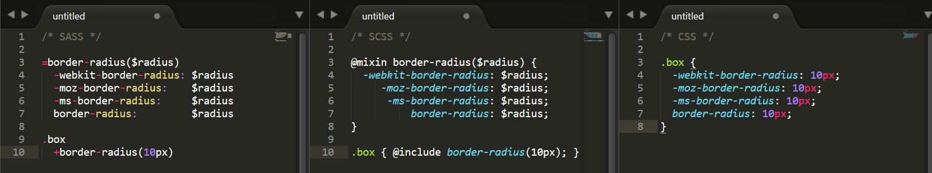
SASS FEATURES
Mixins: A mixin lets you make groups of CSS declarations that you want to reuse throughout your site

Slide 19
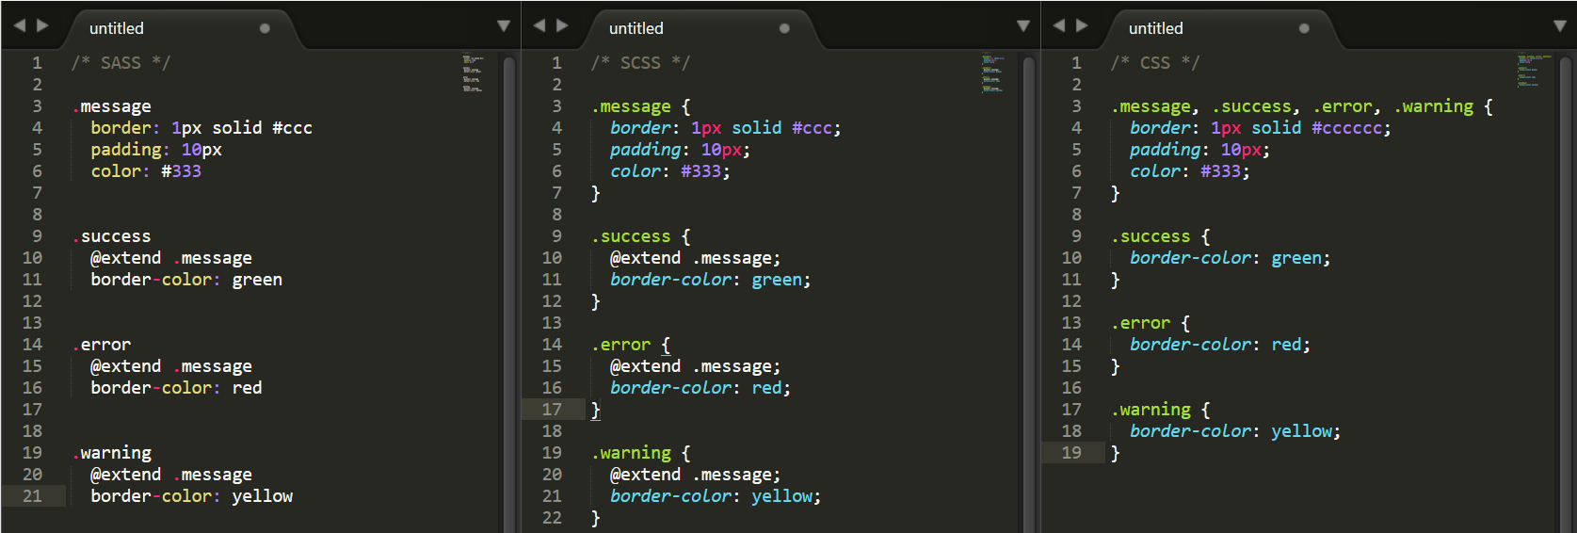
SASS FEATURES
Extend/Inheritance: Using @extend lets you share a set of CSS properties from one selector to another

Slide 20
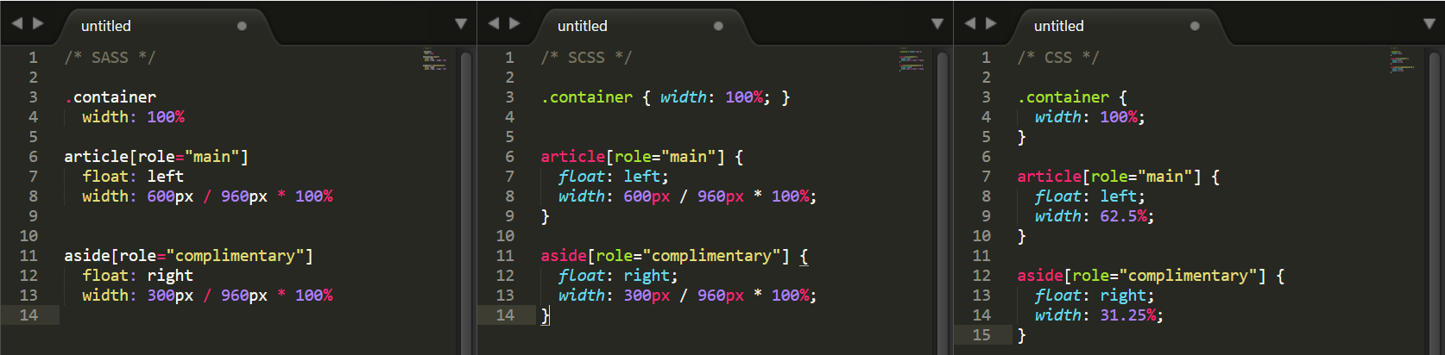
SASS FEATURES
Operators: Sass has a handful of standard math operators like +, -, *, /, and %

Slide 21
CONTROL DIRECTIVE & EXPRESSIONS
if()
@if
@for
@each
@while
http://sass-lang.com/documentation/file.SASS_REFERENCE.html#control_directives__expressions

Slide 22
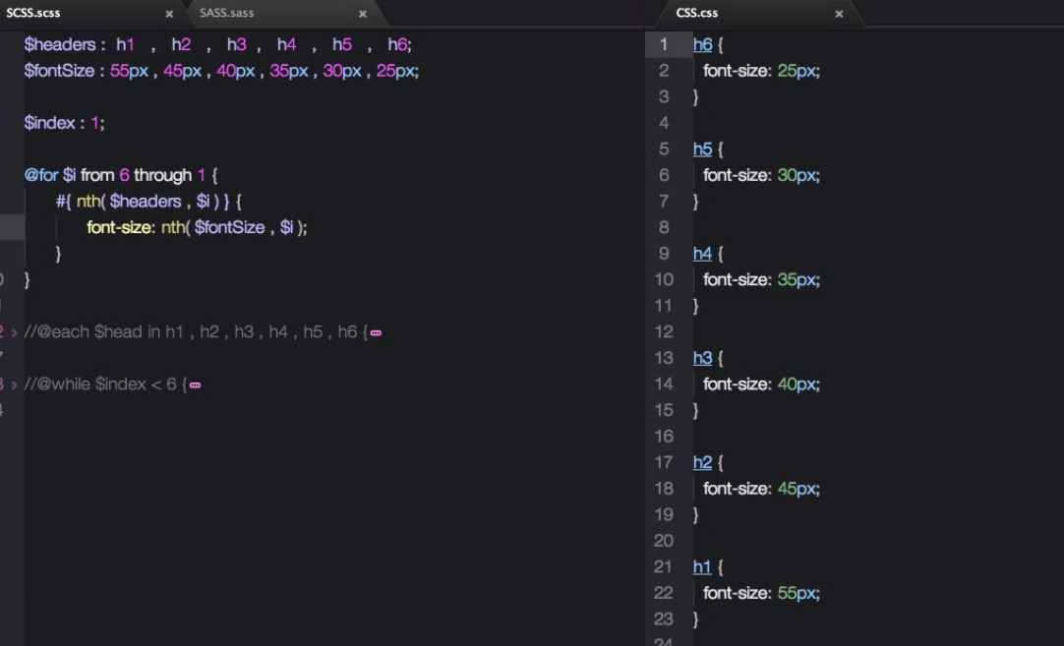
CONTROL DIRECTIVE & EXPRESSIONS

Slide 23
Issue in IE8 limit CSS
Tool used to checkcss file and fails if the selector count exceeds IE limits http://snippet.bevey.com/css/selectorCount.php
NoteJS - Windows Installer (.msi)
https://nodejs.org/en/download/
Install notejs
npm install -g bless@3.0.3
Break
blessc css\styles.css css\style.css
http://blesscss.com/

Slide 24
REFERRENCES
SASS Documentation http://sass-lang.com/
Udemy - Step by Step Sass https://www.udemy.com/step-by-step-sass/

Slide 25
THANKS!
Any questions?

