Slide 1

Fashion Recommender
Phạm Xuân Lộc
Nguyễn Đức Tiến
Phạm Tiến Mạnh
Computer Vision course
Lecturer: Dr Nguyễn Hồng Thịnh

Slide 2
Introduction
Over the past decade, with the rapid advancement of computer hardware, deep learning showed its appearance in every corner of life and proved its superiority as compared with classical methods
Popular deep classification models include Alexnet, VggNet, ResNet, MobileNet, ... with the increasing accuracy and decreasing size through time
In this project, we choose VggNet to implement the Fashion Recommender system. The accuracy of the system reaches 94%

Slide 3
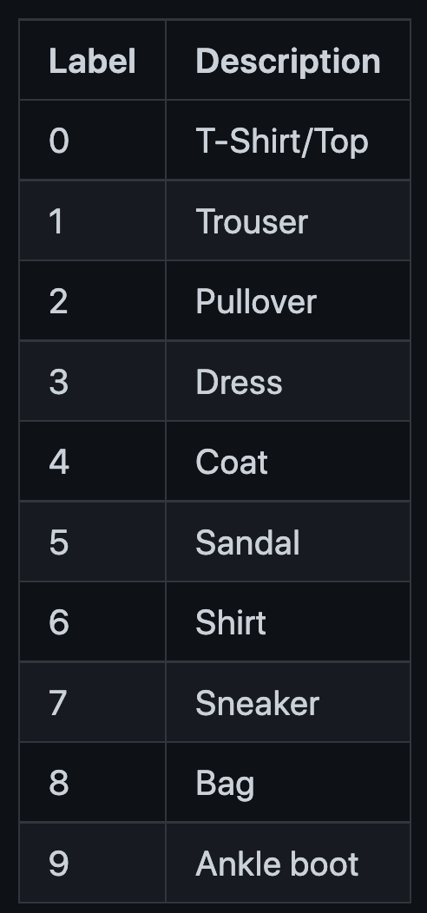
Dataset
The dataset used in this project is the FashionMNIST dataset
Data preprocessing is needed to fit the model input
Training: 60,000 images
Testing: 10,000 images
Number of classes: 10
Image size: (224,224,3)

Slide 4

VGG Net
VGG-11 is used instead of the original VGG-16
The structure of VGG-11 is illustrated in the figure below:

Slide 5
VGG Net
Model input size: (224,224,3)
Kernel size: (3,3)
Conv layer is used to extract features
Maxpool layer is used to reduce the size of the receptive field
FC layer is used for classification
Softmax layer is used for setting output in the range 0,1

Slide 6
VGG Net
The VggNet used in this project is imported from Pytorch
The imported VggNet has been trained on ImageNet dataset with 1000 classes and the pretrained weight is also provided
To achieve the best performance on our FashionMNIST dataset, we tried 3 modes of VggNet:
Freeze the classification layer and keep the feature extraction layer
Train all parameters of the model from scratch
Finetune all parameters of the model based on pretrained weight of ImageNet dataset.

Slide 7
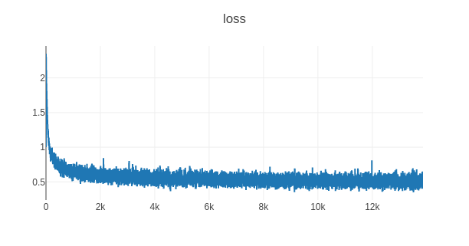
Freeze mode
This mode freezes the feature extraction layers, fixes the pretrained weights on these layers and only updates the classification layer
Classification layer is customized to predict 10 classes instead of 1000 classes
Below is the training progress log
Loss
Epoch

Slide 8
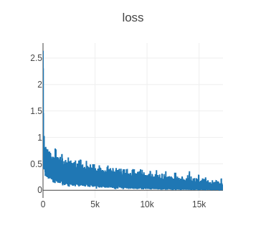
Scratch mode
In this mode, all parameters of the model is trained from the scratch with random initialization
Below is the training progress log
Loss
Epoch

Slide 9
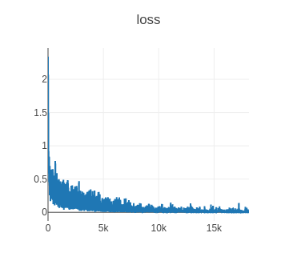
Finetune mode
In this mode, all parameters of the model is trained based on the pretrained weights
Below is the training progress log
Loss
Epoch

Slide 10
Results
The accuracy is calculated by the number of corrected predictions/ number of prediections
The accuracy of the 3 models is as follows:
Freeze mode | Scratch mode | Finetune mode
84% | 93% | 94%

Slide 11
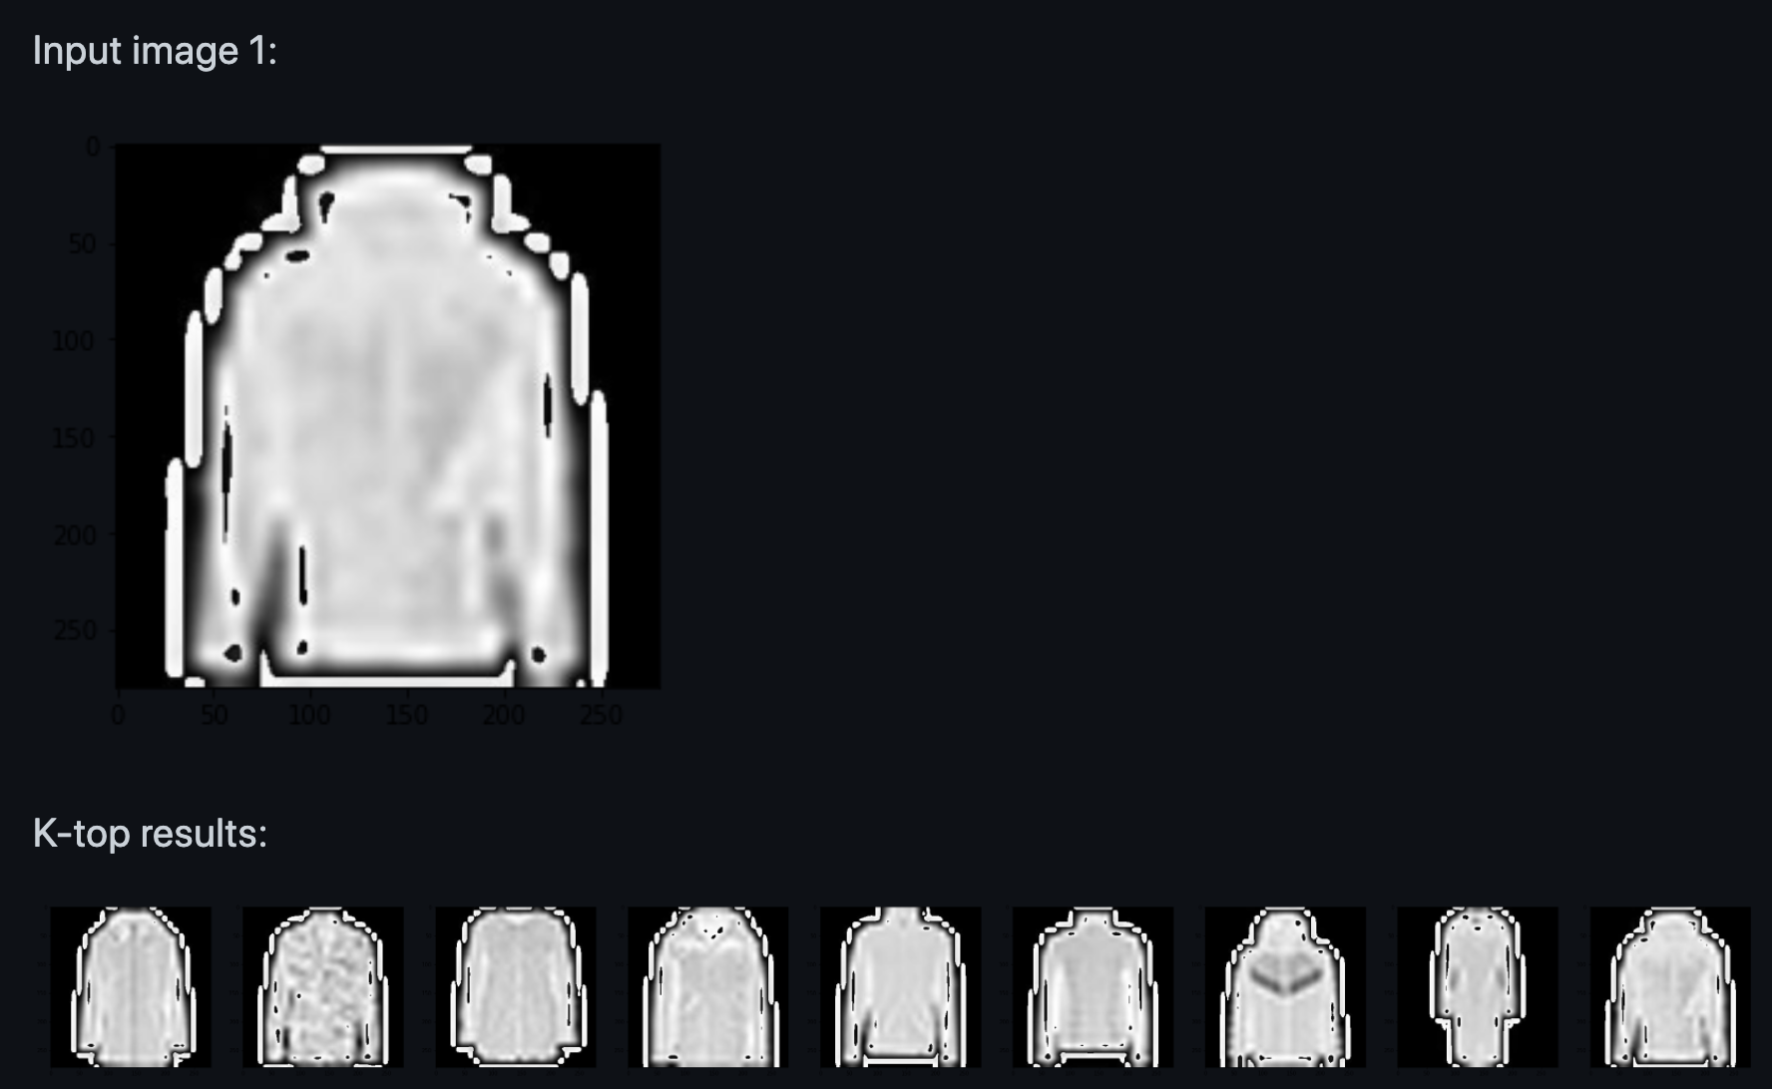
Results

Slide 12
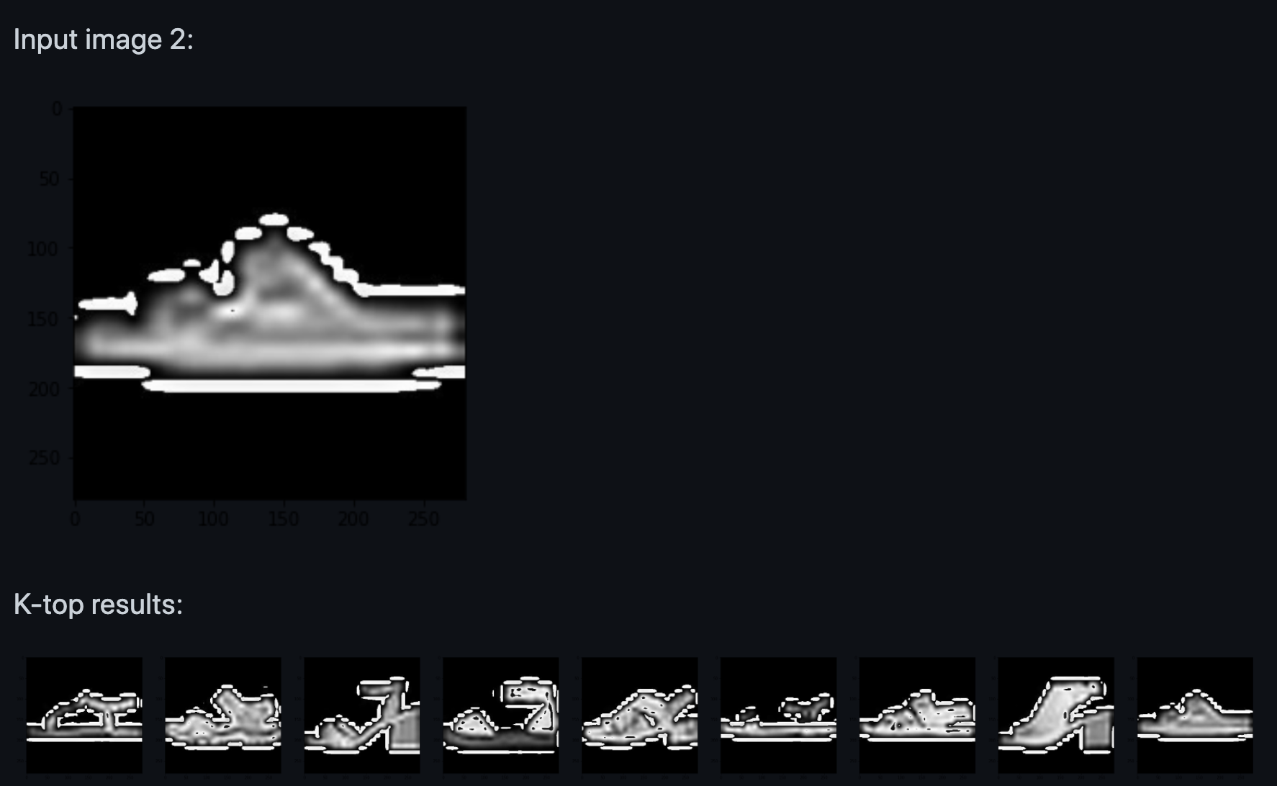
Results

Slide 13
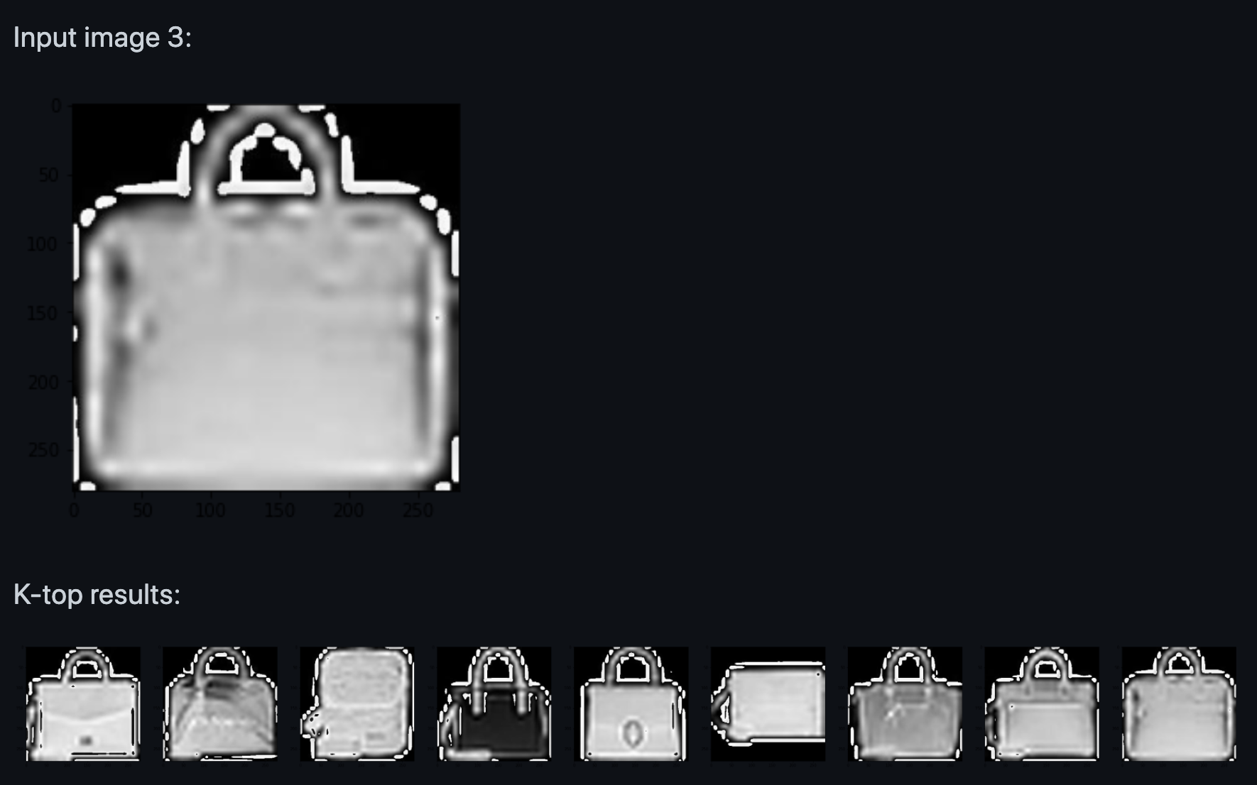
Results

Slide 14
Discussion
Freeze mode:
Fastest convergence due to reusable feature extraction weights and few training parameters
Lowest accuracy due to the incompatibility between ImageNet and FashionMNIST dataset
Finetune mode:
Use pretrained weights instead of random initialization
Highest accuracy

Slide 15
Conclusions
A Fashion Recommender system based on Deep learning is successfully implemented
Several methods have been tried to obtain the highest accuracy of 94%, using finetune mode as training methodology

Slide 16
Reference
For more details regarding code and explaination of the project, please refer to the github https://github.com/LocPham263/Fashion_recommender.git

