Slide 1
Trần Phước Lộc
44.01.104.130

Slide 2
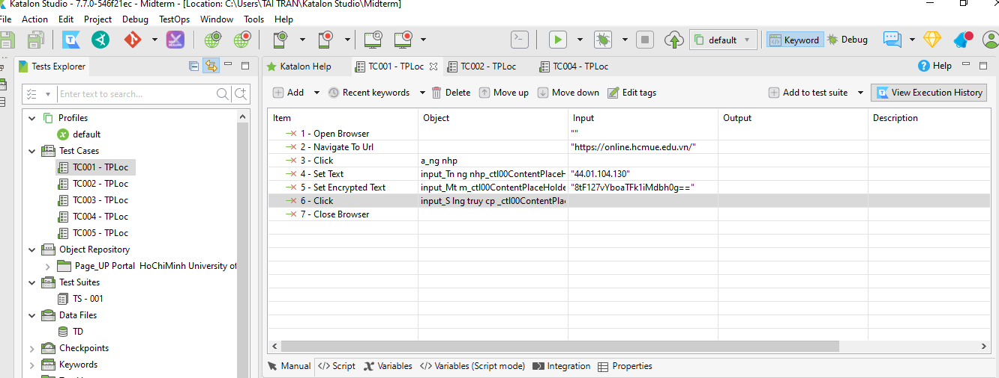
Lab01
Tạo testcase, testsuite

Slide 3


Slide 4

Lab02
Verify Element Present, Text
Wait For Element Present

Slide 5
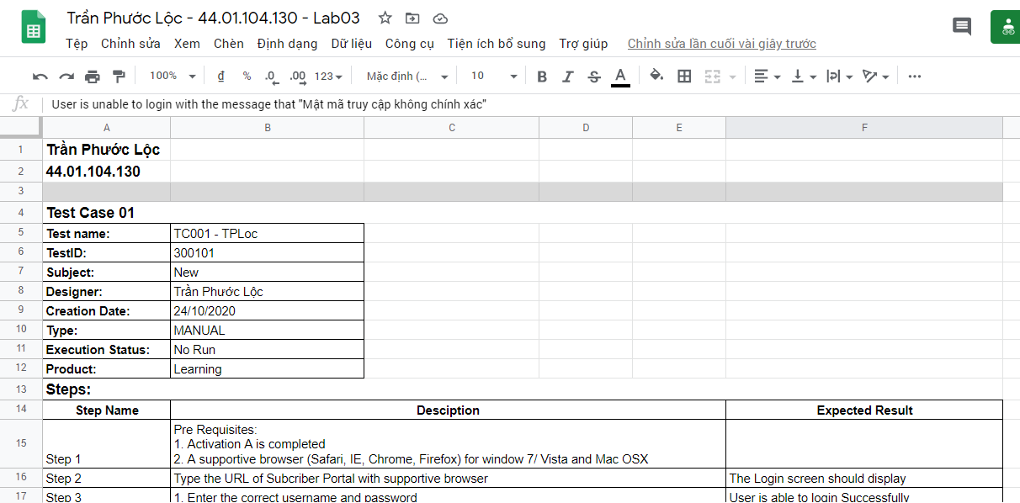
Lab03
Testcase (GG Sheet)

Slide 6
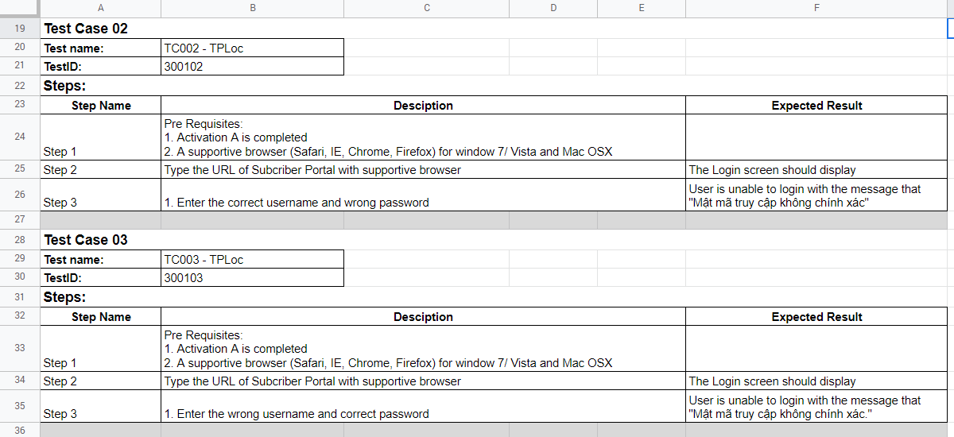

Slide 7


Lab04
Profile

Slide 8
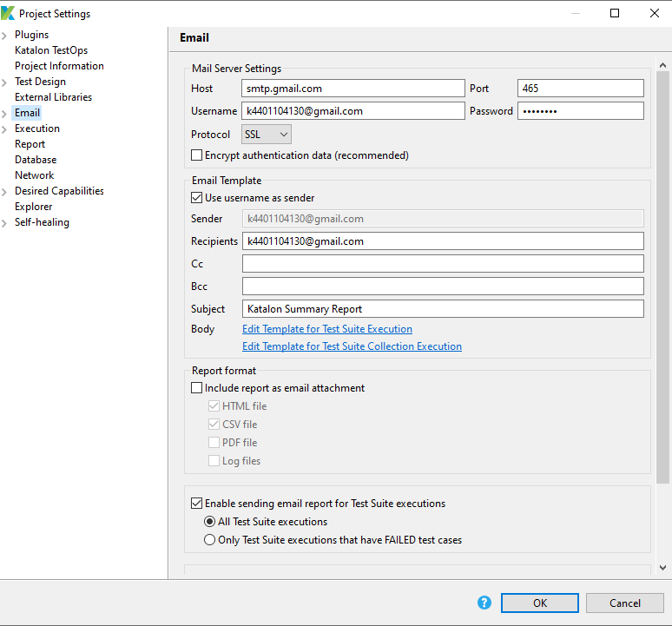
Lab05
Email Notification

Slide 9
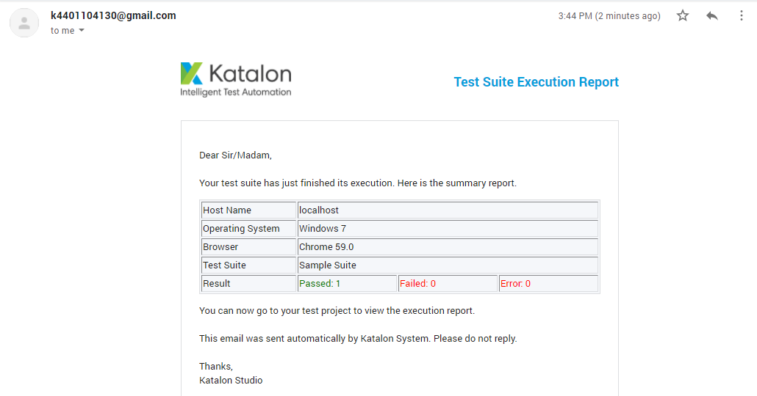

Slide 10
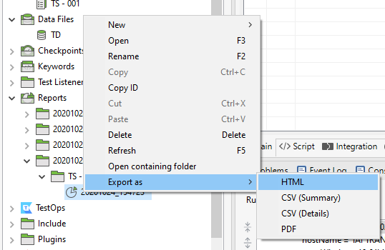
Lab06
Export Report

Slide 11
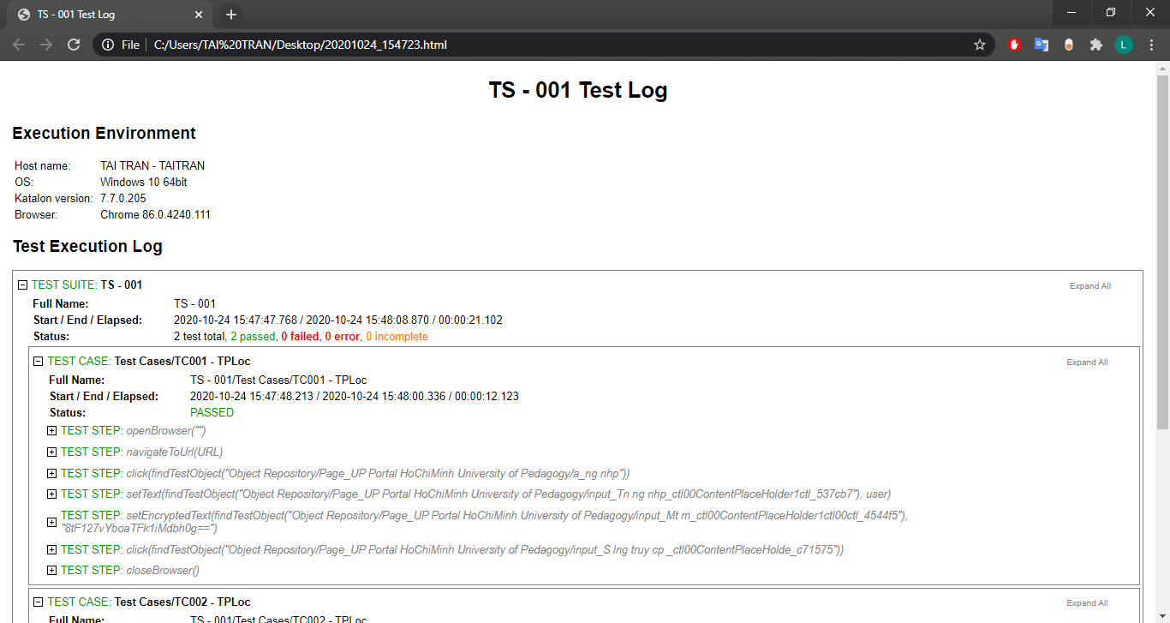

Slide 12
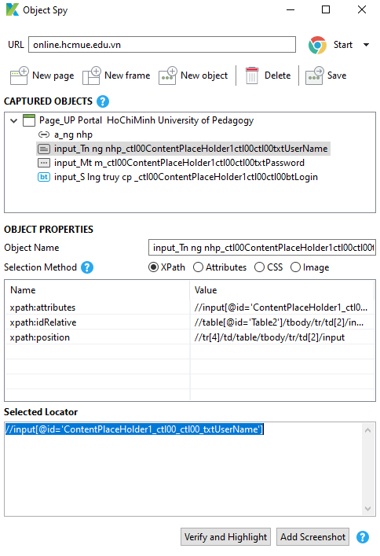
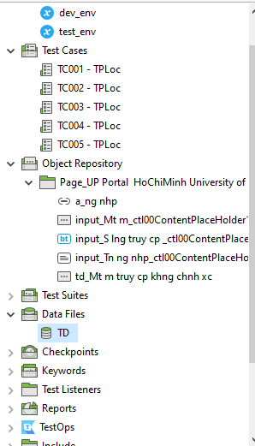
Lab07
Spy Object

Slide 13
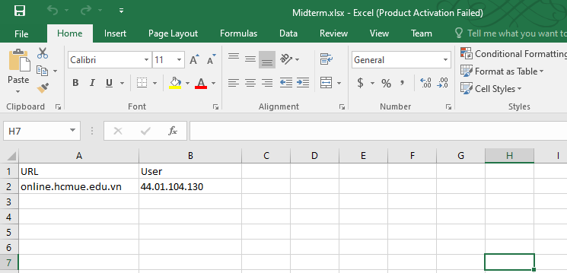
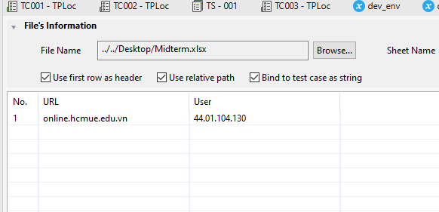
Lab08
Read data from excel

Slide 14


Slide 15
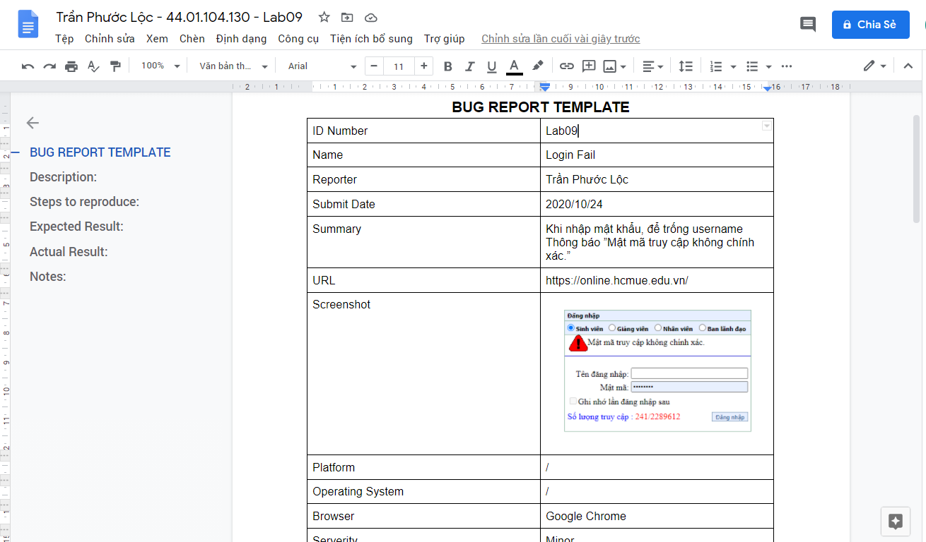
Lab09
Bug Report

Slide 16
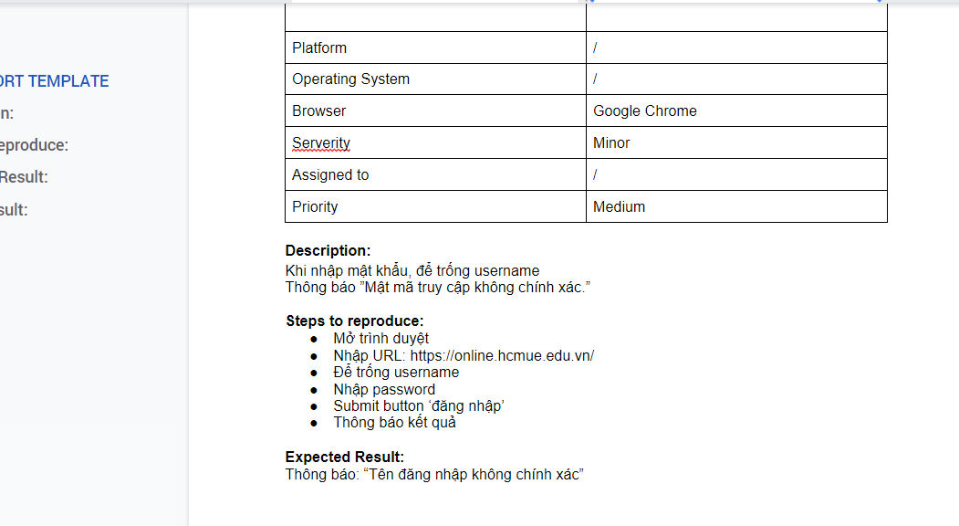

Slide 17
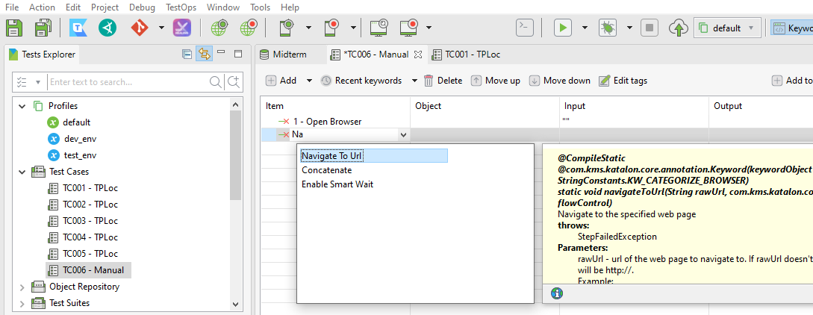
Lab10
Manual Script

Slide 18
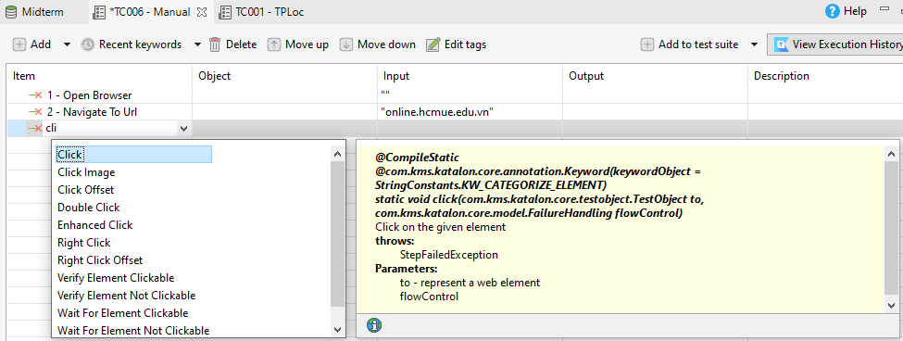
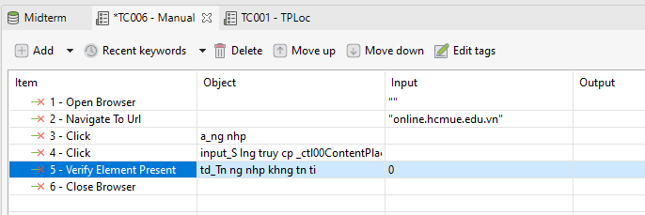

Slide 19


