Slide 1
A POINT OF VIEW ABOUT A.I

Slide 2
CONTENTS
BIG PICTURE
MACHINE LEARNING
DEEP LEARNING
TIMELINE
ASIA & VIETNAM

Slide 3
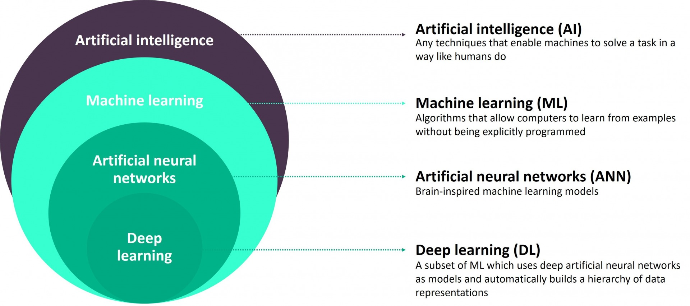
1.BIG PICTURE
https://blog.forumias.com/understanding-artificial-neural-networks/

Slide 4
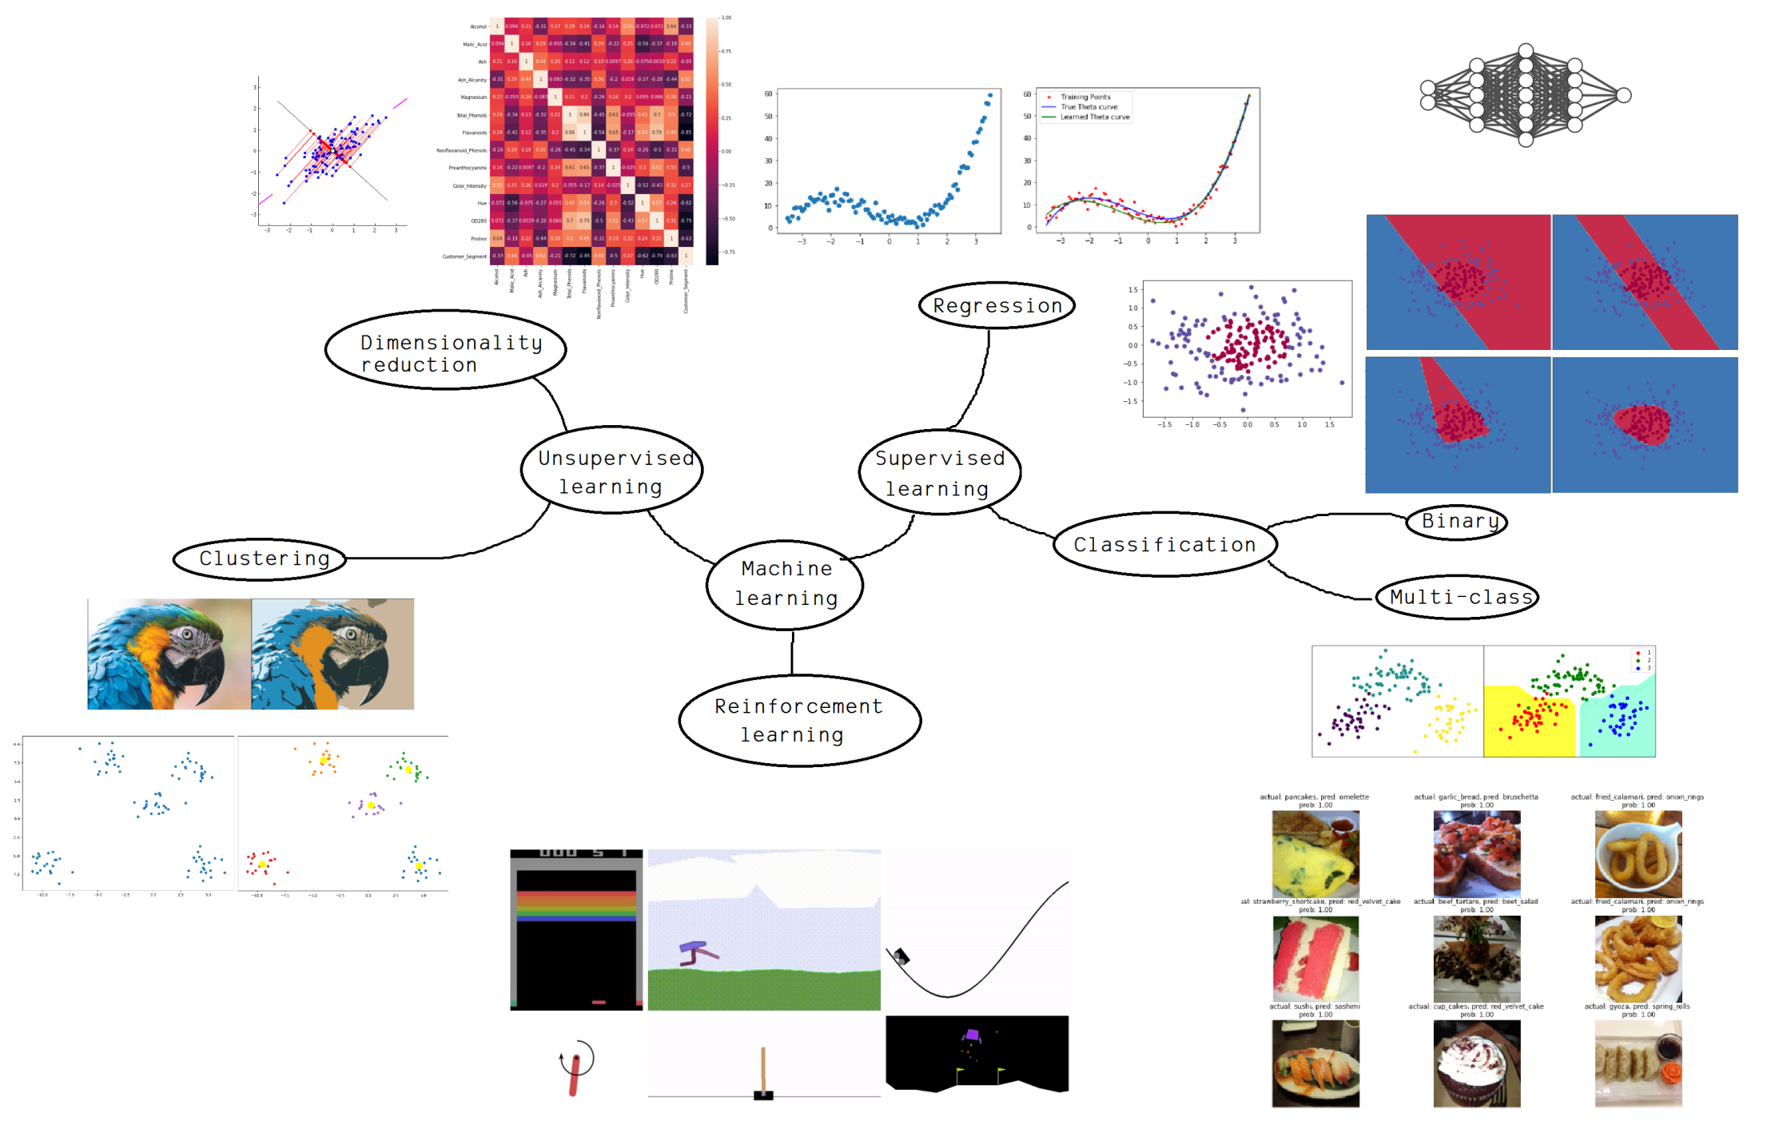
2.MACHINE LEARNING (ML) - OVERVIEW

Slide 5
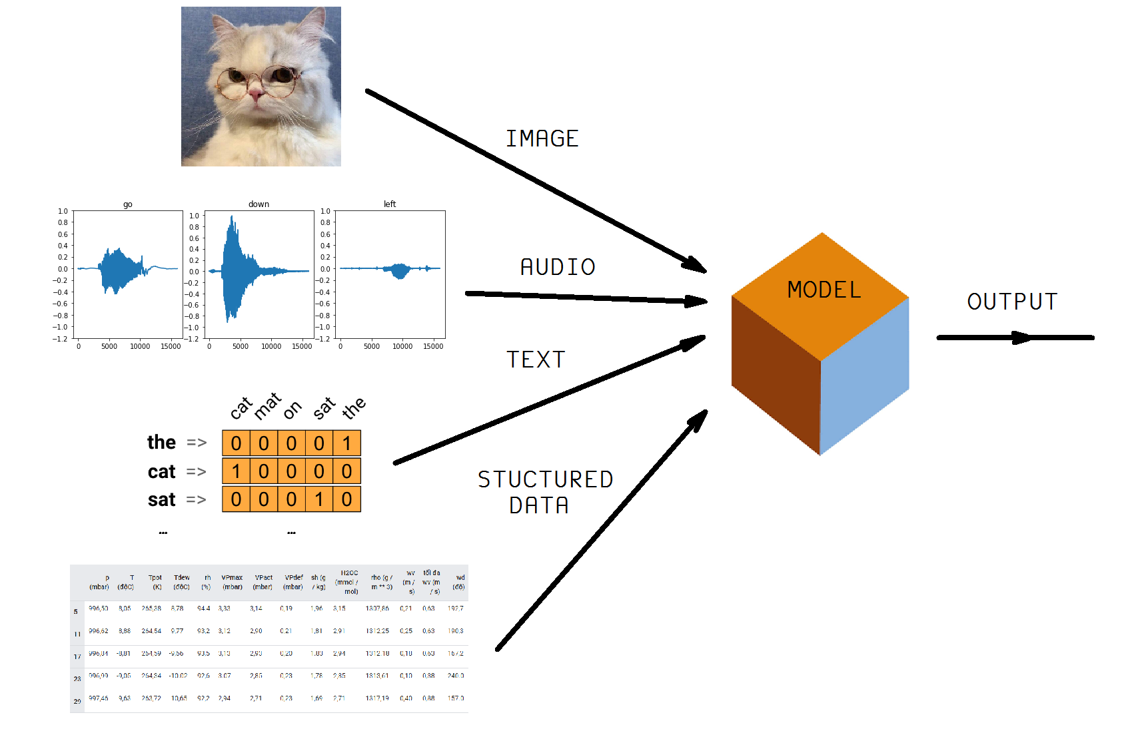
2.ML – KIND OF INFOMATION
https://www.tensorflow.org/tutorials

Slide 6
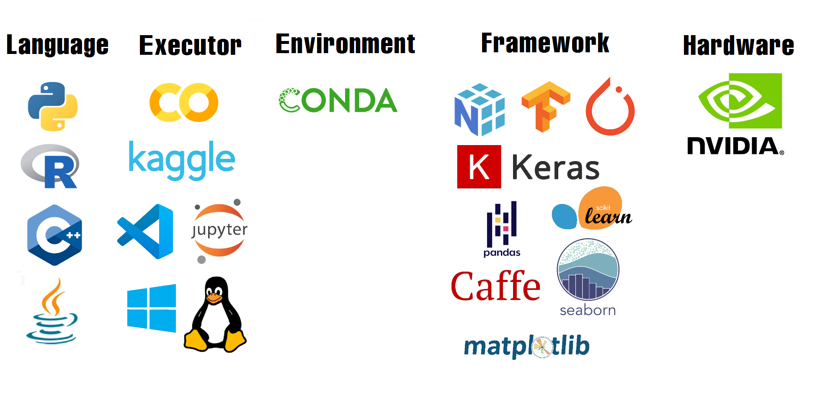
2.ML – TOOLS & PLATFORMS

Slide 7
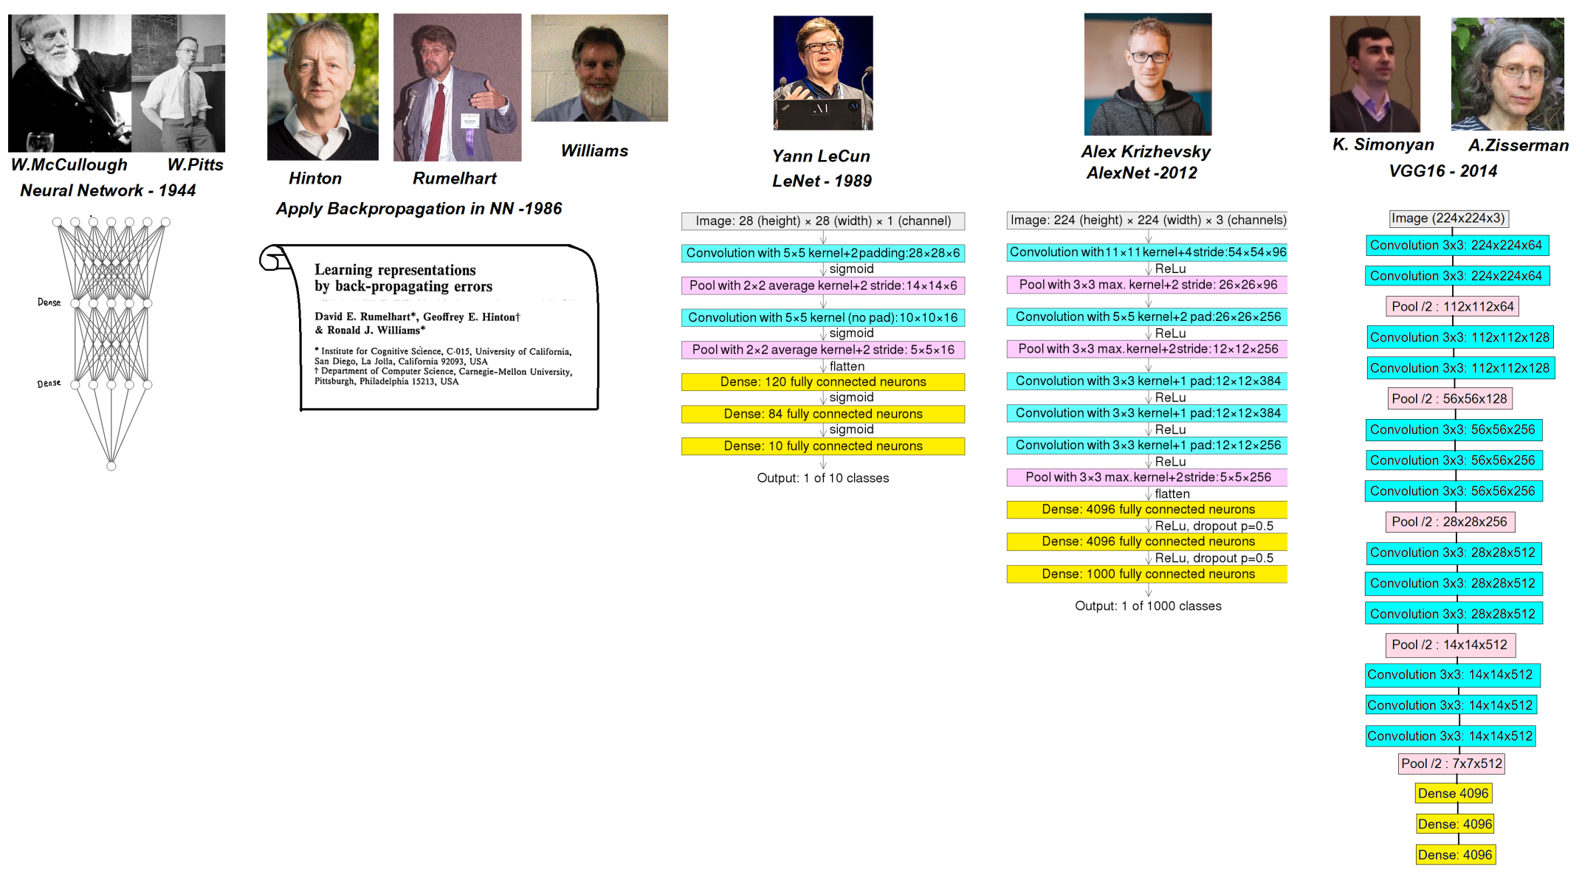
3.DEEP LEARNING

Slide 8
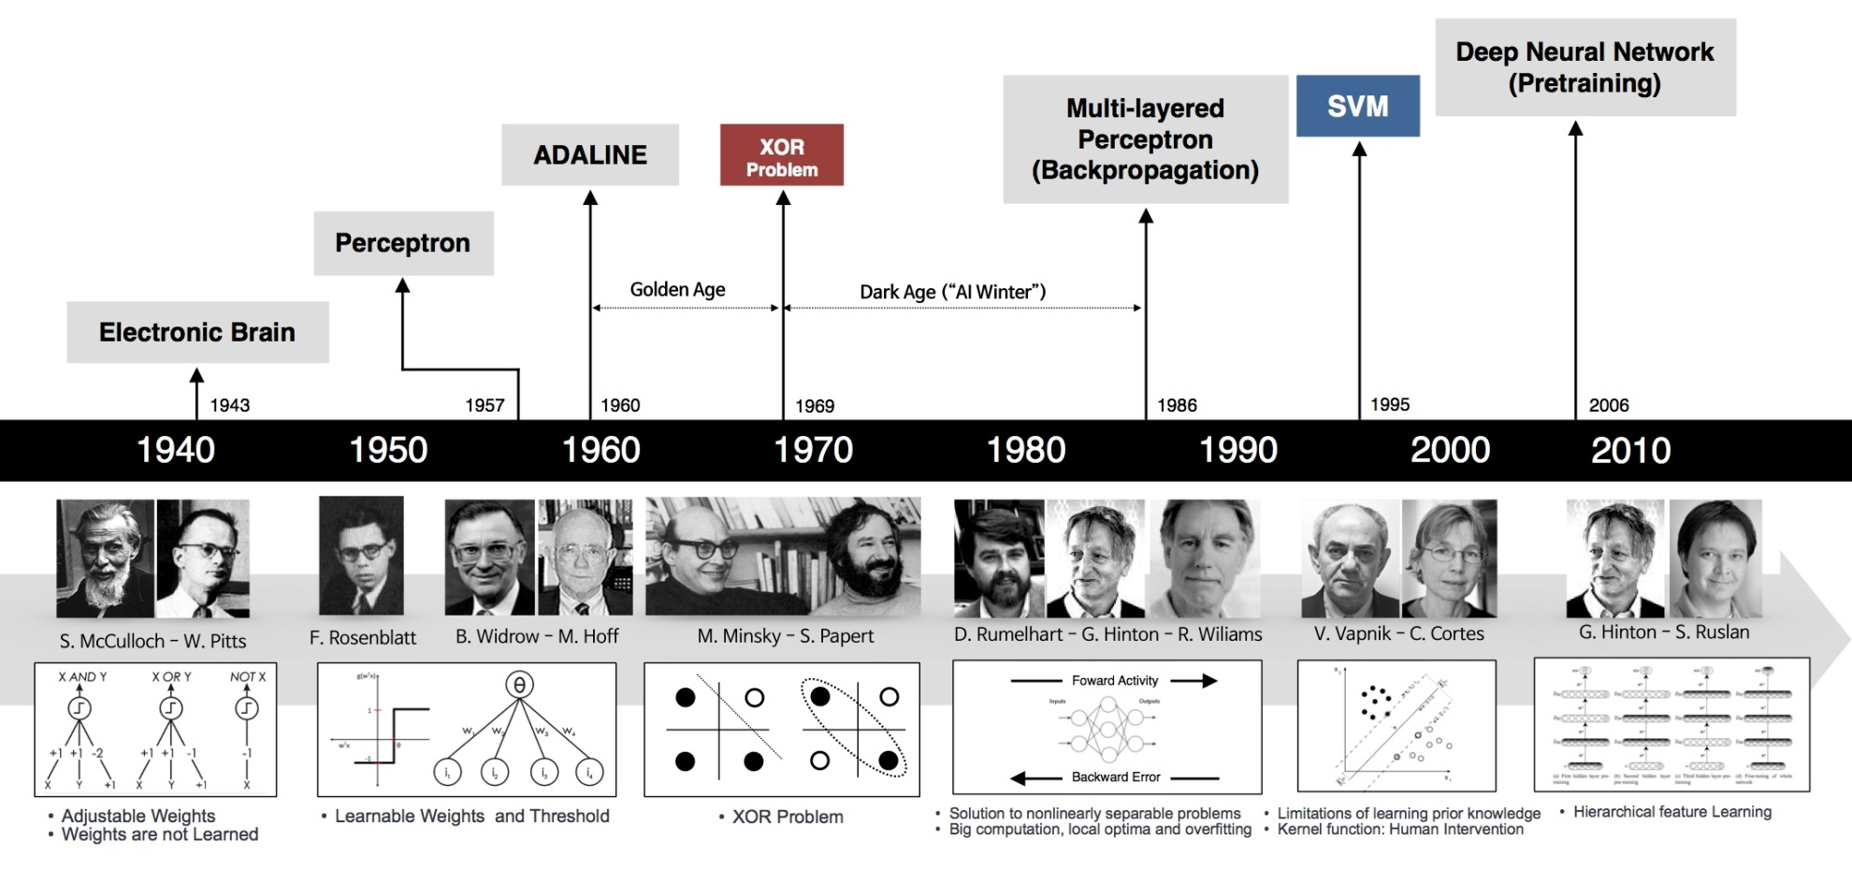
4.TIMELINE
https://machinelearningcoban.com/assets/35_deeplearning/nn_timeline.jpg

Slide 9
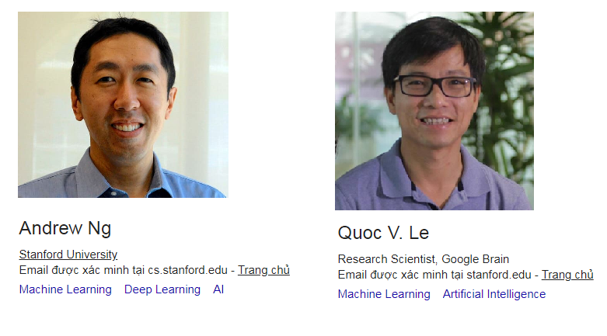
5.ASIA & VIETNAM
Andrew Ng Google scholar:
https://scholar.google.com.vn/citations?user=mG4imMEAAAAJ&hl=vi
Quoc Le Google scholar:
https://scholar.google.com/citations?user=vfT6-XIAAAAJ&hl=vi

