Slide 1

AI-Drone
Anthony Lock
Damian Pang
Dhugald Spry

Slide 2
Identify task
Goal – build a drone to go to an address to deliver a pizza
We found that in New Zealand there was no service to do a task similar to what we wanted to do

Slide 3
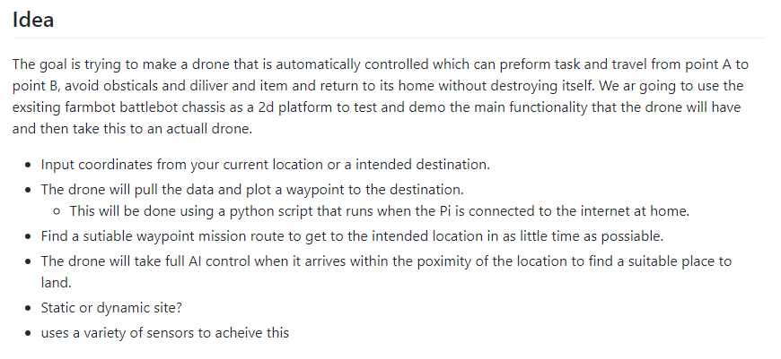

Slide 4
GitHub
https://github.com/Lockam1/AI-Drone
https://dronewebpage.netlify.app/
https://github.com/Lockam1/DroneWebPage
Throughout the process we contributed to these GitHub repos.
Although we didn’t have multiple sprints listed in the GitHubs we had meetings weekly to decide what tasks we wanted to complete that week, we had a schedule on the white board for the final half of the semester. (Erased for game jam ☹)

Slide 5
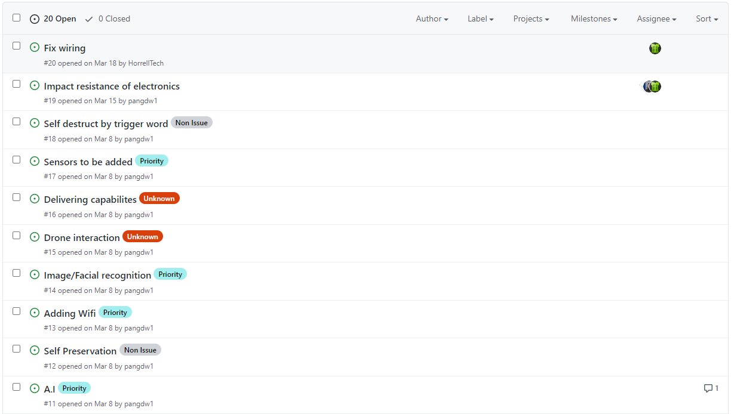
GitHub tasks / issue board

Slide 6
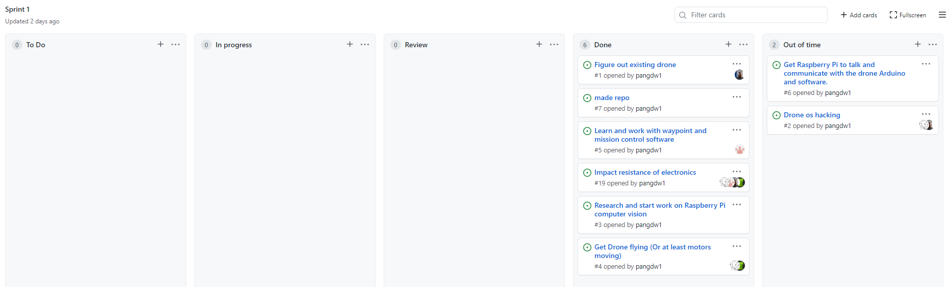
Main sprint Kanban

Slide 7
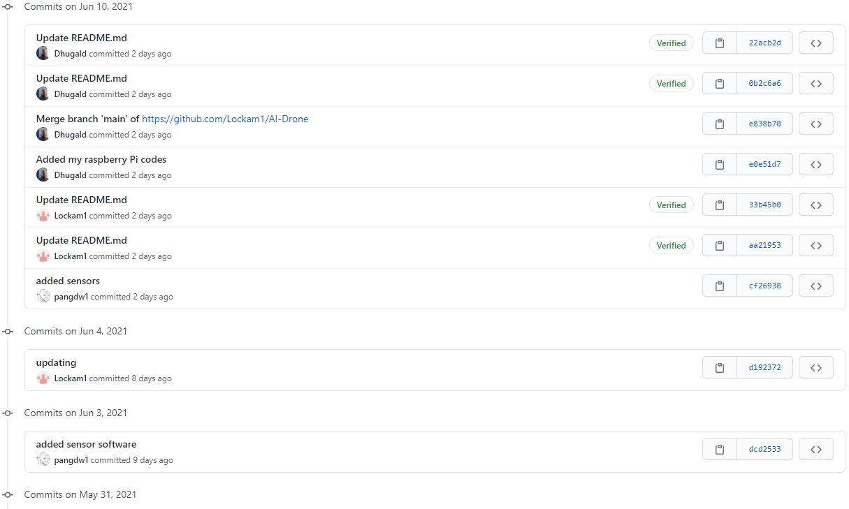
Latest commits

Slide 8
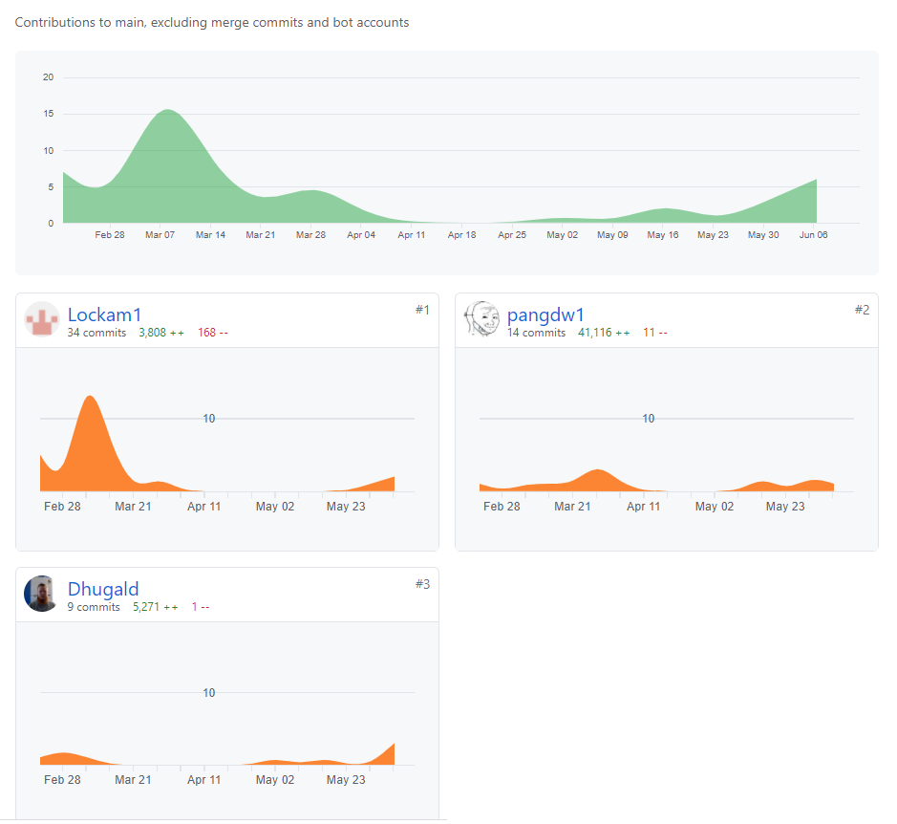
GitHub commits

Slide 9
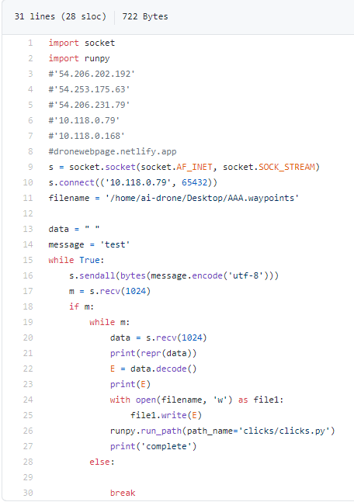
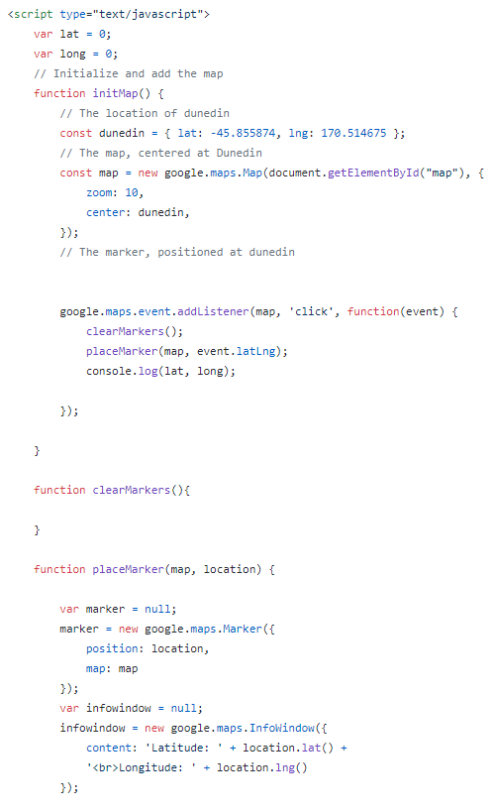
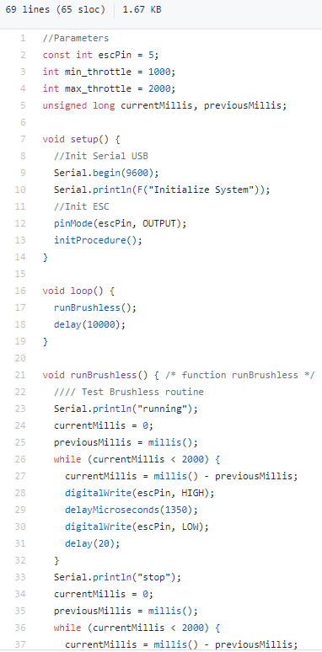
Samples of code

Slide 10
Research
A lot of the research we did was individual throughout the semester.
The initial research was finding parts that would work for the base of the drone we were given
A lot of research went into finding what would work for the software and hardware on the existing drone throughout the semester

Slide 11
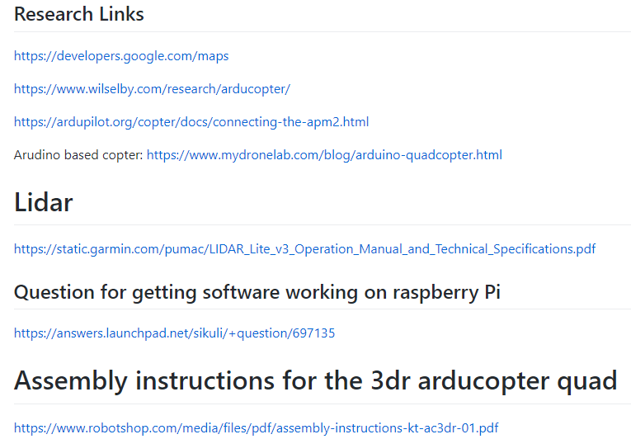
Research Links

Slide 12
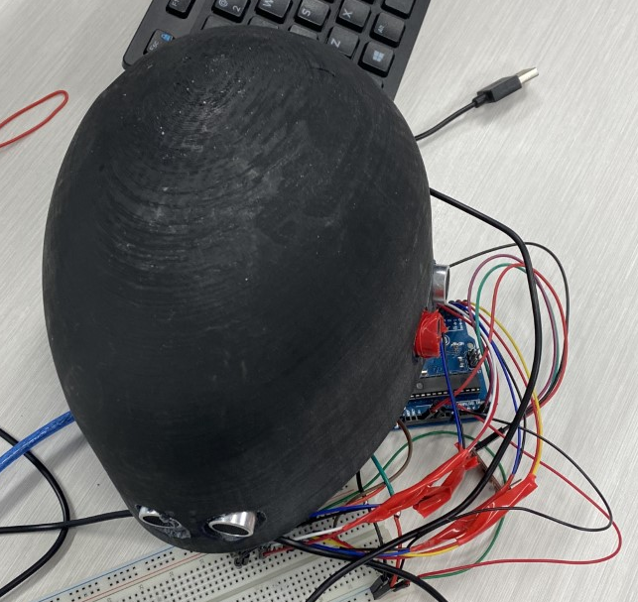
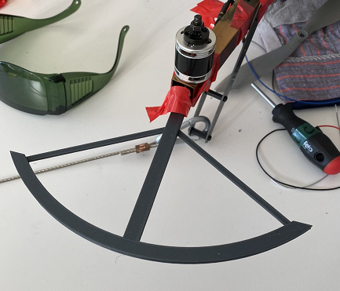
Part of the research was finding a way to protect the drone.
We decided to 3d model something to protect the rotors and to protect the boards on the drone.

Slide 13
Communication
Our main form of communication was through teams.
We had weekly meetings to decide on what we wanted to complete for the week.

Slide 14
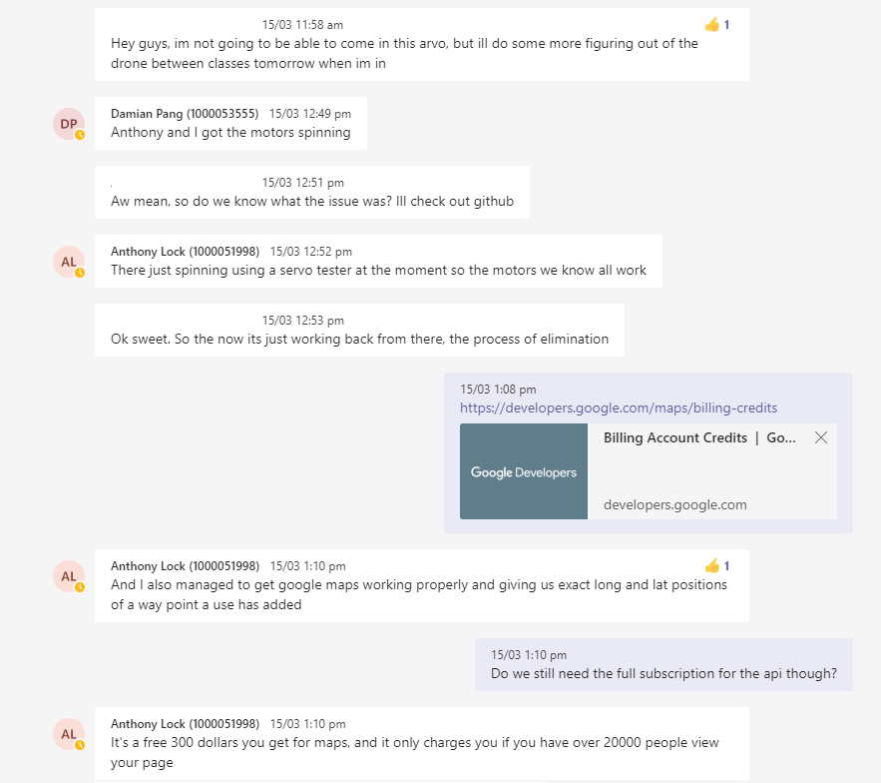
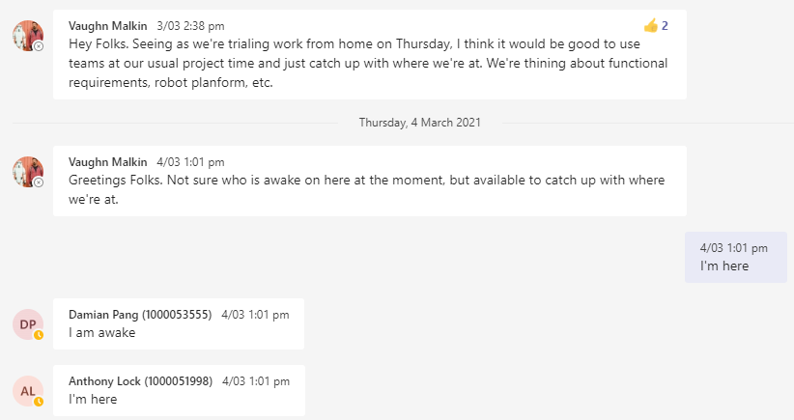
Teams chat

Slide 15
Unused features
Due to time constraints and losing a member we were unable to implement the AI and machine learning features into the drone, With more time we think that we would have been able to add the features we had planned on in the start.
We believe we have all the pieces of the drone ready but we aren’t able to put them together currently, due to location we were unable to get parts for the drone (IMU and Motors) to work with the drone software.
With more time we would have ideally invested into a new flight controller kit (DJI or Pixhawk)

