Slide 1

From Llm to AI Agent
Presentation Florian von Wieding

Slide 2
IDEA: RAG FOR STRATASYS DOCUMENTS
Use LLM pipeline to get information quicker from large technical PDFs
In this case from industrial 3d printers
Ended up in something a bit different…

Slide 3
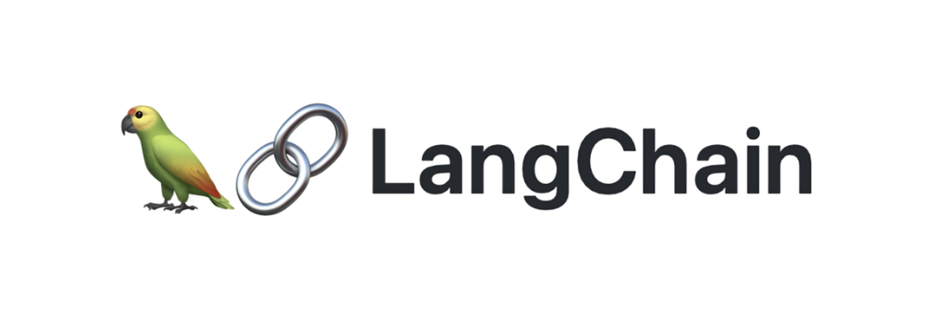



Technologies

Slide 4
Class CONFIG.py
🌐 API Access
How to connect to an external AI service (e.g. which key to use and what model to call).
💾 Where to Save Data
It specifies the folder to store the database used for searching documents.
🔍 How Much to Retrieve
It tells the system how many pieces of information to fetch when answering a question (e.g. 5 related chunks).
🎯 AI Behavior
How “creative” the AI should be (temperature)
How large each text piece should be (chunk_size)
How much overlap there should be between text chunks (chunk_overlap)
How long to wait before a request times out (request_timeout)
🧠 Which AI Model to Use
It defines which AI model is used to understand the text.

Slide 5
Class Ingest_docs.py
📥 Upload a PDF
The system starts by loading a PDF file and reading its content.
✂️ Break Text into Pieces
Since long documents are hard for AI to understand at once, the text is split into smaller chunks (like paragraphs or sentences).
🧠 Turn Text into “Embeddings”
Each chunk is converted into a numerical fingerprint (called an embedding) using AI. These fingerprints help the computer know what the text is about — even if different words are used.
💾 Save in a Smart Database (Chroma)
These chunks and their fingerprints are stored in a database, so the system can later search and find relevant parts quickly.
📁 Organize by Collections
Documents are grouped into collections, like folders, so different PDFs don’t get mixed up.
🧹 Delete or List PDFs
The tool can also list what’s been uploaded or delete PDFs and their data if no longer needed.
🌐 Provide Access to Stored PDFs
It gives a link to each stored PDF, so you can still view or download the original document.

Slide 6
RAG-GRAPH.py
🧠 What Is This?
This code builds a question-answering assistant for technical documents using AI. It can answer questions based on the content of uploaded PDFs — accurately and in detail.
This is called a “RAG Pipeline” — short for Retrieval-Augmented Generation. Think of it as an AI that first looks up the right information, then gives a smart answer.

Slide 7
RAG-GRAPH.py
🧰 How Does It Work?
1. 🔎 Retrieval
The system first searches the saved documents for pieces that are relevant to the question.
It doesn’t guess — it only looks in what was actually stored.
It collects useful parts (called chunks) and notes where they came from (e.g. page numbers).
2. 💬 Answer Generation
Then it sends the question and the found text pieces to an AI.
The AI uses that context to generate a detailed, reliable answer in German.
If the answer isn’t in the documents, it says so — no guessing allowed.

Slide 8
App.py
Streamlit to create Frontend as interactive web app
Upload PDF documents
Ask questions about the content
Get precise answers from AI
See which parts of the document were used
View the original PDF alongside the chat

Slide 9
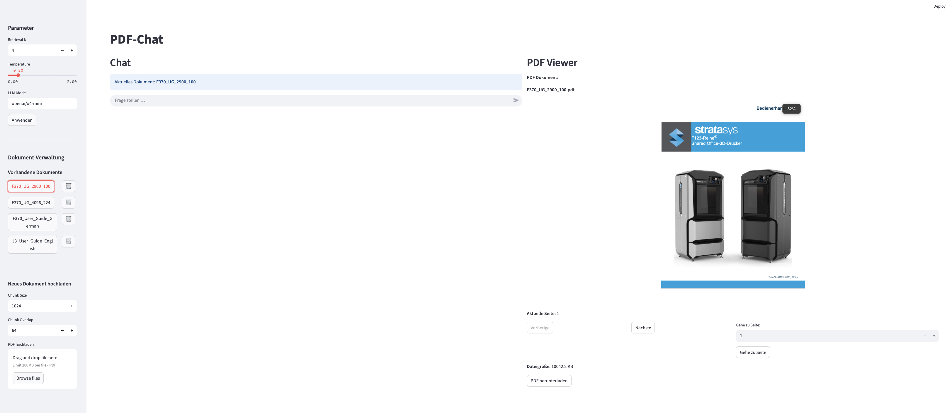
Overview

Slide 10
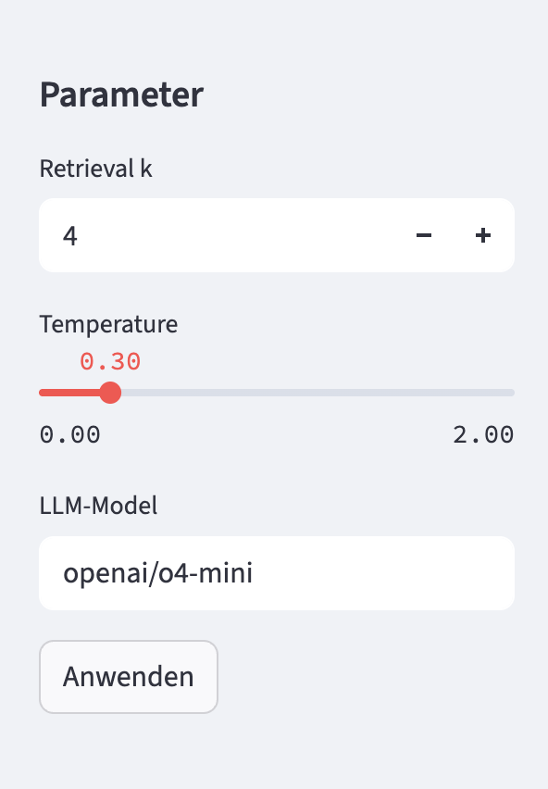
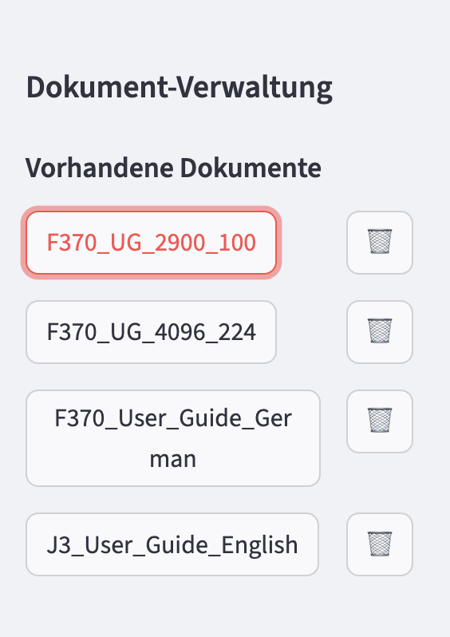
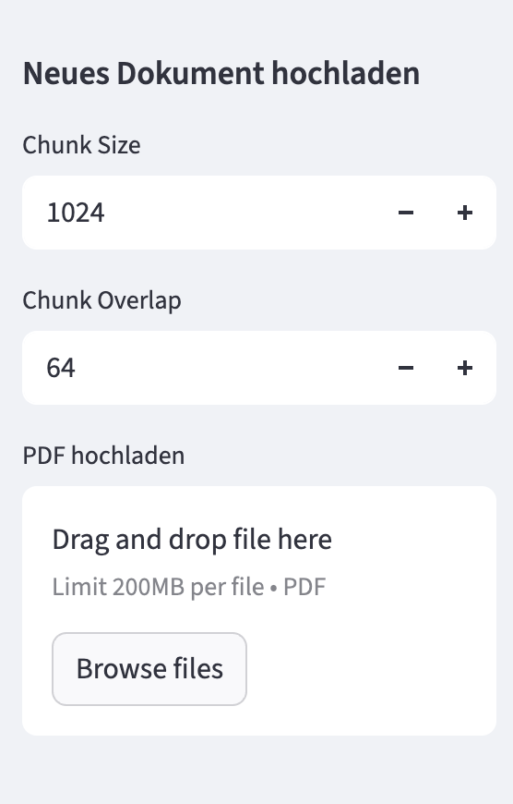
SIDEBAR

Slide 11
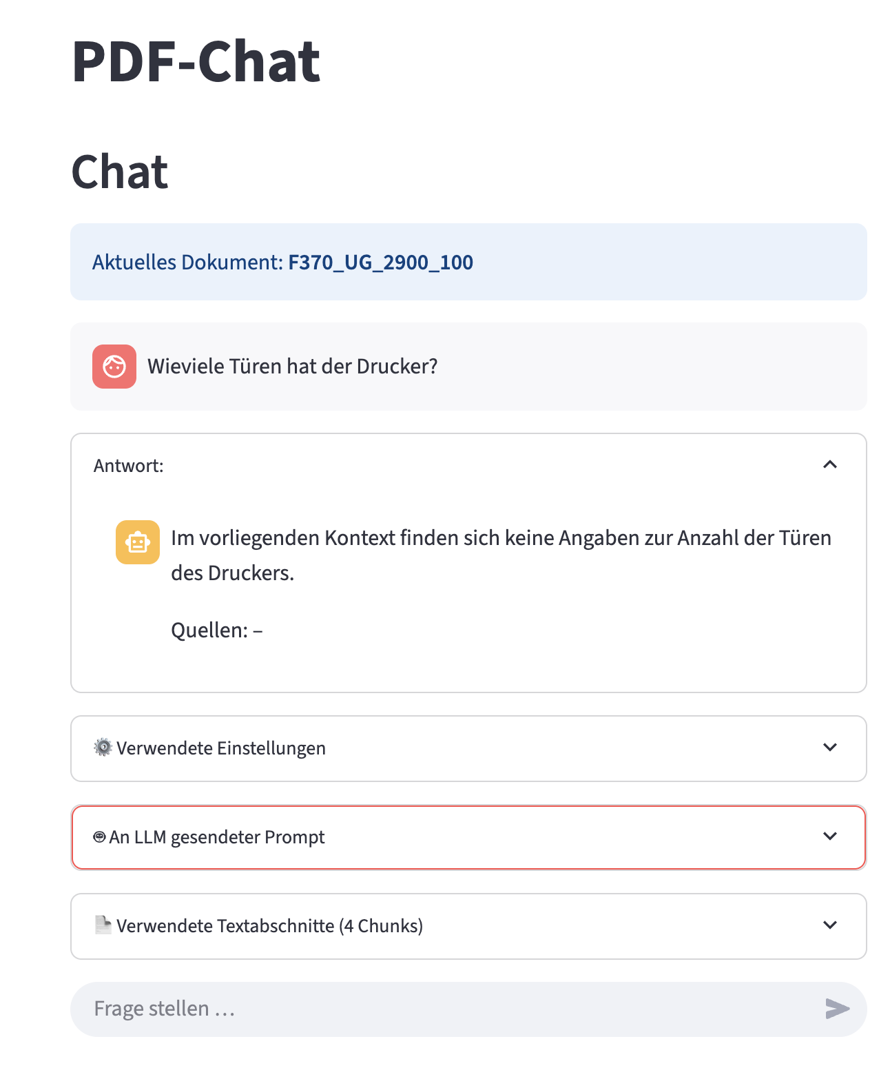
Chat

Slide 12
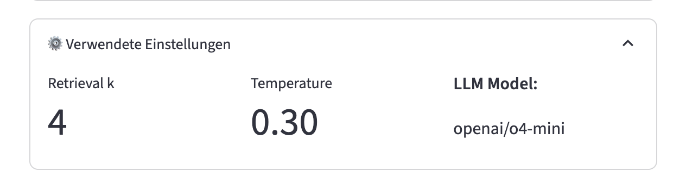
Chat – USED SETTINGS

Slide 13
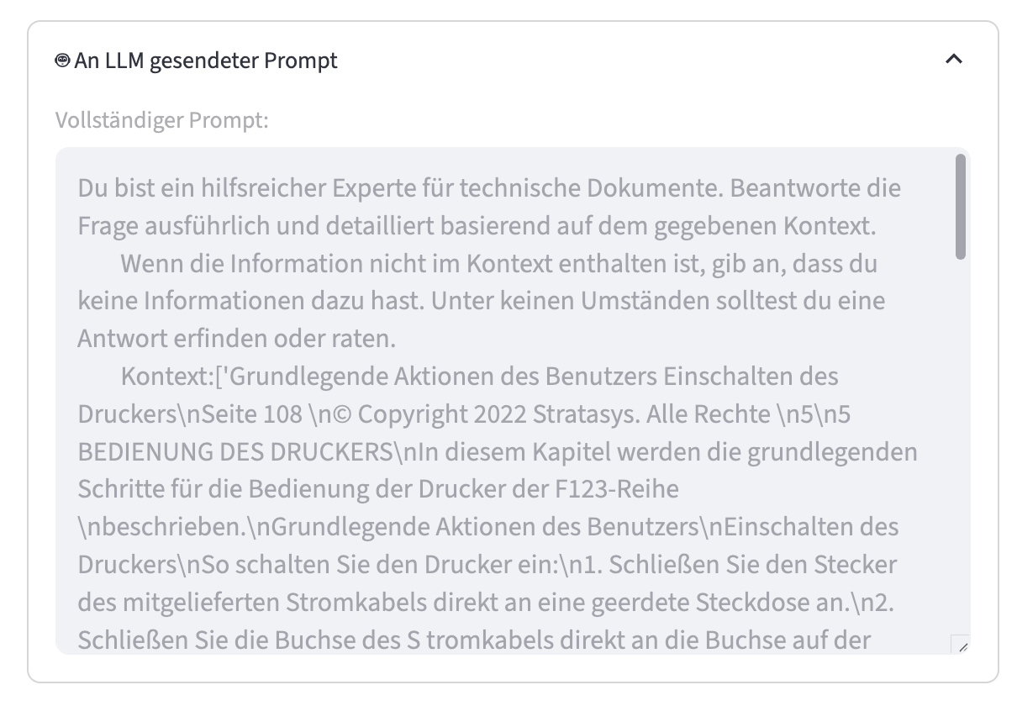
DATA SEND TO LLM

Slide 14
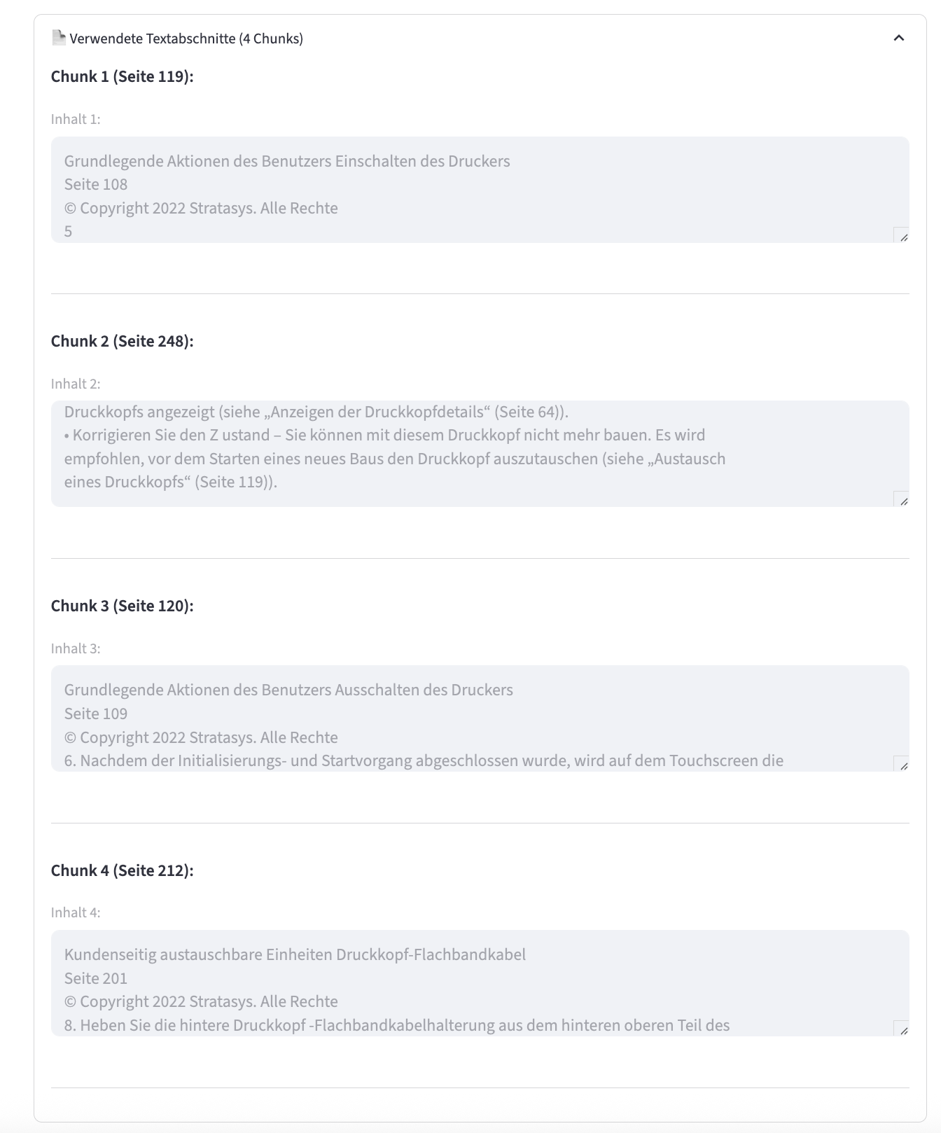
Used CHUNks

Slide 15
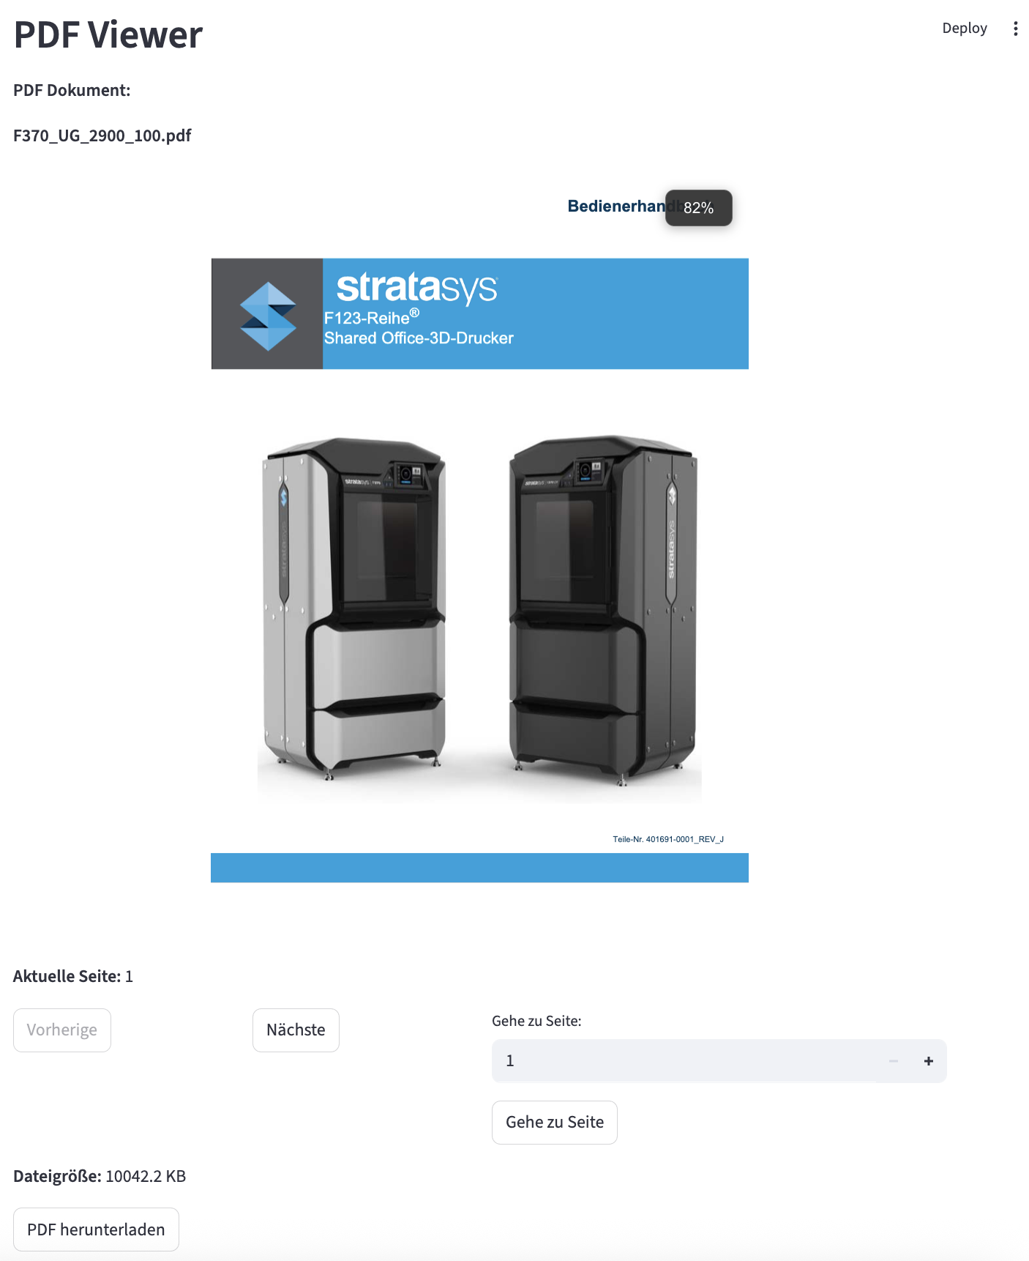
PDF Viewer

