Slide 1
AUCTION SITE
MPCS51205
Final Presentation
Group 6: Bottleneck

Slide 2
Development Methodology
For the purpose of learning microservices, we followed traditional Waterfall methodology, going through different phases of the project (e.g., requirement, design, implementation, verification, etc.) according to the course design.
Requirement Document
Strategic Design
Implementation
Verification
Produced a draft of Domain Vision Statement, outlining the central value the product will provide from a competitive point of view
Designed a Context Map based on our current conceptual approach towards a strategic architecture
Produced a draft of a Microservices Architecture Blueprint (page 2) by leveraging our Context Map and Domain Vision Statement and
Defined Messages and Service Models following API-FIRST principle
Created User Stories for each services
Drafted Domain Model for Bounded Context
Set up collaboration repository on GitHub
Divide and conquer by microservice
Front-end: Chip
Authentication: Chip
User: Kenny
Notification: Kenny
Item: Xiangshi
Auction: Xiangshi
Payment: Michelle
Delivery: Michelle
Revise User Story and Microservice scope to reflect the planning changes during the process
Trouble-shooting / debugging
More iterations

Slide 3
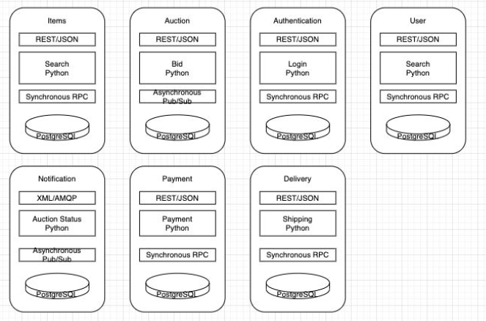
Context Map & High-Level Architecture

Slide 4
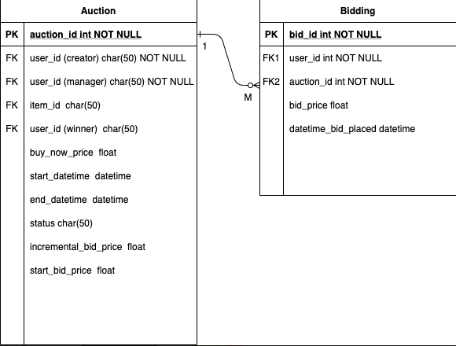
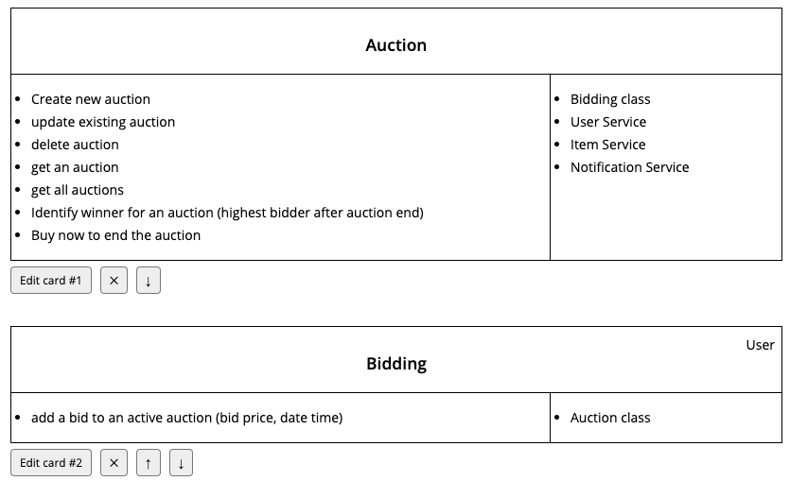
Microservice Architecture – Auction Service
Domain Model
CRC

Slide 5
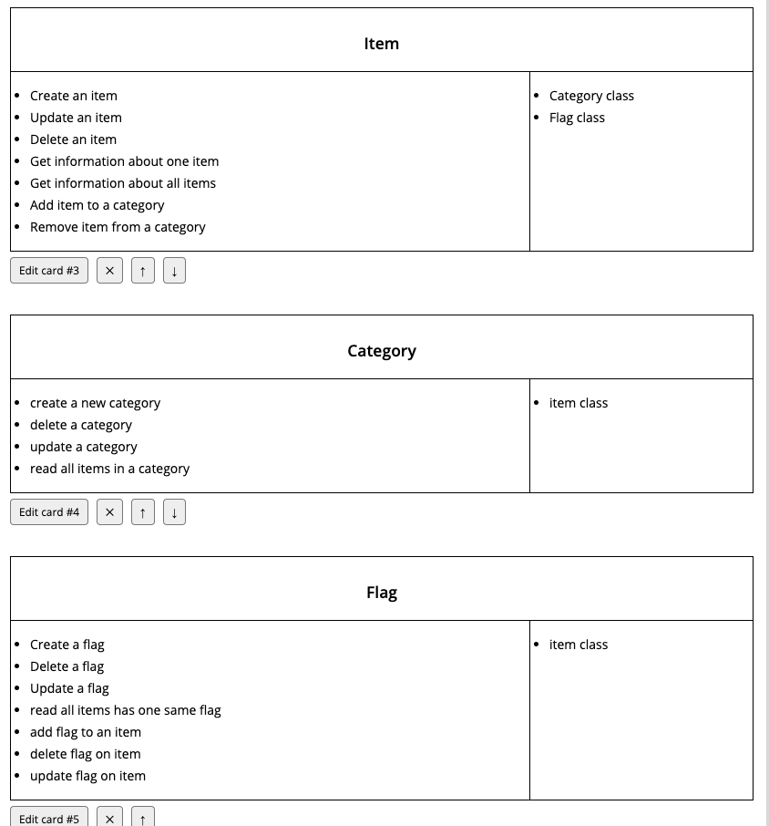
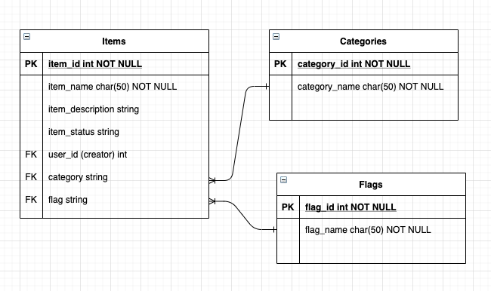
Microservice Architecture – Item Service
Domain Model
CRC

Slide 6
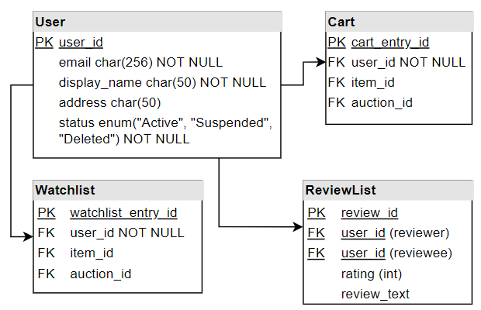
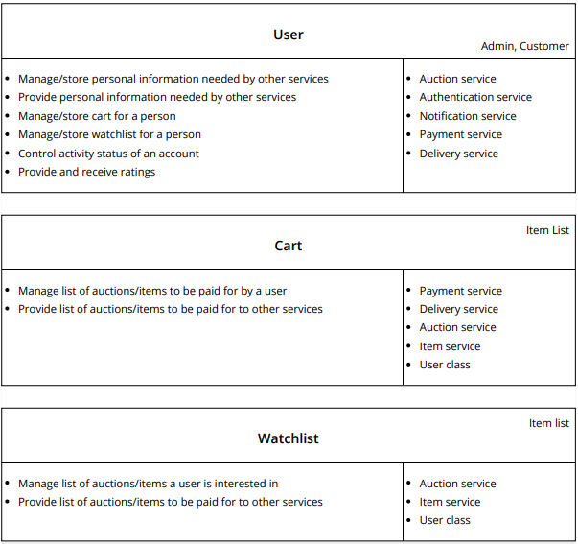
Microservice Architecture – User Service
Domain Model
CRC

Slide 7
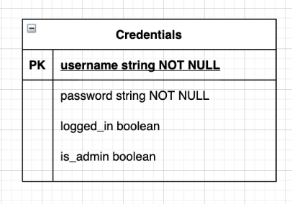
Microservice Architecture – Authentication Service
Vocabulary & User Story
CRC
Vocabulary
Login: A request to begin a session.
Logout: A request to end a session.
Session: A duration of activity during which a user is able to exchange information with the site.
Password: A string of characters connected to a user that verifies the user's identity, necessary for completing a login.
Username: The display name of a user to other users on the site.
role A label attached to a user that is associated with a set of permissions, allowing access to certain use cases on the site.
User Stories
As a user, I want to login to interact with the site.
As a user, I want to logout to end my session when I am done with my business on the site.
As a site admin, I want to ensure only admins can access certain features on the site.
As a site admin, I want to perform an action that is reserved for site administrators

Slide 8
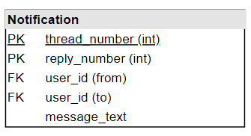
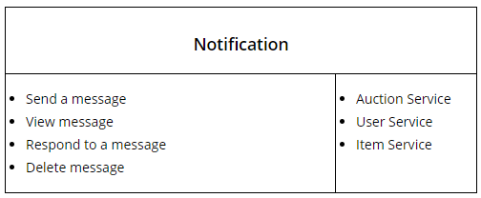
Microservice Architecture – Notification Service
Vocabulary & User Story
CRC / Domain Model

Slide 9
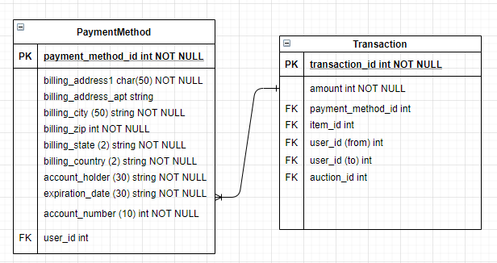
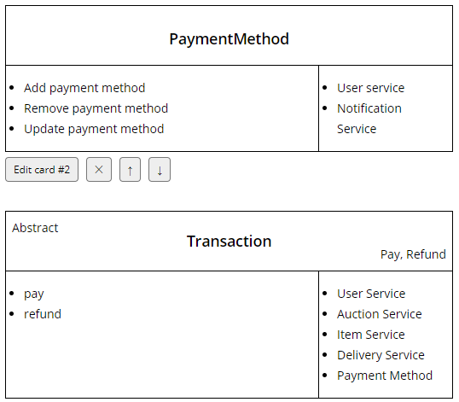
Microservice Architecture – Payment Service
Domain Model
CRC

Slide 10
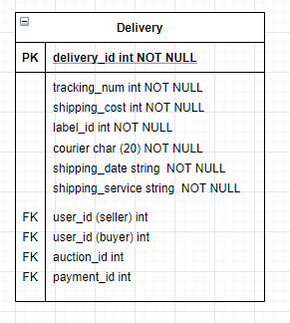
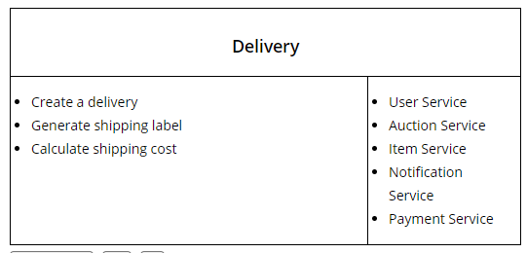
Microservice Architecture – Delivery Service
Domain Model
CRC

Slide 11
Pain Points
Technical
Organization
Getting Started
The Challenge: Starting from scratch, convert theoretical knowledge into practices
Our solution: Study external resource and information (e.g., YouTube, StackExchange, etc.) and ask our classmates for help
Asynchronous Implementation?
The Challenge: ….
Our solution: …..
Remote Class
The Challenge: Unable to whiteboard (which would be much more productive) and collaborate in-person
Our solution: Active communication through Zoom meeting, Google Doc sharing and Whatsapp / Email

Slide 12
During Implementation
What we thought would be easy that turned out hard
What you thought would be hard that turned out easy
[….]
…
…
[….]
…
…
[….]
…
…
[….]
…
…

Slide 13
Our Product Moment & Discovery

Slide 14

Thank You!

