Slide 1
$236,451 per door
The federal penalty for a single ADA repeat violation (90 FR 29445, July 2025)
8,800
ADA Title III federal lawsuits filed in 2024 (+7% YoY, Seyfarth Shaw)
Max federal penalty per repeat violation: $236,451 ($118,225 first)
28.7% of U.S. adults live with a disability (~70M, CDC 2022 BRFSS)
The only way to find violations today: one person, a tape measure, a clipboard.
We built the measurement layer for a better way.
Team Lead

Slide 2
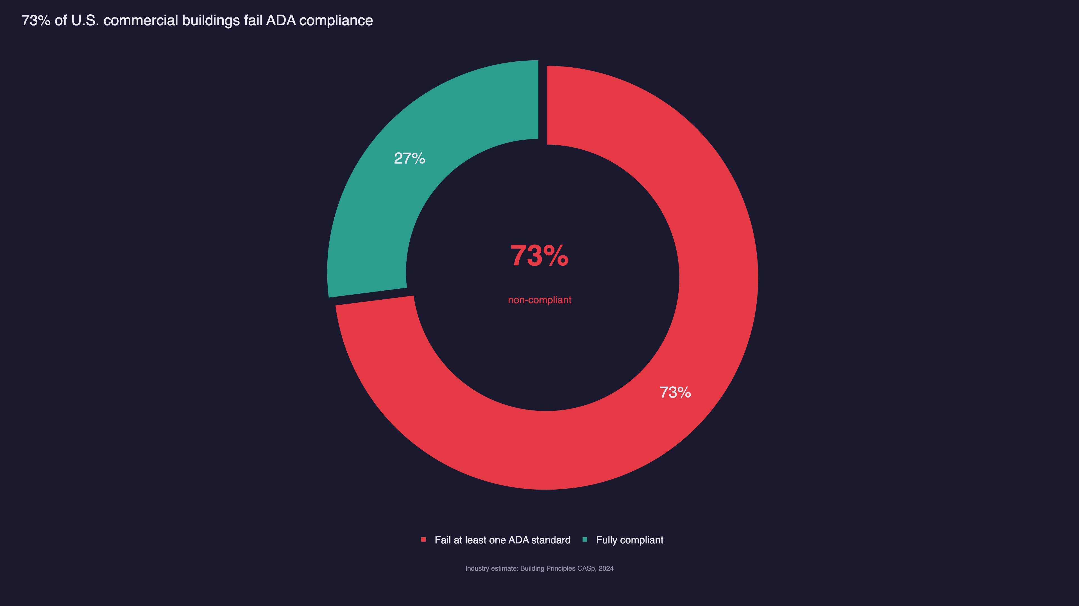
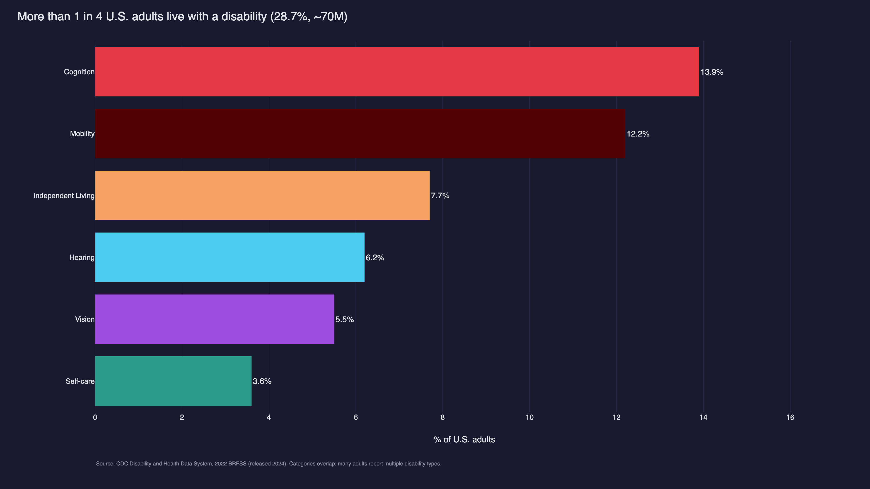
The problem: who even measures this?
Industry estimate: ~73% of U.S. commercial buildings fail >=1 ADA standard (Building Principles). Only 32% of commercial property buyers ask (Focus Building Inspections). CASp audit: $800-$50,000+ depending on scope, 2-5 days on-site.
Team Lead

Slide 3
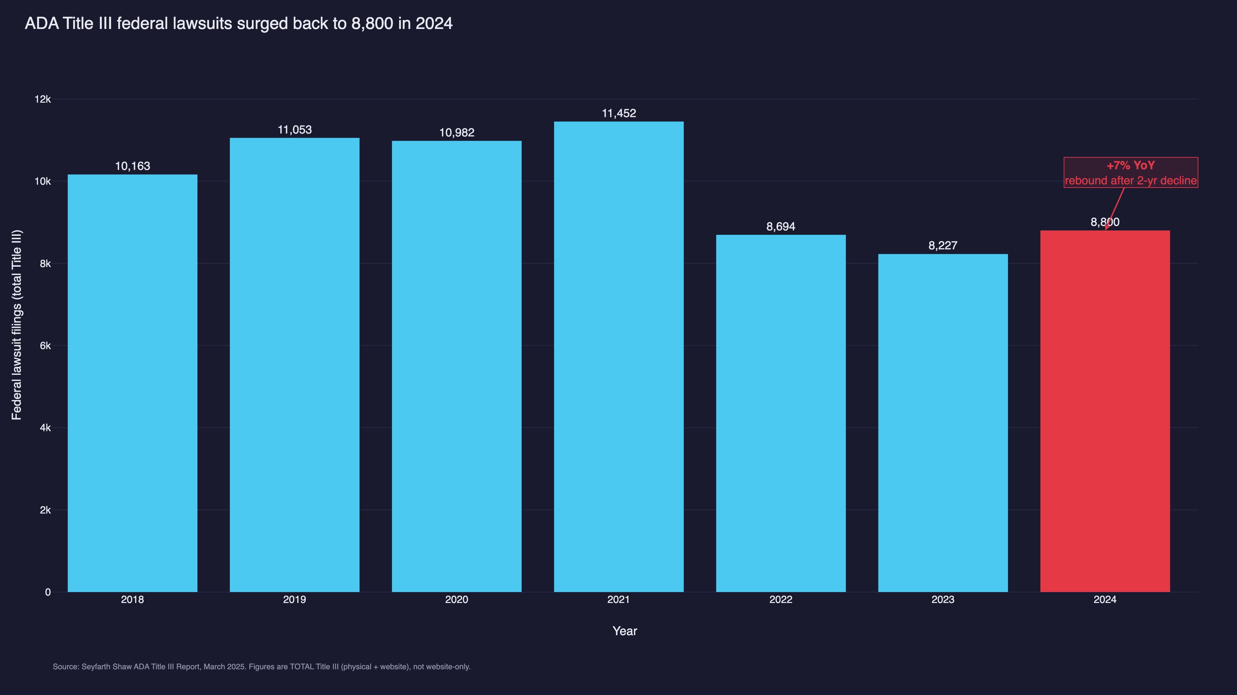
Why now: enforcement is accelerating
8,800 filings in 2024
CA: 3,252 (So Cal Equal
Access Group filed 2,598)
NY: 2,220. FL: 1,627. TX: 224.
DOJ Title II rule:
WCAG 2.1 AA by April 2026
for public entities,
TAMU included.
Physical access pressure follows.
Member 2

Slide 4
STAR: a platform for continuous ADA measurement
Distributed robot + compliance engine, ROS2 Jazzy, open source
Platform (demo-ready today):
- Raspberry Pi 5 + custom RX72N PCB
- RPLiDAR C1 + IMX219-83 stereo + 2 IMUs
- slam_toolbox async + Nav2 + frontier explore
- SPI 10 Mbps + HARQ/FEC + nanopb
- 143 ROS2 tests, 0 failures
Compliance engine (new for this capstone):
- Ramp slope >1:12 [IMPLEMENTED]
- Trip hazard >0.25" [STRETCH]
- Path width <36" [STRETCH]
- Ramp width / landing / door clear / threshold [ARCHITECTED]
- PDF audit report at scan complete
Member 2

Slide 5
Tech stack
Hardware
- Raspberry Pi 5 (ROS2 Jazzy + UI + compliance engine)
- Custom RX72N PCB (ThreadX, 250 Hz PID, 4 MB Flash / 1 MB SRAM)
- SLAMTEC RPLiDAR C1 (360, 10 Hz, 12 m)
- Waveshare IMX219-83 (dual 8 MP, 60 mm baseline)
- BNO055 IMU (on chassis) + ICM20948 IMU (on camera)
- 4x HC-SR04 ultrasonic + DS18B20 + BMP280
- 4x DFRobot FIT0520 motors + 4x TI DRV8263H drivers
- GPTW 32-bit 20 kHz PWM, MTU/TPU quadrature encoders
Software
- ROS2 Jazzy (star_bringup, star_spi_bridge, star_safety_monitor)
- slam_toolbox async + robot_localization EKF
- Nav2 (NavFn A* + DWB) + m-explore-ros2 frontier
- Compliance engine: Python + Open3D + OpenCV + reportlab
- Gateway: Go + gRPC-Web + WebSocket + HTTP
- UI: React 19.2 + Vite + TypeScript + Zustand (20 panels)
- Firmware: C23, ThreadX, nanopb, HARQ/FEC
- Open source: github.com/Locked-Inc/STAR
Hardware Lead

Slide 6
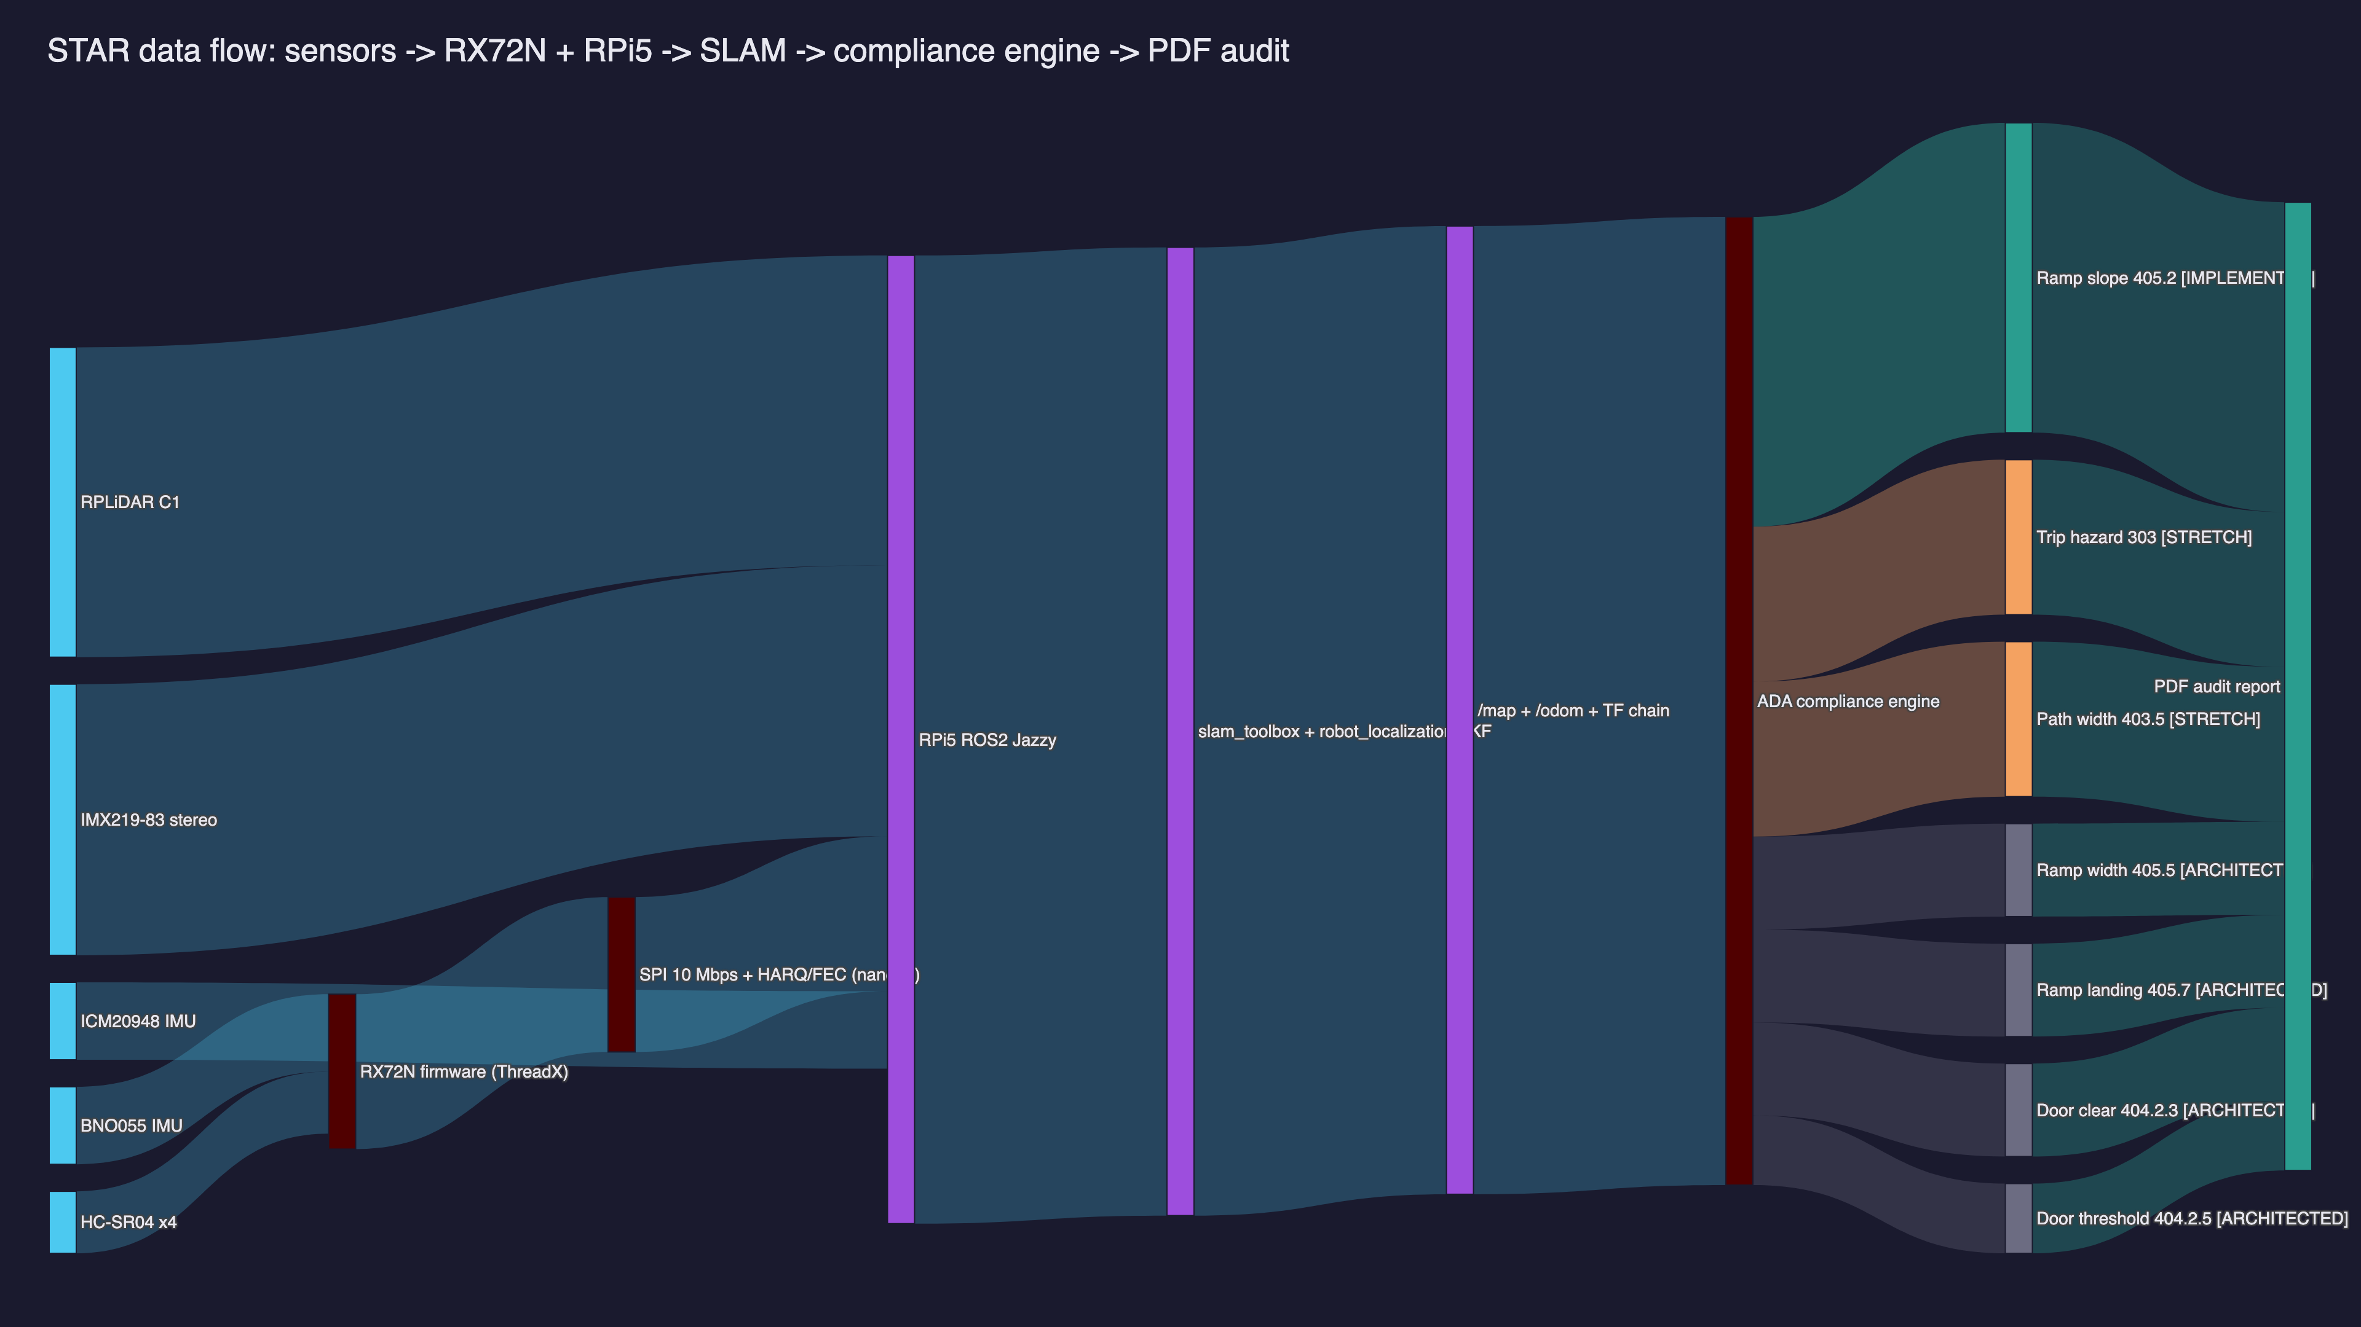
System architecture (real pipeline)
Hardware Lead

Slide 7
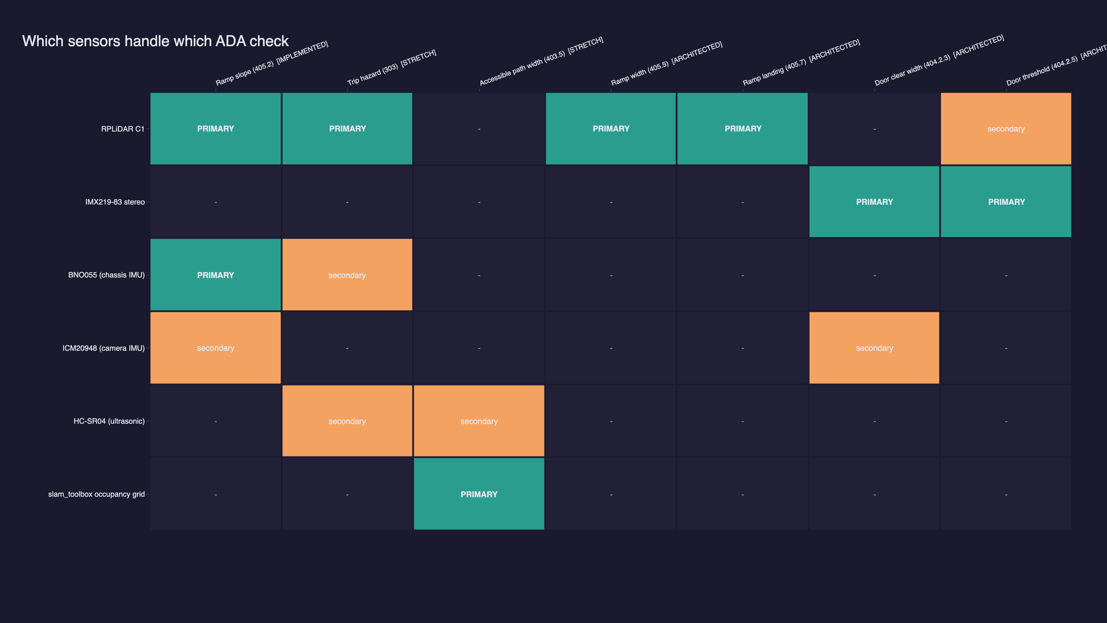
Seven ADA checks: status vs. sensor
Software Lead

Slide 8
Demo: autonomous explore + live ramp-slope check
(or pre-recorded backup)
Robot autonomously explores the on-campus hallway (no floor plan)
slam_toolbox async builds the map on the projected RViz feed
Nav2 handles cost-map inflation around the 32 cm robot envelope
Ramp is encountered: LiDAR plane normal and BNO055 pitch agree within 0.5 deg
Slope > 4.76 degrees -> violation flagged, pose logged, CSV row written
Scan completes: compliance engine emits audit_report.pdf with the flag
Software Lead

Slide 9
Validation: what we can defend
Platform (complete):
- 143 / 143 ROS2 tests passing
- slam_toolbox map at 0.5 Hz on RPi5
- Full TF: map -> odom -> base_link -> laser_frame
- Nav2 autonomous goals executed
- SPI frame protocol at 1.6% utilization
Compliance (implemented one check):
- Wixey WR300 angle-gauge ground truth
- BNO055 vs. LiDAR-plane-normal agreement
- On-campus ramp, n = 5 to 30 sessions
- Numbers are what we measured, not what we hoped for
Software Lead

Slide 10
Broader impact
TAMU College Station: 5,200 acres, hundreds of buildings.
Any CASp audit pass is a six- or seven-figure cost and runs months of specialist time.
STAR re-uses the same robot across buildings at amortized hardware cost.
Stakeholder fit:
- Department of Disability Resources (471 Houston St, Student Services Bldg, Suite 122) - user advocacy
- Office of Risk, Ethics & Compliance (orec.tamu.edu/ada) - compliance program owner
- Facilities Services / Office of the University Architect - remediation execution
Code released open source: github.com/Locked-Inc/STAR
Same economic shift cybersecurity scanners brought to IT compliance a decade ago.
Team Lead

Slide 11
Future work (architected, not vaporware)
Complete the architected ADA checks (ramp width, landing, door clear, threshold)
RTAB-Map full LiDAR + RGB-D fusion (in-progress on main)
Multi-floor traversal via elevator integration
ML fixture recognition (restrooms, fountains, signage) for ADAS Chapter 6
Outdoor mode (GPS + RTK) for curb ramps and accessible parking
Fleet management: campus-as-a-service deployment pilot with Facilities Services
Member 2

Slide 12
Team Locked Inc.
github.com/Locked-Inc/STAR - Pilot building partners welcome
Team Lead - research, system integration, presentation
Member 2 - motor control, electrical, PCB
Hardware Lead - sensor integration, mechanical, validation
Software Lead - ROS2, compliance engine, SLAM
Questions?
All four

