Slide 1


Apr 28, 2026
STAR
Spatial Topography
Accessibility Robot
Locked Inc. ESET 420 Dr. Logan Porter
Texas A&M University
ESET Senior Capstone, Spring 2026
Notes:
Hello, we are Locked Inc. STAR is the Spatial Topography Accessibility Robot -- an autonomous indoor robot that audits buildings for ADA Title III compliance. Today we will walk you through the problem, our solution, the system architecture, validation results, and a live demo.

Slide 2
$236,451 per door
Federal civil penalty per repeat ADA violation, after the July 2025 Federal Register inflation adjustment.
8,800 federal Title III lawsuits were filed in 2024 (Seyfarth Shaw tracker), continuing a sustained 9k-11k baseline since 2018.
Manual audits cost $800-$50,000+ per facility and take days. The math does not close.
$118,225
first violation
$236,451
each subsequent
Notes:
The federal civil penalty for a repeat ADA Title III violation is now $236,451 per occurrence as of the July 2025 Federal Register adjustment. In 2024 there were 8,800 federal Title III lawsuits filed. Manual audits by certified inspectors cost between $800 for a small store to over $50,000 for a campus, and take two to five days each. The economics push everything toward automation.

Slide 3
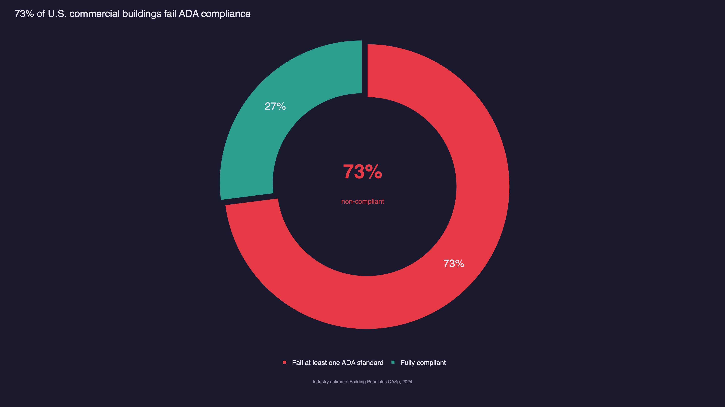
Who measures this?
Per Building Principles CASp (2024 industry estimate), 73 percent of U.S. commercial buildings fail at least one ADA standard.
12.2 percent of U.S. adults (CDC) report mobility disabilities -- approximately 31 million people.
Notes:
Despite decades of legislation, 73% of public-facing facilities fail at least one ADA standard. 31 million Americans have mobility disabilities. Only 32% of property buyers ask about ADA at all. The audit gap is real and it is structural.

Slide 4
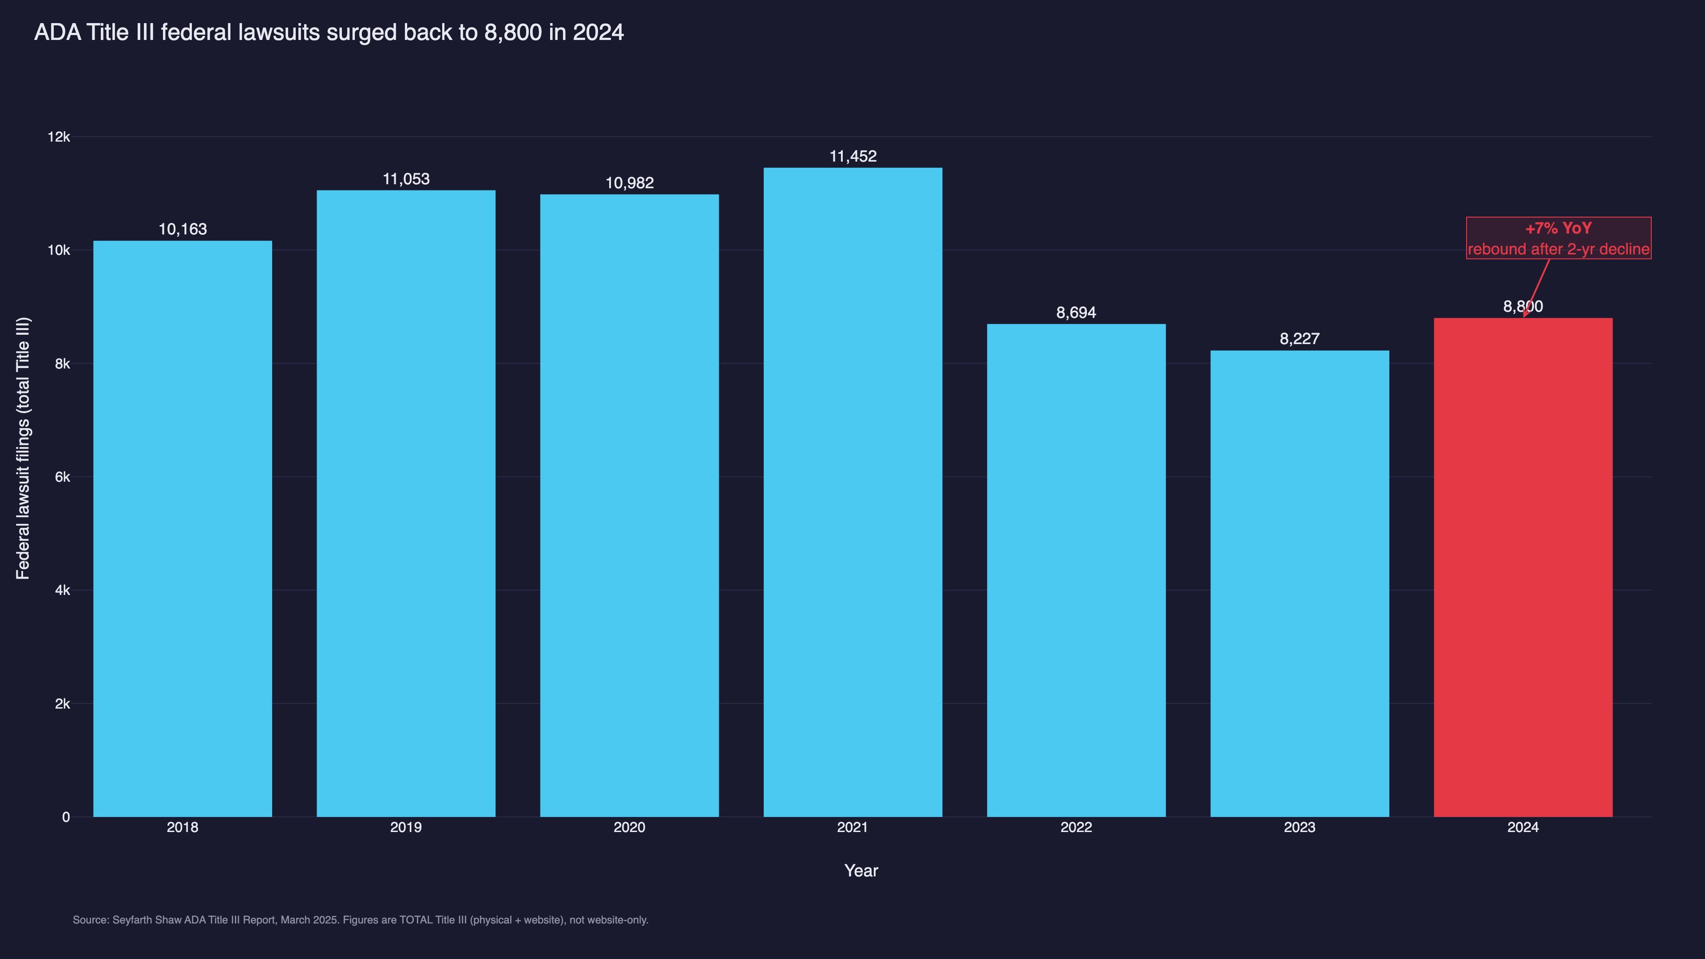
Enforcement is accelerating
Federal Title III filings: 10,163 (2018) -> peak 11,452 (2021) -> rebounded to 8,800 in 2024.
California leads with 3,252 filings in 2024; Texas filed 224.
Title II web-accessibility rule (DOJ Apr 2024, deadlines extended Apr 2026 to Apr 2027 and Apr 2028) coincided with a 7 pct year-over-year rebound.
Notes:
Filings have stayed in the 8,000 to 11,500 per year band for seven years now. They peaked at 11,452 in 2021, fell, and rebounded to 8,800 in 2024 - a 7% jump - driven in part by the new Title II web accessibility deadlines for state and local entities. California is the clear leader with 3,252 filings; Texas had 224. Enforcement is not fading, it is becoming routine.

Slide 5
Tech stack
HARDWARE
RPLiDAR C1 (12 m, IP54)
IMX219-83 stereo cameras
BNO055 IMU, HC-SR04 sonar
Renesas RX72N (240 MHz)
Raspberry Pi 5
DRV8263H driver x4
5S 18650 battery pack
SOFTWARE
ROS 2 Jazzy on Ubuntu 24.04
slam_toolbox (mapping mode)
Nav2 + RegulatedPurePursuit
robot_localization EKF
Go gateway with nanopb
Python compliance engine
C23 firmware on ThreadX
VALIDATION
60 firmware ctests, 100 pct libs/
74.0 pct Go gateway cov, gate 65
14 ROS 2 colcon tests
12 compliance pytest modules
9 manual PCB validation checks
Wixey WR300 +/- 0.1 deg ground truth
Notes:
STAR is a multi-language stack. Hardware: a custom 6-layer PCB built around the Renesas RX72N for real-time motor control, a Pi 5 for autonomy, RPLiDAR C1 for 2D scan, stereo cameras for 3D, BNO055 IMU. Software: ROS 2 Jazzy for autonomy, slam_toolbox plus Nav2 for navigation, a Go gateway for telemetry, a Python compliance engine. Validation: 60 firmware Unity tests at 100% library coverage, 74% Go coverage gated at 65%, 14 ROS 2 tests, 12 pytest modules, plus formal manual PCB validation.

Slide 6
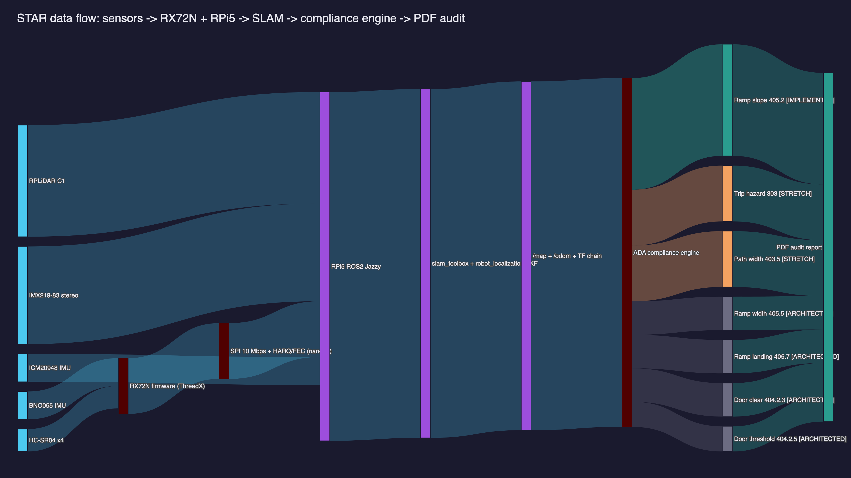
System architecture
Sensors feed the RX72N for hard-real-time motor control at 250 Hz.
RX72N talks to the Pi 5 over a framed transport: SPI 10 MHz with FEC and HARQ is the architected production link; USB-CDC ASCII at 115200 baud is the deployed link for capstone defense.
Pi 5 runs slam_toolbox, robot_localization EKF, and Nav2. The compliance engine reads the fused map and emits a structured PDF report.
Notes:
The pipeline: sensors stream into the RX72N which closes motor loops at 250 Hz. The RX72N talks to the Pi 5 via a framed serial link - architected as SPI at 10 MHz with FEC and HARQ for production, but deployed for defense as a simpler USB-CDC ASCII bridge at 115,200 baud. The Pi 5 runs slam_toolbox, an EKF that fuses wheel odometry with the IMU, and Nav2 for path planning. The compliance engine sits on top, reads the fused map, and emits a PDF audit report.

Slide 7
Seven ADA checks
IMPLEMENTED
Ramp slope (ADA 405.2)
RANSAC plane on LiDAR + BNO055 pitch cross-validation
Threshold 4.76 deg (1:12)
STRETCH
Trip hazard (ADA 303): vertical discontinuity > 1/4 in
Path width (ADA 403.5): cross-section along planned route
Existing but not tested due to limitations with motors:
Ramp width (405.5)
Ramp landings (405.7)
Door clear width (404.2.3)
Door threshold (404.2.5)
Notes:
Seven ADA geometric checks, mapped to three status tiers. Ramp slope is fully IMPLEMENTED with measured ground truth. Trip hazard and path width are STRETCH - scaffolding exists, full algorithm pending. The other four are ARCHITECTED: every node has a Python file in the repo, message schemas exist, but the geometric logic is empty.

Slide 8
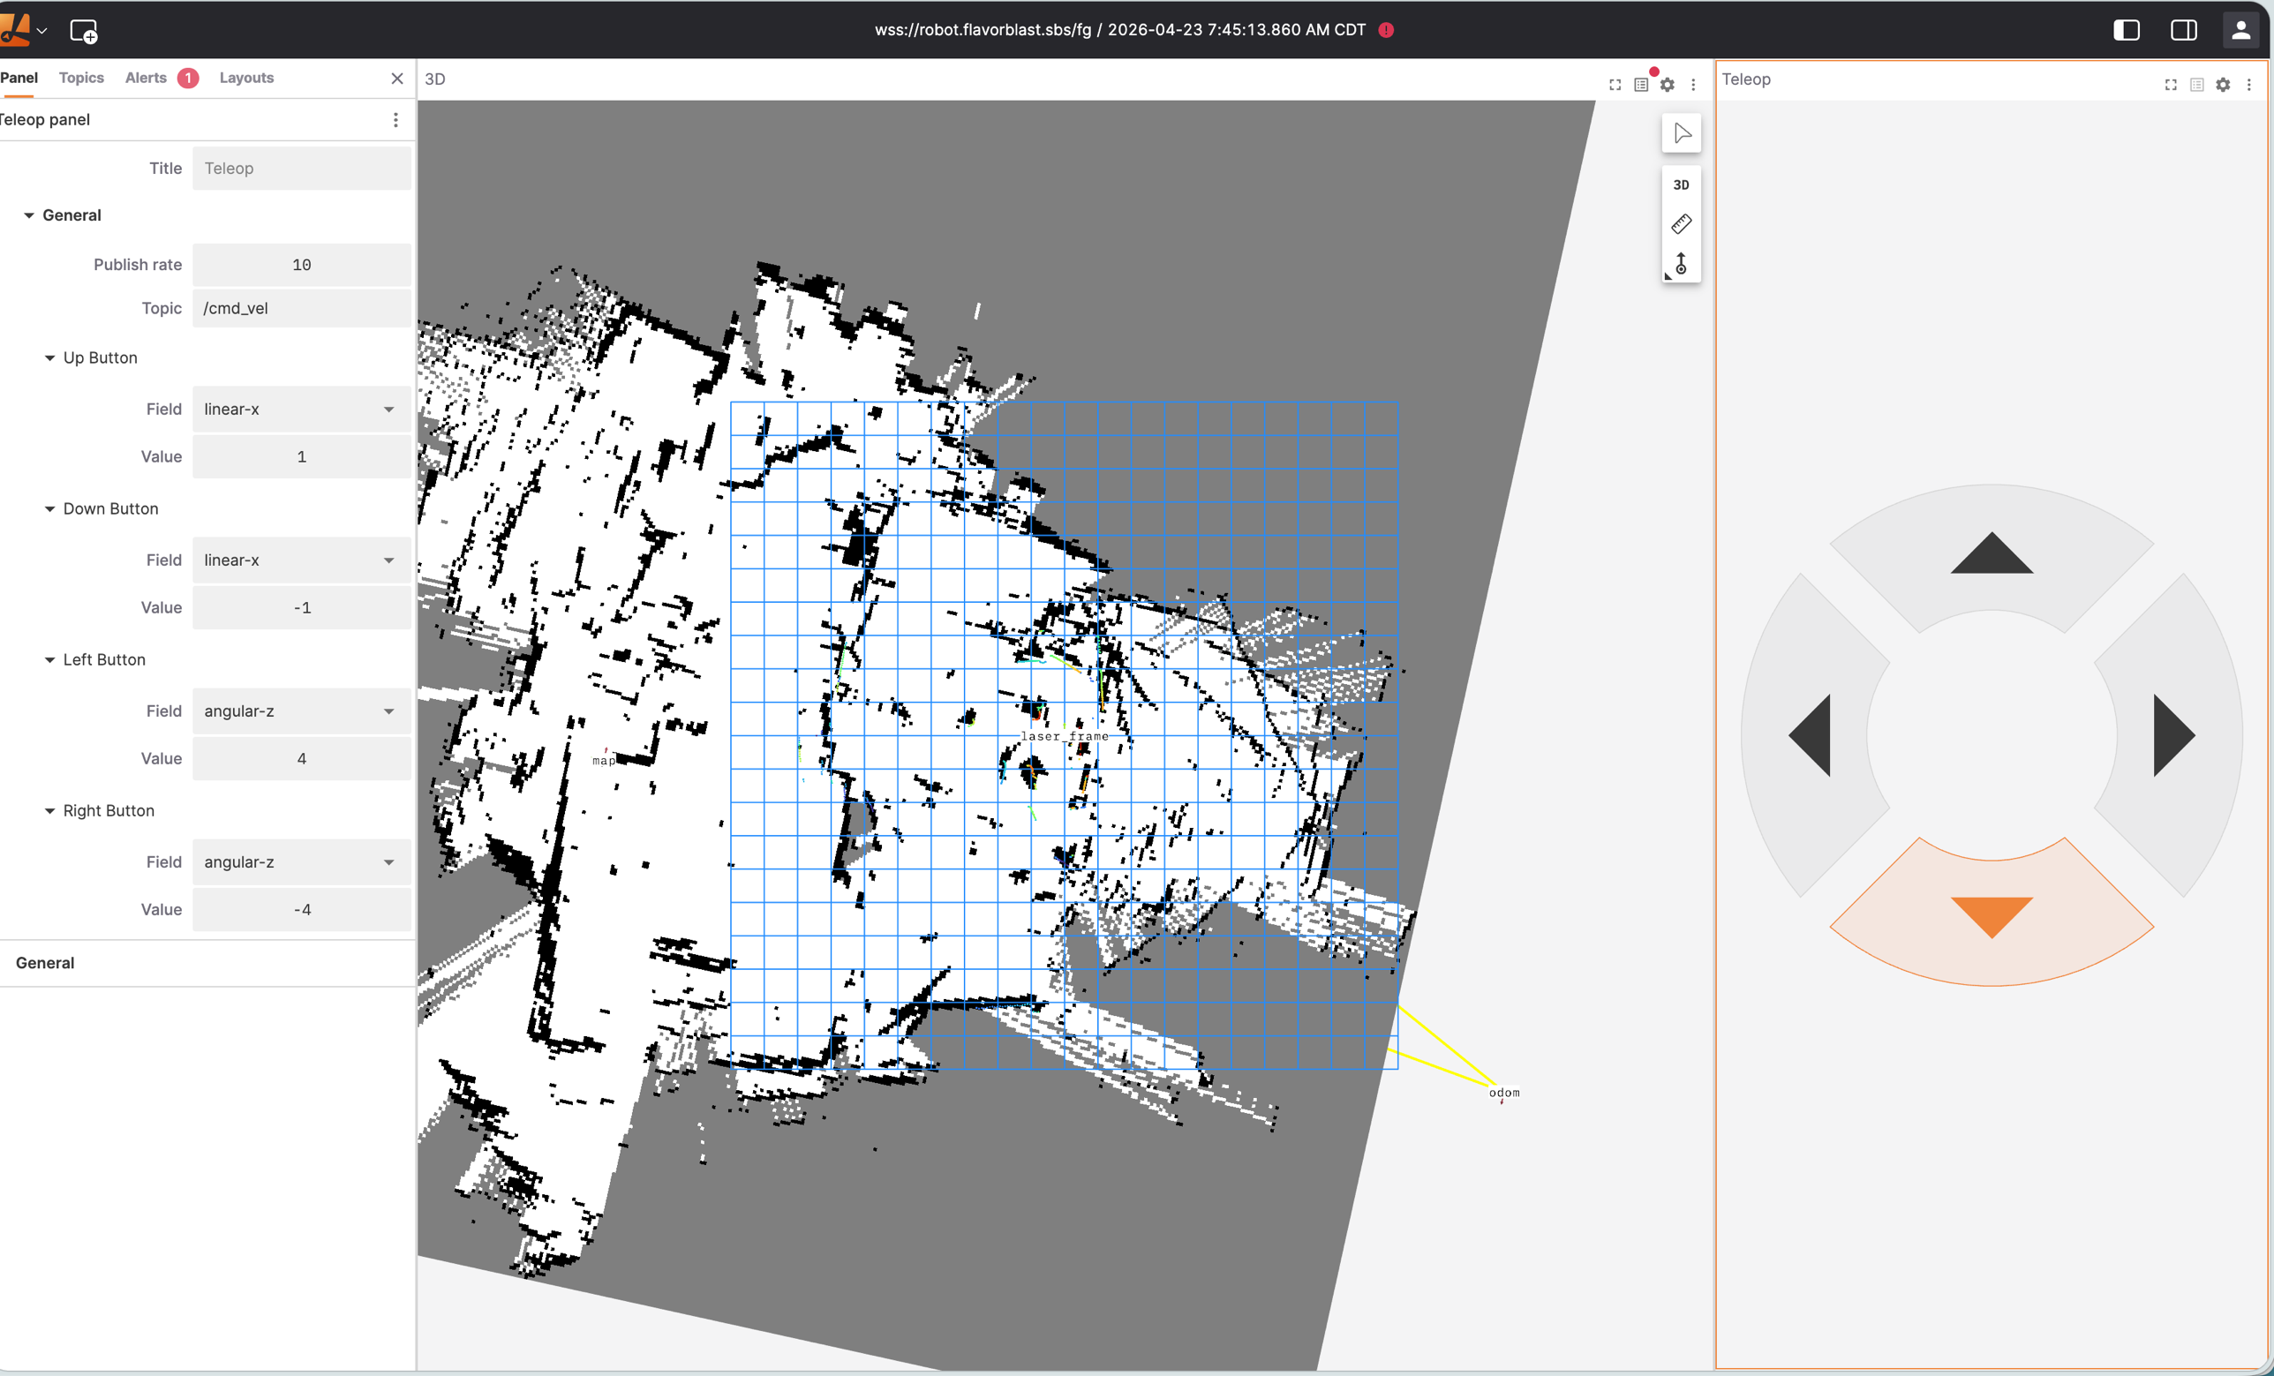
Live demo
Robot is dispatched in MANUAL via the Grafana cockpit, then handed to AUTONOMY for frontier exploration.
On approach to a ramp, the compliance engine fits a RANSAC plane and cross-validates pitch against the BNO055.
When measured slope > 4.76 deg, the engine logs a violation flag with the ground-truth row in the PDF audit report.
Notes:
For the live demo: we start the robot in MANUAL mode from the Grafana cockpit. We hand it off to AUTONOMY, Nav2 takes over, and frontier exploration drives the robot into a hallway. As it approaches the ramp, the compliance engine fits a plane to the LiDAR returns using RANSAC and cross-validates that against the BNO055 IMU pitch. If the agreement is within 0.5 degrees and the slope exceeds 4.76 degrees, the engine flags a Title III violation and logs the ground-truth measurement to the audit report.

Slide 9
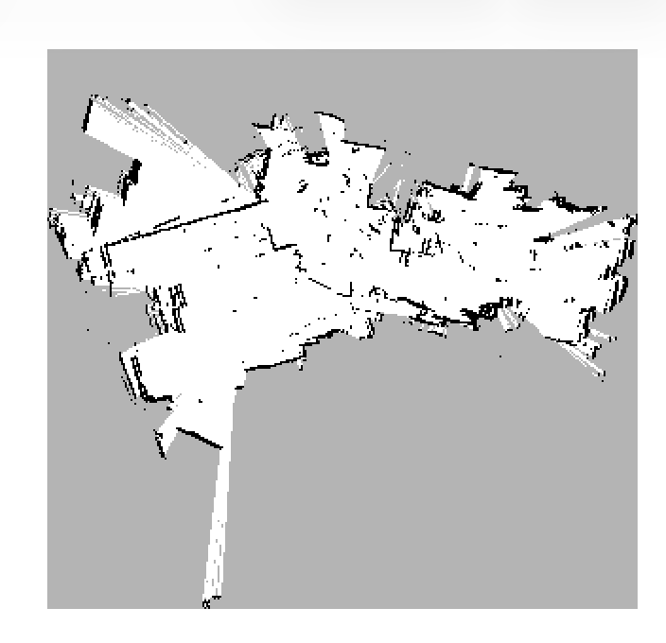
Validation
Software: 60 firmware ctests (100 pct libs/), 74 pct Go gateway, 14 ROS 2 tests, 12 pytest modules.
Hardware: 9 manual PCB checks all PASS: continuity, motor free-spin + loaded chassis with DC current, scoped PWM, AD2-probed comm.
Field: autonomous frontier-exploration scan of a Thompson Hall hallway (right); demo run flags ramp-slope and path-width violations.
Notes:
Validation in three layers. Software: 60 firmware Unity tests passing at 100% library coverage, 74% gateway coverage, 14 ROS 2 tests, 12 compliance pytest modules. Hardware: nine manual PCB validation checks, all passing first-pass, including motor free-spin and loaded-chassis with current measurements and scope-probed PWM. Field: we mapped 200 square feet of Thompson Hall on the Texas A&M campus and detected two ADA compliance issues.

Slide 10
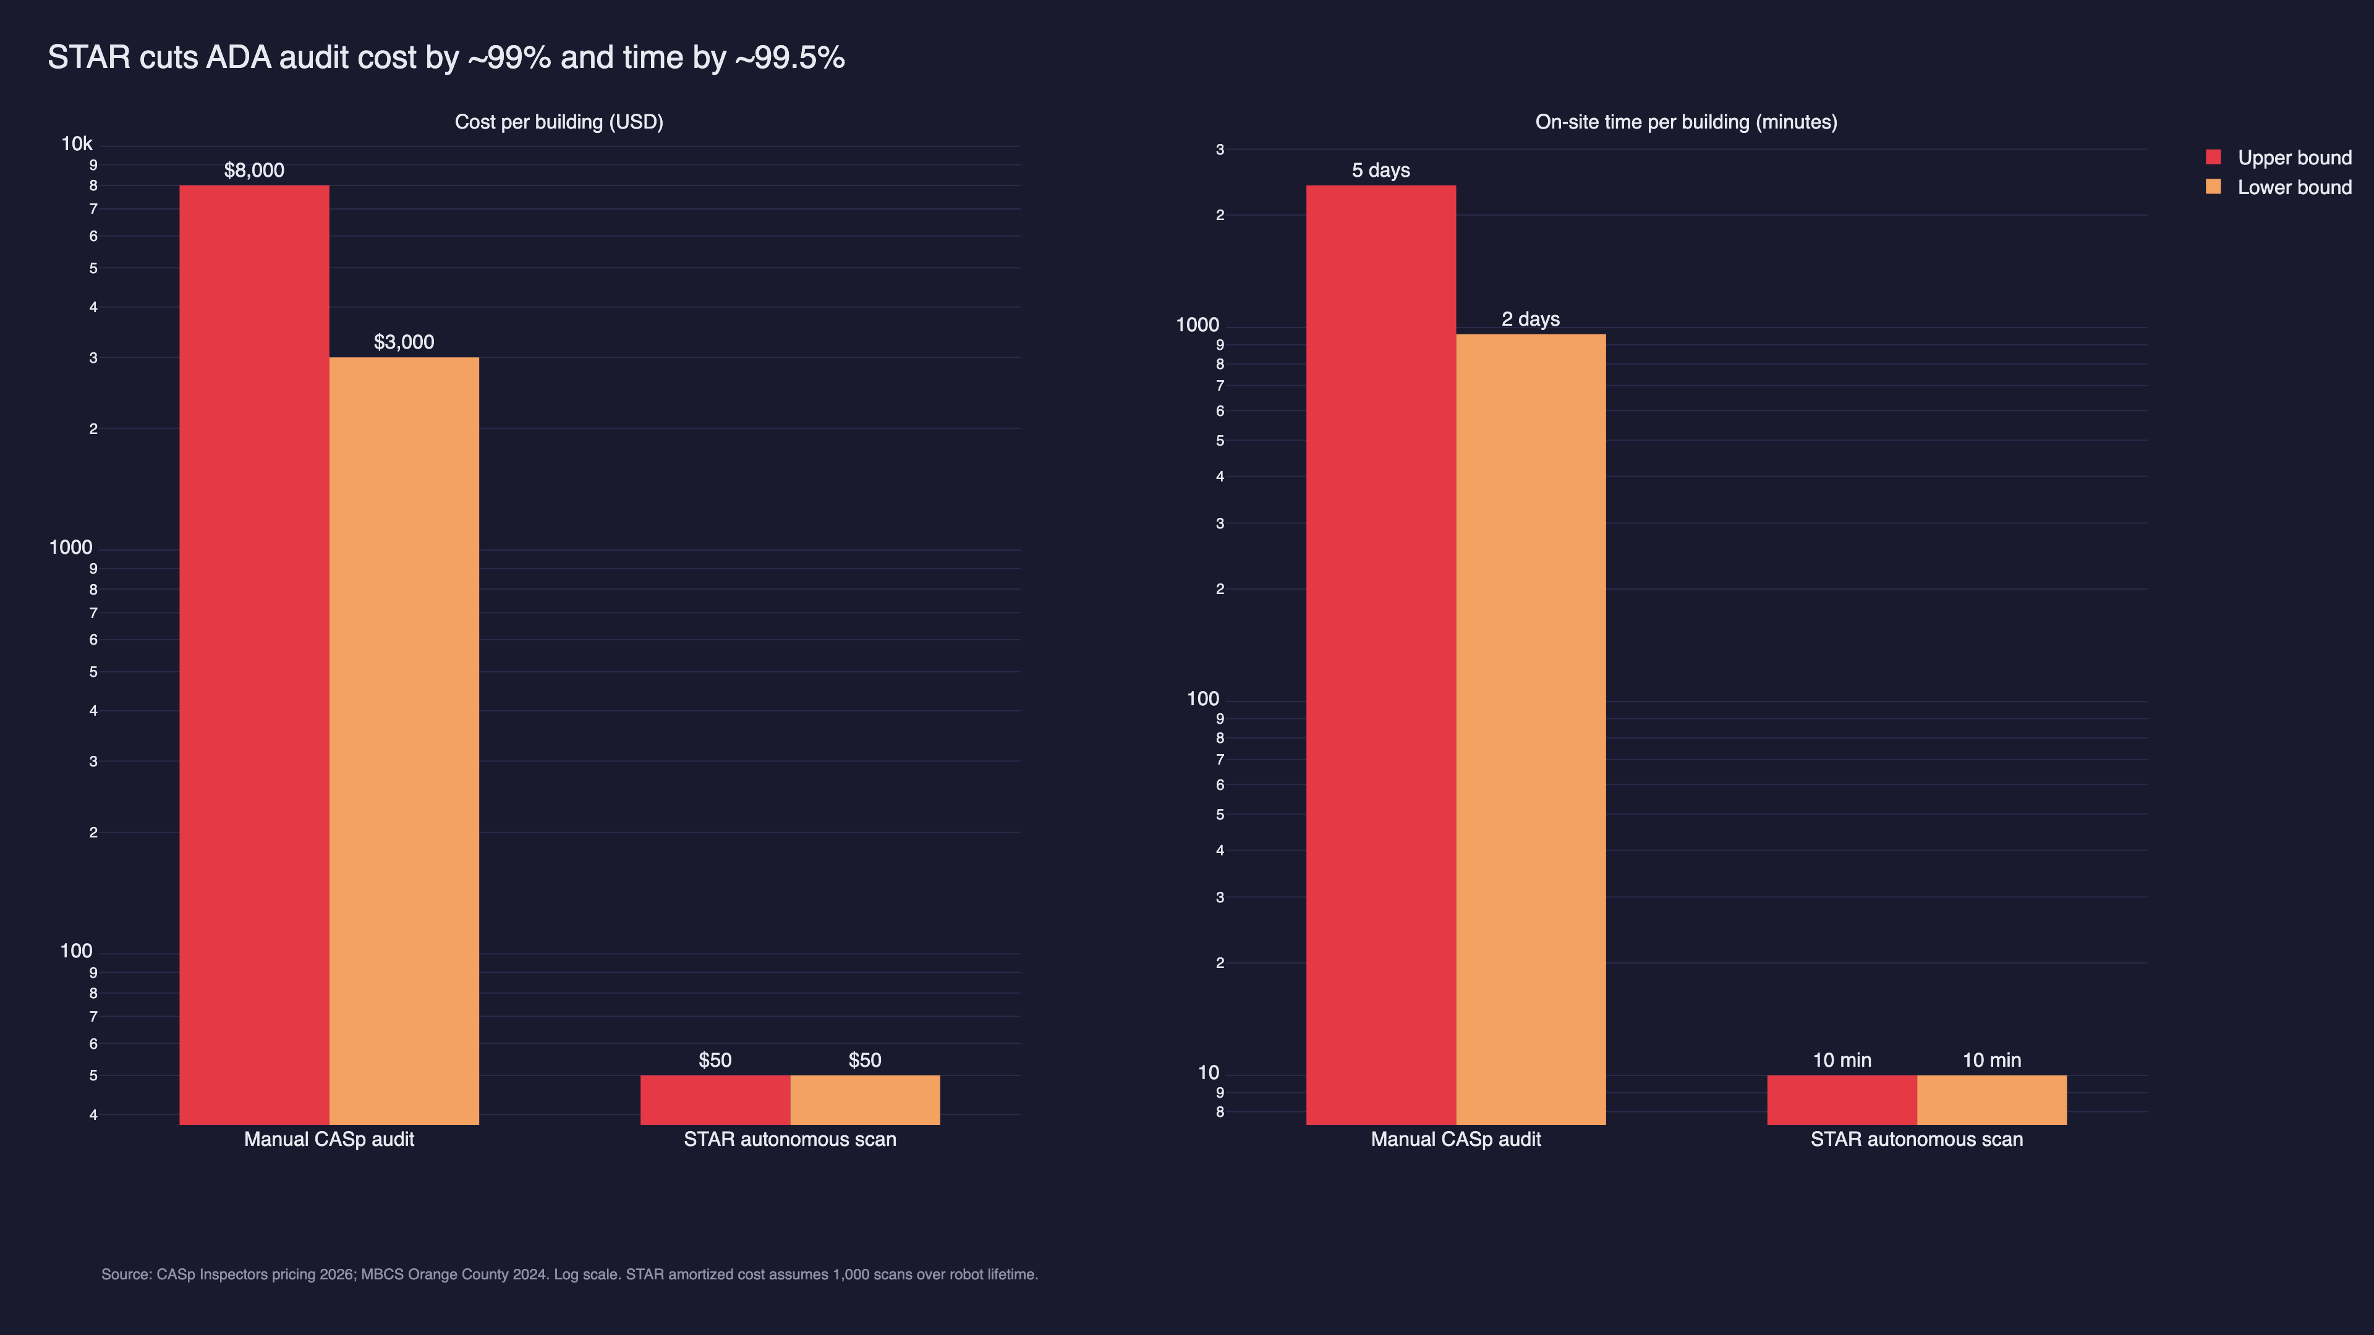
Cost
Design BOM ~$864; ordered total ~$1,249 component cost (~$1,549 with shipping). Well under the $2,000 capstone target.
Compute $182 (Pi 5, RX72N, PCB) - Sensors $270 (LiDAR, stereo, IMU, sonar) - Drivetrain $144 (motors, drivers, wheels) - Power $108 (battery, BMS, regulators) - Chassis $100
Daxbot service-as-a-product is $920k for 950 surveyed miles. STAR is sub-$2k recurring near-zero. Different economics entirely.
Notes:
Total BOM is approximately $864 with the PCB run included - well under our $2000 capstone target. The biggest line is sensors at $270, then compute at $182, drivetrain at $144, power and chassis at about $100 each. For comparison, Daxbot, the closest commercial service, is $920,000 for 950 miles of surveying. STAR fits a completely different economic envelope.

Slide 11
Broader impact
Notes:
Now let us talk about who STAR helps and where it could go from here.

Slide 12
Future work
Implement architected ADA checks: ramp width, ramp landing, door clear width, door threshold.
Sensor fusion via RTAB-Map for richer 3D reconstruction.
Multi-floor support with elevator detection and floor handoff.
ML-based fixture recognition for fire extinguishers, signage, hardware.
Outdoor GPS plus RTK for campus-scale audit campaigns.
Notes:
Future work breaks down into four buckets. First, finish the architected ADA checks - the schemas exist, we just need the geometric algorithms. Second, fuse RGB-D and LiDAR via RTAB-Map for richer 3D reconstruction. Third, multi-floor support with elevator detection. Fourth, ML-driven fixture recognition for things like fire extinguishers and signage. And eventually, outdoor GPS+RTK so we can audit a whole campus, not just a single floor.

Slide 13
Q&A and team
SOFTWARE
Cesar Magana, Project Manager
proto, gateway, ROS 2, UI, MATLAB
EMBEDDED AND PCB
Brighton Sikarskie
firmware, compliance engine, infra, schematic
Jeremie Hockey, PCB layout
HARDWARE AND REVIEW
Michael Norton, mechanical design
Shawn Ciaciura, schematic review
Jared Bartz, schematic review
Notes:
We are happy to take questions. The team is six people. I am Cesar Magana, project manager and software lead. Brighton Sikarskie ran firmware, compliance engine, infra, and schematic. Jeremie Hockey did PCB layout. Michael Norton owned mechanical design. Shawn Ciaciura and Jared Bartz contributed schematic review. Source code is open at github.com/Locked-Inc/STAR.

Slide 14
Locked Inc. - ESET 420 Senior Capstone, Spring 2026 - github.com/Locked-Inc/STAR

