Slide 1
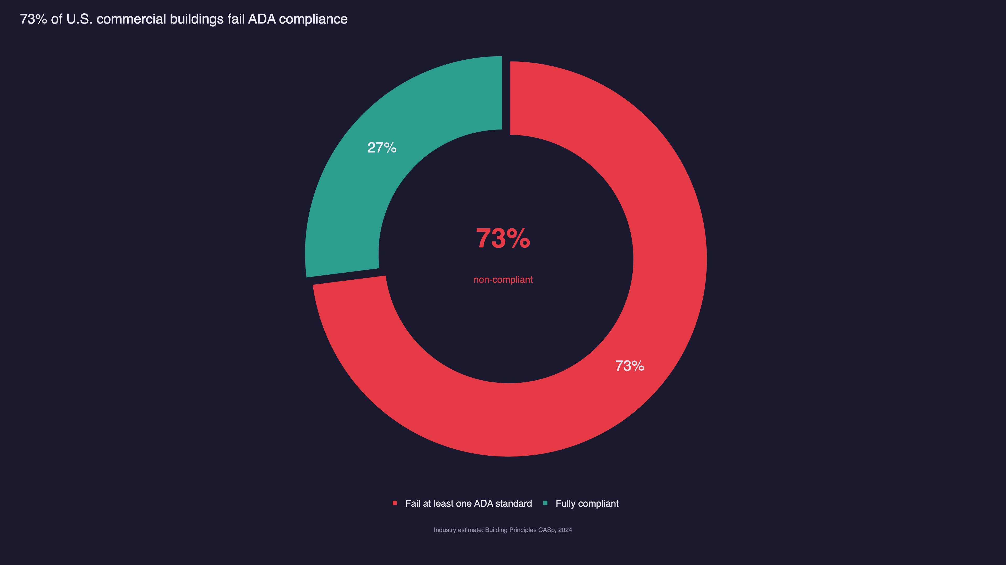
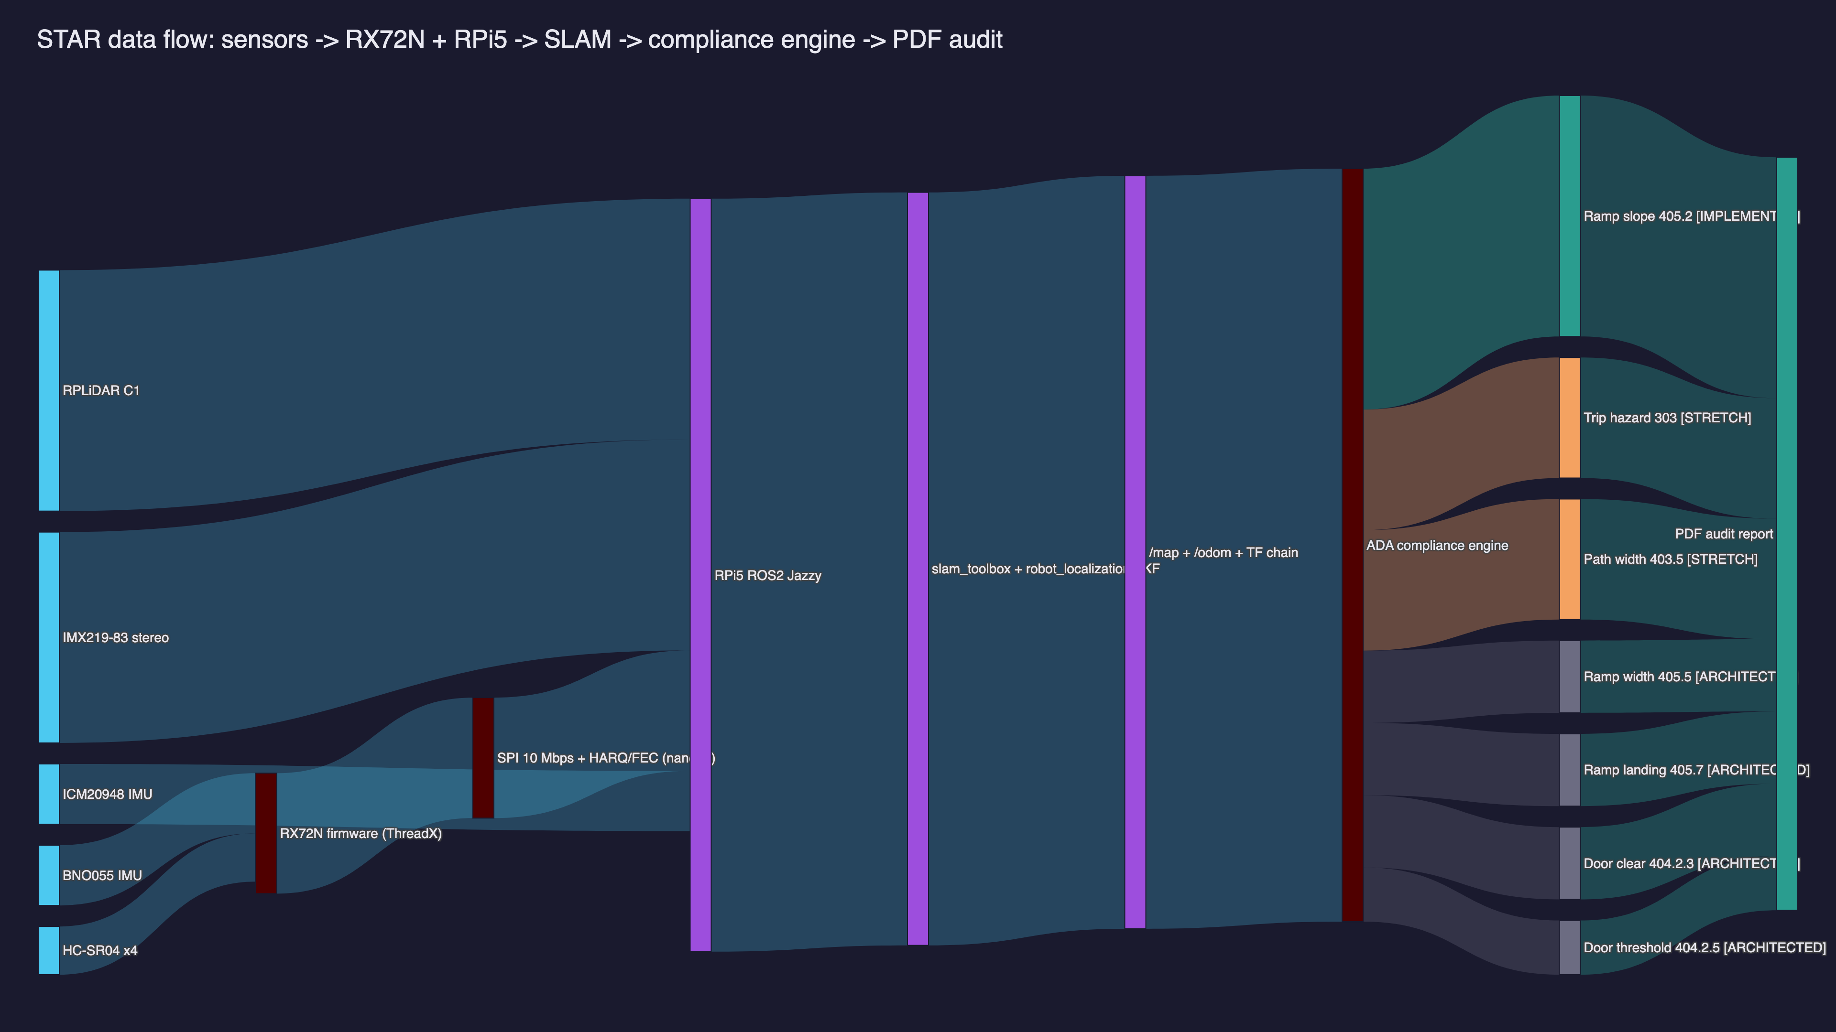
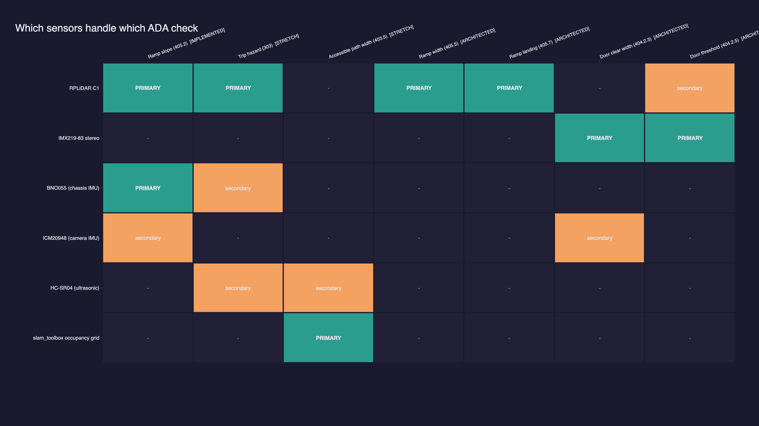
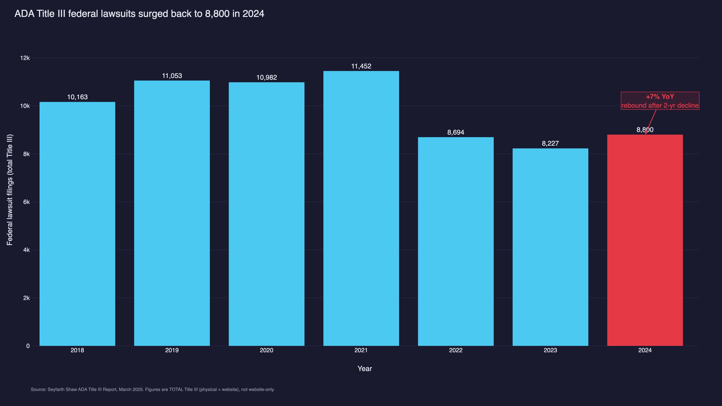
STAR: Spatial Topography Accessibility Robot
A distributed autonomous ground-robotics platform for continuous indoor ADA compliance measurement
Team Locked Inc. | TAMU ESET Senior Capstone, Spring 2026
Department of Engineering Technology & Industrial Distribution
Project Sponsor Logo (If Appropriate)
Departmental Logo
Problem Definition
28.7% of U.S. adults (~70M) live with a disability (CDC 2022 BRFSS).
Industry estimate: ~73% of U.S. commercial buildings fail >=1 ADA standard.
8,800 ADA Title III federal lawsuits filed in 2024 (+7% YoY, Seyfarth Shaw).
DOJ penalties: $118,225 first / $236,451 subsequent (90 FR 29445, 2025).
Only 32% of buyers ask about ADA at commercial inspection (Focus Bldg. Insp.).
The bottleneck is measurement: a CASp audit costs $800-$50,000+ per building and takes 2-5 days.
TAMU College Station: 5,200 acres, hundreds of buildings. Auditing every one manually is infeasible.
Methodology
Distributed platform: Raspberry Pi 5 high-level + custom RX72N PCB real-time, connected by SPI 10 Mbps with HARQ Chase Combining + FEC (K=7, rate-1/2) + nanopb Protocol Buffers over a CRC-32 frame protocol.
Sensors (all physically wired):
- SLAMTEC RPLiDAR C1 (360, 10 Hz, 12 m, +/- 3 cm)
- Waveshare IMX219-83 stereo (dual Sony IMX219 8 MP, 60 mm baseline)
- BNO055 9-DoF IMU (on RX72N) + ICM20948 9-DoF IMU (on camera)
- 4 x HC-SR04 ultrasonic, DS18B20, BMP280
Motor control: 4 x DFRobot FIT0520 (6 V, 210 RPM, 341 PPR Hall) + 4 x TI DRV8263H H-bridges + GPTW 32-bit PWM @ 20 kHz. RX72N runs 250 Hz discrete-time PID; Pi5 issues 100 Hz velocity commands.
ROS2 Jazzy: slam_toolbox async + robot_localization EKF + Nav2 + m-explore-ros2 frontier exploration. 143 tests, 0 failures across 4 packages.
Engineering Analysis
Seven ADA 2010 geometric checks, implementation status labeled:
[IMPLEMENTED] 1. Ramp slope > 1:12 (4.76 deg) - ADA 405.2
Open3D RANSAC plane normal + BNO055 pitch cross-validation (+/- 0.5 deg gate)
[STRETCH] 2. Trip hazard > 0.25 inch - ADA 303
LiDAR vertical delta + BNO055 jolt correlation during traversal
[STRETCH] 3. Accessible path width < 36 inches - ADA 403.5
Medial-axis transform on slam_toolbox occupancy grid
[ARCHITECTED] 4. Ramp width < 36 inches - ADA 405.5
Plane-polygon bounding + principal-axis projection
[ARCHITECTED] 5. Ramp landing < 60 x 60 inches - ADA 405.7
Inscribed-rectangle test on flat adjacent regions
[ARCHITECTED] 6. Door clear width < 32 inches - ADA 404.2.3
IMX219-83 stereo SGBM + door-frame detection at handle height
[ARCHITECTED] 7. Door threshold > 0.5 inch - ADA 404.2.5
LiDAR + stereo vertical profile across door bottom edge
Why two IMUs?
BNO055 sits on the chassis and reads robot-body pitch (authoritative for ramp slope).
ICM20948 rides on the stereo camera board and gives the visual pipeline its own inertial reference for future visual-inertial odometry.
Outcomes
Platform (complete)
143/143 ROS2 tests passing across 4 packages.
slam_toolbox async produces /map at 0.5 Hz on Raspberry Pi 5.
Full TF chain: map -> odom -> base_link -> laser_frame.
Nav2 autonomous goal execution validated.
m-explore-ros2 frontier exploration to completion (no pre-loaded map).
SPI transport: 1.6% utilization at 10 Mbps; HARQ/FEC protects against bit errors.
250 Hz discrete-time PID motor loop, tuned against first-order model (tau = 75 ms).
Compliance engine (this capstone)
Ramp slope check implemented end-to-end.
Wixey WR300 digital angle gauge ground truth (+/- 0.1 deg).
On-campus ramp, n measurements logged to validation_log.csv.
BNO055 pitch vs. LiDAR plane normal agreement gate +/- 0.5 deg.
Auto-generated PDF audit report with georeferenced flag + sensor evidence.
Live numbers on the printed poster come from the dress-rehearsal validation log, not from estimates. See extras/STAR_ValidationLog.xlsx.
Impact
At TAMU's 5,200-acre campus, continuous ADA measurement at amortized hardware cost is the same economic shift cybersecurity scanners brought to IT compliance a decade ago.
Stakeholders
- Department of Disability Resources: user advocacy
471 Houston Street, Student Services Bldg, Suite 122
- Office of Risk, Ethics & Compliance: compliance ownership
orec.tamu.edu/ada
- Facilities Services / Office of the University Architect: remediation
Open-source release: github.com/Locked-Inc/STAR
References
Seyfarth Shaw ADA Title III Report, March 2025.
Federal Register 90 FR 29445 (July 2025) - DOJ civil penalty adjustment.
CDC Disability and Health Data System, 2022 BRFSS (released July 2024).
Okoro et al., MMWR 2018; 67(32):882-887.
Saha et al., Project Sidewalk, CHI 2019 (Best Paper). ACM 10.1145/3290605.3300292.
Weld et al., ASSETS 2019 (Best Student Paper). ACM 10.1145/3308561.3353798.
Hara et al., Tohme, UIST 2014. ACM 10.1145/2642918.2647403.
Sun et al., Sensors 2024, 24(21):6828 - Stereo+LiDAR Loosely Coupled SLAM.
Lang et al., Gaussian-LIC, arXiv:2404.06926, ICRA 2025.
Turkan & Che, Automated ADA Curb-Ramp Assessment, Oregon State PacTrans.
ADA 2010 Standards for Accessible Design, sections 303, 403.5, 404.2, 405.
Full BibTeX: final_capstone/extras/references.bib. Source matrix: research/source_verification.md.
Acknowledgments
TAMU ESET capstone faculty, TAMU Department of Engineering Technology & Industrial Distribution, TAMU Disability Resources for early stakeholder input.

