Slide 1

Easy Reading Introduction
By Justin&Lockey
May 17th 2019

Slide 2

Why reading?
Channel:
1） YouTube, Youku, Bilibili
2） “混沌大学”,”得到”
3） talk with peers
4） Kindle
5） Easy-Reading

Slide 3

Why easy reading?
She can:
Professional article suggestion
Translate different languages to you
Adjustable lexicon
Interactive reading system – no boring reading anymore
Image recognition

Slide 4

What’s more?
You can chat with your friends
Search one word, we will give you the result as:
*What the word means
*The related articles
*The user with the ID
*The learning group with the keywords

Slide 5
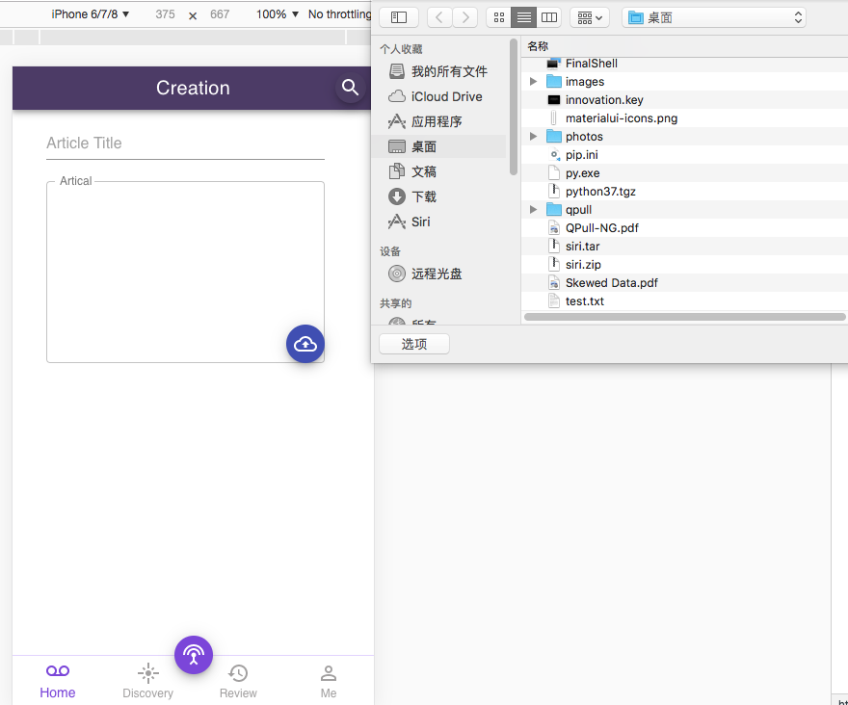
Really???
Show me!!
Link: https://lockeycheng.github.io/iooi/reading.html#/

Slide 6
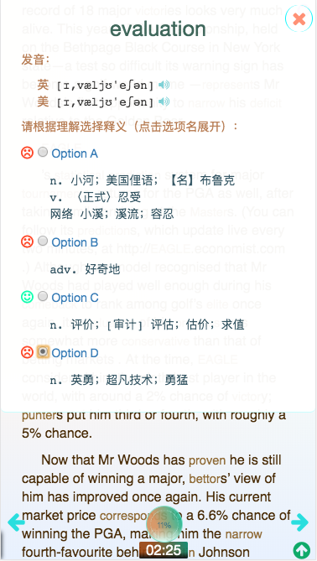
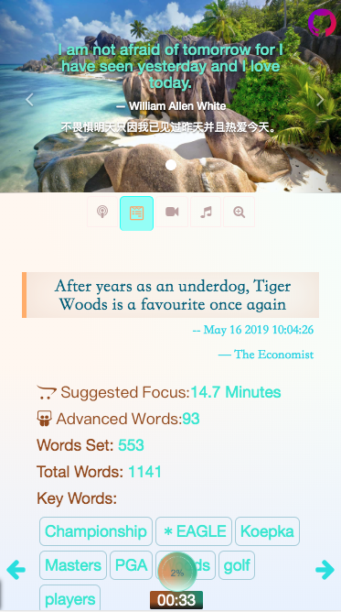
How it works:

Slide 7
Q&A

Slide 8
THANK YOU FOR YOUR READING!

