Slide 1

Easy Reading Introduction
By Justin&Lockey
May 17th 2019

Slide 2

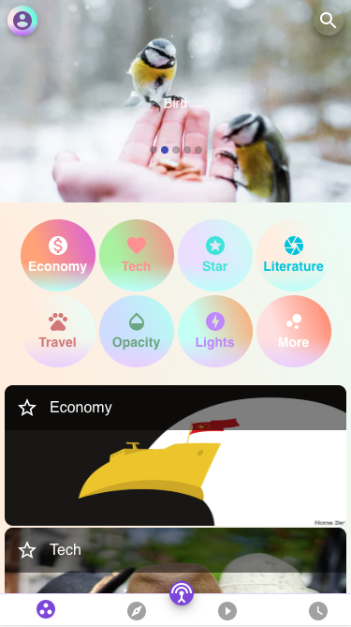
Why reading?
Where we can learn from?:
1） YouTube, Youku, Bilibili
2） “混沌大学”,”得到”
3） talk with peers
4） Kindle
5） Easy-Reading

Slide 3

Why easy reading?
She can:
Professional article suggestion
Translate different languages to you
Adjustable lexicon
Image recognition
Interactive reading system – no boring reading anymore

Slide 4

What’s more?
You can chat with your friends
Search one word, we will give you the result as:
*What the word means
*The related articles
*The user with the ID
*The learning group with the keywords

Slide 5
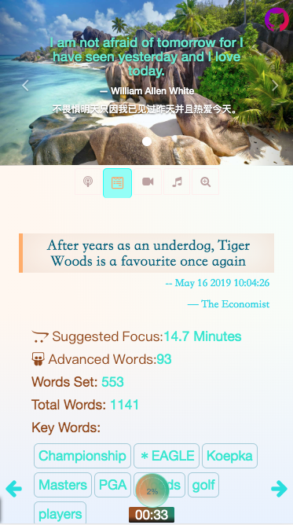
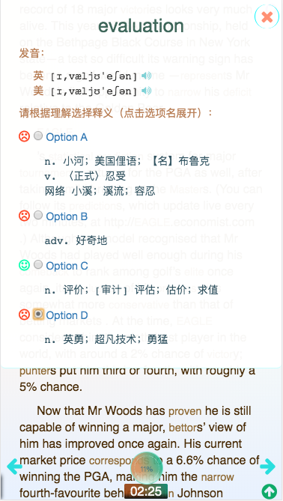
Really???
Show me!!
Link: https://lockeycheng.github.io/iooi/reading.html#/

Slide 6
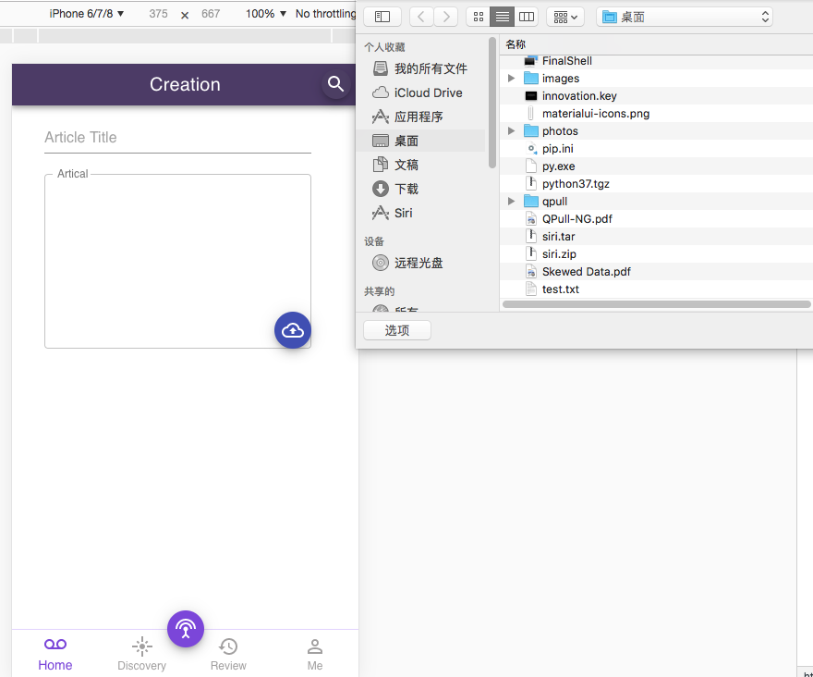
How it works:

Slide 7
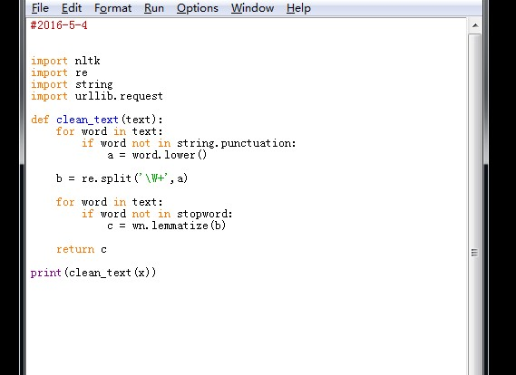
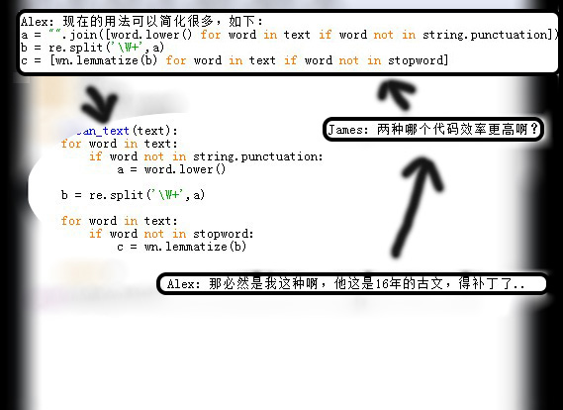
How interactive
reading model
works:

Slide 8
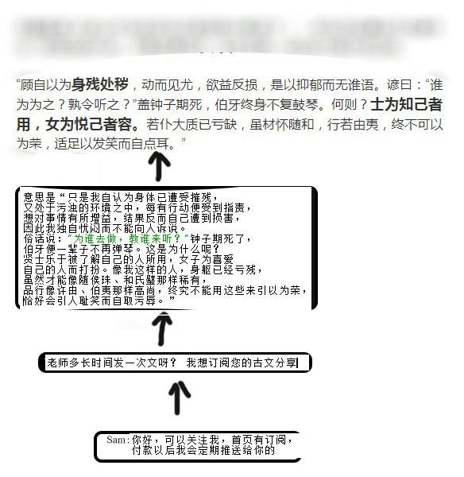
How it works:

Slide 9
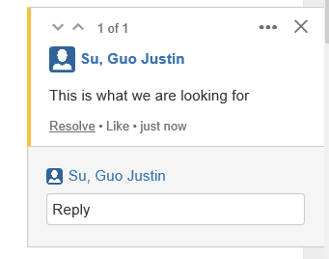
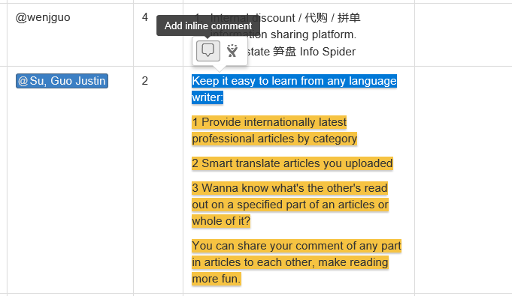
How interactive
reading model
works:

Slide 10

You can pay a comment, pay a user for his/her read out, or even subscribe someone’s post.

Slide 11
Q&A

Slide 12
THANK YOU FOR YOUR READING!

