Slide 1

Deep learning proxy of reservoir simulation
ACSE 9 - Independent Research Project
Raha Moosavi
Supervisors : Dr Daniel Busby, Dr Yves Leory

Slide 2
Problem statement
Deep learning proxy of reservoir simulation
Most simulation software use numerical simulation like FD,FE &FV
Accuracy improvement requires to increase discretization grids
History-matching needs several simulation runs
Conventional simulation techniques are very time-consuming (several minutes to several days)
Next

Slide 3
Objectives and Motivation
Deep learning proxy of reservoir simulation
Creating a deep neural networks to simulate reservoir pressure and saturation from geological parameter map (permeability)
Assessing the surrogate model performance in simulating reservoir properties (pressure and saturation)
Improving the performance network by changing deep learning model architecture

Slide 4
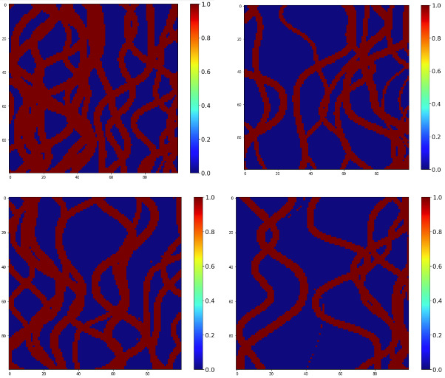
Synthetic dataset
Deep learning proxy of reservoir simulation
Composed of 3000 permeability maps(Channelized facial map)
Corresponding pressure and saturation for 61 time step simulating using Intersect
2250 training / 750 Testing

Slide 5
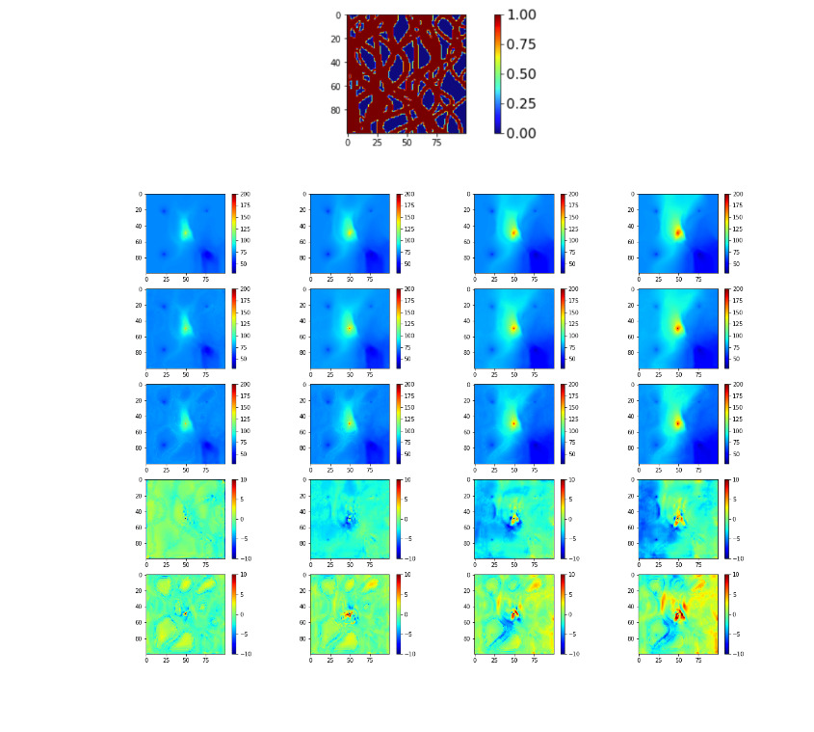

Data preparation
Deep learning proxy of reservoir simulation
Facies and saturation are between 0 & 1.
Pressure is in range of 0-500 bar.
Normalization improves the model accuracy for pressure prediction.
Permeability map and its corresponding pressure and saturation

Slide 6
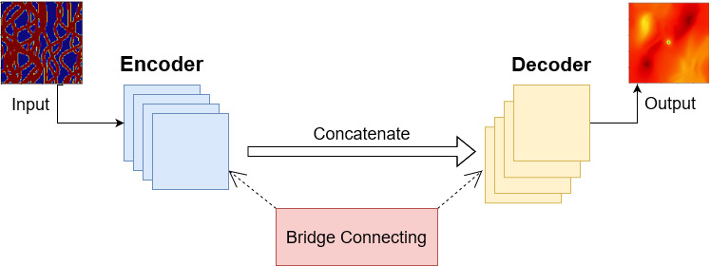
Deep learning model
Deep learning proxy of reservoir simulation
Input : Permeability maps & their corresponding initial saturations/pressures
U-Net (Encoder/decoder) model
Output : pressures/saturations

Slide 7
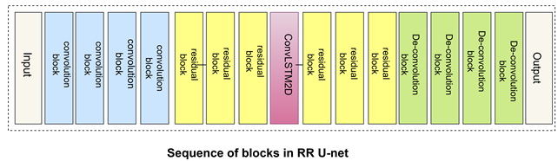
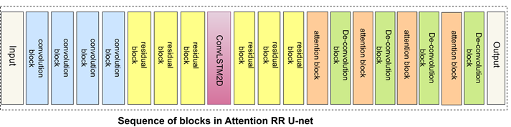
Deep learning model architecture
Deep learning proxy of reservoir simulation
Recently proposed model: Residual Recurrent U-Net (Tang et al.)
Our proposed model: Attention Residual Recurrent U-Net

Slide 8


Comparison between pressure results from different models
Deep learning proxy of reservoir simulation
Pressure results from Intersect
Pressure results from our proposed model
Pressure results from previous proposed model
Difference between our proposed model and Intersect
Difference between previous proposed model and Intersect

Slide 9
Deep learning proxy of reservoir simulation
Model accuracy improvement :
Saturation: 0.2%
Pressure: 0.2%

Slide 10
Future work
Deep learning proxy of reservoir simulation
2021/09/10
Some issues that can be investigated in future works:
Relative error increases with increasing time steps.
Training time increased with increasing number of timesteps exponentially.
Applying A RR U-NET model to 3D geological map.
Next

Slide 11
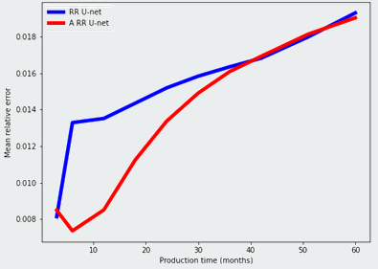
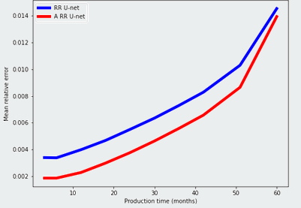
Relative error versus production time
Deep learning proxy of reservoir simulation
Pressure
Saturation

Slide 12
Deep learning proxy of reservoir simulation
Back

Slide 13
Acknowledgment
Deep learning proxy of reservoir simulation
Dr. Daniel Busby
Dr. Yves Leroy
Abderrahmane Yewgat
Imperial College London
TotalEnergies
Any Questions?

