Slide 1

Deep learning proxy of reservoir simulation
ACSE 9 - Independent Research Project
Raha Moosavi
Supervisors : Dr Daniel Busby, Dr Yves Leory

Slide 2
Problem statement
Deep learning proxy of reservoir simulation
Most simulation software using Numerical simulation like FD,FE &FV
Need to increase discretization grids to increase accuracy
History-matchings need several simulation runs
Next

Slide 3
Deep learning proxy of reservoir simulation
Elapsed Time for Simulation In Sec.
Resource : History Matching In Parallel Computational Environments

Slide 4
Deep learning proxy of reservoir simulation
Objective function
Resource : History Matching In Parallel Computational Environments

Slide 5
Objectives and Motivation
Deep learning proxy of reservoir simulation
Applying deep neural networks to simulating reservoir pressure and saturation by feeding geological parameter map (permeability) to network.
Assessing the surrogate model performance in simulating reservoir properties (pressure and saturation).
Put the performance of the proposed method in relation to surrogate models using shallow networks.

Slide 6
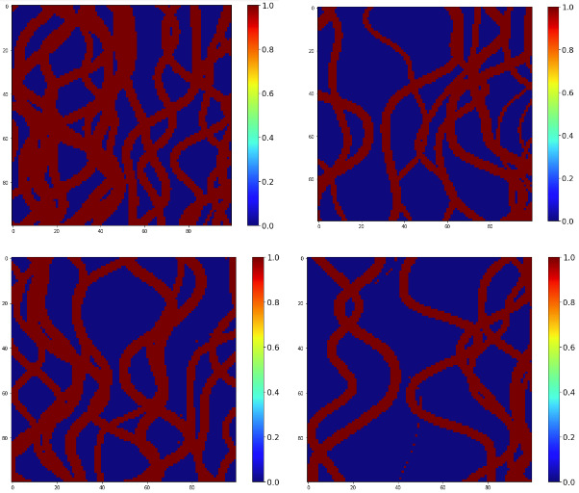
Synthetic dataset
Deep learning proxy of reservoir simulation
3000 permeability map (Channelized facial map)
Simulating corresponding pressure and saturation
Simulating for 61 time step using Intersect
2250 training /750 Testing

Slide 7
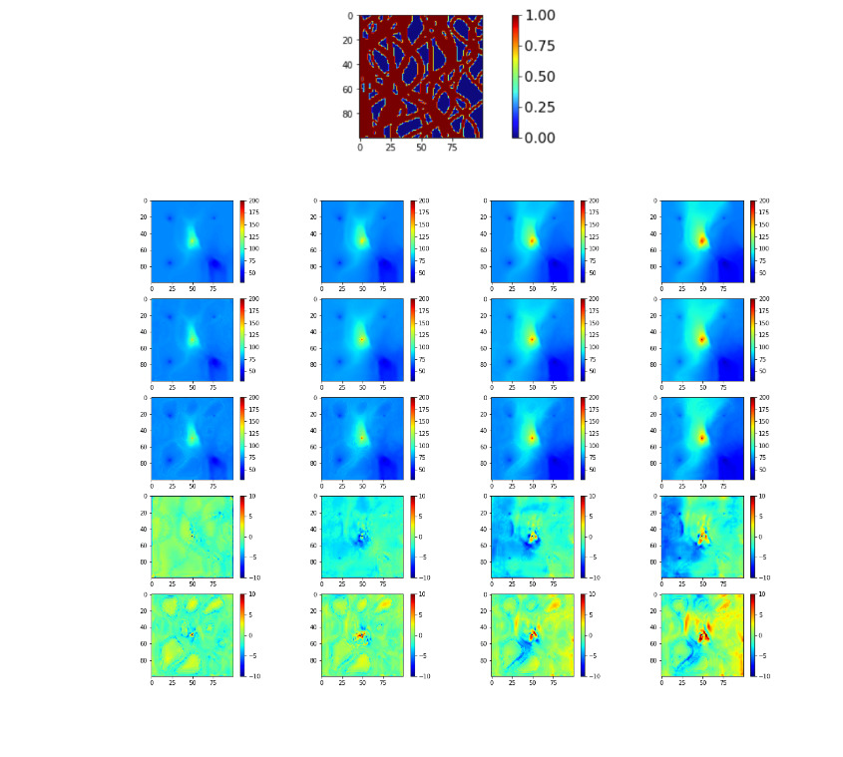

Data preparation
Deep learning proxy of reservoir simulation
Permeability and saturation are between 0 & 1.
Pressure is in wide range.
This normalization improves the model accuracy for pressure prediction.
Permeability map and its corresponding pressure and saturation

Slide 8
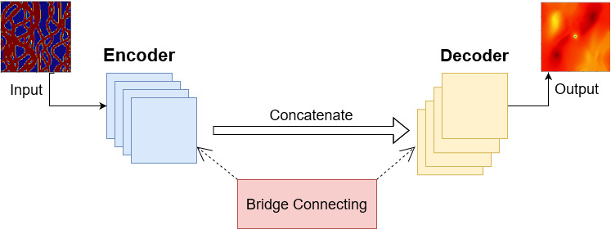
Deep learning model
Deep learning proxy of reservoir simulation
Input : Permeability map & initial saturation or pressure
U-Net (Encoder/decoder) model
Output : pressure or saturation

Slide 9
Deep learning model architecture
Recently used model: Residual Recurrent U-Net
Our propose model: Attention Residual Recurrent U-Net
Convolution block
Residual block
ConvLSTM
Attention block
Deconvolution block

Slide 10
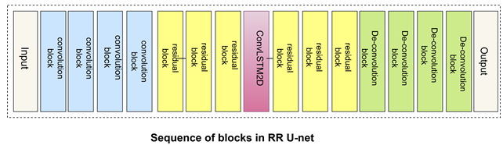
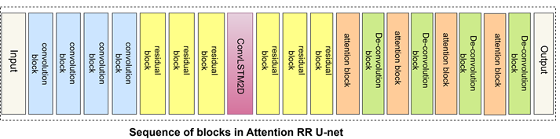
Model architecture
Deep learning proxy of reservoir simulation

Slide 11
Result
Deep learning proxy of reservoir simulation

Slide 12
Deep learning proxy of reservoir simulation
Model accuracy improvement :
Saturation: 1.9%
Pressure: 0.5%

Slide 13
Future work
Deep learning proxy of reservoir simulation
2021/09/10
Some issues that can be investigated in future works:
Relative error increase with increasing time steps.
Training time increased with increasing no. of timesteps exponentially.
Number of required epochs to reach convergence.
Applying A RR U-NET model to 3D problem.
Next

Slide 14
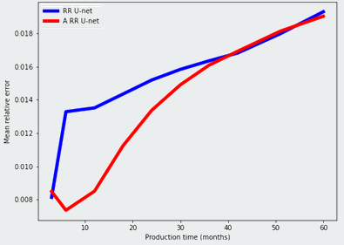
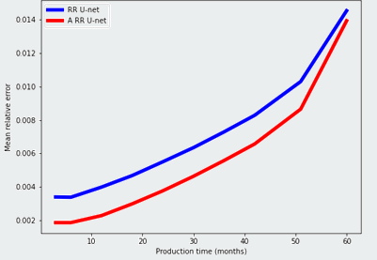
Relative error versus production time
Pressure
Saturation

Slide 15
Deep learning proxy of reservoir simulation
Next

Slide 16
Acknowledgment
Dr. Daniel Busby
Dr. Yves Leory
PhD Students in TotalEnergies
Imperial College London
TotalEnergies
Any Questions?

