Slide 1

TOR

Slide 2


What is TOR ?

Slide 3
TOR usage around the world.

Slide 4
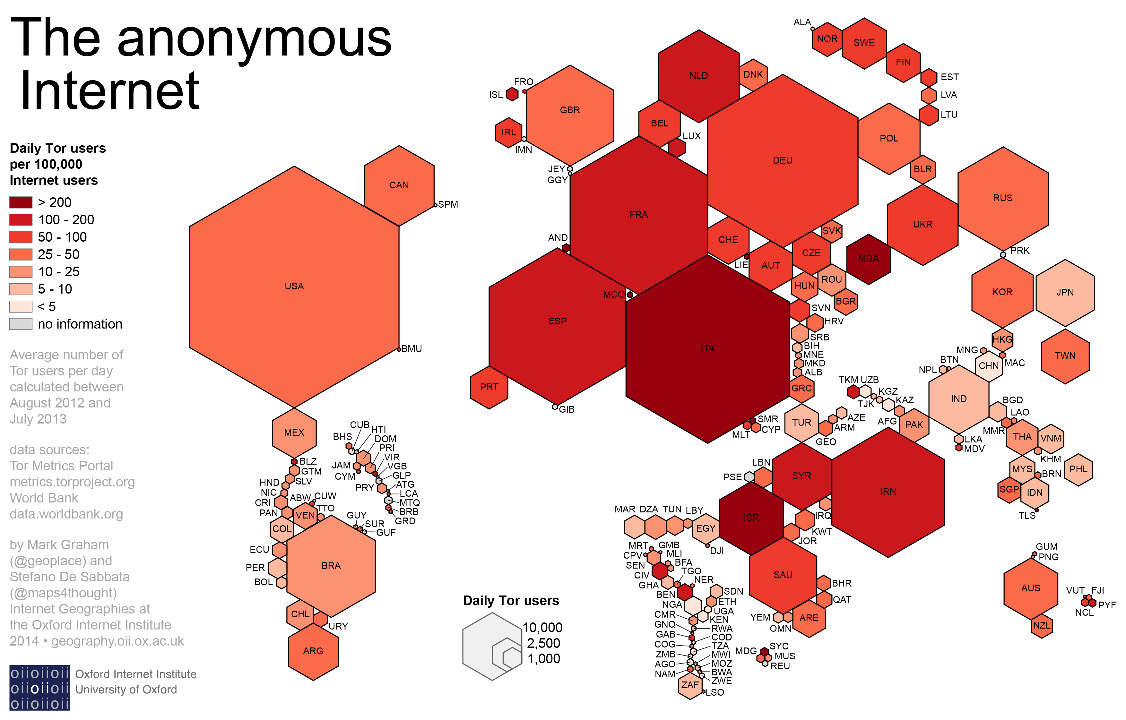

Slide 5
How to get an access and how it works ?

Slide 6



Web Browsers

Slide 7
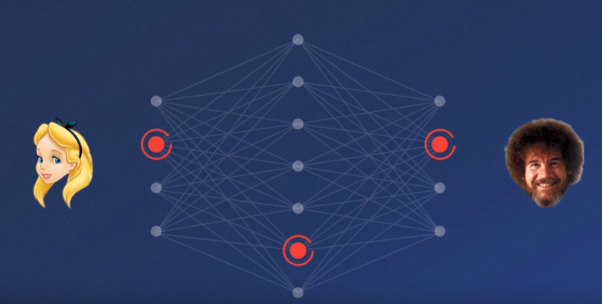
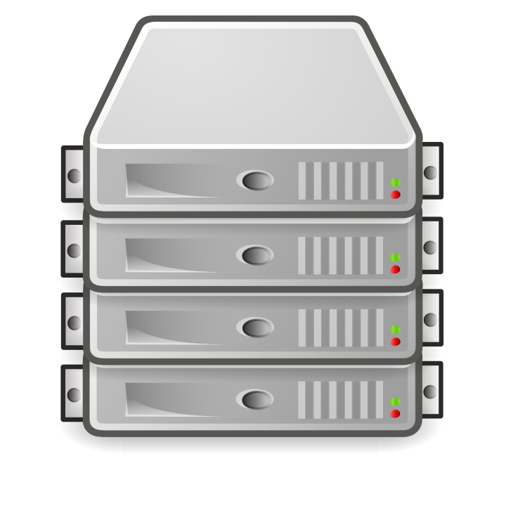


Slide 8
What can we find in this environment that we cannot find in the internet ?

Slide 9





Slide 10
What is a hidden service and how to find some ?

Slide 11
How a hidden service works ?

Slide 12
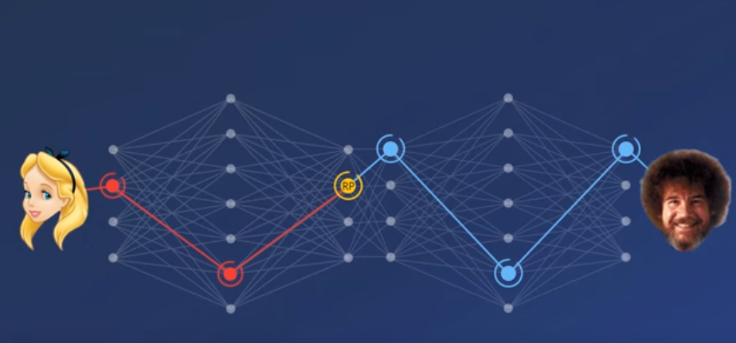
How a hidden service works ?

Slide 13
Why would you hide your website in TOR ?

Slide 14
What's the difference between an onion address and the others ?

Slide 15
en.wikipedia.org
2ogmrlfzdthnwkez.onion

Slide 16
Evolution of
.onion addresses :
Actually ==> 16 characters (SHA1/DH/RSA1024)
http://2ogmrlfzdthnwkez.onion
To V3 ==> 56 characters
(SHA3/ed25519/curve25519)
http://vww6ybal4bd7szmgncyruucpgfkqahzddi37ktceo3ah7ngmcopnpyyd.onion

Slide 17
Demonstration

