Slide 1
Crypto Wallet
What is that?
How does it work? (overview)
Public and private keys
Who can receive what?
Different types
Demonstration

Slide 2




Crypto wallet?
A place where u can store, spend or receive cryptocurrencies
All-in-one wallet

Slide 3
How does it work?
What does the user see and what he doesn‘t: https://imgur.com/a/iNRCJ3q

Slide 4
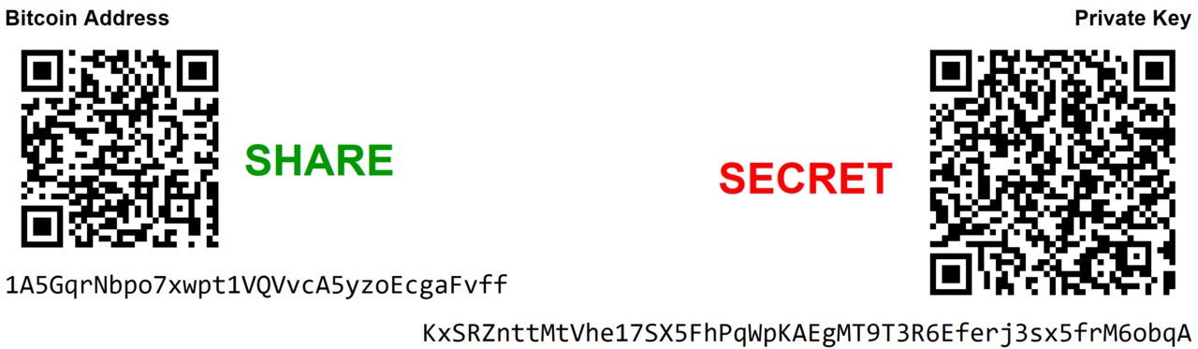
Public and private key

Slide 5
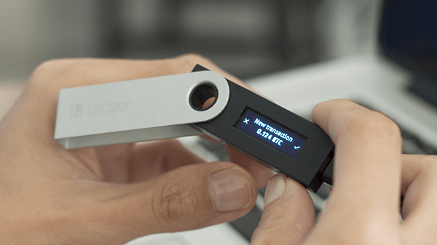
Different types of wallets
Hot wallets and cold wallets

