Slide 1
This is a short and sweet title up to three lines.
Subtitle if needed
Month 00, 0000

Slide 2




Automating application release operations Enterprise Application Delivery
application
LB
Authentication
Portal
AppServ
WebServ
DB
Engines
Middleware
ESB
OS
artifact
Supplier 1
test
acceptance
production
Supplier 2
Supplier 3
Release Intake
Master Release mgmt
Continuous “zero touch” & standardized
Application Release Deployment

Slide 3
Automating application release operations Enterprise Application Delivery
application
LB
Authentication
Portal
AppServ
WebServ
DB
Engines
Middleware
ESB
OS
artifact
Supplier 1
test
acceptance
production
Supplier 2
Supplier 3
Release Intake
Master Release mgmt
Continuous “zero touch” & standardized
Application Release Deployment

Slide 4
This is the blue option for the title slide.
Subtitle if needed
Month 00, 0000

Slide 5
This is the yellow option for the title slide.
Month 00, 0000

Slide 6
This is the orange option for the title slide.
Subtitle if needed
Month 00, 0000

Slide 7
Slide titles should be concise.
Using the Verizon PowerPoint template
These sample slides that show how this template should be used.
The slides contain instructions and specifications you should be familiar with.
Use, modify and/or delete these sample slides as needed.
Template or theme? Template is recommended.
Opening this template from your desktop creates a new file that includes these correctly formatted slides. Saving this template as a theme and applying it to an existing presentation, however, may not format all existing slides correctly. Always check and ensure that all formatting is correct.
The following legal text must appear at the bottom of slides:
Confidential and proprietary materials for authorized Verizon personnel and outside agencies only. Use, disclosure or distribution of this material is not permitted to any unauthorized persons or third parties except by written agreement.

Slide 8
A section title can be up to four lines
Flush left text
Equal
At least 1/5
of the circle’s diameter
Equal
At least 1/5
of the circle’s diameter
Instructions
After typing the section title above, position the text block so that the visible text is centered within the circle left to right. Delete these instructions.

Slide 9
This is the green section title option
Flush left text
Equal
At least 1/5
of the circle’s diameter
Equal
At least 1/5
of the circle’s diameter
Instructions
After typing the section title above, position the text block so that the visible text is centered within the circle left to right. Delete these instructions.

Slide 10
This is the blue section title option
Flush left text
Equal
At least 1/5
of the circle’s diameter
Equal
At least 1/5
of the circle’s diameter
Instructions
After typing the section title above, position the text block so that the visible text is centered within the circle left to right. Delete these instructions.

Slide 11
This is the yellow section title option
Flush left text
Equal
At least 1/5
of the circle’s diameter
Equal
At least 1/5
of the circle’s diameter
Instructions
After typing the section title above, position the text block so that the visible text is centered within the circle left to right. Delete these instructions.

Slide 12
This is the orange section title option
Flush left text
Equal
At least 1/5
of the circle’s diameter
Equal
At least 1/5
of the circle’s diameter
Instructions
After typing the section title above, position the text block so that the visible text is centered within the circle left to right. Delete these instructions.

Slide 13
Here’s an alternate section header up to four lines.
Supporting text goes here. Use this text level as a lead-in or summary paragraph. Use the “Increase List Level” and “Decrease List Level” buttons in the “Paragraph” section of the Home tab to change text levels.
Additional text levels are possible, like this.

Slide 14
This is the green option for the alternate section header.
Supporting text goes here. Use this text level as a lead-in or summary paragraph. Use the “Increase List Level” and “Decrease List Level” buttons in the “Paragraph” section of the Home tab to change text levels.
Additional text levels are possible, like this.

Slide 15
This is the blue option for the alternate section header.
Supporting text goes here. Use this text level as a lead-in or summary paragraph. Use the “Increase List Level” and “Decrease List Level” buttons in the “Paragraph” section of the Home tab to change text levels.
Additional text levels are possible, like this.

Slide 16
This is the yellow option for the alternate section header.
Supporting text goes here. Use this text level as a lead-in or summary paragraph. Use the “Increase List Level” and “Decrease List Level” buttons in the “Paragraph” section of the Home tab to change text levels.
Additional text levels are possible, like this.

Slide 17
This is the orange option for the alternate section header.
Supporting text goes here. Use this text level as a lead-in or summary paragraph. Use the “Increase List Level” and “Decrease List Level” buttons in the “Paragraph” section of the Home tab to change text levels.
Additional text levels are possible, like this.

Slide 18
Agenda
Introduction
Results
Next steps
(Please note: PowerPoint automatically adds increasing numbers in a list, so if numbers need to refer to slide or chapter numbers, this layout should be manually created by removing the automatic numbers and adding your own.)

Slide 19
Slide title is Arial Bold 26pt.
Level one text is Arial Bold 16pt. Level one text does not use a bullet and can be used as a lead-in or summary sentence/paragraph.
Level two text is Arial 16pt. Level two text also does not use a bullet and should be formatted as a paragraph of body text.
Use level three text for bullet points.
Level three is also Arial 16pt.
Use the “Increase List Level” and “Decrease List Level” buttons in the “Paragraph” section of the Home tab to change text levels. Don’t manually add bullets as it may mess up the formatting.
This slide is an example of the “Title and Content” slide layout.

Slide 20
Avoid cramming slides full of text. Try leaving a little breathing room.
0.75"
breathing room
This slide uses the “Two Line Title & Content” slide layout.
This slide layout is the same as the “Title and Content” layout of the previous slide except that the area for the slide title accommodates two lines, and the body text starts lower on the slide.
You can select the appropriate slide layout for each slide.
If you need to force master slide elements into a default formatting, reset the slide layout.

Slide 21
The content area can be used for text, tables or graphics.
See design guidelines before creating graphics, and don’t use this slide layout for pictures. Also note that you don’t always need both level one and level two text. Sometimes just one or the other will suffice.
Step 1
Step 2
Step 3
Step 4

Slide 22
Use this “Statement” slide to make a single important statement of up to four lines.

Slide 23
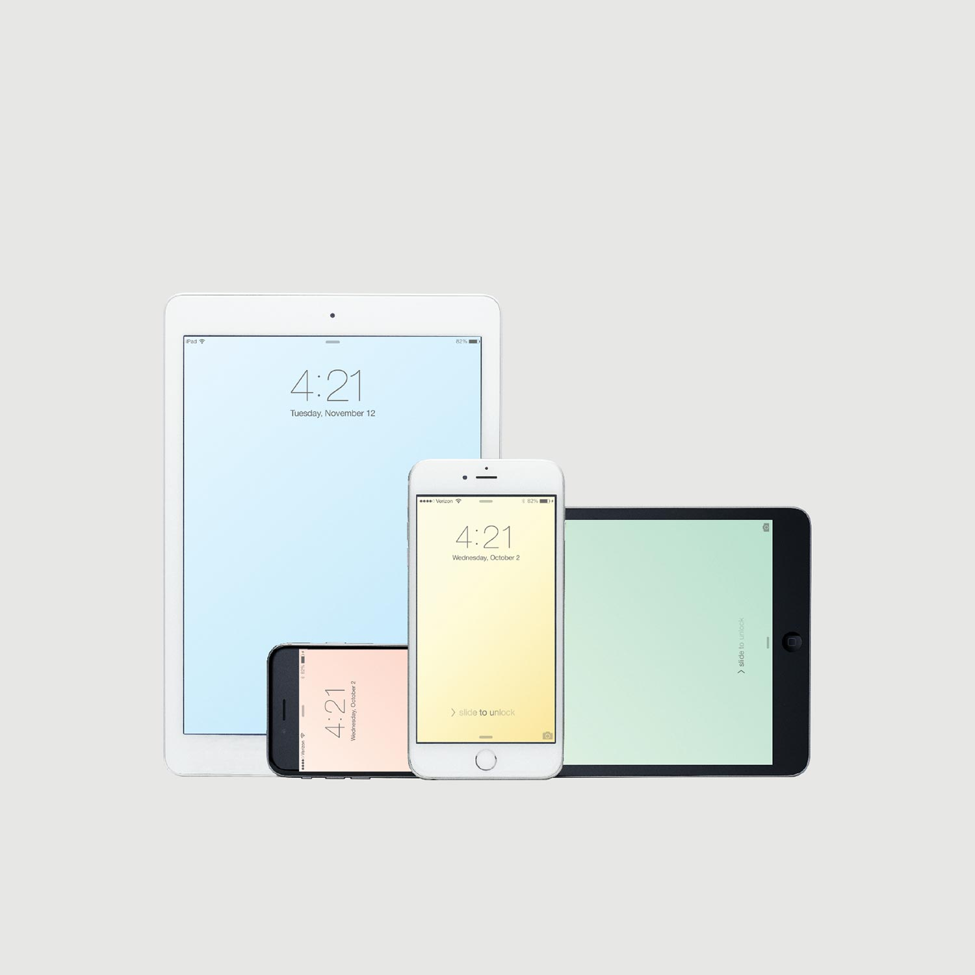
Instructions
Ensure all pictures fill the entire area defined by the placeholder.
Delete these instructions.
This is a “One Statement & Picture” slide.
Use supporting text if needed, and the “Increase List Level” button in the “Paragraph” section of the Home tab to change text levels.

Slide 24
You can vertically center content if desired.

Slide 25
This is a “One Statement & Content” slide.
Supporting text goes here. Use the “Increase List Level” and “Decrease List Level” buttons in the “Paragraph” section of the Home tab to change text levels. To vertically center text, select a text box and then click “Align Text > Middle” in the “Paragraph” section of the Home tab.
Additional text levels are possible.

Slide 26
This is a “One Statement & Chart” slide.
This slide layout is also not for pictures. Instead, use one of the approved picture layouts later in this template.

Slide 27
You can vertically center content if desired.

Slide 28
You can vertically center content if desired.

Slide 29
The “Three Statement” slide is for three big statements.
Text is Arial Bold 26pt.
Statements should be written to fit within a six-line maximum.
Supporting text can be used if needed. Use the “Increase List Level” button in the “Paragraph” section of the Home tab to change text levels.

Slide 30
Use the “Six Statement” slide to make six statements.
Text is Arial Bold 20pt.
Do not add bullets or supporting text to these statements.
Keep statements brief enough to fit in the defined area without resizing.
The background grid uses colors from the approved color palette.
Use sentence case. Only capitalize words that need to be capitalized.

Slide 31
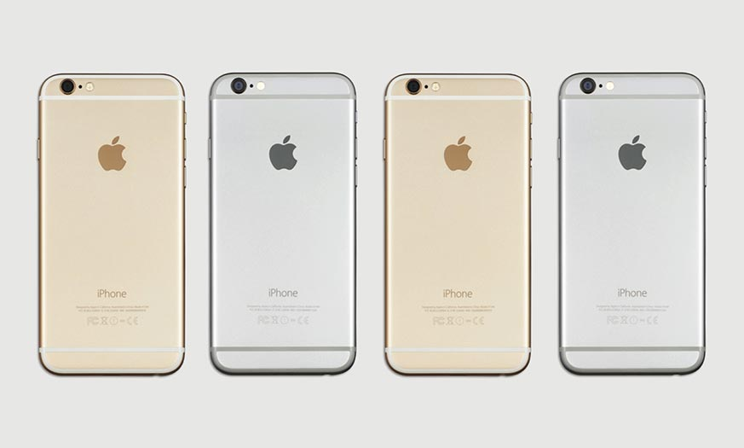
This is a “Text & One Picture” slide.
Use the left column for title and body text. Use this text level as a lead-in or summary paragraph.
Use this level for paragraph-formatted body text.
And use this level for bullet points.
Optional caption goes here in Arial 9pt.

Slide 32
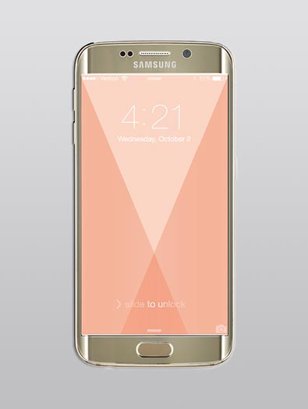

This is a “Text & Two Picture” slide.
Use the left column for title and body text. Use this text level as a lead-in or summary paragraph.
Use this level for paragraph-formatted body text.
And use this level for bullet points.
Optional caption goes here.
Optional caption goes here.

Slide 33

Optional caption goes here.
Optional caption goes here on one or two lines.
Optional caption goes here.

Slide 35
Tables
The “Verizon Table 1” table style is automatically used for all new text tables, but it also can be manually applied to existing tables to reformat them.
The table below was created with the table options “Header Row,” “Banded Rows” and “First Column” turned on. While consistency is important, you can use the Verizon table style as a starting point, but modify the table as needed to communicate the data clearly.
 | Header 1 | Header 2 | Header 3
Item 1 | Text goes here. | Text goes here. | Text goes here.
Item 2 | Text goes here. | Text goes here. | Text goes here.
Item 3 | Text goes here. | Text goes here. | Text goes here.

Slide 36
Full-width tables and charts
If necessary for legibility, the main content area may be extended to the right as far as the slide number (9" wide instead of the usual 7.75" wide) to accommodate full-width tables and charts. Avoid cramming slides full of text and graphics.
See the “PowerPoint reference” section for examples of how to use several charts on one slide.
Tables and charts may be full-width if necessary for legibility.

Slide 37
PowerPoint reference
The following slides provide details and specifications for elements that are used in this PowerPoint template.
The slides are intended to be informational and not design or layout recommendations.

Slide 38
Color palette
Here are the approved colors in the built-in color palette. The RGB formulas for each approved color are shown below for reference. PowerPoint charts will automatically use the first six colors (our primary colors and pops of color) in the order shown. Other approved colors can be manually selected. You should always use approved colors.
Verizon Red
R 205
G 4
B 11
Primary Gray
R 228
G 229
B 227
Teal
R 130
G 206
B 172
Sky
R 171
G 224
B 249
Gold
R 251
G 211
B 98
Salmon
R 249
G 178
B 149
Green*
R 233
G 248
B 233
Blue*
R 232
G 246
B 254
Yellow*
R 254
G 255
B 228
Orange*
R 254
G 240
B 232
White
R 255
G 255
B 255
Black
R 0
G 0
B 0
Support Gray
R 246
G 246
B 246
Charcoal
R 51
G 51
B 51
(Background)
(Text)
(Banded table rows)
(Legal, caption & table text)
*These secondary colors are used as background colors on some of the slides in this template.

Slide 39
Text color and ADA compliance
To comply with ADA accessibility requirements, text must always be clearly legible and contrast sufficiently against the background. The color combinations below have been tested and approved or rejected as indicated. Use the text and background colors coded into this template, and always avoid unapproved color combinations.
Black
Charcoal
Black
Charcoal
Black
Charcoal
Black
Charcoal
Black
Charcoal
Red
Black
Charcoal
Red
Black
Charcoal
Red
Black
Charcoal
Red
Approved
White
Red*
White
Red*
White
Red*
White
Red*
White
White
White
White
Rejected
Do not use
*Red may be used in this combination only when text is 18pt or larger.

Slide 40
SmartArt
SmartArt is PowerPoint’s built-in tool to create process charts, organization charts, Venn diagrams, etc.
SmartArt dynamically creates the graphic based on what you type. For example, if you have a cycle with five circles but you want to add a sixth, just add a sixth text entry and SmartArt creates the circle for you.
After editing SmartArt, you may need to update some formatting—like color— to stay within the style guidelines.
Assess
Plan
Design
Implement
Review

Slide 41
Using several charts on one slide

Slide 42
Using several charts on one slide, continued

Slide 43
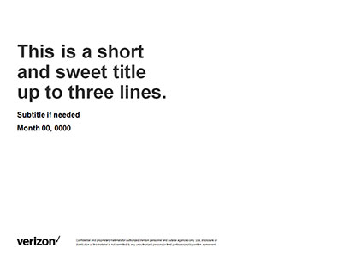

Printing in grayscale and black & white
If you’re printing this template in grayscale or black & white, items on master slides have been configured to print appropriately. For example, the gray background on section headers disappears, and the white circle becomes gray.
However, other elements may not print as expected. For example, white circles in SmartArt and user-drawn graphics may print with black outlines.

