Slide 1
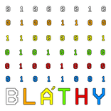
Network design and construction examination papers
Budapesti Műszaki SZC Bláthy Ottó Titusz Informatikai Technikum
Kis Tibor Lócska Gergő István Szamosi Krisztián Benjamin

Slide 2

Introduction
Szálkapari Zrt. as a key contributor to the furniture industry

Slide 3
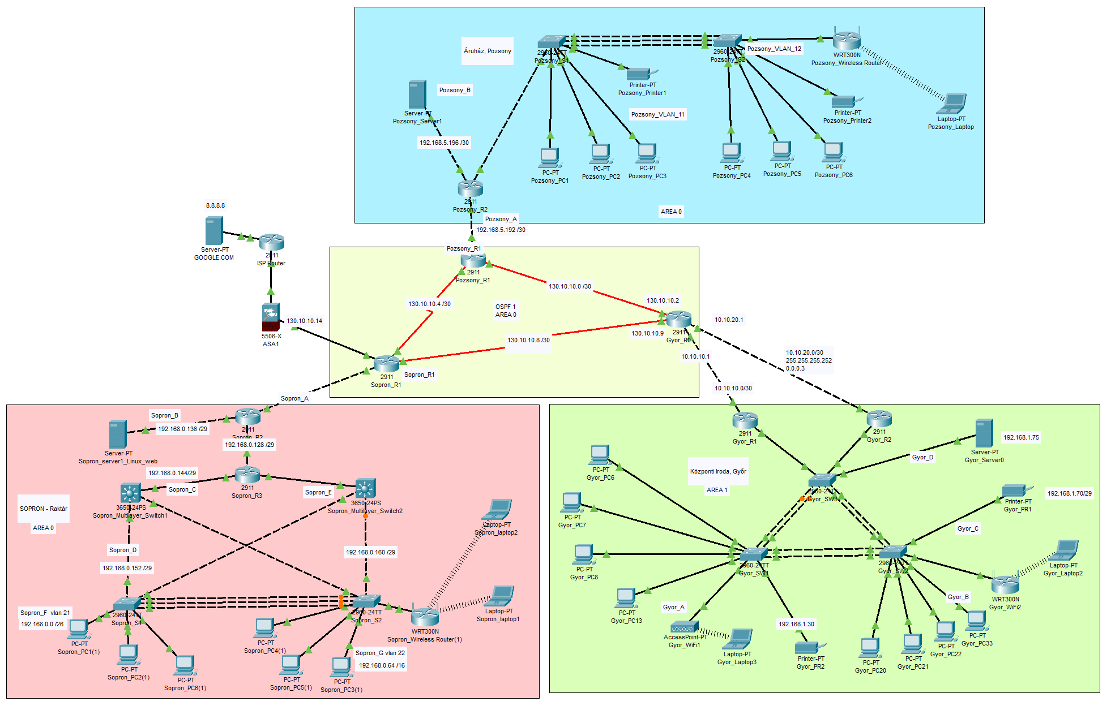
Notes:
GERGŐ kezd Sopronnal
TIBI Győrrel
KRISZTIÁN Pozsonnyal

Slide 4
Physical structure of the network
In order to establish communication in the corporate network, we need to create a channel between the source and destination stations in Győr, Sopron and Bratislava.
Notes:
Ceated:
Sopron
Győr
Bratislava
High-speed leased line.
Internet connection at Sopron site.
Other sites also use this gateway.
The physical firewall is also installed at the Sopron site.

Slide 5
Network logic structure
The distribution layer at each site is divided beyond the physical partition into several logically separate parts, virtual networks. The following figure shows the configuration of these VLANs:
Notes:
GERGŐ

Slide 6
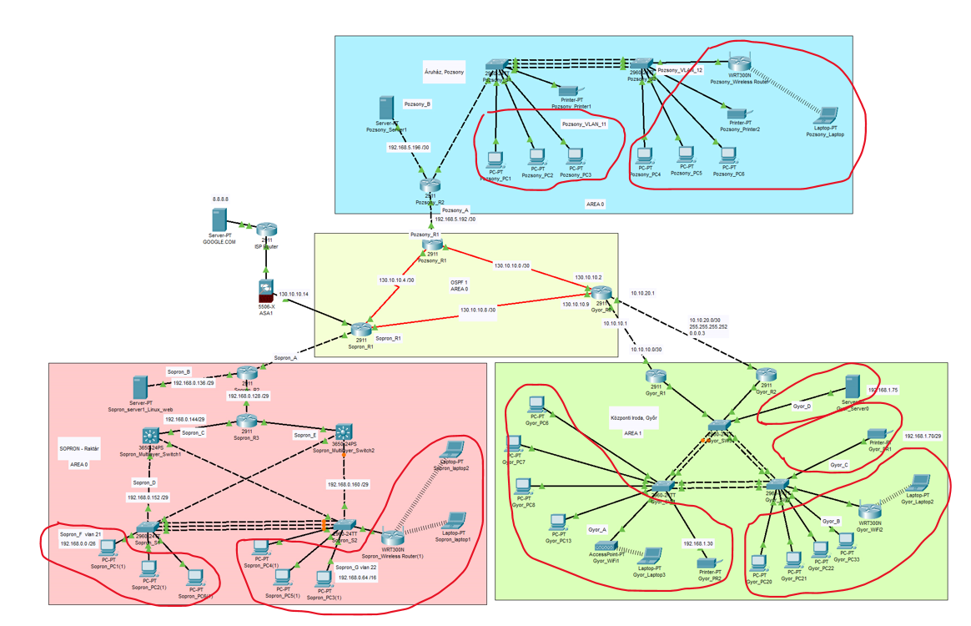
Notes:
GERGŐ

Slide 7
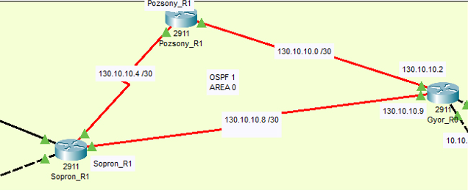
Traffic management
Dynamic traffic management within and between the sites was achieved by creating OSPF areas:
Notes:
GERGŐ
Multi-area OSPF was created, where the backbone network was assigned area "0", in all other cases

Slide 8
IP address allocation
Server PC, traffic routing and statically configured IP address assignment have been implemented in some parts of the company's network.
Notes:
TIBI
The ip address assignment was done in several ways.It has been done by DHCP server, router assigned, or statically.
IPV6 address assignment was also implemented at the Győr site.
The IP address allocation took into account the usage needs of the respective department.
So, where there is more movement there DHCP was implemented, in one case static address allocation, guests can use the wifi router - with dhcp.

Slide 9
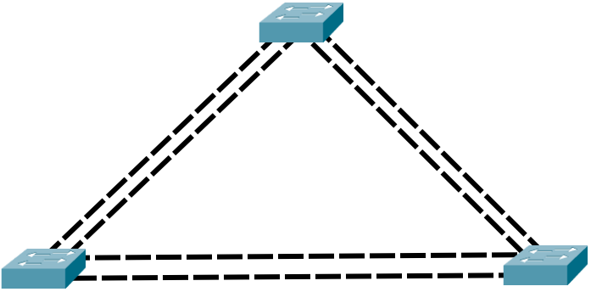
EtherChannel
The EtherChannel (port channel) interface has several advantages:
- Provides redundancy
- You can increase speed with it
Notes:
KRISZTIÁN
It was implemented at all sites, this shows the ether channel implemented at the Győr site
Redundancy
In computing, we call everything redundant that is present in an IT system more often than is usually needed.
This is necessary because if an element were to fail for some reason, another similar element can take over its role, so the system remains operational.

Slide 10
Virtual Private Network
The configuration and implementation of a VPN (Virtual Private Network) is essential for secure communication between the internal networks of the two organizations. The communication between the server in Sopron and the server in Bratislava was realized with a VPN connection.
Notes:
GERGŐ
Based on internal regulations, a more secure VPN connection was established between the server in Sopron and Bratislava.
AES 256-bit encryption
IPsec and ISAKMP
Sh crypto ipsec sa
The submitted exam set contains a video about its operation, due to the shortness of time, we do not want to show it.

Slide 11
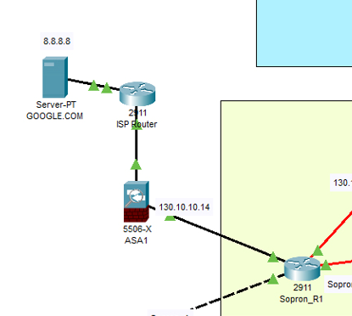
FIREWALL - ADAPTIVE SECURITY APPLIANCE
The firewall plays a critical role in the secure operation of the network.
Notes:
GERGŐ
ASA (Adaptive Security Appliance)
Towards the Internet, the physical firewall was implemented with an ASA device. The two-way traffic is filtered and limited based on the defined rules.

Slide 12
Security functions on the router
As a basic security function, all routers in the network limit access to devices by password protection and by setting access rules. Also, in the case of the availability of the intranet website, we made the https protocol exclusive.
Notes:
KRISZTIÁN
Many security functions can be implemented with ACLs.
Communication between network sites takes place on a leased line, so from a security point of view, it is not exposed to a threat, as if the communication takes place over the Internet.
That is why we found it sufficient to restrict http in the first step.

Slide 13
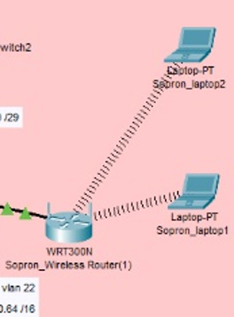
Wireless network
WiFi access is available in several network segments. In some places, this is done with an Access Point, while in others with a WiFi Router.
Notes:
TIBI
The use of wireless networks is inevitable and should not be a goal.
In addition to the many advantages they provide, their disadvantages are insignificant.
Mobility and convenience from the user side, while scalability, cost reduction or installation flexibility make the technology attractive from the owner and system administration side.
In the case of routers, the IP address was assigned using DHCP in all cases.

Slide 14
Windows server configuration
We installed the following services on the Windows Server 2016 operating system:
DHCP
Active Directory
DNA
File and print server
Timed backup
Notes:
TIBI
Why WinServer?
User-friendly interface
Compatibility with clients
Extensive support (bug fixes, updates)
Competitive virtualization solution (Hyper-V)
Many applications
House rules

Slide 15
Linux server configuration
We installed the following services on the Linux (Ubuntu server) operating system:
DNA
Apache web server
SSH
FTP
Samba - file server
Notes:
TIBI
Why not WinServer?
License cost, Resource requirement, Closed source code,The Linux server operates at the Sopron location.
After installation, it received the name Sopron-linux and a static IP address.DNS-> BIND 9, this server is also specified for the windows server, so they can also work with other name resolution.
Performs web server name resolutionApache web server - intranet web service, where there is a company phone book, useful employee informationSSH - secure remote login, for remote and secure access to your linux serverFTP - we do not use it, but it is set as a basic functionSamba - file server - a significant part of our network includes Windows clients, these can optimally connect to the Linux file server with the services of Samba

Slide 16
Future developments
DMZ
Automated save
Introduction of a company management system
To strengthen the role of the Home Office in the life of the company, where possible
Notes:
KRISZTIÁN
DMZ (innovative implementation, for the purpose of implementing a company management system)-
Automated save
- Creation of Home Office VPNs, cost reduction

Slide 17
Teamwork
Collaboration, patience and a little humor are essential factors for teamwork.
Notes:
KRISZTIÁN
Pozsony – Krisztián
Sopron – Gergő
Győr – Tibi
(IP számítás, helyi topológia, hibakeresés, forgalomirányítás)
Topológia - Gergő + Krisztián
Szerverek - Tibi
VPN konf. – Gergő
Logo, szövegezés, lektorálás, költségvetés, fordító – Krisztián
Trello, Microsoft Teams, Messenger, GitHUB és személyes találkozó

Slide 18
Thank you for your attention!

