Slide 1

Webshop for home brewing
Made by:
Balázs Lelovics, Gergő Lócska

Slide 2
The purpose of the application:
The webshop is an online platform that offers ingredients, equipment, and packages necessary for home brewing to customers. The goal of the webshop is to provide a user-friendly interface where customers can easily browse and purchase products. The system will include user management and shopping cart functionality.

Slide 3
The functions of the application:
Listing and filtering products by categories.
User registration.
Managing user login and logout.
Shopping cart management.

Slide 4
The technical implementation:
Backend:
Laravel 9
Php
Frontend:
Vue 3
Vite
Rest API
Axios
Bootstrap
Pinia store:
Database:
MySQL 8

Slide 5
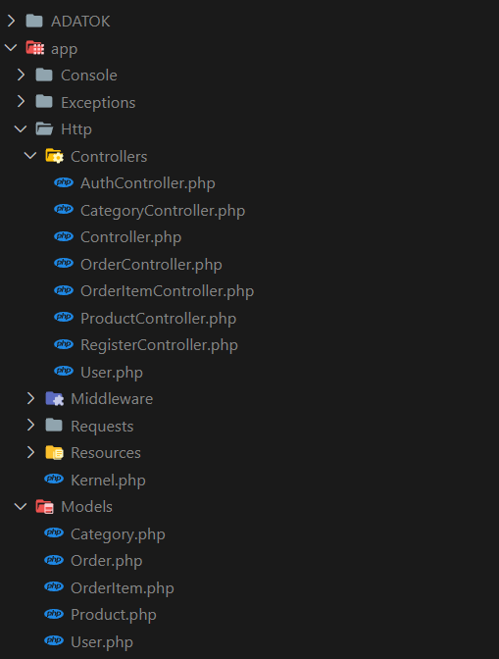
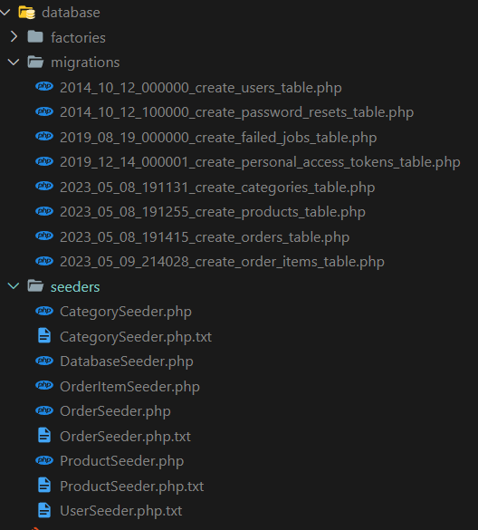
Backend:
Model
Migration
Seeders
Controllers
Requests
Resource
Api routes

Slide 6
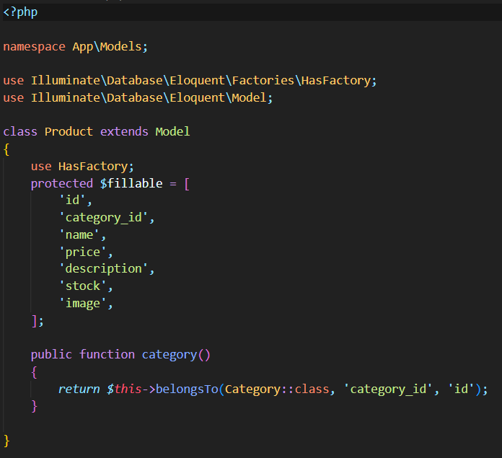
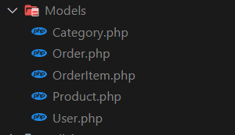
Models:

Slide 7
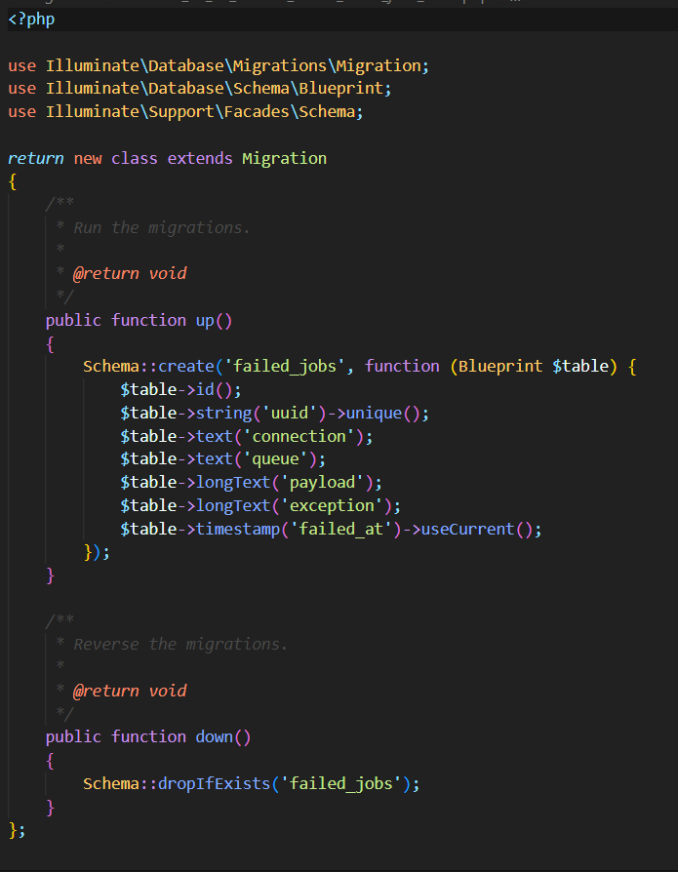
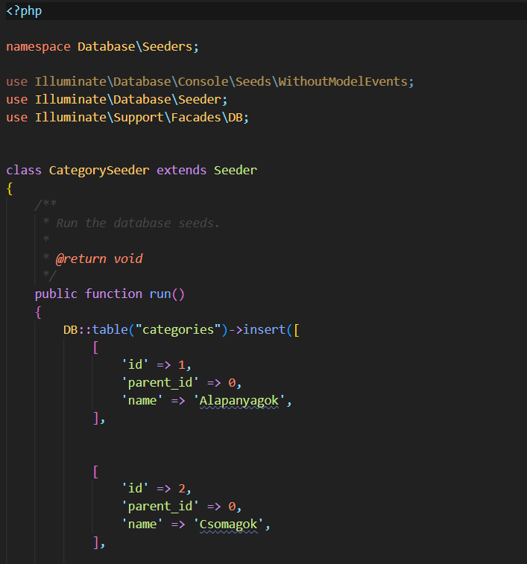
Migration:
Seeders:

Slide 8
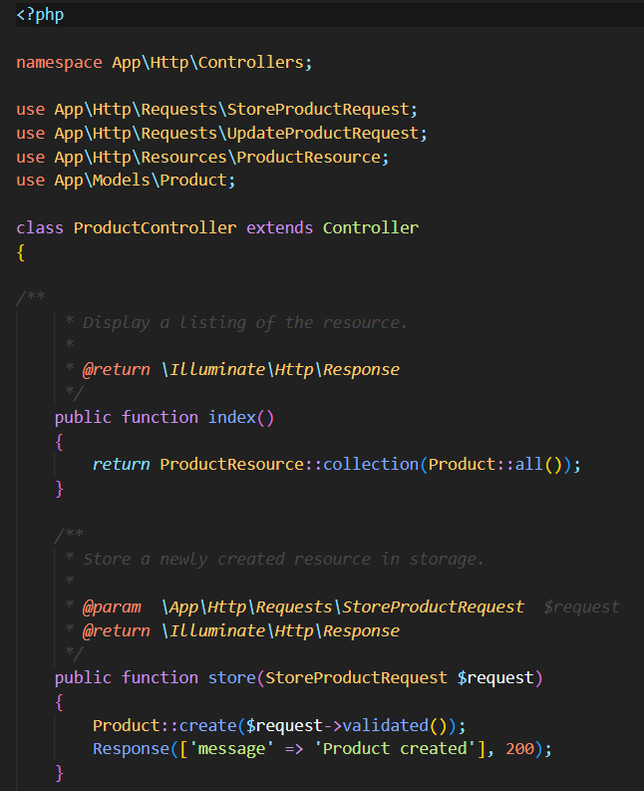
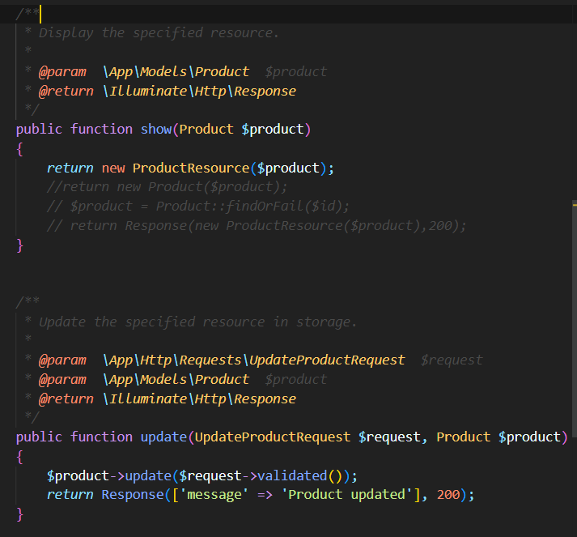
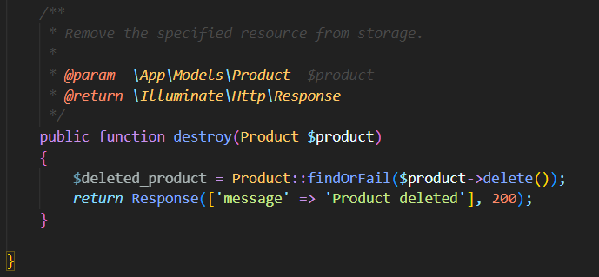
Controllers :

Slide 9
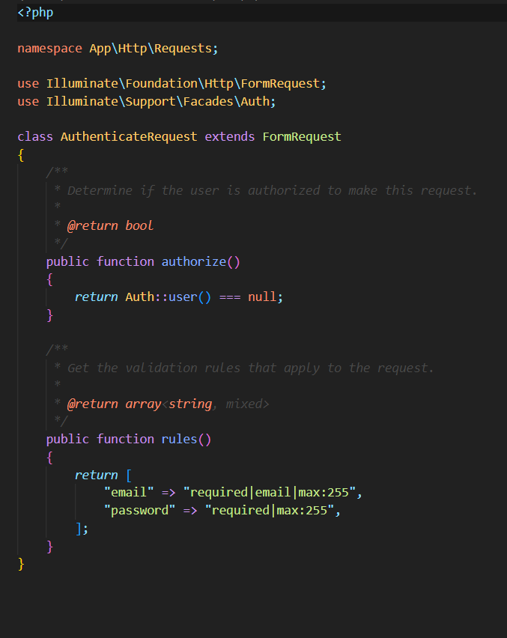
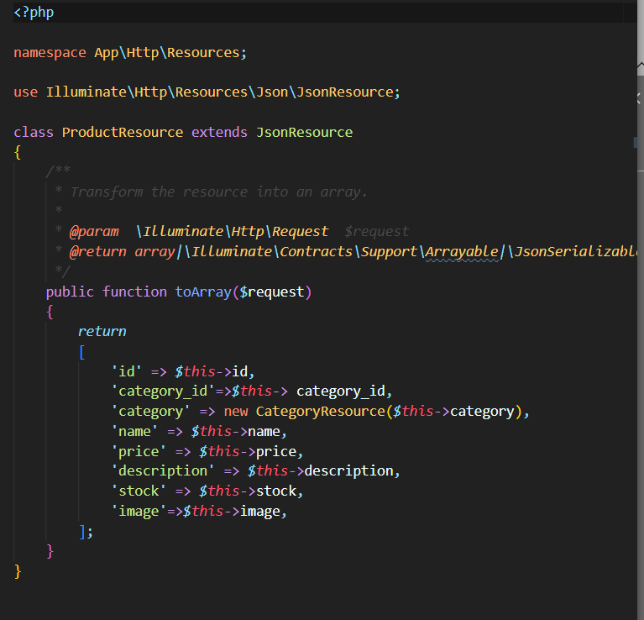
Requests:
Resource :

Slide 10
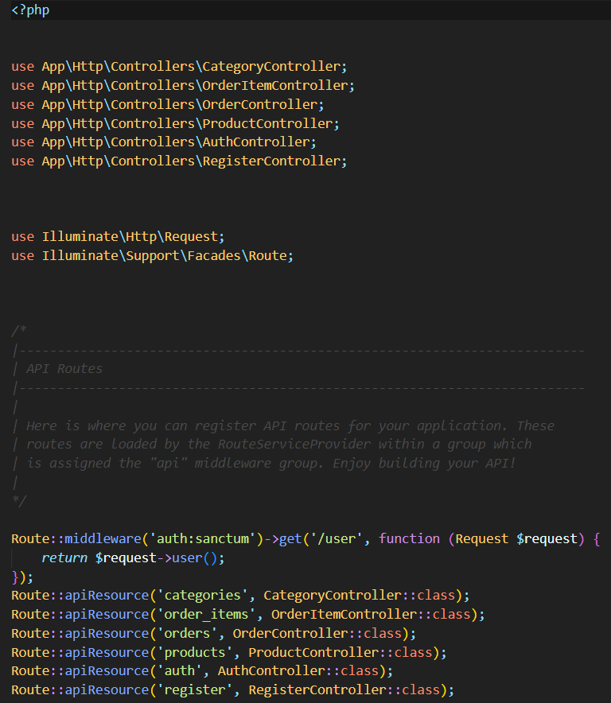
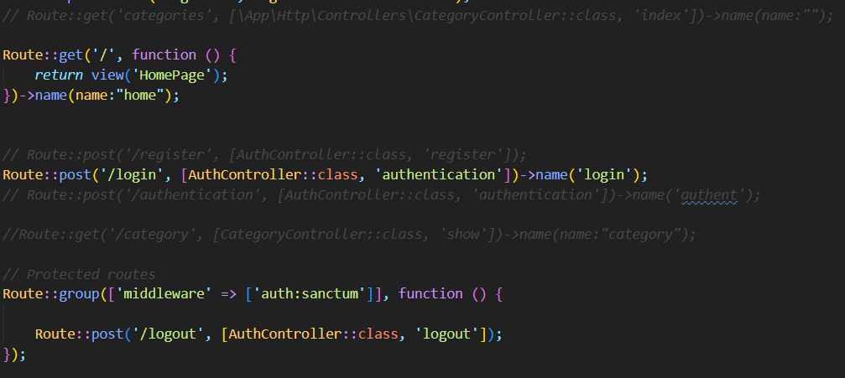
Api routes
:

Slide 11
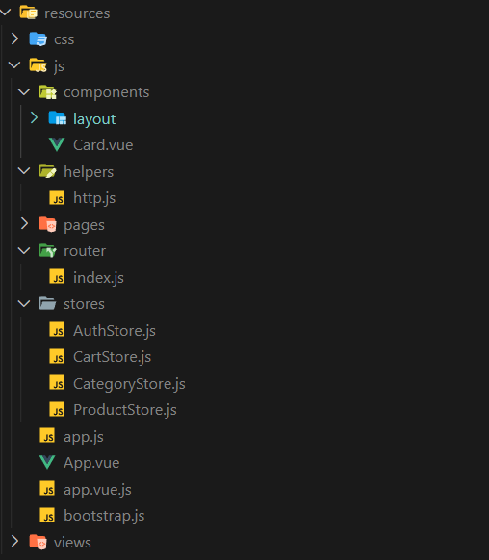
Frontend: • Components • Pinia store • Pages • Route

Slide 12
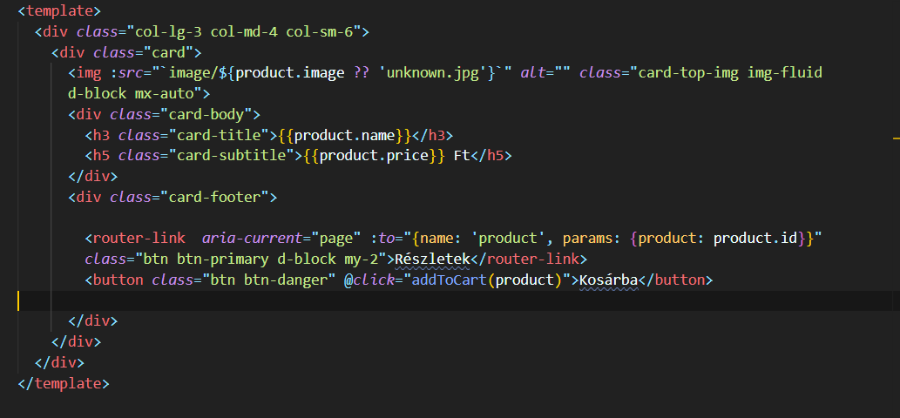
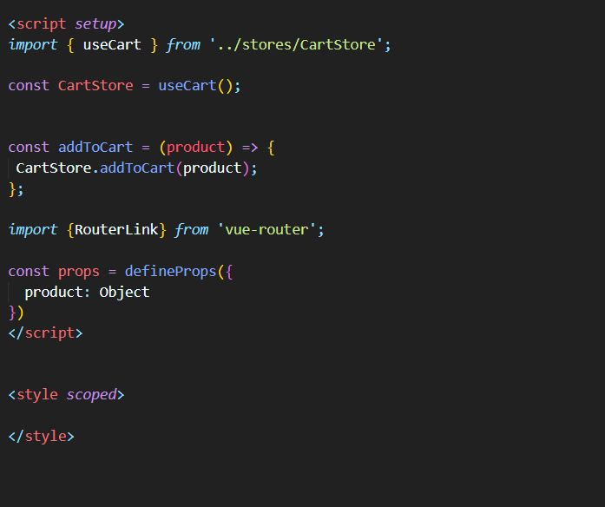
Components:

Slide 13
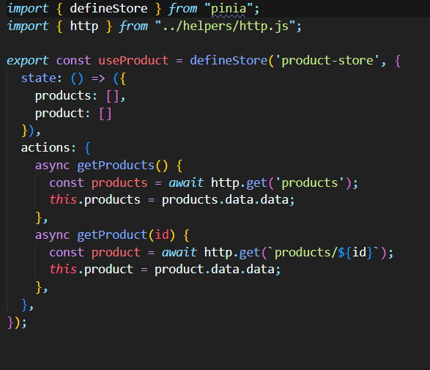
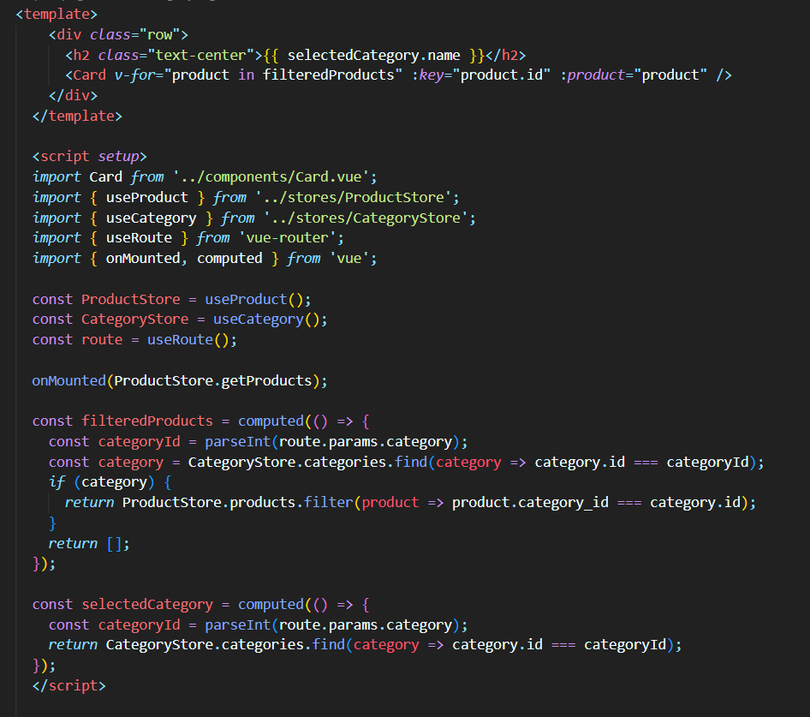
Pinia store:
Pages

Slide 14
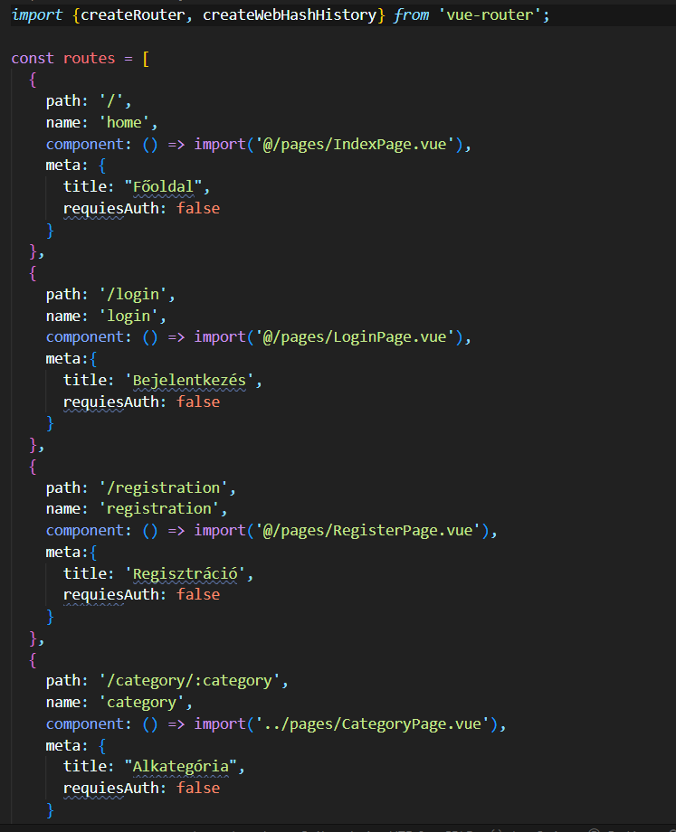
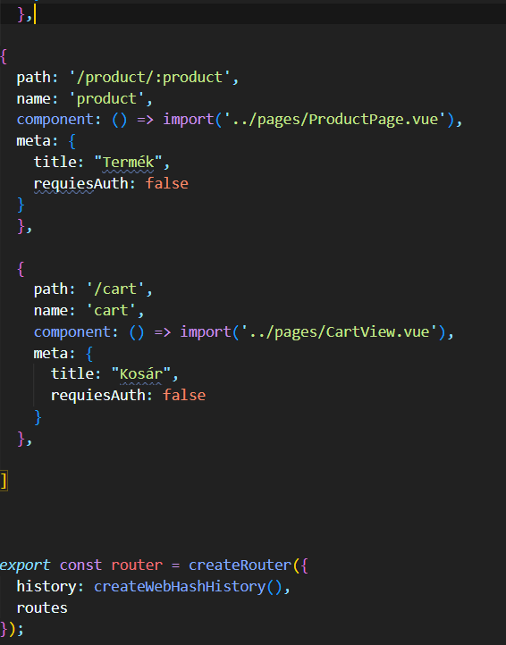
Route

Slide 15
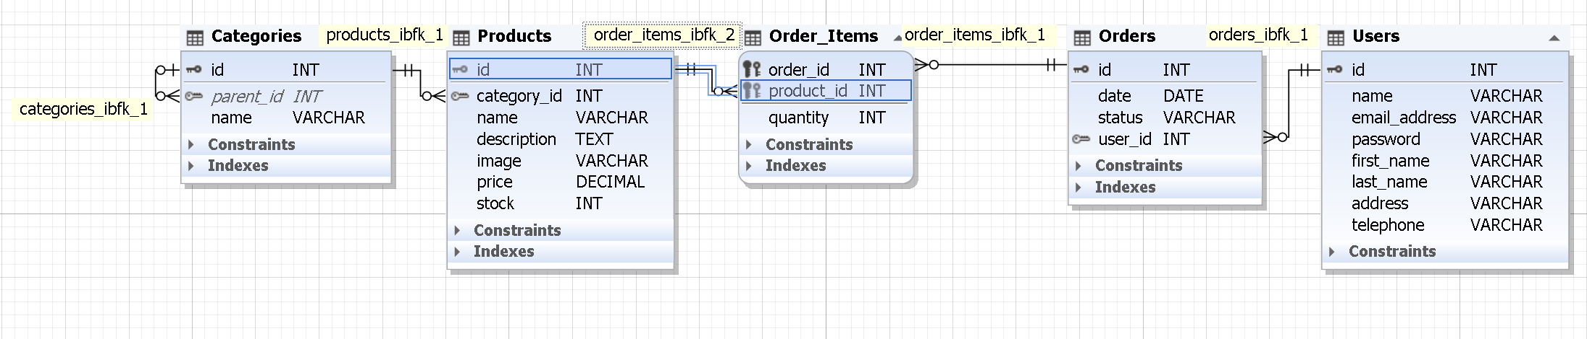
Database ER diagram:

Slide 16
Assigning tasks, organising teamwork:
Organising teamwork:
Github
Google Drive
Onenote
Discord
Clean Code
Assigning tasks:
Backend:
model Balázs
migráció Together
seeder Gergő
controller Balázs
request Balázs
resource Balázs
api route Gergő
Assigning tasks:
Frontend:
Components:
Cart, Sidebar: Gergő
Card, Navbar: Balázs
Pinia store:
Cart store: Gergő
Category, Product, Auth: Balázs
Pages:
Cart, Category, Product: Gergő
Login, Register: Balázs
Index: together
Route:
index.js:together

Slide 17
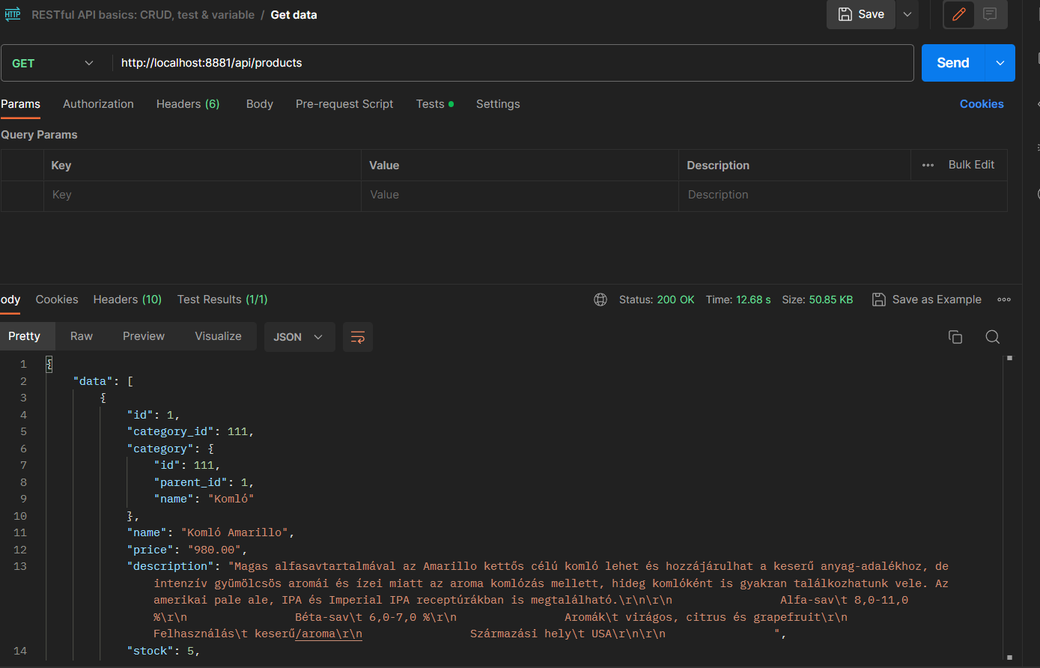
Presentation of tests:
Over-the-shoulder review
User Test
API Test - POSTMAN

Slide 18
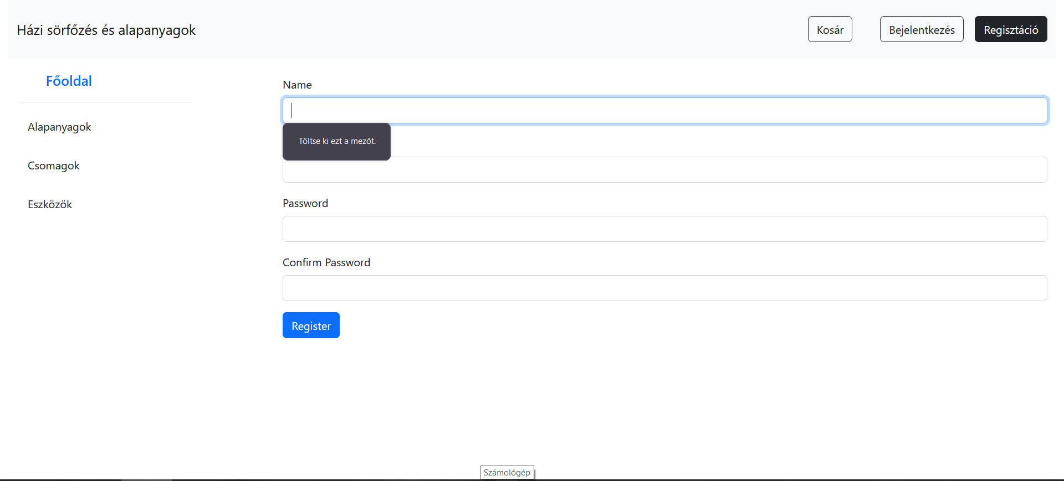
Register site :

Slide 19
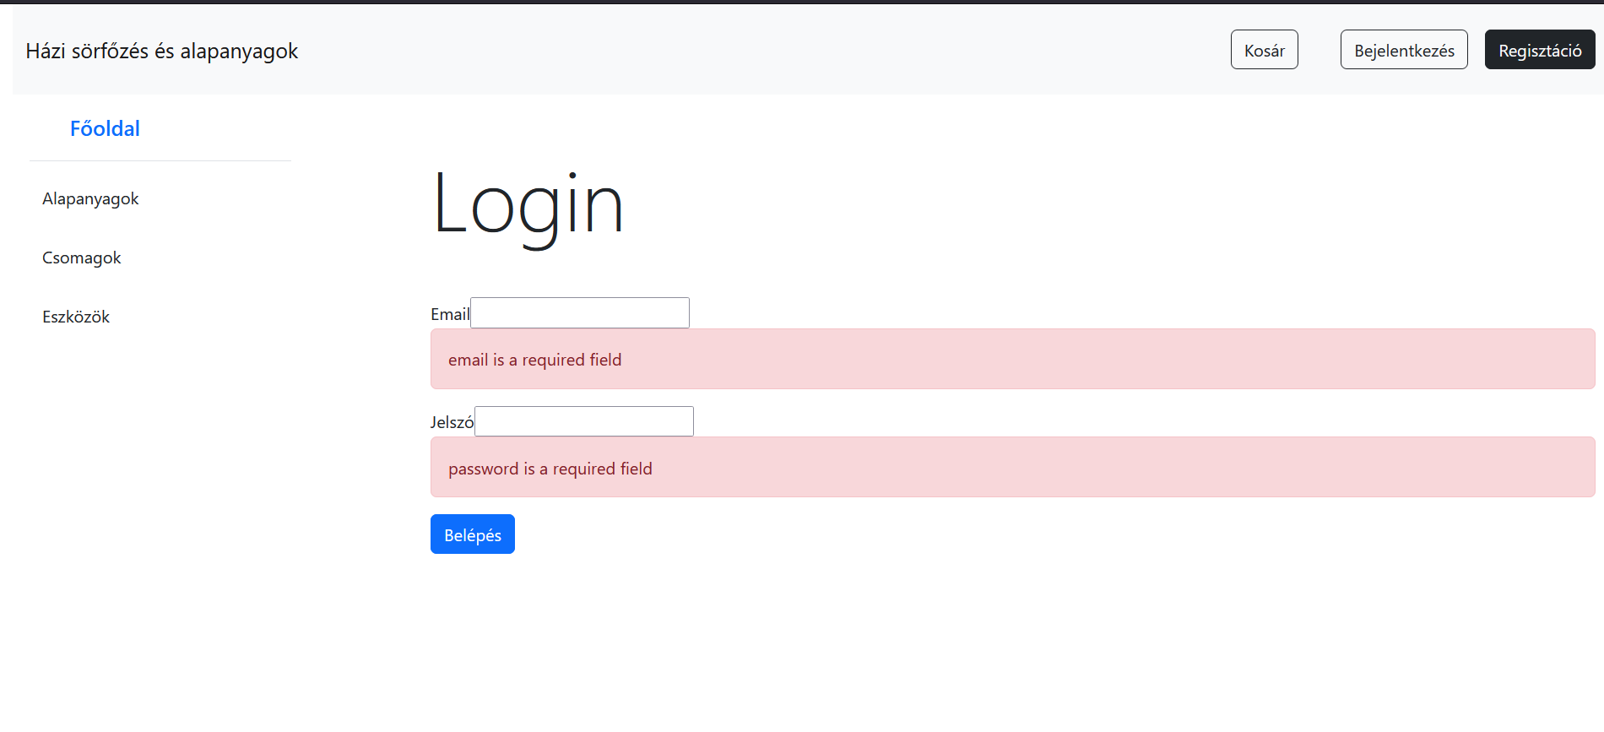
Login site:

Slide 20
The operation of the application:
The application is designed to provide an online platform for home brewing enthusiasts to easily browse, purchase, and manage the necessary ingredients and equipment for brewing beer at home. The following is an overview of how the application functions:
Product Listing and Filtering:
Users can browse and search for products based on different categories and filters.
The application retrieves the product data from a database and presents it to the users in an organized manner.
User Registration:
Users can create an account by providing their information through a registration form.
The application validates the input data and stores it securely in a user database.
User Login and Authentication:
Registered users can log in using their credentials to access personalized features.
The application verifies the user's login information and grants access to restricted areas.

Slide 21
Cart Management:
Users can add desired products to their shopping cart.
The application keeps track of the selected items and allows users to modify the quantities or remove items from the cart.
The cart data is stored either in the user's session or linked to their account for persistent use across sessions.
Frontend Interaction:
The frontend of the application processes and presents the data provided by the backend.
Various pages are designed to fulfill specific functions, such as displaying product listings, managing user registration and login, and handling cart-related operations.
Components, such as the navigation bar and sidebar, facilitate navigation and user interaction.

Slide 22
Backend Functionality:
The backend of the application handles data retrieval, storage, and business logic.
It communicates with the frontend through APIs, responding to requests for data and performing necessary operations.
Backend controllers process the incoming requests, validate the data if needed, and execute the corresponding actions.

Slide 23
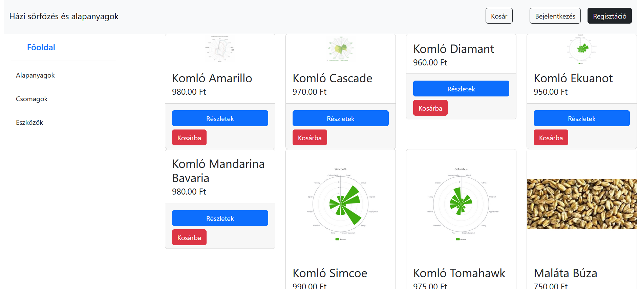
Introduction of the application

Slide 24
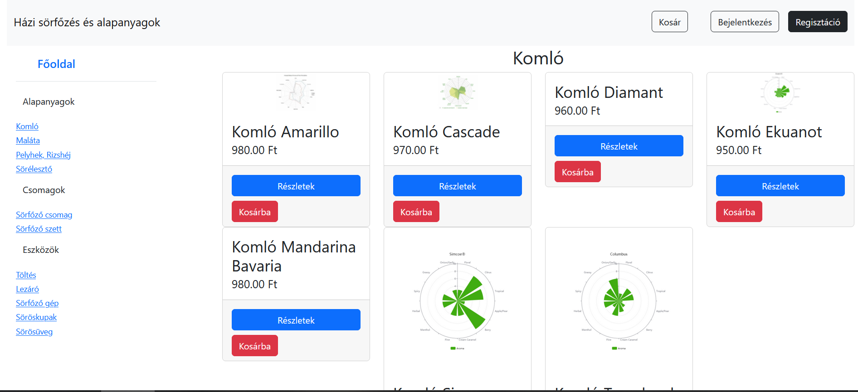

Slide 25
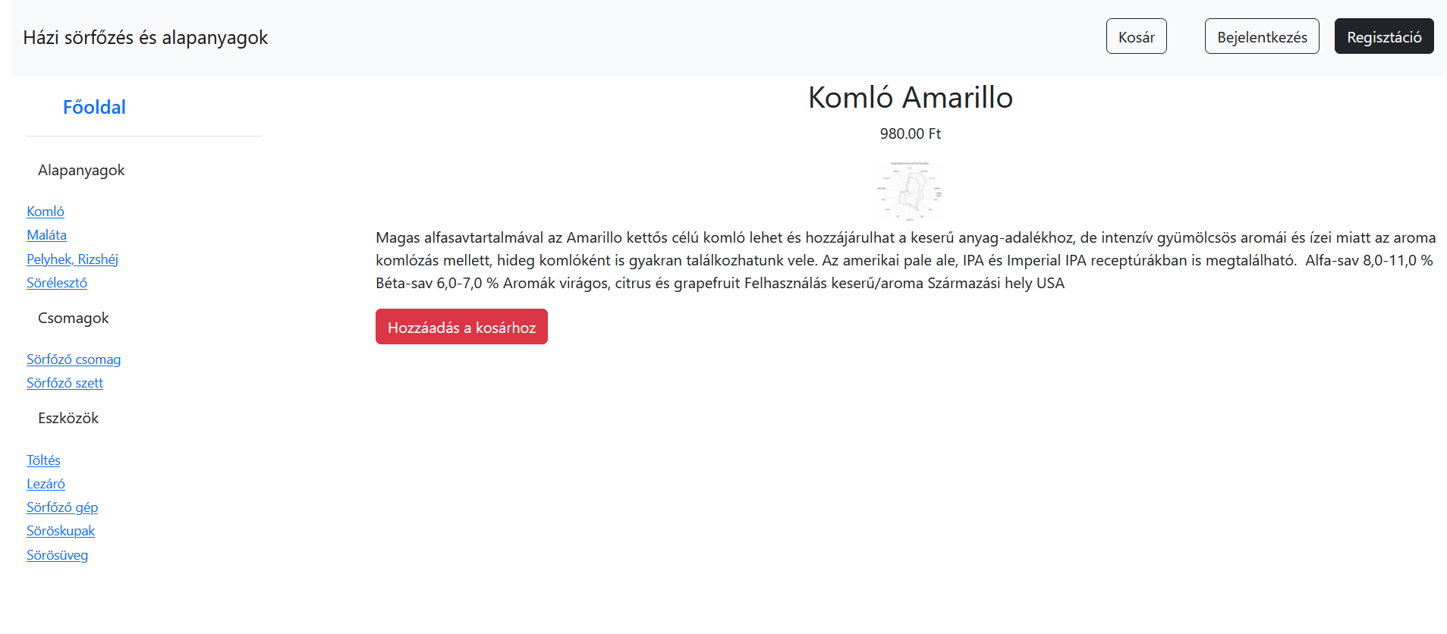

Slide 26
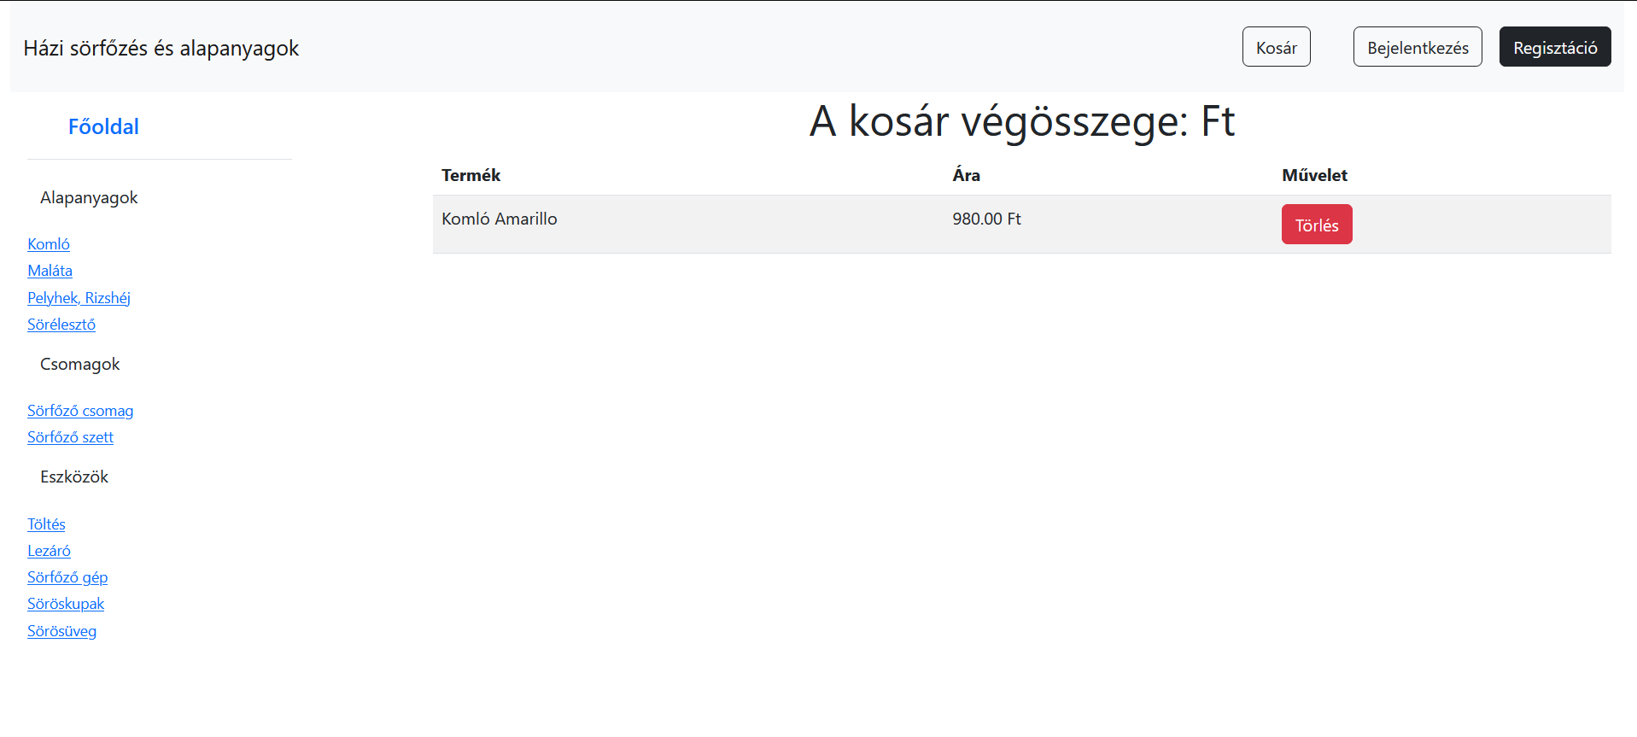

Slide 27
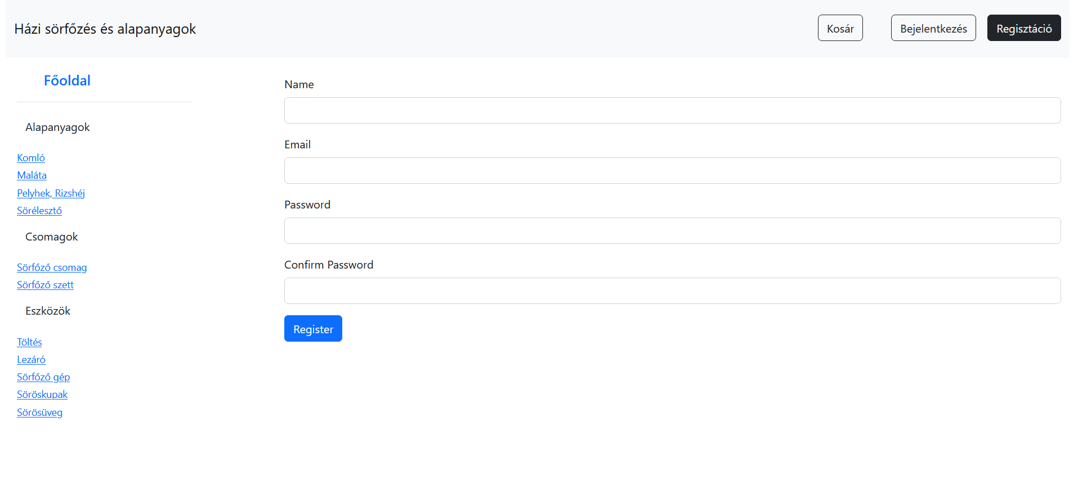

Slide 28
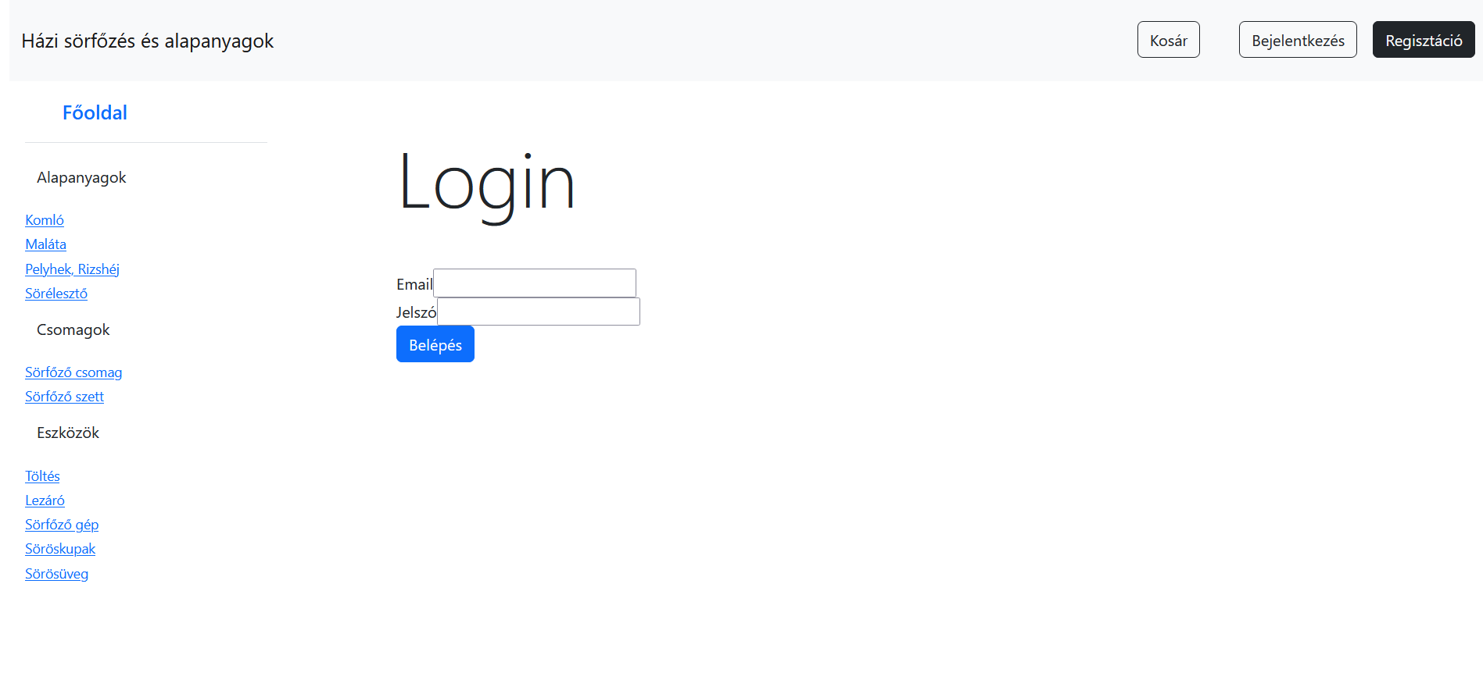

Slide 29
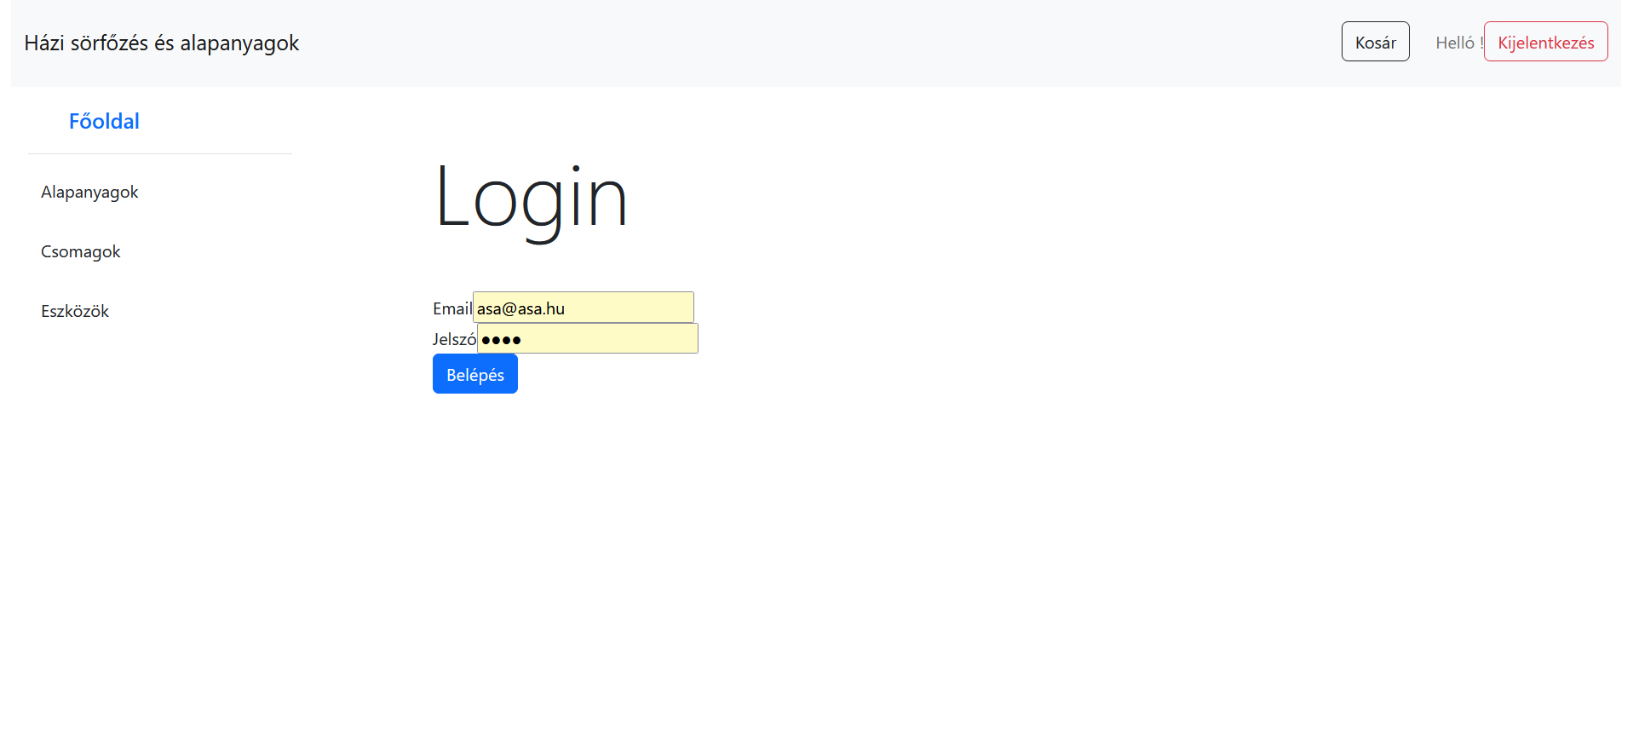

Slide 30
Register site :

Slide 31
Login site:

Slide 32
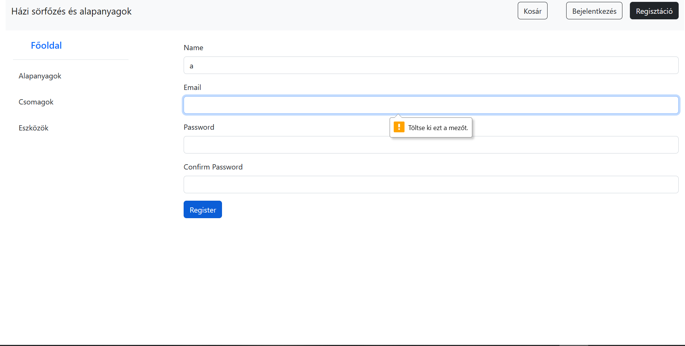

Slide 33
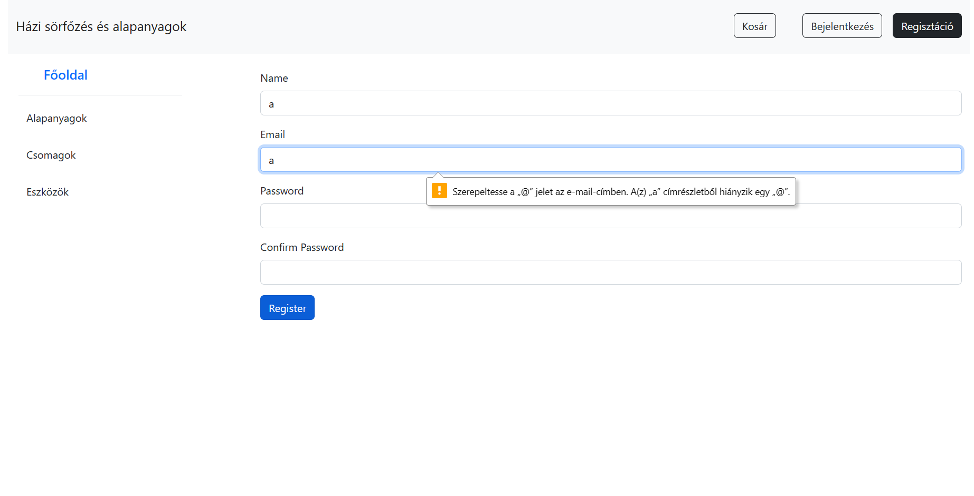

Slide 34
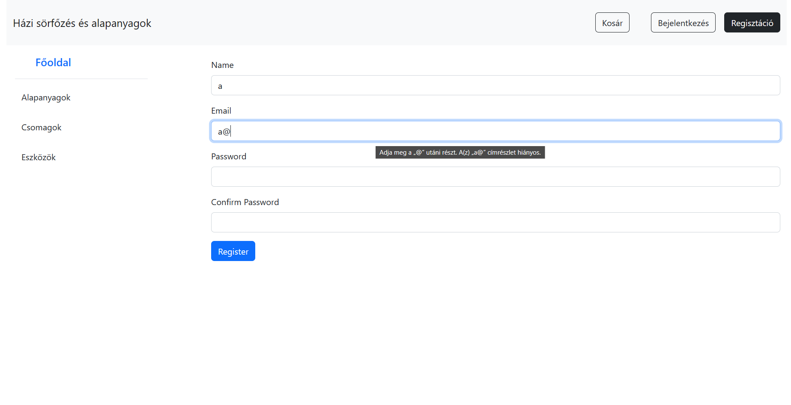

Slide 35
Future Plans:
The application has potential future enhancements, such as implementing user notifications for login, logout, and registration events, calculating the total cost of the cart, incorporating payment options, managing delivery information, developing an admin interface for administrative tasks, and creating a user profile interface for personalized settings.

Slide 36
Köszönjük a figyelmet!

