Slide 1
Self-driving car renting service

Slide 2
1. Benefit of app

Slide 3
- You do not have to spend time going to the place to choose a car, but anywhere you can choose a vehicle for yourself.
-The interface is designed for users to use easily, quickly and efficiently. Use local (search) filters, vehicle type, price, etc. to find the car that suits you best. Vehicle information and images are also presented clearly and concisely.
-All information about the car owner and the car is displayed on the app for customers to know
-All customer information will be kept strictly confidential

Slide 4
2. The functions of the app

Slide 5
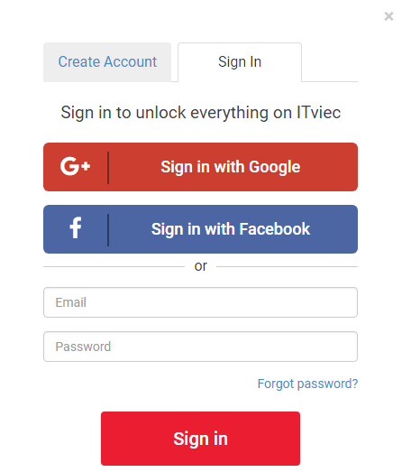
All users authenticate with gmail.

Slide 6
- The system must allow customer to register for reservation. - The system must allow customer to view detail information of particular car. - The system must view list of available car during reservation. - The system shall allow the customers to cancel their reservation using reservation confirmation number. - The system shall present an option for advanced search to limit the vehicle search to specific categories of vehicles search.E.g. By Brand, Type and Model. - The system shall allow the customers to extend their reservation when their reservation is due. - The system shall allow the customers to view their reservation history.

Slide 7
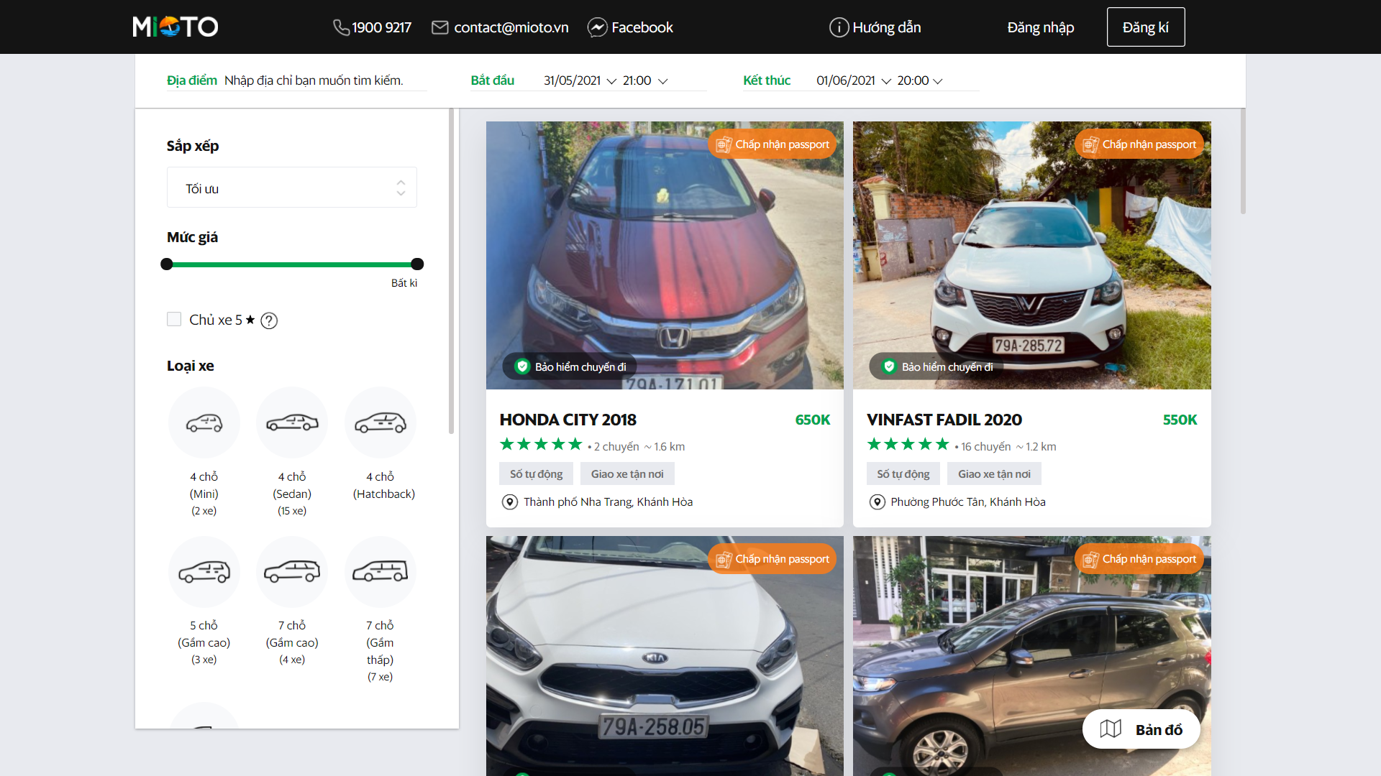

Slide 8
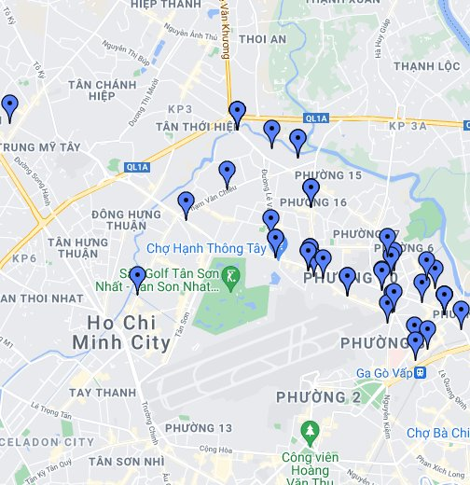
The system shall allow the customer to choose their nearest garage for them to pick up their vehicle.

Slide 9
- The system should allow staff to register new cars. - The system shall allow staff to update information of the car in need of modification. - The system shall allow staff to display all lists of car - The system shall allow staff to cancel the booking of customers into rental list. - The system shall allow staff to display all rented car. - The system shall allow staff to display all off duty car.

Slide 10
- The system shall allow staff to select cars in the list - The system shall allow staff to update about customer rent record details in the rental list. - The system shall be able to save all changes made on the customer rent list. - The system shall allow staff to select customer rent record by specific search category - The system shall allow staff to display customers, who rent cars. - The system shall allow staff to display all customers rent record.

Slide 11
- The system shall allow the manager to update user account. - The system shall allow the manager to delete user account. - The system will allow the vehicle lessor to register a new vehicle. - The system will allow the lessor car to cancel a car on the rental list. - The system will allow the lessor car to update a car on the rental list. - The system will allow the lessor car to display all lists of cars on the rental list.

Slide 12
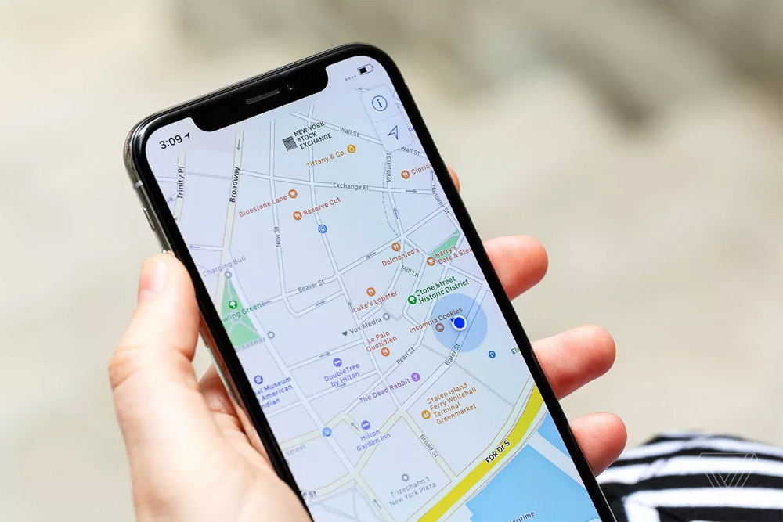
- The system will have constant updates on the specific location of the cars.

Slide 13
Cảm ơn thầy và các bạn đã lắng nghe

