Slide 1

Distributed Message broker

Slide 2
01
Distributed Message broker
Broker Architecture Style
02

Slide 3
1.
Broker Architecture Style

Slide 4
Broker Architecture Style
Broker
Client-side Proxy (Stub)
find_server
find_client
forward_request
forward_response
Server-side Proxy (Skeleton)
Pack_data
unpack_data
send request
return
Pack_data
unpack_data
call_service
send_response
Bridge
Client
Server
Pack_data
unpack_data
forward_message
transmit_message
Call_server
start_task
use_broker_API
Initialize
register_service
enter_main_loop
run_service
use_broker_API
Broker
...................

Slide 5
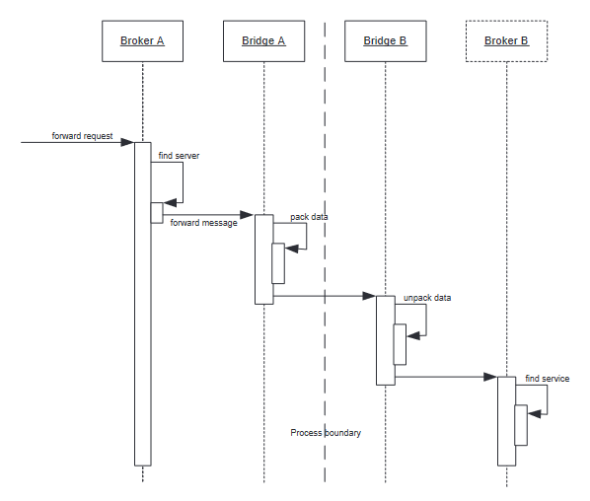

Slide 6
01
Reusability
02
Advantages
Maintainability
03
Flexibility

Slide 7
01
Overhead
Disadvantages
02
Indirection complexity
03
Difficult testing

Slide 8
2.
Message Broker Architecture

Slide 9
What is a message broker?
Message broker (also known as integration broker or interface engine) is an intermediary module that transfers messages from sender to receiver. It is an architectural pattern for inspecting, relaying, and navigating messages; mediate between applications, simplifying communication between them, and to maximize the efficiency of splitting into smaller blocks. The main task of a Message broker is to receive messages from applications and perform some action.

Slide 10
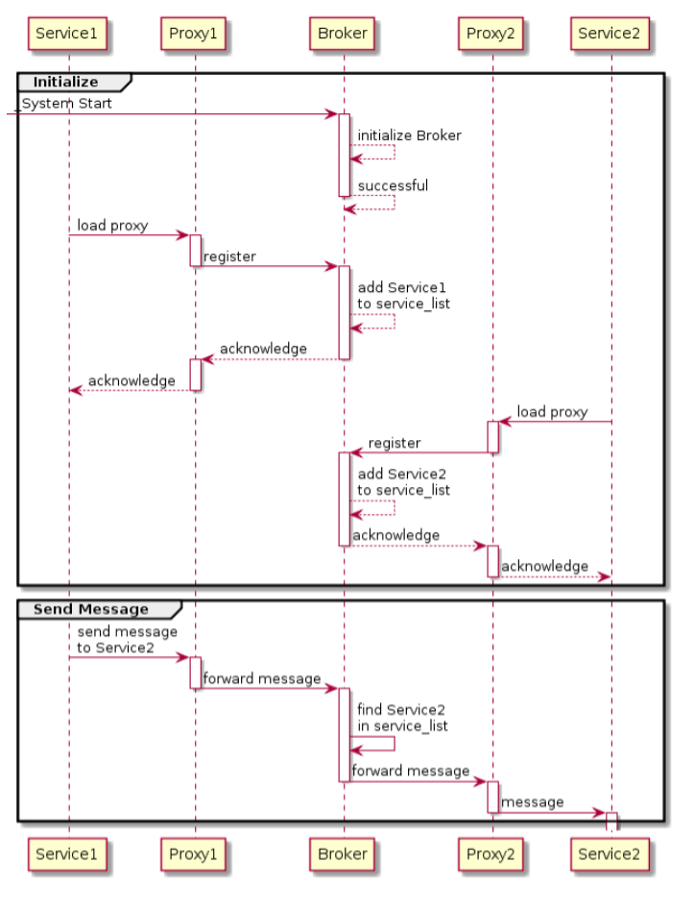
Sequence diagram

Slide 11
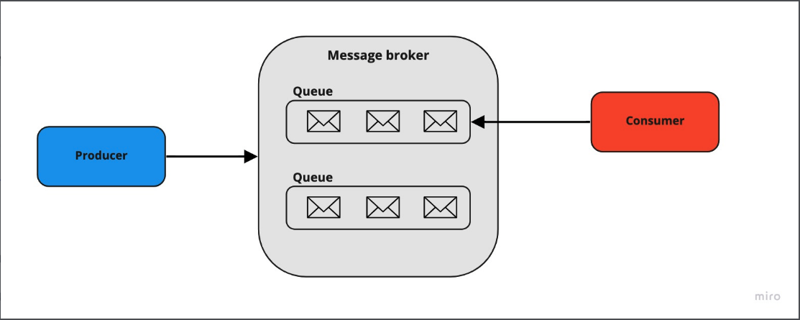
Two most common distribution patterns
Point-to-point messaging
In this pattern, there is one-to-one relation set between the sender and the receiver of the message. Each message is sent and consumed only once.
The message broker guarantees that message will not be lost in case of failure of the consumer. It’s stored safely in the message broker queue.

Slide 12
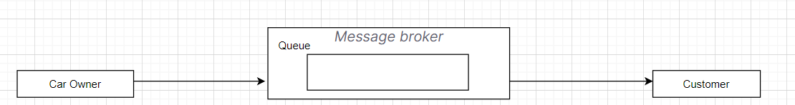
Two most common distribution patterns
contract
conversation

Slide 13
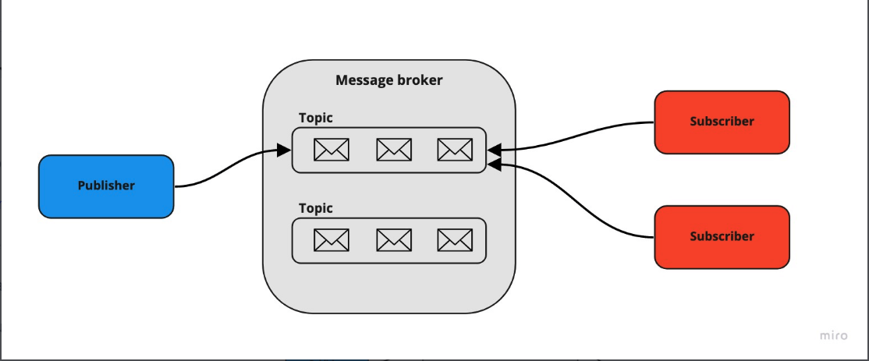
Two most common distribution patterns
Publish/subscribe
Here, the sender of the message doesn’t know anything about receivers. The message is being sent to the topic. After that, it’s distributed among all endpoints subscribed to that topic. It can be useful e.g. for implementing notifications mechanism or distributing independent tasks. This solution can also lead to implementing an event-driven architecture-based system, where applications have fewer dependencies between each other.

Slide 14
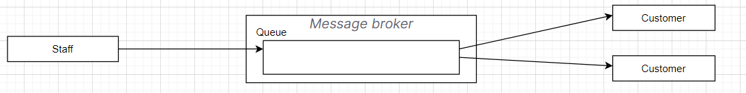
Two most common distribution patterns

Slide 15
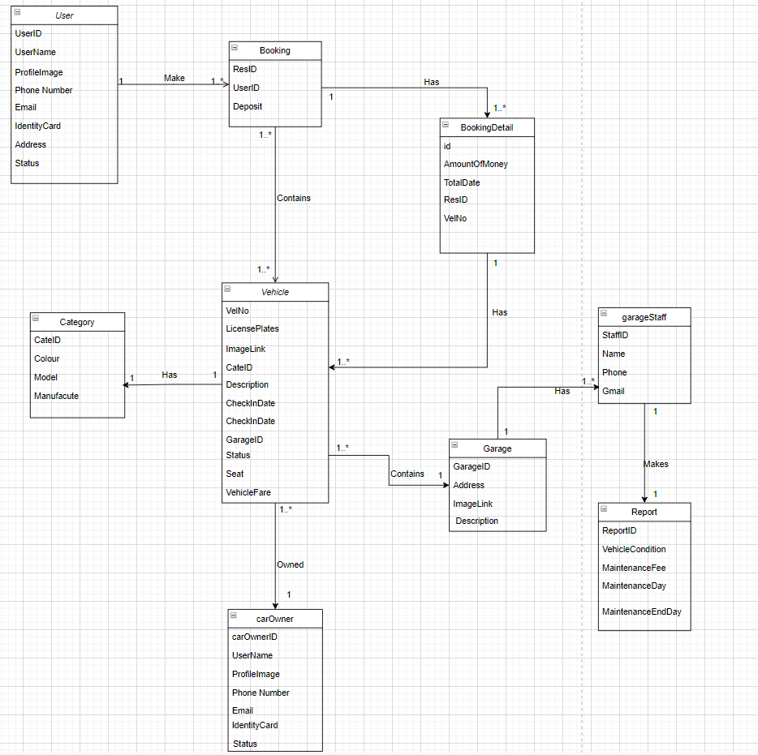

Slide 16
THANKS!

