Slide 1

Self-driving car renting service

Slide 2
1.
Message Broker Architecture

Slide 3
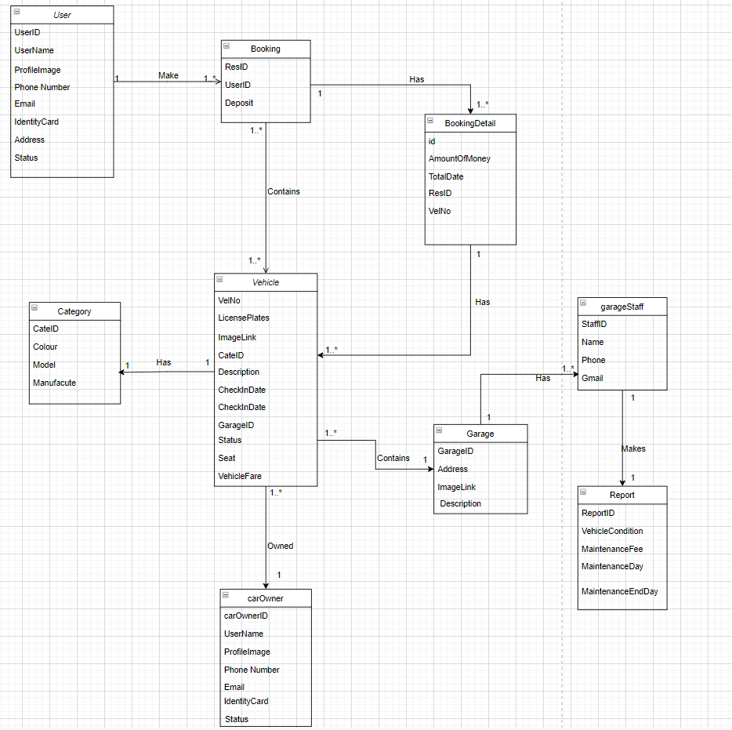

Slide 4
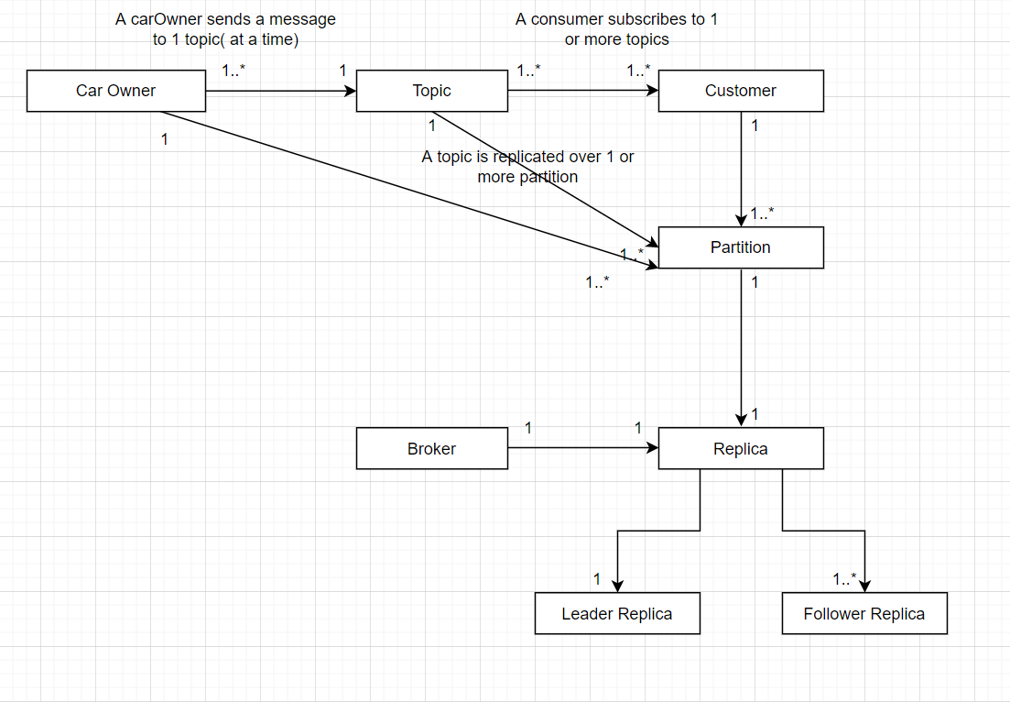
This is a slide title
Here you have a list of items
And some text
But remember not to overload your slides with content
Your audience will listen to you or read the content, but won’t do both.

Slide 5
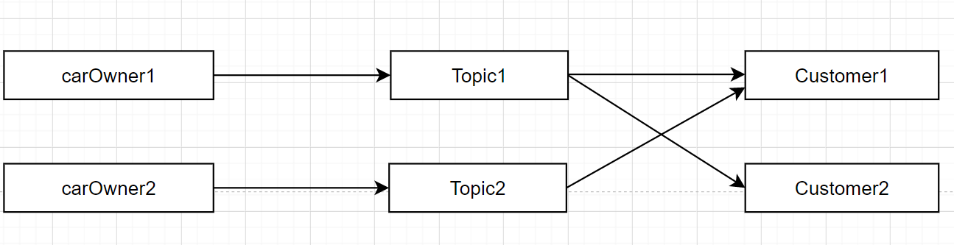
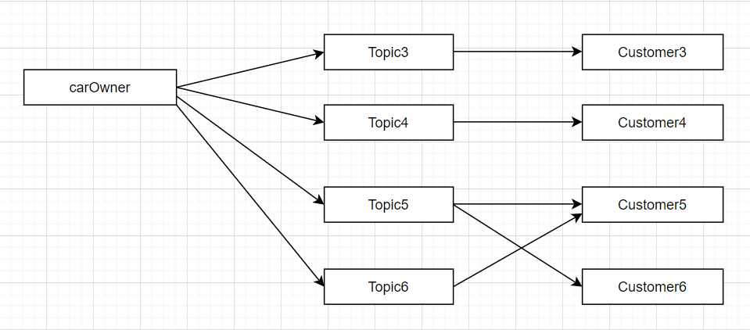

Slide 6
2.
Asynchronous communication & Synchronous communication

Slide 7
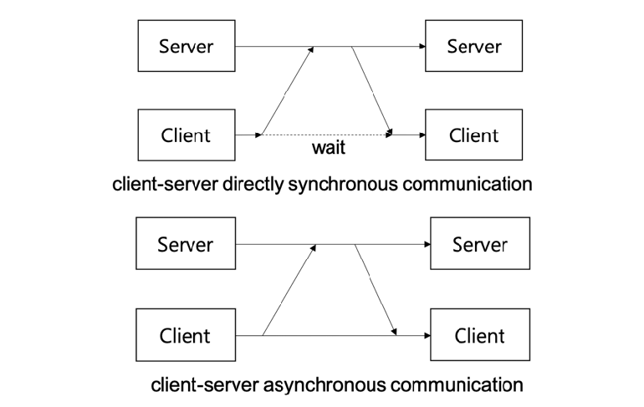

Slide 8
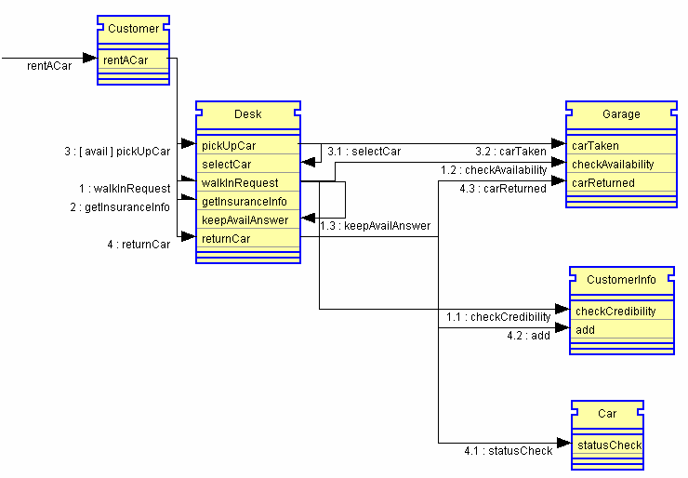

Slide 9
3.
Interaction

Slide 10
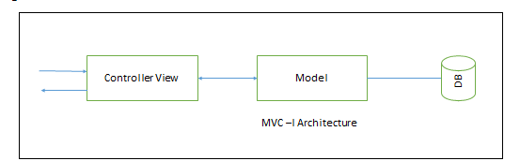
MVC-I Architecture

Slide 11
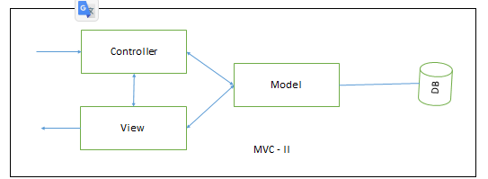
MVC-II Architecture

Slide 12
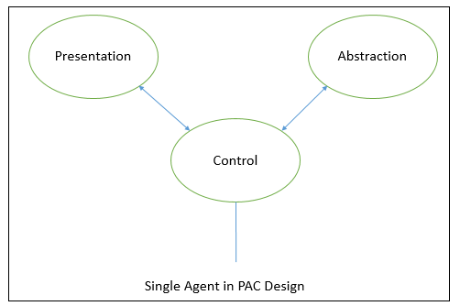
Presentation-Abstraction-Control (PAC)
A block diagram for a single agent in PAC design.

Slide 13
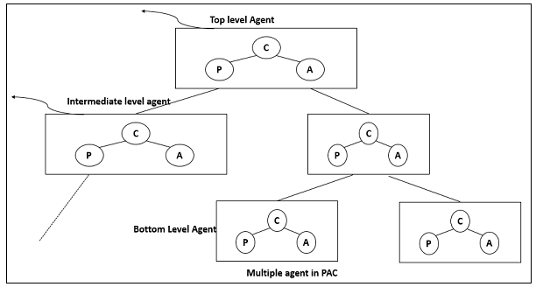
PAC with Multiple Agents

Slide 14
4.
Hierachical

Slide 15
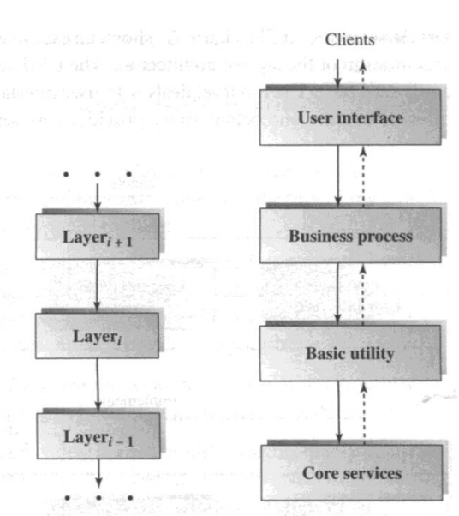
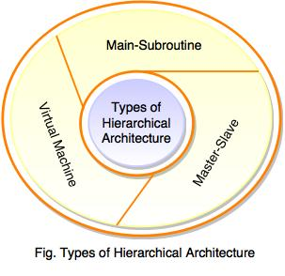

Slide 16
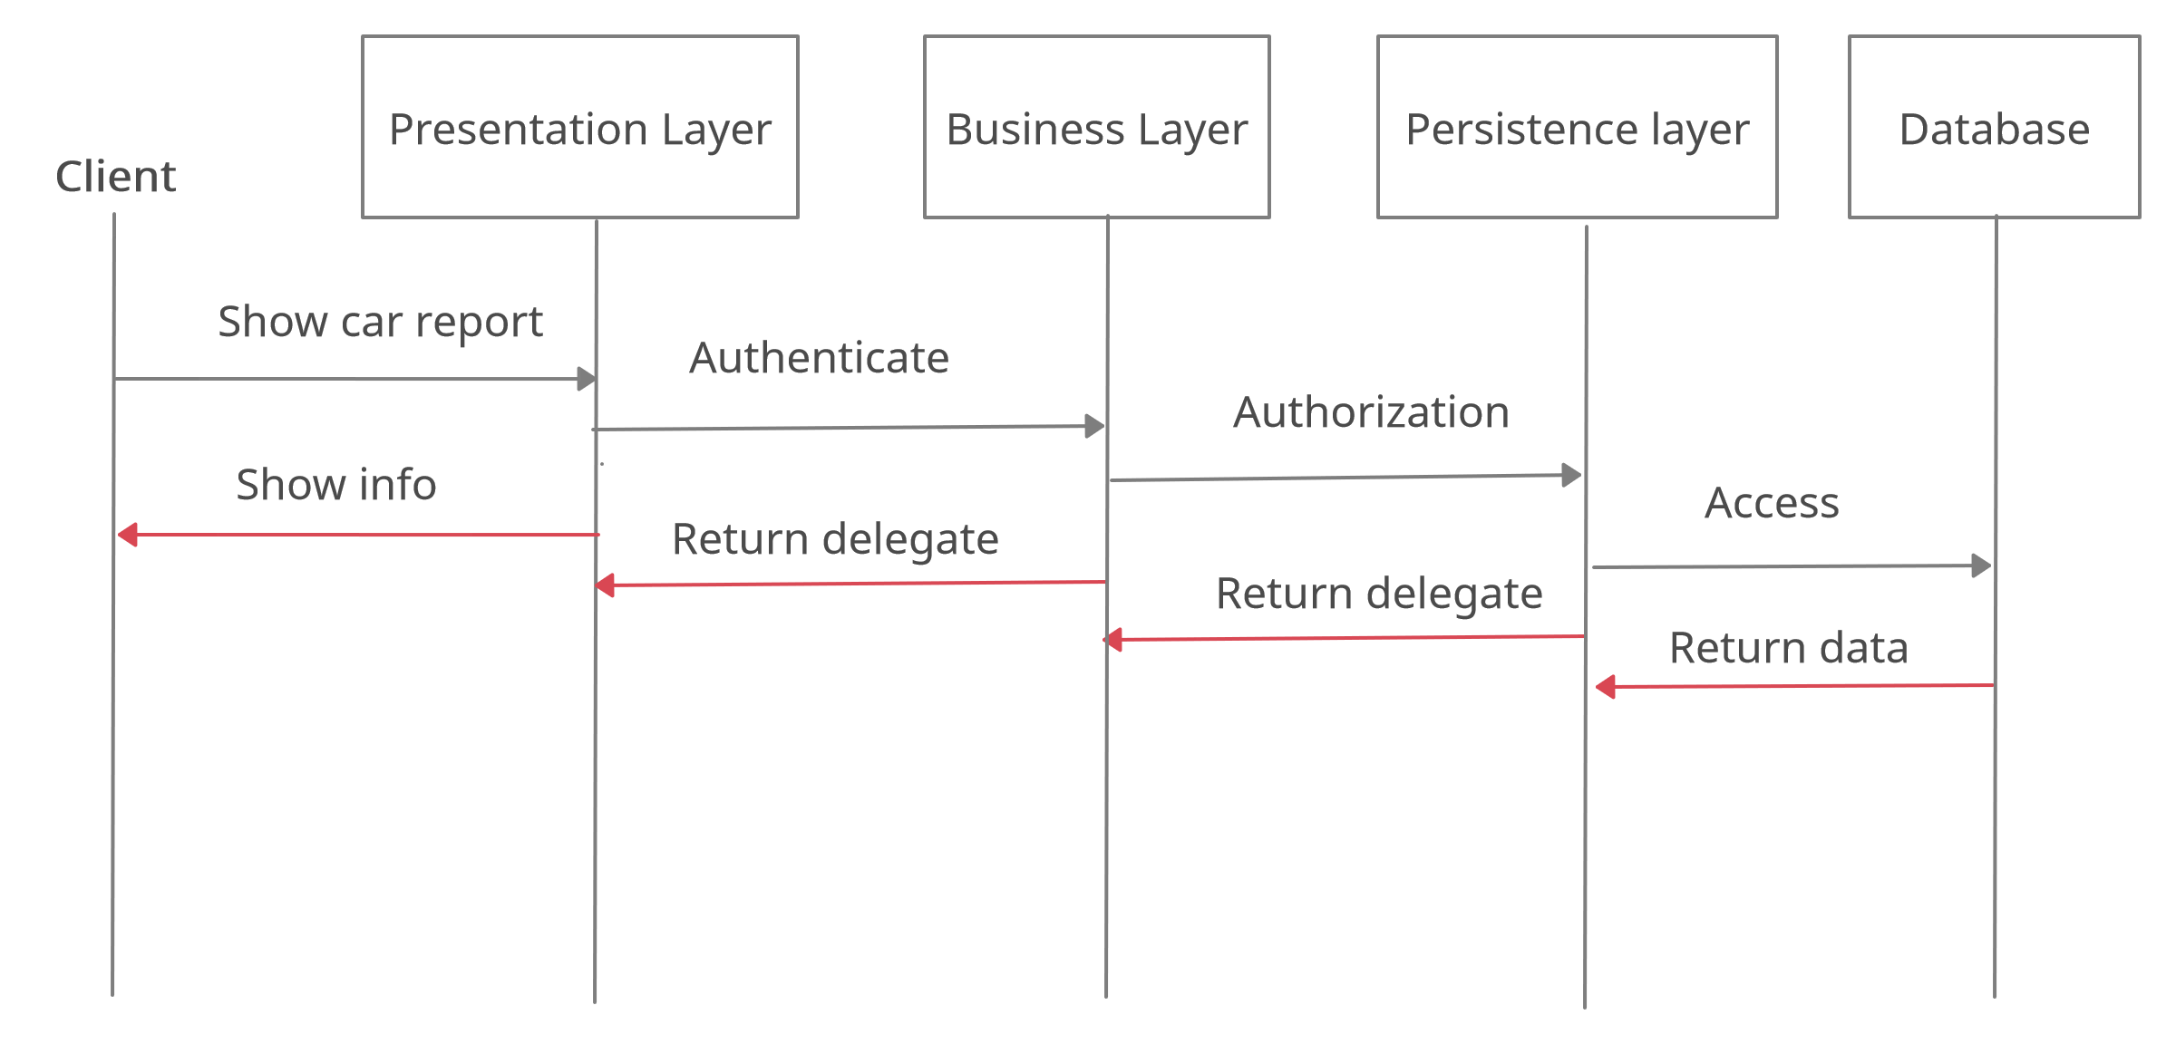
Implementation

Slide 17
THANKS!

